Slide 1

DOM Manipulation & jQuery

Slide 2
Why we need JavaScript on the web
HTML and CSS can make web pages, but they don't move. They aren't programming langs.
JavaScript gives the page logic and dynamic behavior.
This makes so many modern apps possible! FaceBook, Instagram, Netflix, and many many more…
Every browser has a JavaScript engine built in. For Chrome it is called V8. Firefox's is called SpiderMonkey.

Slide 3
But how? - The “Web API”
JavaScript isn't inherently able to change the page. But the browser provides this ability through the web API.
It is a bunch of objects and methods defined in the browser that let you change the page.
This means we need a way to represent the page as objects. This is the Document Object Model (a.k.a. the DOM).

Slide 4
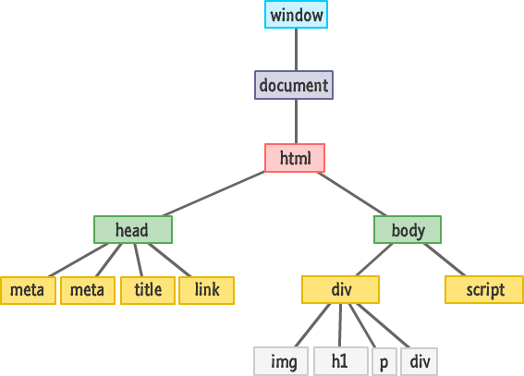
The DOM

Slide 5
The DOM is a tree
Data sctructures are a fundamental part of web development!
The success of ReactJS depends on it's ability to find differences between trees. Hence they need a good algorithm…
Read how they turned an O(n³) problem into an O(n) one! https://facebook.github.io/react/docs/reconciliation.html

Slide 6
What kind of powers does JS have?
Add/change the text
Add and remove DOM elements
Change the CSS
Respond to events (e.g. clicks)
Other crazy stuff like navigating to other pages, drawing pictures, stealing your credentials, and much much more...

Slide 7
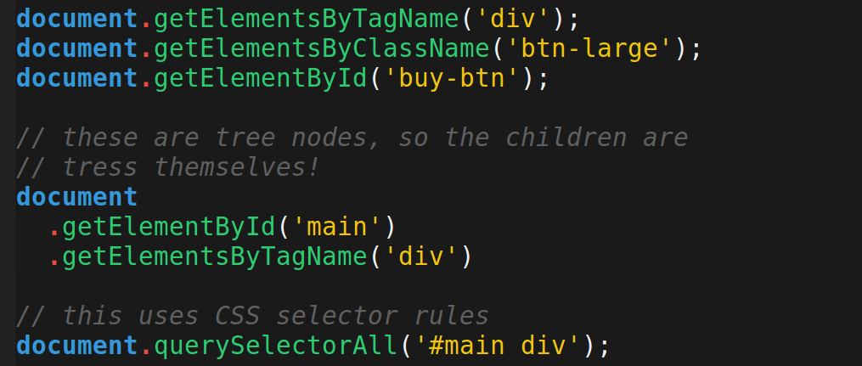
Traversing the DOM
Find DOM elements with some methods

Slide 8
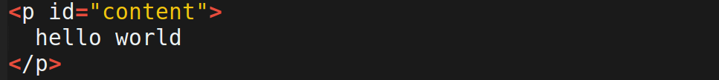
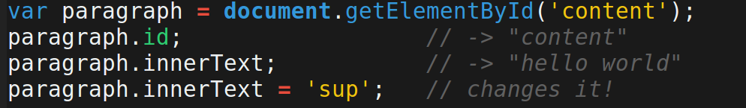
Changing the elements

Slide 9
Learn the methods and stuff
Create new DOM elements with document.createElement
for more resources:http://www.w3schools.com/js/js_htmldom.asp

Slide 10
JavaScript events
Websites have things like clicking and filling out forms.
We need to be able to execute functions when things like users clicking a button happens.
For this we have “event listeners” which can run a callback when the event its listening for happens.

Slide 11
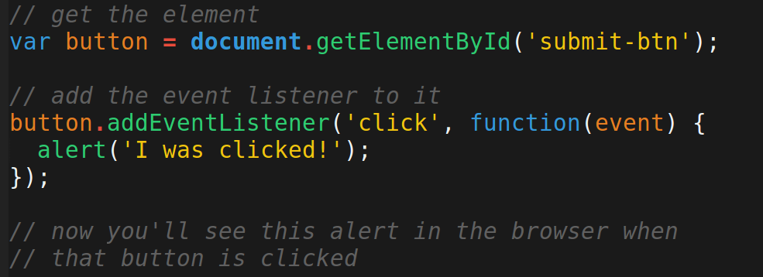
Event Listeners

Slide 12
jQuery
jQuery is not another language. It's just JavaScript. It's a library.
The web API is kind of annoying. jQuery makes it easier.
Including jQuery on your page gives you a function called $. This function also have properties and methods on it.

Slide 13
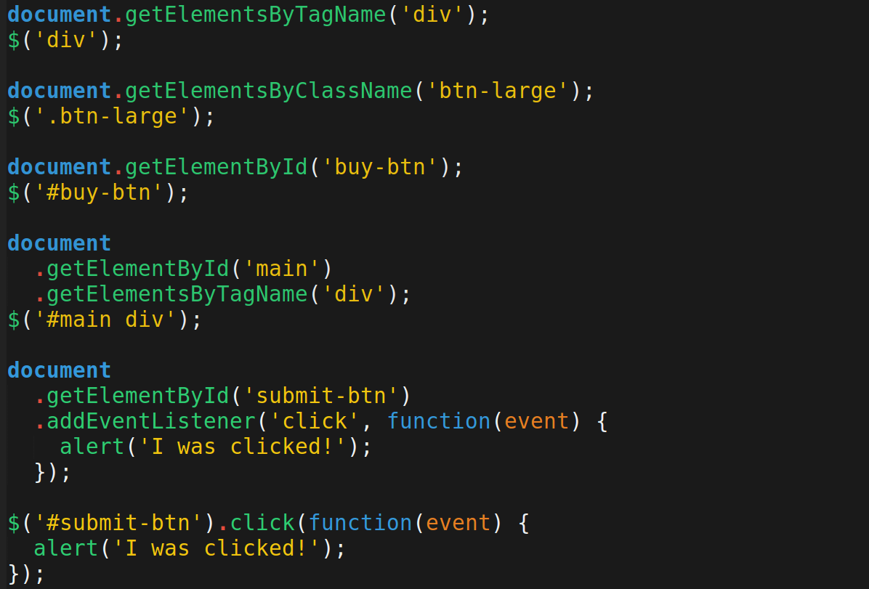
What it looks like

Slide 14
Demo!
https://youtu.be/esR4cRSxCoM

