Slide 1


Slide 2
The problem
HTTP requests are slow.
Until the request is done, the display and behavior of the browser is blocked!
Imagine waiting a second or two every time you click the “like” button or post a comment.

Slide 3
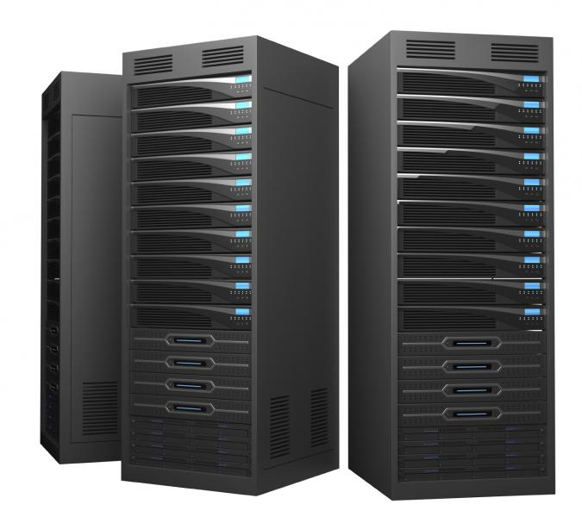
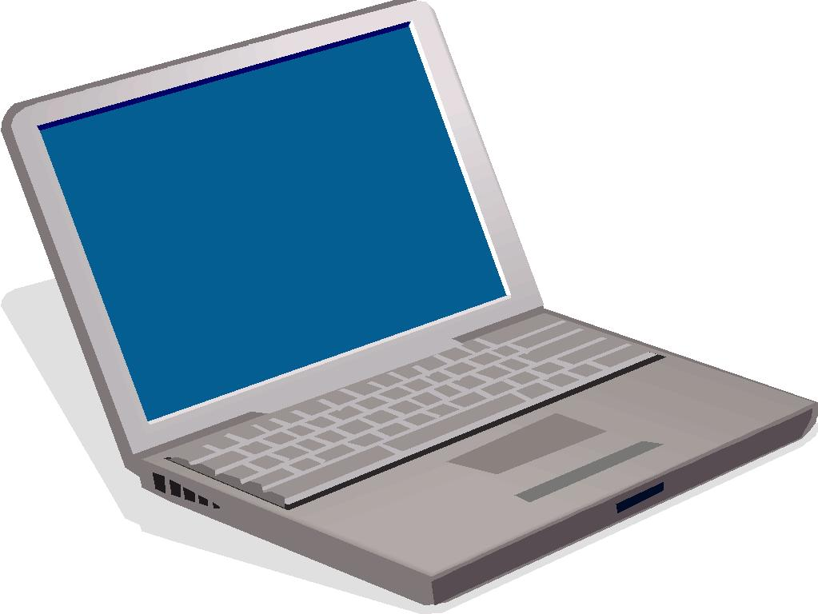
What visiting a page actually looks like
GET ebay.com
{ Accept: text/html }
200
{ Content-Type: text/html }
<html>bunch of stuff</html>

Slide 4
What visiting a page actually looks like
<html>
…
<link href=”/style.css” />
…
GET ebay.com/style.css
{ Accept: text/css }
200
{ Content-Type: text/css }
.container { margin: 0 auto; }

Slide 5
What visiting a page actually looks like
<html>
…
<link href=”/style.css” />
…
<script src=”/main.js” />
</html>
GET ebay.com/main.js
{ Accept: application/javascript }
200
{ Content-Type: js }
console.log('hello world');

Slide 6
The problem
Very inefficient
Many sites have a lot of shared HTML and CSS across pages, like the facebook navigation bar.
Why reload all that on every page change??
What is the solution?

Slide 7

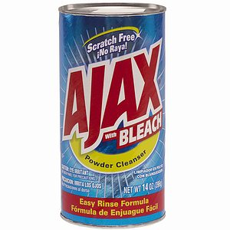
Clean your house

Slide 8
Asynchronous JavaScript and XML
Don't block the browser when an HTTP request is made. Do it in the background!
AJAX is an HTTP request made by JavaScript. It is handled by the browser without interfering with the current page.
When the response comes back, you can use JS to change the DOM.

Slide 9
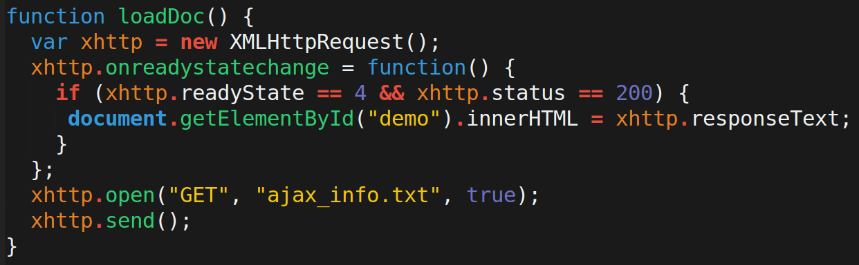
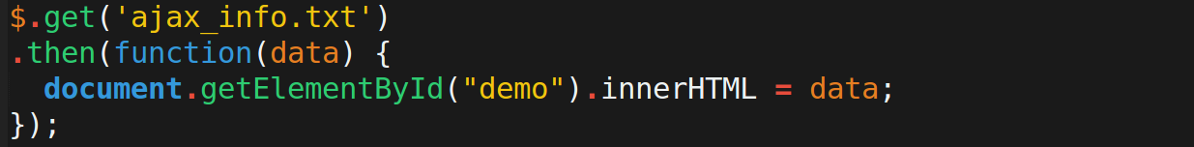
Demo
http://www.w3schools.com/ajax

Slide 10
Why XML?
AJAX was intended to request XML (as opposed to a whole new HTML page).
Nowadays, AJAX rarely gets XML.
Usually it gets JSON.
Regardless, it requests a little piece of information and then manipulates the DOM instead of reloading the whole page!

