Slide 1


Slide 2
The problem
We've already established that HTML is slow. It sucks for another reason.
HTML isn't very expressive. It's designed for marking up things like wikipedia pages.
Not good for smart things like calendar widgets or chat boxes.
No variables. Groups of HTML tags aren't reusable.

Slide 3
What is ReactJS?
React is an open-source JavaScript framework made by Facebook “for creating user interfaces”.
Intended to encapsulate the look and behavior of groups of HTML into “components”.
Components are classes. They can be reused.

Slide 4
Components and the Virtual DOM
React
components
DOM
render

Slide 5
Pass Down Data Via Props
variable
props
props

Slide 6
One-way data flow
<Box value=”X” />
this.props.value

Slide 7
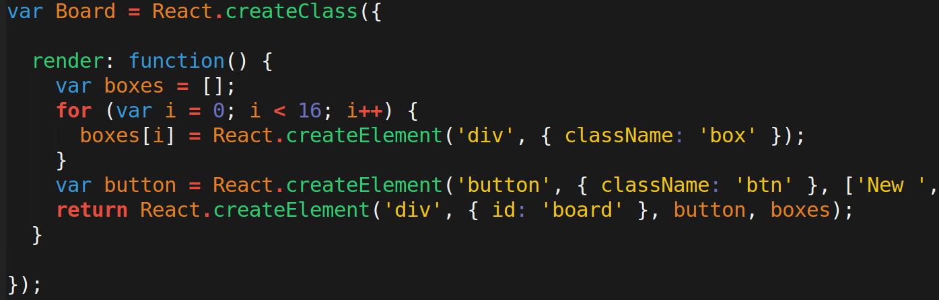
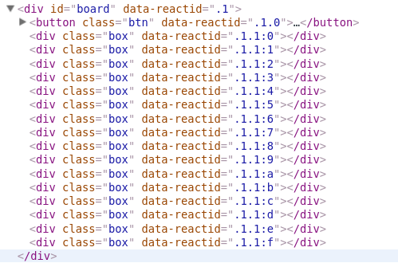
Make your own Components

Slide 8
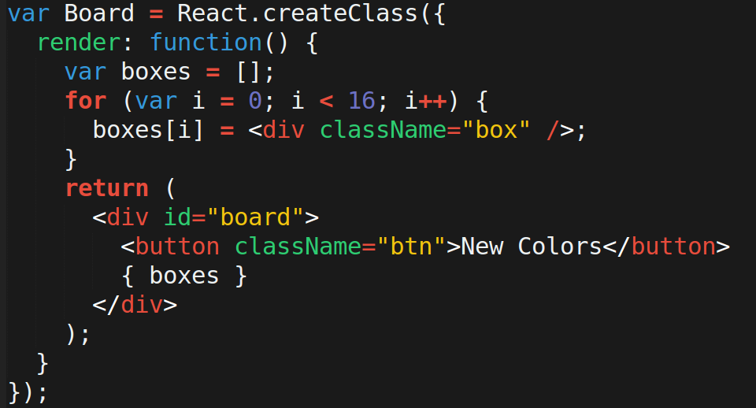
JavaScript XML (JSX)

Slide 9
But how do we change the page?
Props can pass values from parent to child. But they don't change (immutable).
We need a variable that will re-render the DOM when it's updated.
React has a “state.” It's an object who's values will control the DOM.

Slide 10
React State
For a component to have a state, give it a getInitialState method.
Pass down info from state to the child elements via props.
Change is by calling:
this.setState({ key: “new value” });
This will automatically trigger a re-render.

Slide 11
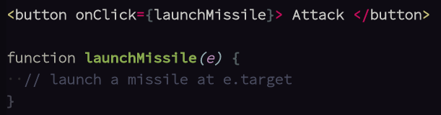
React Events
jQuery makes creating event listeners easy.
React makes it even easier. Built-in props that take callbacks.
onClick, onSubmit, onChange, etc...

Slide 12
