Slide 1
The Event Loop
How JavaScript achieves concurrency

Slide 2
The Call Stack
The Call Stack
function multiply(a, b) {
  return a * b;
}
function square(n) {
  return multiply(n, n);
}
function printSquare(n) {
  var squared = square(n);
  console.log(squared);
}
printSquare(4);
multiply(4, 4)
square(4)
console.log(16)
printSquare(4)

Slide 3
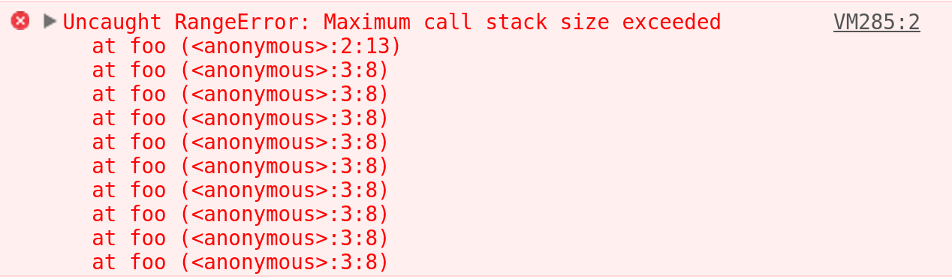
The Call Stack
foo()
foo()
foo()
The Call Stack
function foo() {
  return foo();
}
foo();
foo()
foo()
foo()
foo()
foo()
foo()
foo()

Slide 4
The Call Stack
JavaScript is...
single-threaded (i.e. ONE callstack)
one thing at a time
but...
JavaScript is...
concurrent.
oopsie()
daisy()
hehe()

Slide 5

Sync would suck...
The Call Stack
var andy = $.ajax({
type: 'GET',
async: false,
url: 'http://andy.ca',
…
});
doStuffWith(andy);
var alex = $.ajax({...});
doStuffWith(alex);
doStuffWithTheUser();
called()
called()
$.ajax({...})
doStuffWith(andy)

Slide 6
Asynchronicity
The Call Stack
console.log(“I will”);
setTimeout(function() {
  console.log(“for you.”);
}, 5000);
console.log(“be there”);
5
seconds
later
Where is this coming from??
> I will
> I will
> be there
> I will
> be there
> for you.
console.log(“I will”)
setTimeout( ... )
console.log(“be there”)
console.log(“for you.”)

Slide 7

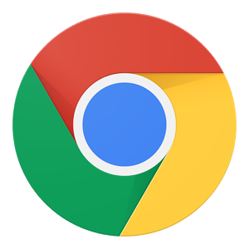
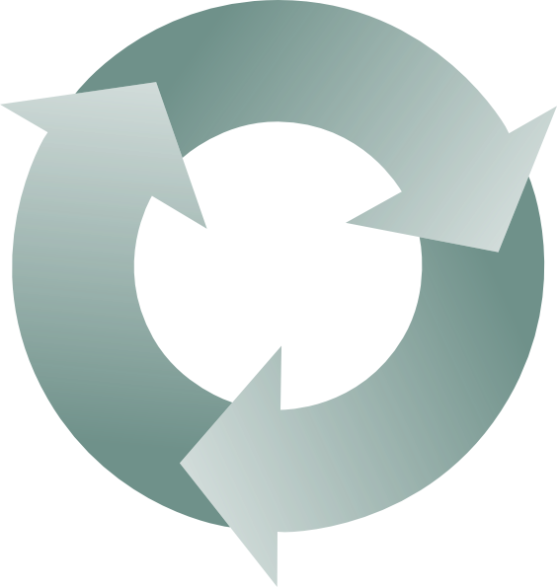
Chrome v8 engine
Web API
call stack
function() {
console.log(“<3”);
}
console.log(...)
function() {
console.log(“<3”);
}
function() {...}
setTimeout(...)
event
loop
event/callback queue

Slide 8
So what was that setTimeout zero thing?
console.log('this song');
setTimeout(function() {
  console.log('bass');
}, 0);
console.log('needs more');

Slide 9
Chrome v8 engine
Web API
database
call stack
function(data) {
pleaseUser(data);
}
pleaseUser(...)
function() {...}
function() {...}
$.ajax({...})
event
loop
event/callback queue

Slide 10
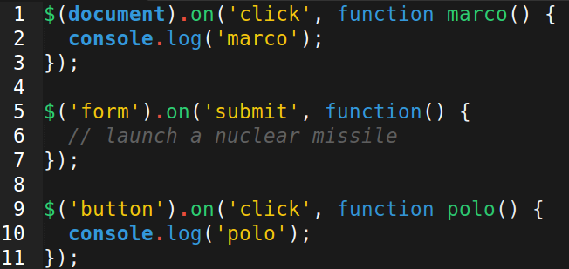
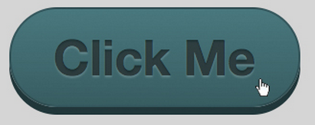
{
type: 'click'
target: 'button',
}
Web API
$(document).on('click', ...)
$('form').on('submit', ...)
$('button').on('click', ...)
marco() {...}
polo() {...}
event
loop
event/callback queue

Slide 11
Let's visualize this better...
http://latentflip.com/loupe/

