Slide 1


Git & GitHub

Slide 2
Git
Version control (source control) software
Written in 2005 by Linus Torvalds (creator of Linux)
Most popular of its kind

Slide 3
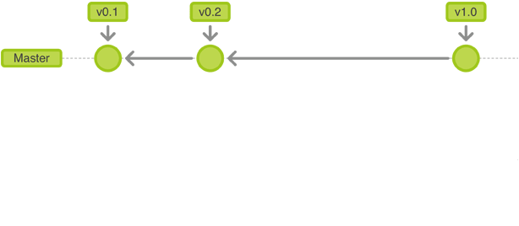

Slide 4
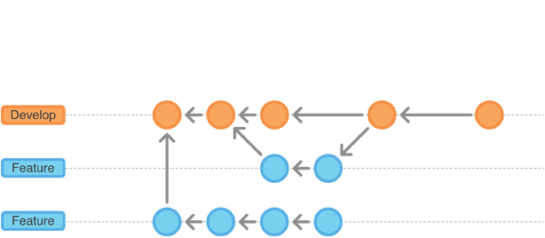
Master

Slide 5
GitHub
One of the options for Distributed Source Control for Git. (BitBucket, GitLab).
Most popular for Git.
Allows sharing and collaboration for code.

Slide 6
Your computer

Slide 7
origin
Github
(remote)
(the cloud)
remote
Your computer
(local)
(the ground)

Slide 8
origin
Github
(remote)
(the cloud)
git push origin master
remote
Your computer
(local)
(the ground)

Slide 9
origin
fork
remote
local

Slide 10
origin
fork
git remote add upstream <url>
remote
local

Slide 11
upstream
origin
fork
git pull upstream master
remote
local

Slide 12
upstream
origin
fork
remote
git push origin master
local

Slide 13
upstream
origin
fork
remote
local

Slide 14
origin
Github
(remote)
(the cloud)
remote
Your computer
(local)
(the ground)

Slide 15
origin
Github
(remote)
(the cloud)
git push origin <branch>
remote
$
Your computer
(local)
(the ground)

Slide 16

origin
Github
(remote)
(the cloud)
remote
$
Your computer
(local)
(the ground)

Slide 17
origin
Github
(remote)
(the cloud)
git checkout master
remote
$
Your computer
(local)
(the ground)

Slide 18
origin
Github
(remote)
(the cloud)
git pull origin master
remote
$
Your computer
(local)
(the ground)

Slide 19
origin
Github
(remote)
(the cloud)
remote
$
Your computer
(local)
(the ground)

Slide 20
Git for Teams
One remote (fork) person.
Work on branches. Push to a branch on GitHub.
Pull request into master. DO NOT PUSH DIRECTLY TO MASTER.

Slide 21
upstream
fork
fork
fork
cool_username
azai91
acarl005

Slide 22
upstream
origin
fork
git remote add upstream <url>
remote
git clone <url>
local

Slide 23
upstream
origin
fork
“auth”
upstream:master vs.
origin:auth
remote
remote
git push origin auth
$
“auth”
local

Slide 24
upstream
origin
fork
“auth”
remote
remote
git checkout master
git pull upstream master
$
“auth”
local

Slide 25
upstream
origin
fork
“auth”
remote
remote
git push origin master
“auth”
$
local

Slide 26
upstream
origin
fork
“auth”
remote
remote
“auth”
$
local

Slide 27
upstream
fork
fork
fork
cool_username
azai91
acarl005

Slide 28
upstream
origin
fork
remote
remote
git checkout master
git pull upstream master
“navbar”
$
local

Slide 29
upstream
origin
fork
remote
remote
git push origin master
“navbar”
$
local

Slide 30
upstream
origin
fork
remote
remote
git checkout navbar
git merge master
“navbar”
$
local

Slide 31
upstream
origin
fork
remote
remote
“navbar”
$
local

Slide 32
git rebase
An alternative to merge
“replays” the recent commits on a branch and allows you to add new ones

Slide 33
git merge newfeature
master
newfeature

Slide 34
git merge newfeature
“merge commit”
master
newfeature

Slide 35
git rebase newfeature
master
newfeature

Slide 36
origin
Github
(remote)
(the cloud)
git pull origin newfeature
==
git fetch origin newfeature
git merge origin/newfeature
remote branch (detached state)
origin/newfeature
“merge commit”
master

Slide 37
origin
Github
(remote)
(the cloud)
git fetch origin newfeature
git rebase origin/newfeature
remote branch (detached state)
origin/newfeature
“merge commit”
master

Slide 38
some stuff to google
git rebase – there are a lot of other options to it
“squashing” – combine multiple commits into 1. This is an option when rebasing or merging.
git cherry-pick – yet another alternative (but don't use it)

