Slide 1




Programming Languages

Slide 2
JavaScript is...
a “high-level,” dynamically typed, loosely typed, non-refuting, lexically-scoped, non-blocking, interpreted language.

Slide 3
Loose vs. strong typing
2 + null // → 2
2 + undefined // → NaN
“2” == 2 // → true
1 == [1] // → true
0 == [ [ ] ] // → true
[ ] == [ ] // → false

Slide 4
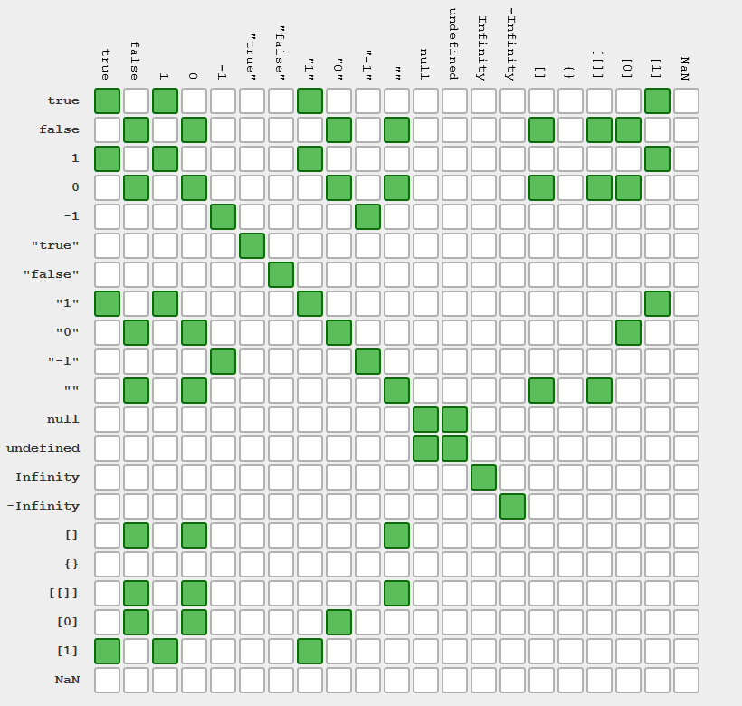
JavaScript == operator

Slide 5
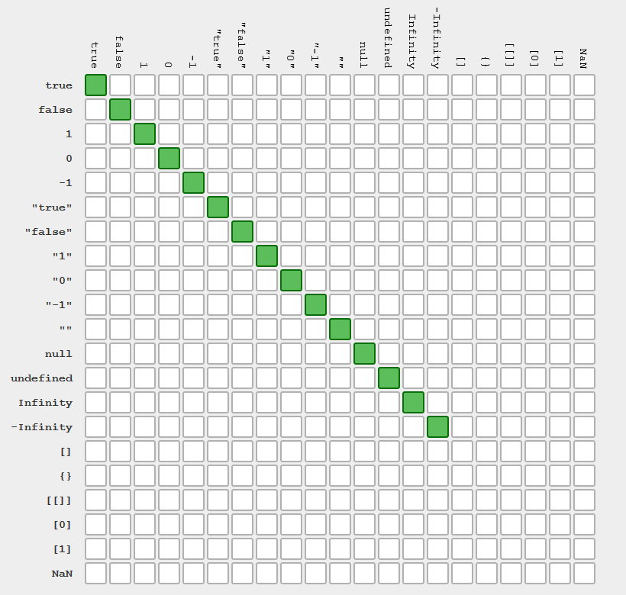
JavaScript === operator

Slide 6
Lack value equality
{ a: 1, { a: 1,
b: 2, === b: 2, // → false
c: 3 } c: 3 }

Slide 7
Dynamic vs. static typing
function add(a, b) {
var sum = a + b;
return sum;
}
add(1, 2) // → 3
add('hel', 'lo') // → 'hello'

Slide 8
Dynamic vs. static typing
int add(int a, int b) {
int sum = a + b;
return sum;
}

Slide 9
Refuting vs. non-refuting
No error thrown if a function is called with the “wrong number” of arguments

Slide 10
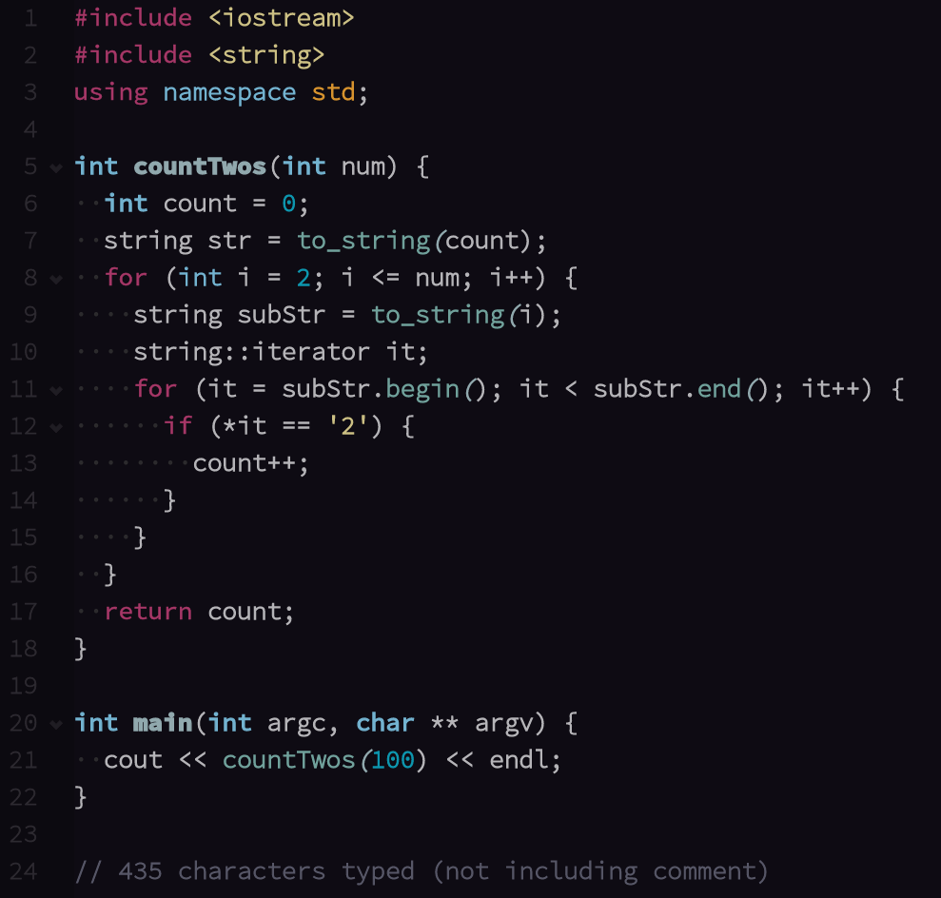
High level?
C++

Slide 11
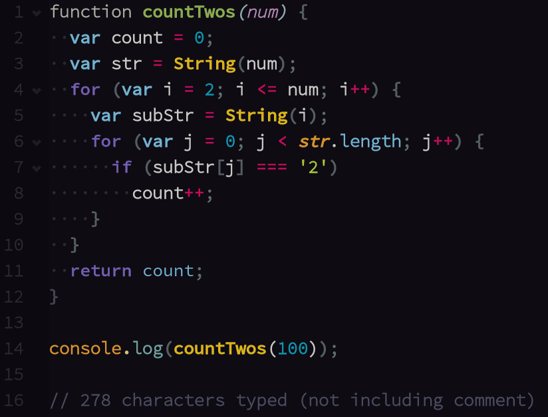
High level?
JS

Slide 12
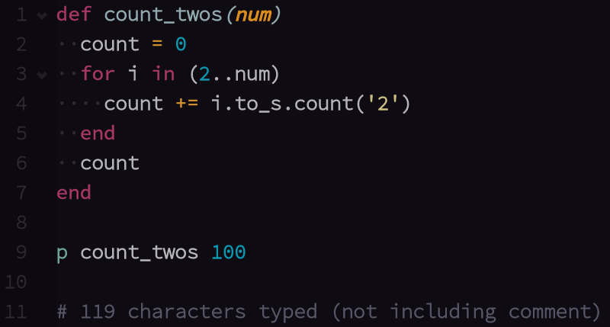
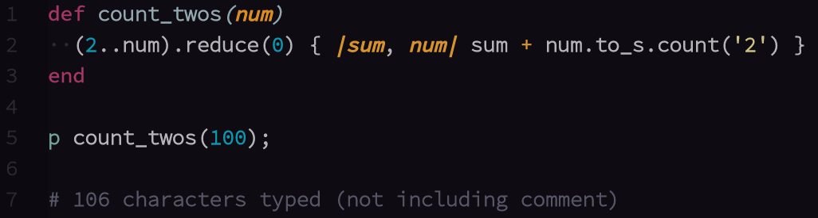
High level?
Ruby:

Slide 13
Lexical scope vs. dynamic scope
Lexical: variable references determined at function definition
Dynamic: variable references determined at execution

Slide 14
Interpreted vs. Compiled
Compiling is the preemptive conversion of source code into bytecode.
e.g. C and C++
Generally faster
Not suitable for dynamic typing

Slide 15
Interpreted vs. Compiled
All conversion to machine code is done at runtime.
More convenient for dynamic languages
More suitable for browser

Slide 16
Blocking vs. non-blocking
queue the project-slack demo!

Slide 17
JavaScript is...
HIGH-LEVEL
DYNAMIC TYPE
STRONG TYPE
NON-REFUTING
COMPILED
STATIC TYPE
LOOSE TYPE
REFUTING
DYNAMIC SCOPE
NON-BLOCKING
INTERPRETED
LEXICAL SCOPE
BLOCKING
COMPILED

