Slide 1

Servers with Node.js

Slide 2







twitter server
199.16.156.0
twitter.com
GET /acarl005
<link href=”/style.css” />
<script src=”/main.js” />

Slide 3
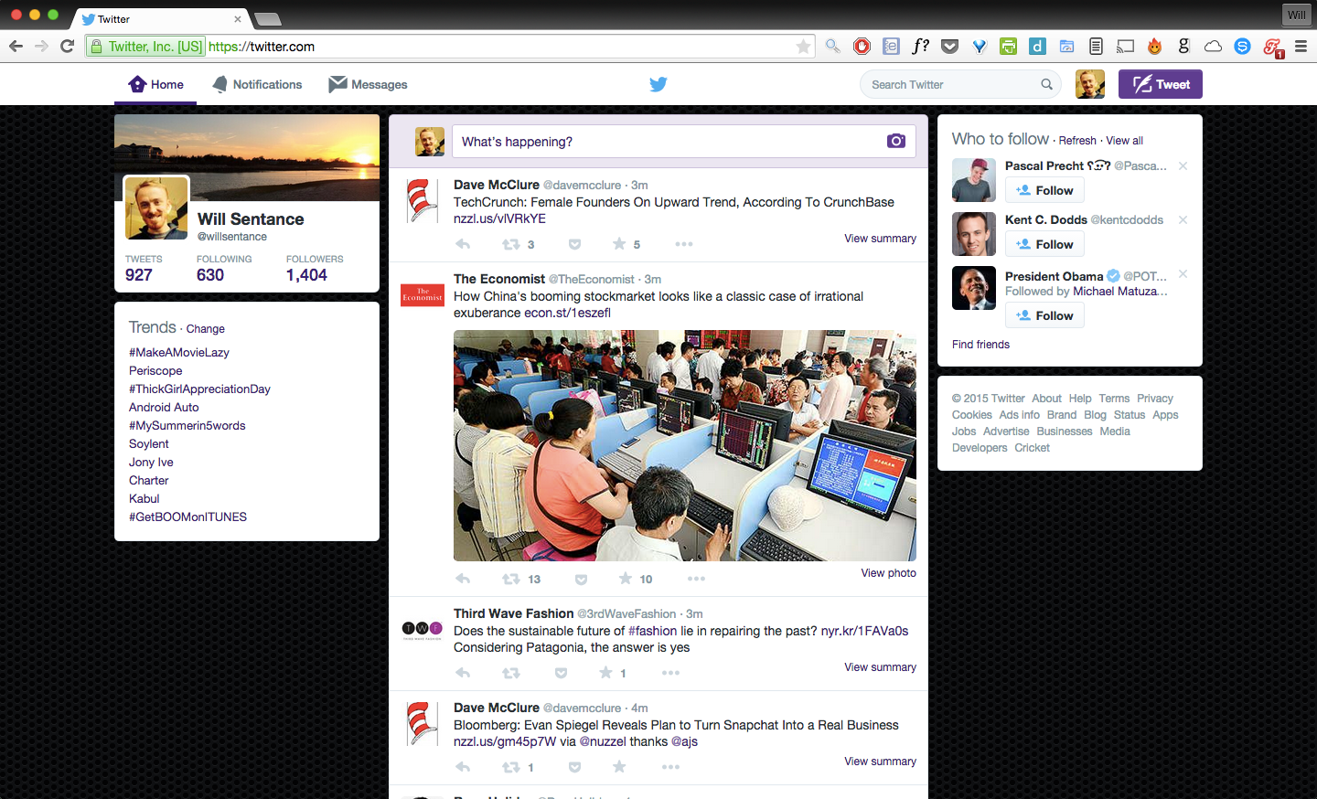
Voila!

Slide 4

twitter server
199.16.156.0
twitter.com

Slide 5



The Server Program
HTTP request
if “GET /style.css”
send
if “GET /main.js”
send
if “POST /register”
create
in
HTTP response

Slide 6
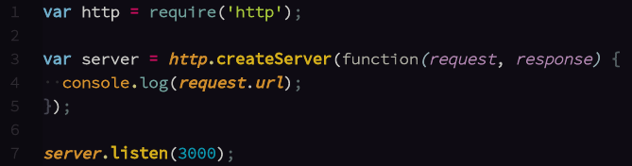
Creating a Server with Node.js

