Slide 1
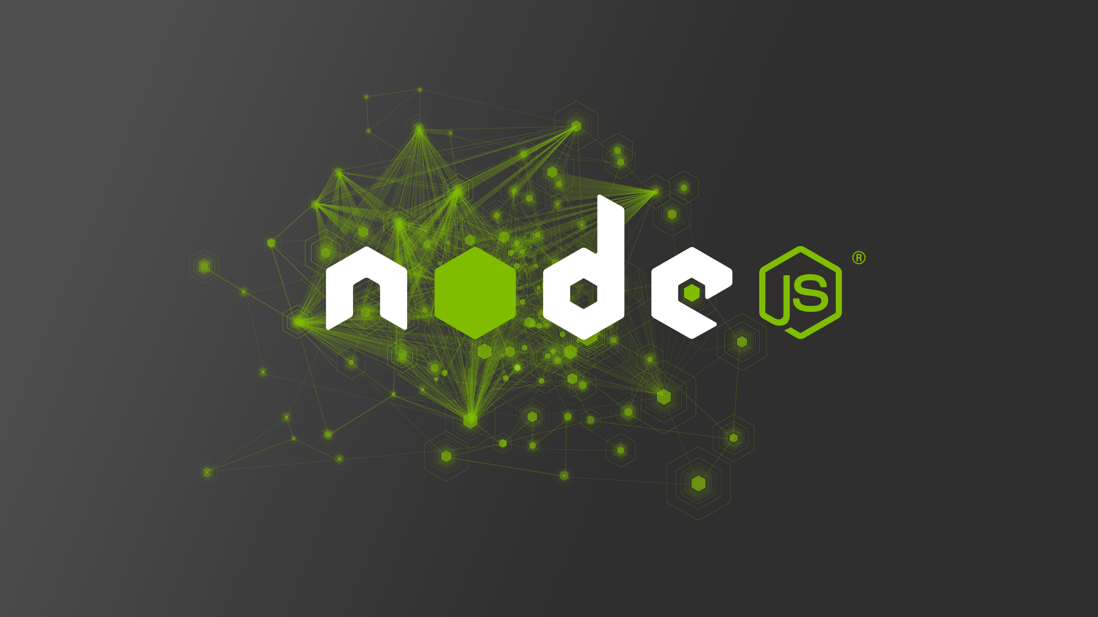
The Powers of...

Slide 2
The Beginnings of JavaScript
JavaScript was originally developed in 10 days in May 1995 by Brendan Eich, a dude working at NetScape.
They wanted the web to have a programming language. Competitor Microsoft's IE3 had VBScript.
Scripting language “sandboxed” in the browser.
JS had no I/O, such as networking (HTTP), storage, or graphics facilities. Relies on its environment.

Slide 3
What is Node.js?
Node.js is an open-source, cross-platform runtime environment for JavaScript at the Linux foundation.
IT IS NOT A JAVASCRIPT FRAMEWORK.
Built on V8, the engine originally created for Chrome.
Has an event loop and an “I/O API” instead of a web API.
Not “sandboxed,” it can do anything. Make files, delete them, kill processes, shut down computer, any system call.

Slide 4
Working with modules
Node has the ability to import (i.e. require) things from other files.
OMG YES. FINALLY!
Each new import is a “module” which keeps the variable within that module in a closure.
Browser lacks this ability. Things are shared using globals. How does front-end cope with this? https://cdnjs.cloudflare.com/ajax/libs/jquery/3.0.0-beta1/jquery.js

Slide 5
What modules are there?
The ones you write yourself.
Built-in Node modules, e.g. “http”, “fs”, “child_process”...
The ones in the open-source ecosystem. You can use NPM to get any of those modules in a matter of seconds. There are hundreds of thousands!

Slide 6
Node Package Manager (NPM)
npm is a command line tool for downloading packages.
You can `npm install` stuff, giving you a `node_modules` folder. You can require packages from there.
e.g. npm install react
File paths are not necessary for stuff that is installed this way. Simply require it by the package name.

Slide 7
Package Dependencies
What does just `npm install` do? Installs all packages listed in the package.json.
For your projects, be sure to add each package you use to your package.json.
Either do it manually or run `npm install --save <package-name>` to add automatically.
Create a package.json file with `npm init`.

Slide 8
What is different?
There is no window, document, navigator, XMLHttpRequest, or any browser-specific stuff from the web API.
But it still has setTimeout, console, and other stuff.
Includes some other system-related globals like __dirname, __filename, and process.
It has the require function for bringing in modules.

Slide 9
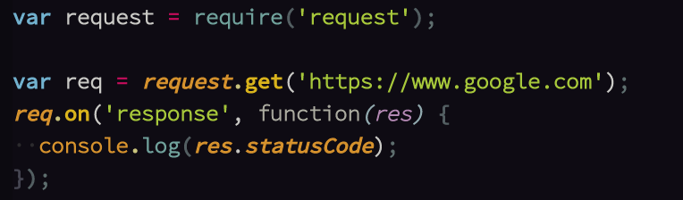
Node has Events!

Slide 10
Why is Node.js a good idea?
It's relatively high-level.
It's the same language as the browser.
It's non-blocking. Able to handle concurrency in a simple and elegant way.
Things like events are great for real-time communication.
NPM packages are awesome.

