Slide 1
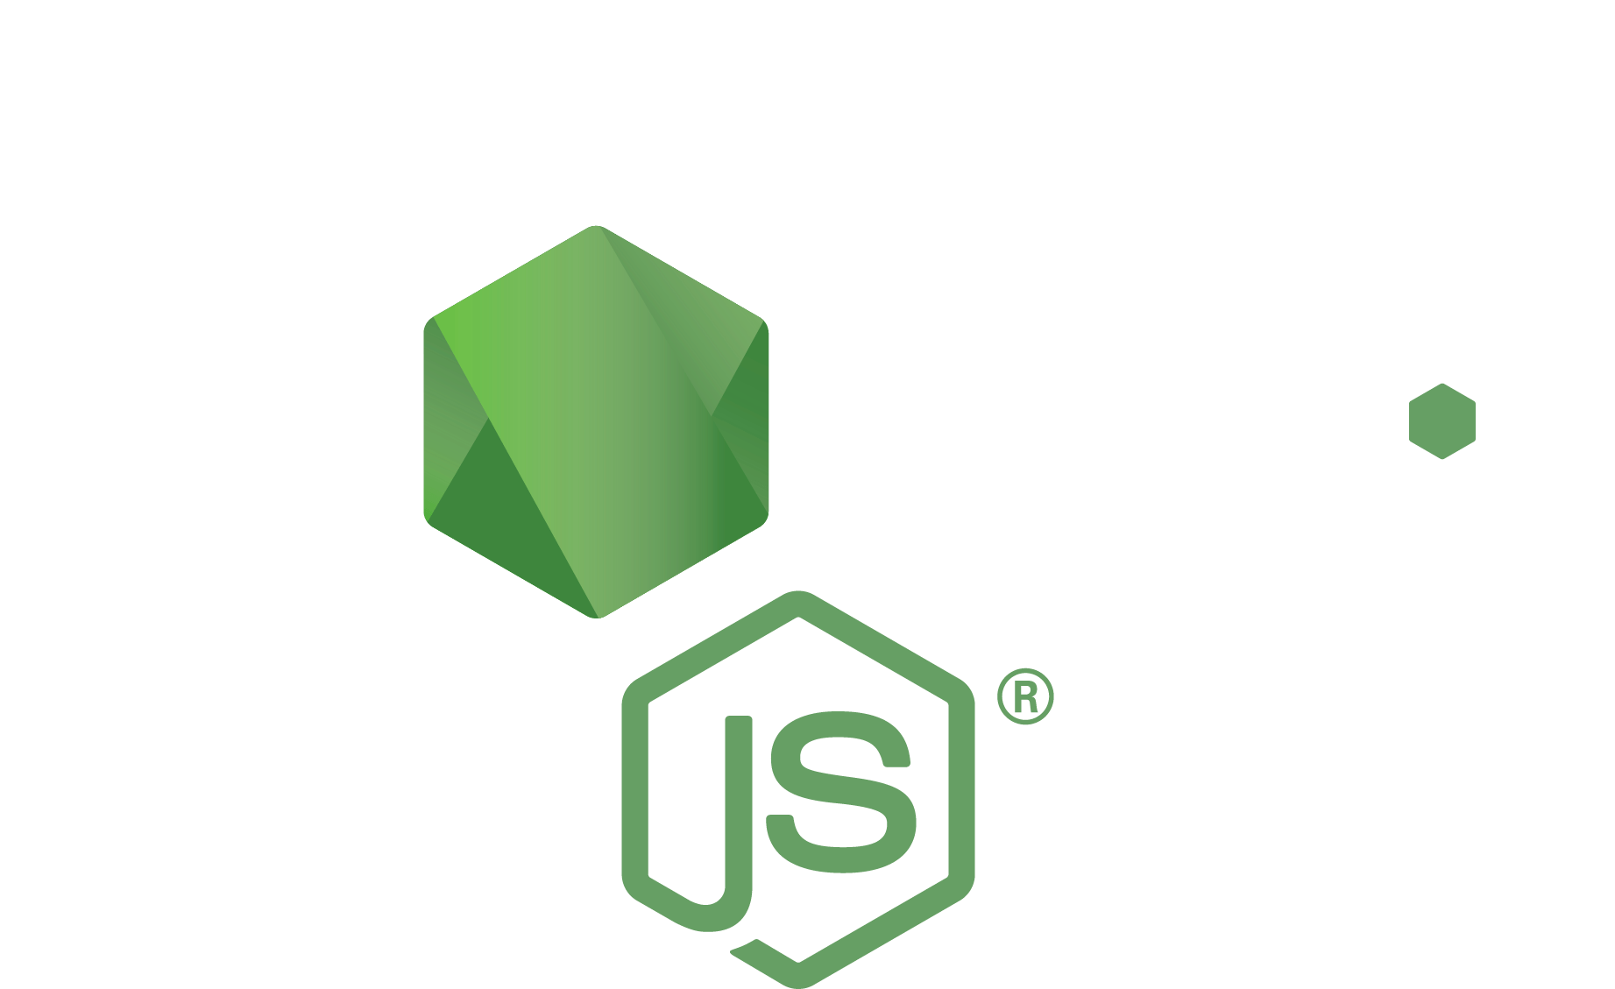
Node.js Frameworks

Slide 2
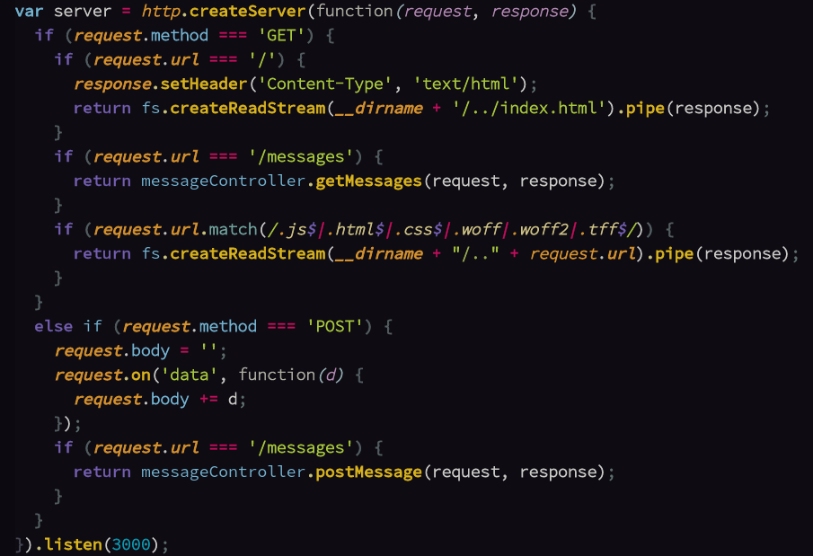
Remember this?

Slide 3
There's got to be a better way...

Slide 4
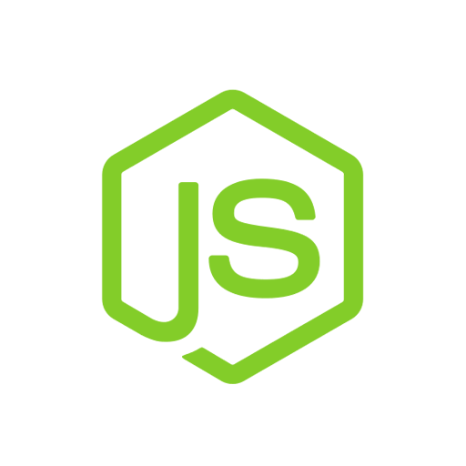


Convention vs. Configuration
Express
Koa
Sails
Rails
configuration
convention
Sinatra
Flask
Hapi
Django

Slide 5
Rails is HEAVY on conventions
Just type a few commands:
$ rails new <app-name>
$ rails generate scaffold user name:string age:integer
$ rake db:migrate
$ rails server
BOOM. Now you have a server listening on port 3000 with a SQL database that has HTML pages that lists all users, shows individuals, creates, deletes, and updates users too.

Slide 6
Routing and controllers automatically
HTTP Verb | Path | Controller method | view file | used for
GET | /users | UsersController.index | index.html.erb | list all users
GET | /users/new | UsersController.new | new.html.erb | get form to create new user
POST | /users | UsersController.create |  | create new user
GET | /users/:id | UsersController.show | show.html.erb | show individual user
GET | /users/:id/edit | UsersController.edit | edit.html.erb | get form to edit existing user
PUT/ PATCH | /users/:id | UsersController.update |  | edits the existing user
DELETE | /users/:id | UsersController.destroy |  | deletes a user

Slide 7
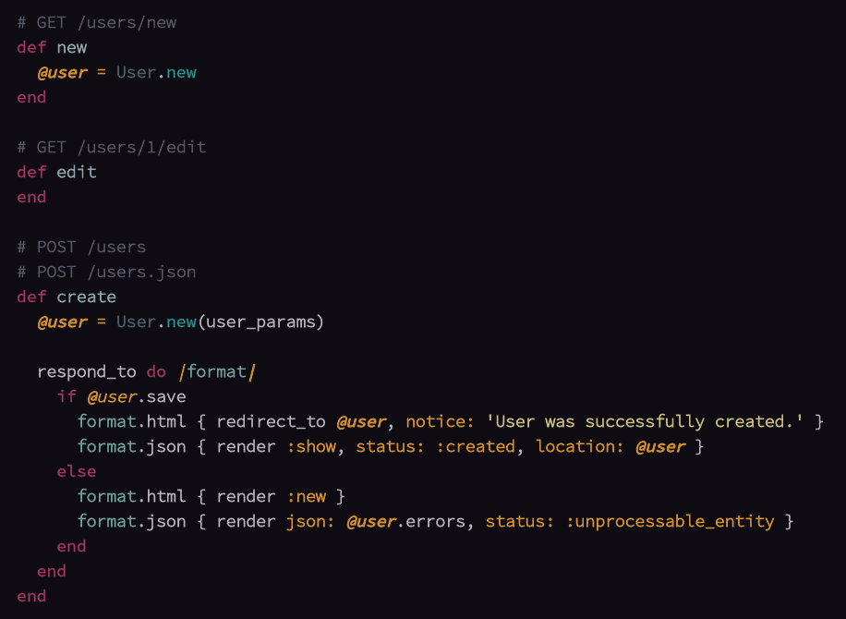
The controller generated
Controller methods that do that stuff.
You don't even need to specify what
view file to look for.

Slide 8
How is this possible?
You get this stuff by sticking with conventions.
Every time to deviate from those, it's more work.
e.g. if you don't want the path to be /users/new, you can change it, but it takes more work.

Slide 9
Configuration
Node has Sails, which is a lot like Rails...
But Node also has Express, which lacks these abilities.
Express = configuration > convention
Set this stuff up yourself HOW YOU WANT IT.

Slide 10
Convention vs. Configuration
Express
Koa
Sails
Rails
configuration
convention
Sinatra
Flask
Hapi
Django

Slide 11
Express just cleans up this a bit...

Slide 12
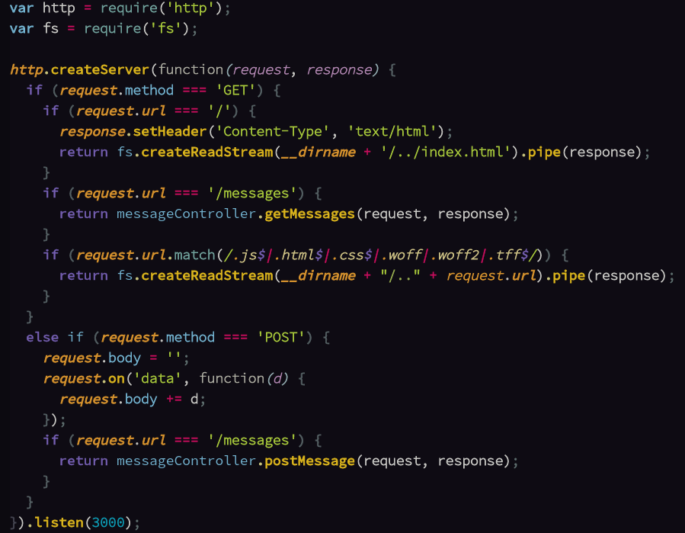
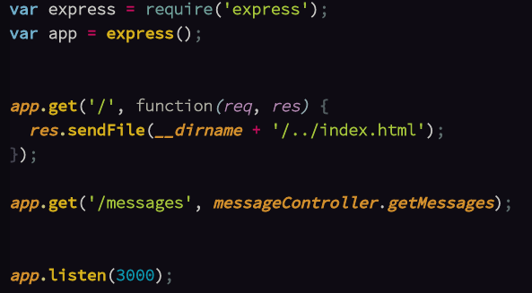

Slide 13
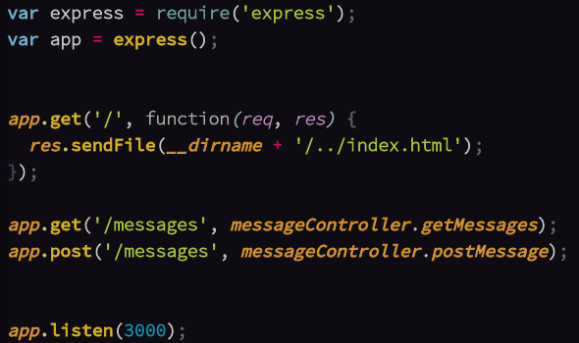

Slide 14
Express Middleware
It's functions.
Intended for shared tasks, e.g. parsing request body.
The request and response pass through middleware before reaching the final handler.

Slide 15
Express Middleware
request
middleware
stack
parse body
POST /messages handler
POST /users handler

Slide 16
Express Middleware
request
parse cookies
middleware
stack
parse body
POST /messages handler
POST /users handler

Slide 17
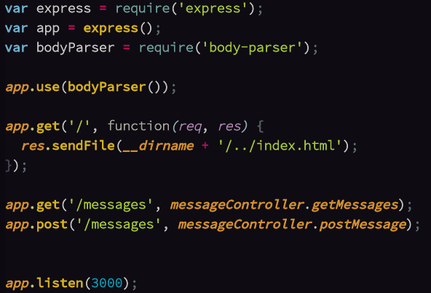

Slide 18
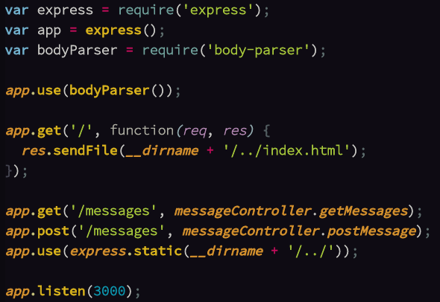

Slide 19
Express and Node
There are tons of other modules you can use with Express.
Automatically handle other stuff like rendering views, web sockets, parsing cookies, authentication, encryption, compression, caching, and so much more.

