Slide 1

Node.js Events and Streams

Slide 2
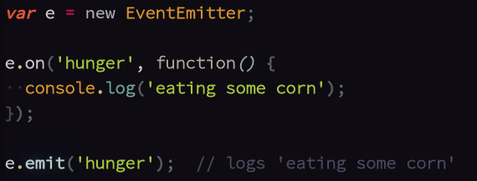
What is an Event Emitter?

Slide 3
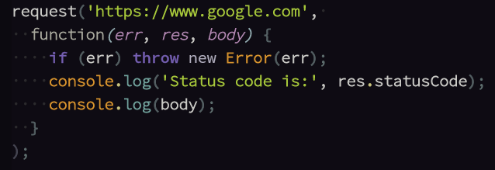
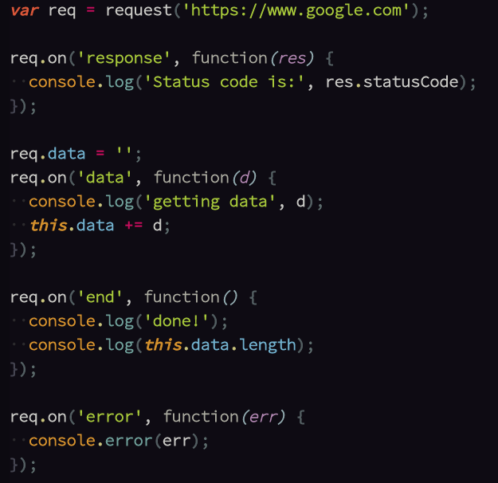
JS Design Patterns
Request / Reply
Publish / Subscribe (PubSub)
Fewer lines of code.
Only access the results once they have all
arrived.
“All or nothing”. No data if there is an error.
More lines of code.
Access results as they appear. They don't
all have to be in memory at once.
Can use partial results before as error
occurs.

Slide 4
Streams
Streams are just event emitters with standard events, i.e. an agreed upon “interface”.
Useful for HTTP, reading/writing files, stdin and stdout.
A stream is either readable, writable, or both.

Slide 5
Readable Streams
Writeable Streams
Events: “data”, “end”, “close”, “error”
Methods: pause(), resume(), destroy(), pipe()
Events: “drain”, “pipe”, “close”, “error”
Methods: write(), end(), destroy()

Slide 6
Streams are cool because of “pipe”
readStream.pipe(writeStream)
event: 'data'
event: 'end'
pause()
resume()
pipe()
event: 'drain'
event: 'pipe'
write()
end()

