Slide 1

Intro to AngularJS

Slide 2
Single-page apps
User experiences too rich for constant page-changes
Normal HTTP requests are just too slow
Need to change the page without leaving it!

Slide 3
What is it?
A front-end JS framework for single-page applications
Runs on every user's browser to run the website
MVC-like architecture
Currently the most popular of its kind
Let's relate this to what we know already...

Slide 4
React: One-way flow
React
state
DOM

Slide 5
Angular: Two-way flow
{ name: 'ty',
age: 900,
...}
Controller
DOM
(view)

Slide 6
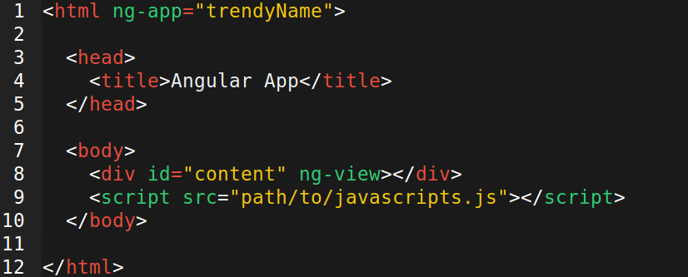
Extending HTML: directives
“angular expression” - a string that gets
converted to JS code and then evaluated.
It's not real JS but not just text.

Slide 7
Important Directives
ng-app : initializes the app
ng-controller : instantiates a controller
ng-model: variable to inner value of DOM element
double curlies {{ insert }} a variable into the DOM
http://jsfiddle.net/acarl005/yh6pwrje/2/

Slide 8
Directives have programming logic!
ng-repeat : loops through a collection
ng-hide : hides DOM element on a condition
ng-click : listens for click event
Directives take you variables (models), do some logic, and turn them into DOM elements.
https://jsfiddle.net/acarl005/pvf1cxxc/

Slide 9
Angular handles different views too
layout
http://site.com/#/home
<div ng-view>
ajax
/home
/stuff
/dogs

Slide 10
Angular handles different views too
layout
http://site.com/#/home
/stuff
/dogs

Slide 11
Angular handles different views too
layout
http://site.com/#/stuff
/home
/dogs

