Slide 1

AngularJS Services

Slide 2
Angular Services
Objects that hold application-wide logic
Can be “injected” (i.e. required) in any controller
Persist through multiple views, existing until user leaves the app

Slide 3
Controllers are instances
controller
controller
controller
view
view
view

Slide 4
Services are singletons
$service
controller
controller
controller
view
view
view

Slide 5
How to Use a Service
https://jsfiddle.net/acarl005/4fgLujnu/

Slide 6
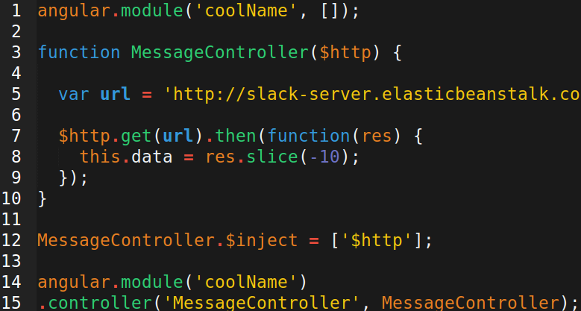
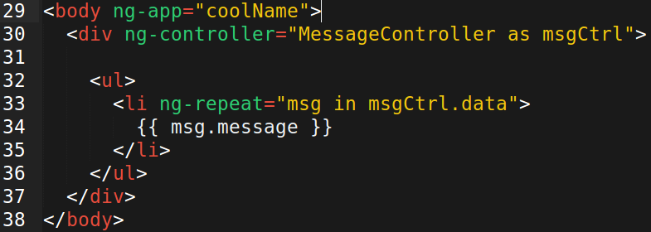
Using the $http service

Slide 7
Good Uses of Services
Some are built-in. You can also make your own!
Ajax/APIs
Auth
Shared variables
Helper functions

Slide 8
Good Uses of Services
Some are built-in. You can also make your own!
Ajax/APIs
Auth
Shared variables
Helper functions

Slide 9
You can write your own directives too
Directives are instances, like controllers. But they don't have a constructor function. Just a regular function that returns an object. That object's properties determines what this directive does.
attributes : https://jsfiddle.net/acarl005/70mjhus0/
elements : https://jsfiddle.net/acarl005/abb26q80/

Slide 10
Directives are pieces of the view
$service
controller
controller
controller
view
view
view
directives

