Slide 1

AngularJS Digest Loop

Slide 2
Two-way data binding
Variables in the controller get rendered in the view
Changes in the view can go back and update the variables in the controller

Slide 3
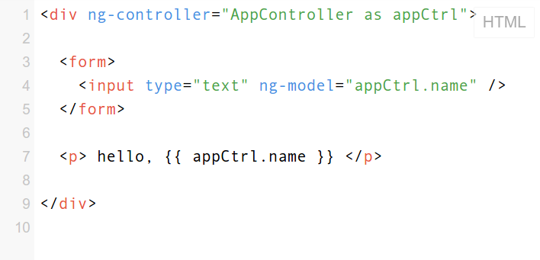

Slide 4
Two-way data binding
Variables in the controller get rendered in the view
Changes in the view can go back and update the variables in the controller
Angular…
HOW???

Slide 5
Dirty-Checking
Angular has a “watch list”, some expressions and functions that get re-evaulated in repeated cycles.
Certain events will trigger these cycles (digest cycles).
When one of those values is “dirty”, i.e. changed, it repaints the appropriate DOM element.
https://jsfiddle.net/acarl005/upv04d7e/
value | callback | old val | digest 1 | digest 2
appCtrl.name | fn() { … } | 'andy' | 'andy' | 'andy'
appCtrl.thing | fn() { … } | 'pong' | 'pong' | 'pong'
appCtrl.age | fn() { … } | 23 | 24 | 24
value | callback | old val | digest 1 | digest 2
appCtrl.name | fn() { … } | 'andy' | 'andy'
appCtrl.thing | fn() { … } | 'pong' | 'pong'
appCtrl.age | fn() { … } | 23 | 24
value | callback | old val | digest 1 | digest 2
appCtrl.name | fn() { … } | 'andy'
appCtrl.thing | fn() { … } | 'pong'
appCtrl.age | fn() { … } | 23

Slide 6

$('input').on('change', fn(e){...})
$watch('appCtrl.name', fn() {...
function(e) {
$apply(function() {
appCtrl.name = e.target.value
});
});
value | old val | digest 1 | digest 2
appCtrl.name | 'andy'
appCtrl.thing | 'pong'
appCtrl.age | 23

Slide 7
$('input').on('change', fn(e){...})
$digest()
function(e) {
$apply(function() {
appCtrl.name = e.target.value
});
});
value | old val | digest 1 | digest 2
appCtrl.name | 'andy' | 'angie'
appCtrl.thing | 'pong' | 'pong'
appCtrl.age | 23 | 23

Slide 8
$('input').on('change', fn(e){...})
$digest()
function(e) {
$apply(function() {
appCtrl.name = e.target.value
});
});
value | old val | digest 1 | digest 2
appCtrl.name | 'andy' | 'angie' | 'angie'
appCtrl.thing | 'pong' | 'pong' | 'pong'
appCtrl.age | 23 | 23 | 23

Slide 9
Angular is highly abstracted
All the variable checking and event listening is handled automatically when you put one of your variables inside {{ }} or ng-model=””.
Similar listeners are set up when you use ng-click, ng-submit, etc.
Built-in services (e.g. $http) call $apply for you.
If you build your own directives or services, you may need to implement some of this stuff manually.

Slide 10
Performance
If a variable affecting an ng-repeat changes, angular will re-create the whole list, even if only one element was changed...
unless… You use a “track by” clause in your ng-repeat.
Same idea as React's key prop.

