Slide 1
Authenticating Single-Page Apps and OAuth

Slide 2
What is “the way?”
There is no “one true” way to implement auth.
It's a series of choices with pros, cons, and varying levels of security.
Here are some examples of approaches to auth on single-page apps

Slide 3


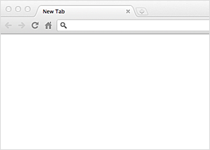
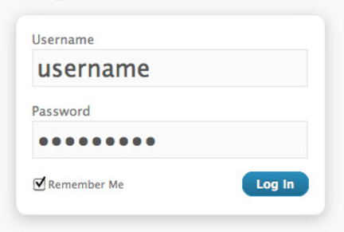

Lock Out of the App Until Logged In
show applicant-portal demo

Slide 4
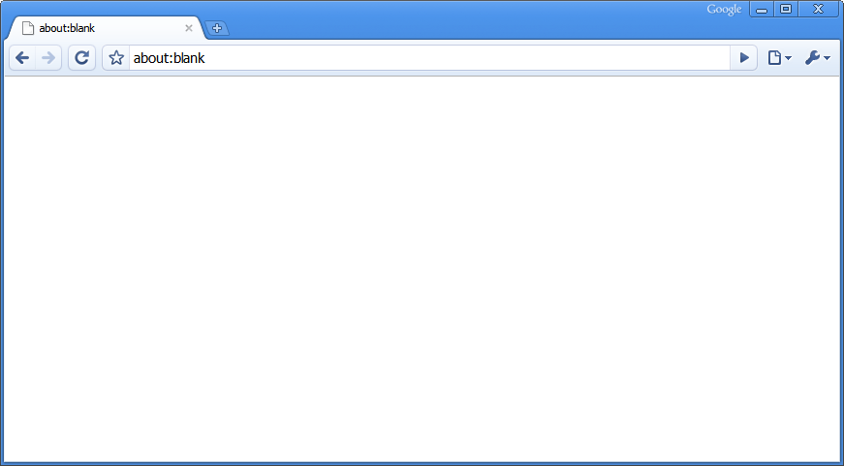
Restrict parts of the app
home
login
show auth-token-decoupled demo

Slide 5
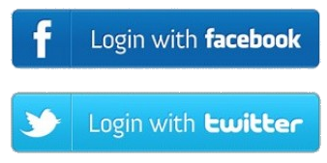
OAuth (Open Auth)
Authentication standard for third-party access (other servers)
You can make a website that utilizes twitter to authenticate.
You can do things like make posts to twitter from your site.

Slide 6
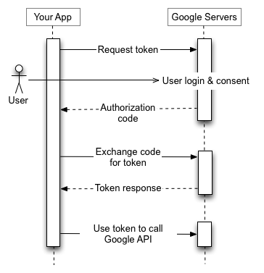

OAuth Flow
user clicks
redirect back w/
OAuth uses hashed access tokens, not JWT
+ user data

Slide 7
OAuth Pros/Cons
Nice feature for UX (making new accounts for everything can be annoying).
Utilize other websites.
Rely on someone else's security and validation.
More setup involved.
Some users might not have/want to use other account.

