Slide 1
QA & UX TECHNICAL STATUS AUDIT
Little Singham: Play & Learn
Detailed Screen-by-Screen QA Status, Orientation, Audio Controls & Flow Verification
Package: com.ct.littlesingham | Device: Vivo V2153 (Android 14) | Display: 2400×1080 (Landscape) / 1080×2400 (Portrait)

Slide 2
TECHNICAL VERIFICATION MATRIX
Complete QA Parameter & Status Checklist
Evaluation Parameter | Status | Visual Reference | Exact Technical Verification Details
Splash Screen / Launch Flow | PASS (VERIFIED) | 01_splash_loading.png | Animated branding with dynamic progress bar. App initialized with 0 crashes.
Landscape Mode (Gameplay) | PASS (LOCKED) | 02_landscape_main_hub.png | Main child hub and all activities run locked in 2400×1080 Landscape orientation.
Parental Gate Protection | PASS (SECURE) | 03_parental_math_gate.png | Randomized arithmetic puzzle (e.g. 55 + 6 = 61) protects parent and account zone.
Dynamic Portrait Mode | PASS (DYNAMIC) | 04_portrait_parent_home.png | System dynamically rotates screen to 1080×2400 Portrait upon parent zone entry.
Audio Settings (BGM Toggle) | AVAILABLE | 05_audio_settings_bgm.png | Parent Preferences menu provides dedicated Background Music ON/OFF toggle.
Gameplay Audio Controls | PASS (ACTIVE) | 07_in_game_audio_mute.png | Dedicated one-tap speaker icon switches directly between unmuted and muted (✕).
Navigation & Level Stars | PASS (ACTIVE) | 06 & 08.png | Clear top-left '<' back button and vertical 1–3 star level progress tube.

Slide 3

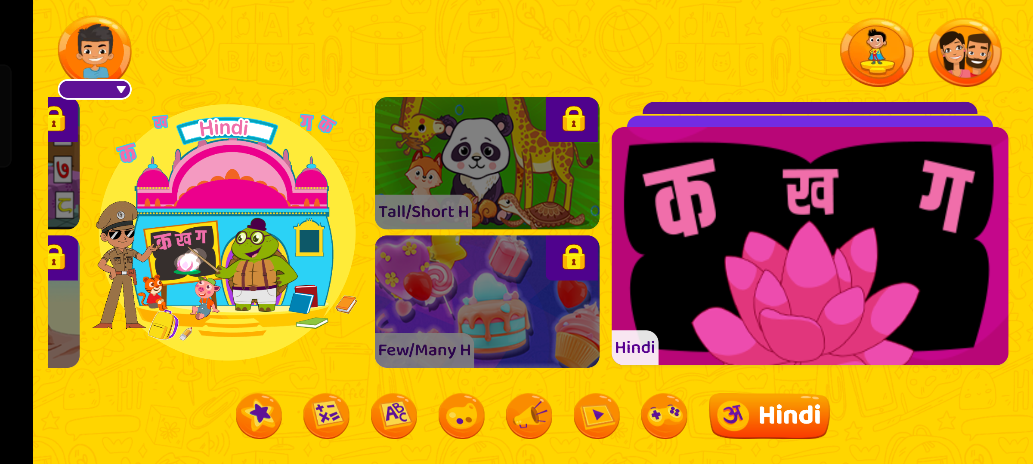
VISUAL EVIDENCE & STATUS
Screen Status Detail: Launch Screen & Main Child Hub
Image 01: Splash Screen & Loading Progress
Status: PASS (VERIFIED)
• Orientation: Landscape (2400×1080)
• UI Elements: Creative Galileo branding, Little Singham IP characters, loading status bar
• Technical Behavior: Loads local and remote game assets, progress bar updates dynamically
• Audio State: Title theme intro audio plays during asset loading
• Stability: App launches smoothly without freezing or ANR timeouts
Image 02: Main Interactive Child Hub
Status: PASS (LOCKED LANDSCAPE)
• Orientation: Landscape (2400×1080 locked)
• UI Elements: Curriculum cards (English, Math, Hindi, Colors), profile badge, Parent Zone lock
• Touch Target Size: Large child-friendly buttons (>80dp width) preventing mis-taps
• Navigation: Horizontal carousel swipe navigation across learning topics
• Audio State: Upbeat cartoon background soundtrack active (loops continuously)

Slide 4
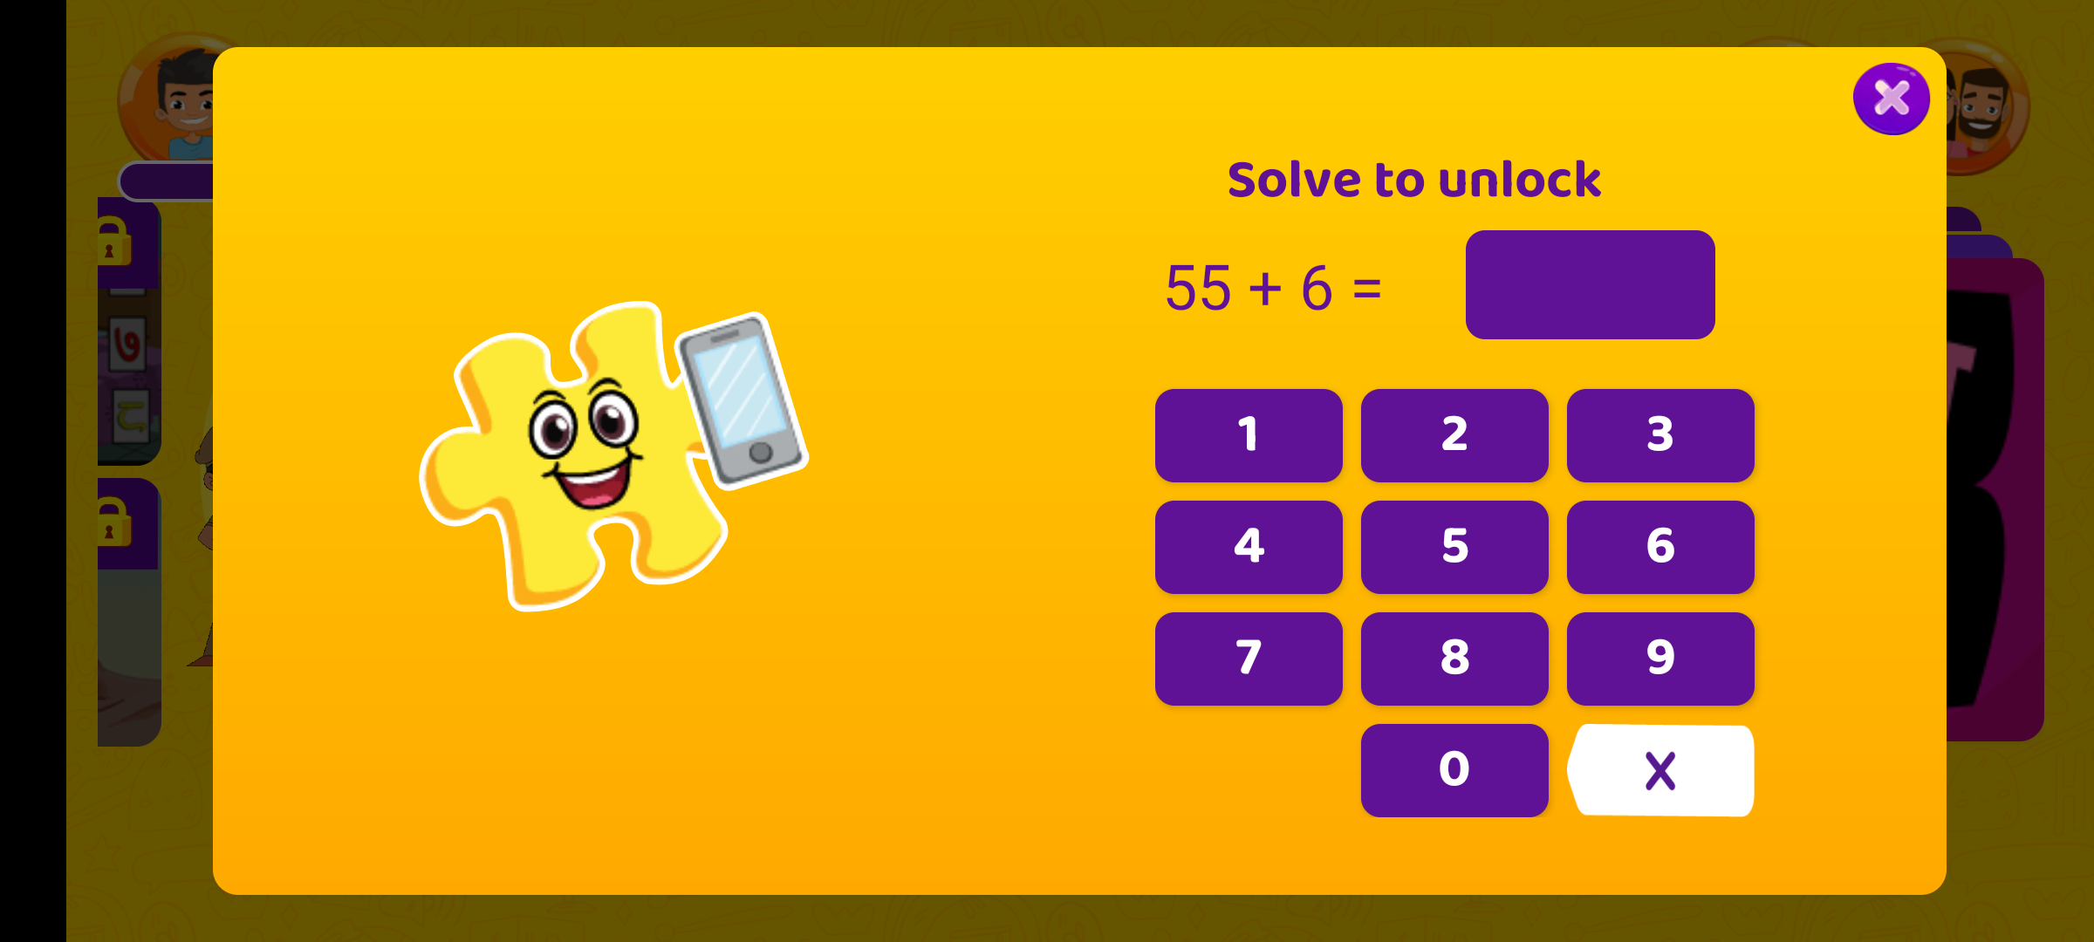
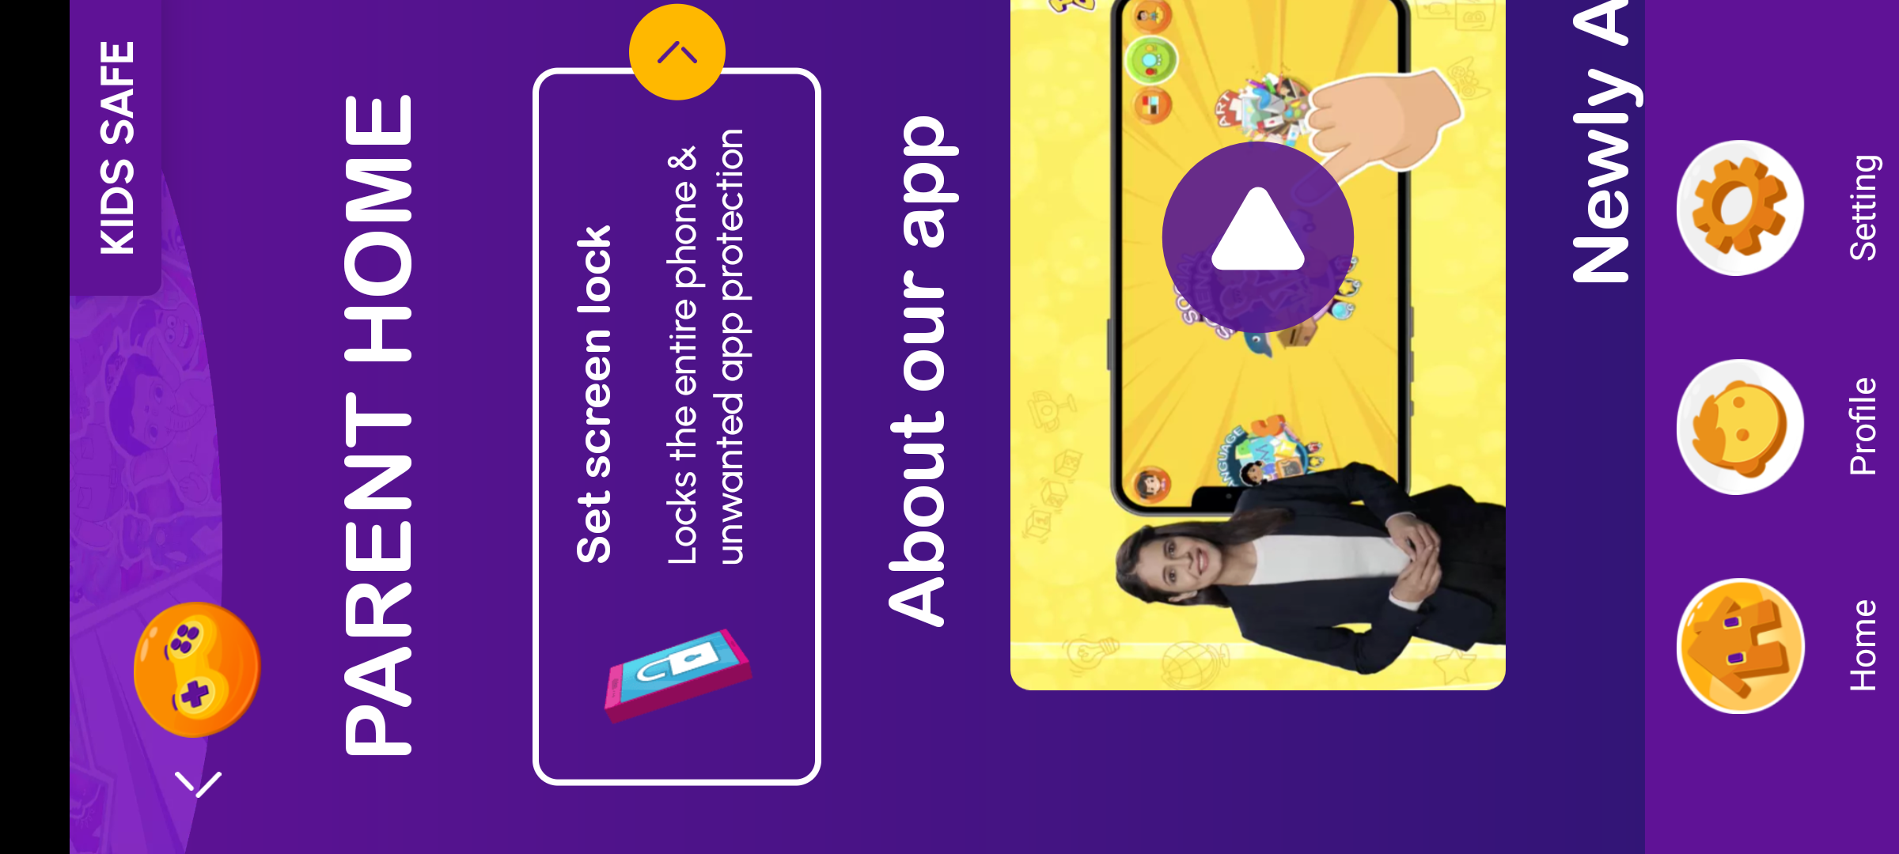
VISUAL EVIDENCE & STATUS
Screen Status Detail: Parental Gate & Dynamic Portrait Switch
Image 03: Arithmetic Parental Gate Modal
Status: PASS (SECURE)
• Orientation: Landscape (2400×1080) overlay
• Challenge Type: Dynamic two-digit math question (e.g. 55 + 6 = 61)
• UI Elements: Arithmetic prompt, numeric input field, Submit button, Close ('✕') button
• Security Purpose: Prevents preschool children from exiting to billing or account settings
• Failure Handling: Incorrect answers refresh the challenge without locking the app
Image 04: Parent Zone (Dynamic Rotation)
Status: PASS (DYNAMIC ROTATION)
• Orientation: Portrait (1080×2400 dynamic switch)
• Trigger: Successfully solving the math parental challenge in Image 03
• UI Elements: Child learning analytics, subscription management, parent preferences
• Ergonomics: Optimized specifically for adult single-handed vertical smartphone use
• Exit Behavior: Returning to child dashboard smoothly rotates device back to Landscape

Slide 5
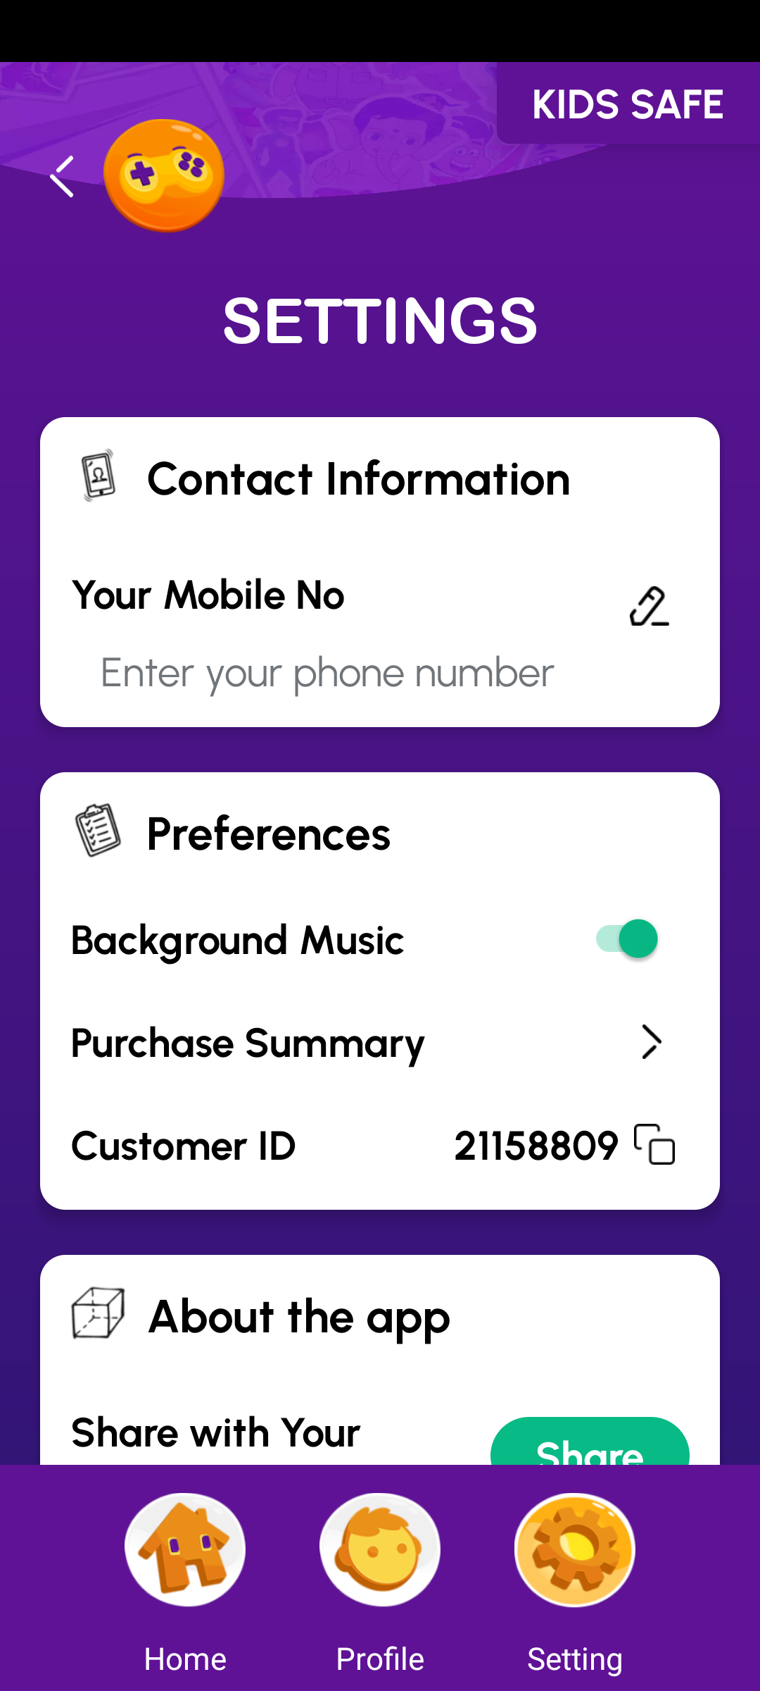
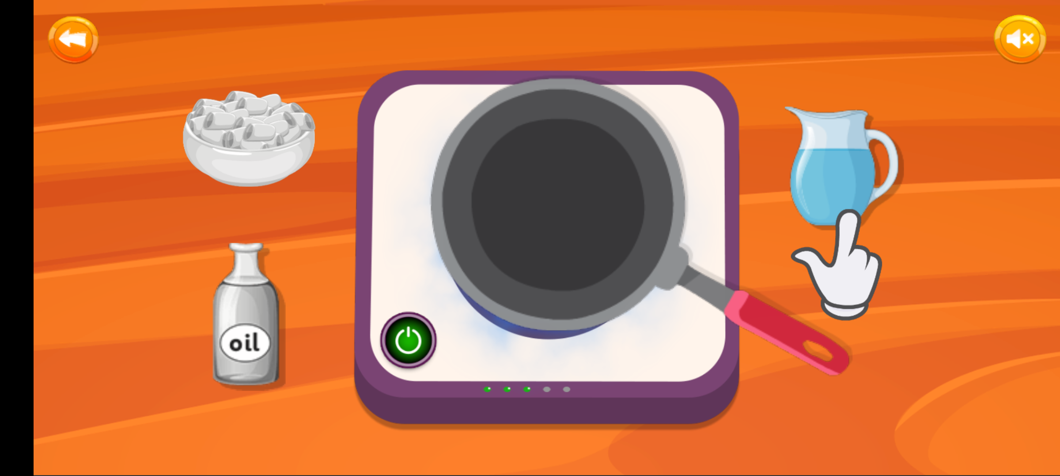
VISUAL EVIDENCE & STATUS
Screen Status Detail: Audio Controls & In-Game Mute
Image 05: Background Music Toggle in Settings
Status: AVAILABLE (TOGGLE ACTIVE)
• Location: Parent Zone > Preferences Menu (Portrait 1080×2400)
• Control Type: Binary Switch Toggle (ON / OFF)
• Function: Globally mutes/unmutes background cartoon soundtrack across all screens
• Persistence: Selected preference is saved locally across app restarts
• Slider Availability: No separate volume slider bars; hardware buttons control volume level
Image 07: Direct In-Game Quick Mute Button
Status: PASS (VERIFIED ACTIVE)
• Location: Top-Right corner of all interactive gameplay screens
• Icon State: Speaker icon toggles dynamically between Sound-ON and Mute ('✕')
• Function: Instant 1-touch muting of both voice instructions and BGM
• Accessibility: Permits quiet classroom/home play without accessing parent settings
• Response Time: Immediate audio cutoff without audio pops or lag

Slide 6
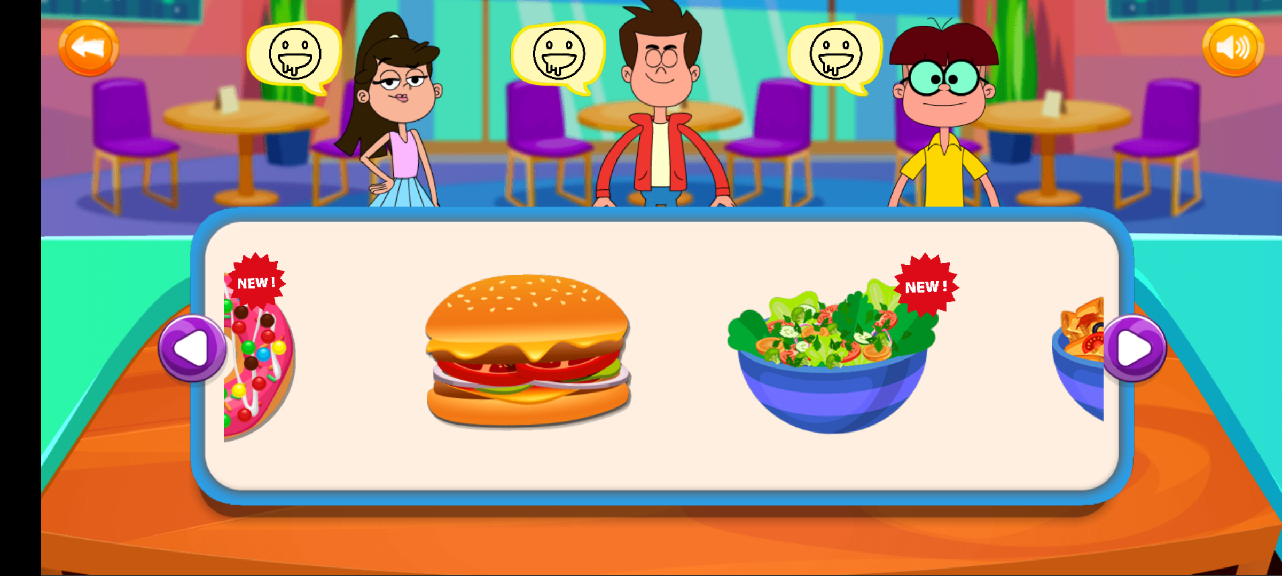

VISUAL EVIDENCE & STATUS
Screen Status Detail: Navigation & Star Reward Progression
Image 06: Gameplay Navigation & Controls
Status: PASS (PRESENT & ACCESSIBLE)
• Orientation: Landscape (2400×1080)
• Back Button: High-contrast circular orange button ('<') positioned at top-left
• Carousel Controls: Left/Right arrow triggers for advancing curriculum activities
• Touch Target: Exceeds 48dp Android accessibility touch guideline
• Exit Confirmation: Navigates directly back to the curriculum category screen
Image 08: Level Progress Tube & 3 Golden Stars
Status: PASS (ACTIVE FEEDBACK)
• Visual Mechanism: Vertical filling tube that rises incrementally as tasks are solved
• Milestones: 3 distinct golden stars positioned along the vertical track
• Feedback Loop: Stars ignite with visual animation upon reaching task thresholds
• Game Over State: No punitive 'Game Over' screen; child is encouraged to continue
• Audio Reinforcement: Positive cheer voiceover cue triggers upon star completion

Slide 7
TECHNICAL AUDIT STATUS
Final Architectural & Verification Summary
LITTLE SINGHAM: PLAY & LEARN — TECHNICAL AUDIT SUMMARY
✔ Splash & Boot Flow: Verified Pass. Animated intro screen with progress bar. No crash or ANR observed during hardware testing on Android 14.
✔ Display & Orientation Architecture: Dynamic Hybrid. Child gameplay is strictly locked to 2400×1080 Landscape. Parent Zone triggers an automatic hardware rotation to 1080×2400 Portrait.
✔ Parental Protection Mechanism: Verified Pass. Two-digit arithmetic question gate (55 + 6 = 61) protects parent zone, external links, and subscription menus.
✔ Audio & Sound Configuration: Verified Available. Global BGM on/off switch in Parent Preferences; dedicated one-tap speaker mute toggle on top-right of active gameplay.
✔ Navigation Architecture: Verified Pass. Circular orange back button ('<') at top-left; carousel next/prev buttons for item browsing.
✔ Scoring & Motivation Mechanics: Verified Pass. Vertical fill meter with 1, 2, and 3 golden star milestones. No punishing fail or timeout screens; purely positive reinforcement.

