Slide 1
QA & UX TECHNICAL STATUS AUDIT
LogicLike: ABC & Math
Detailed Screen-by-Screen QA Status, Star Confetti FX, Word-PIN Gate & UI Details
Package: com.logicappkids | Device: Vivo V2153 (Android 14) | Display: 1080×2400 (Portrait) / 2400×1080 (Landscape)

Slide 2
TECHNICAL VERIFICATION MATRIX
Complete QA Parameter & Status Checklist
Evaluation Parameter | Status | Visual Reference | Exact Technical Verification Details
Splash Screen & Video Launch | PASS (VERIFIED) | 01_portrait_welcome_splash.png | High-fps video demonstration splash with 'Get Started' and 'Sign in' buttons.
Portrait Onboarding Wizard | PASS (ACTIVE) | 02_onboarding_next_continue.png | Step-by-step age selection wizard in Portrait mode (1080×2400) with Continue button.
Paywall Close ('✕') Button | PASS (PRESENT) | 03_paywall_close_x.png | Prominent white '✕' button at top-left allows immediate paywall dismissal.
Landscape Learning Hub | PASS (LOCKED) | 04_landscape_learning_hub.png | Automatically rotates to Landscape (2400×1080) for expansive course curriculum.
Parental Word-PIN Gate | PASS (SECURE) | 05_parental_pin_gate.png | English number prompt ('THREE FIVE SIX') with numeric keypad and cancel button.
Audio Settings (Music Toggle) | AVAILABLE | 06_audio_settings_music.png | Parent Settings provides dedicated 'Music' binary ON/OFF switch toggle.
Voice Replay, Score & Confetti | PASS (ACTIVE) | 07 & 08.png | Voice speaker button reads instructions; +4 ⭐ score with animated multi-color star confetti.

Slide 3
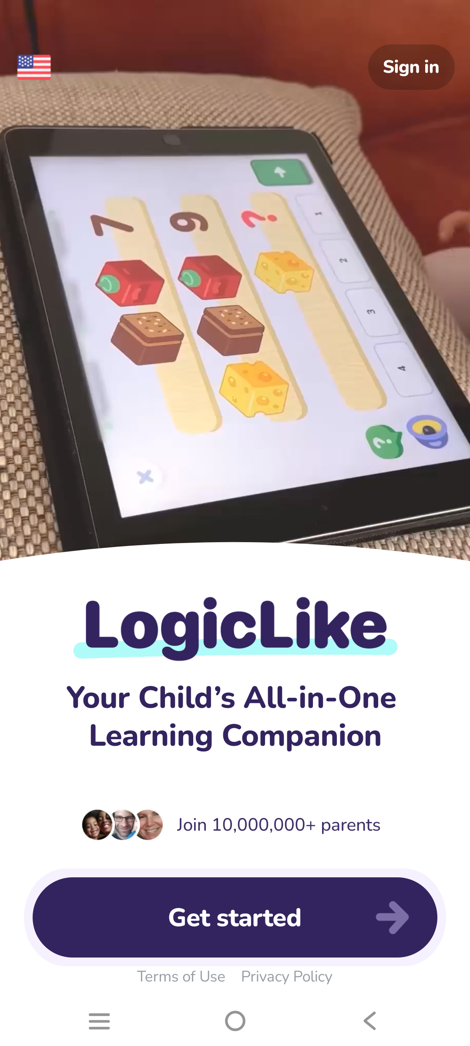
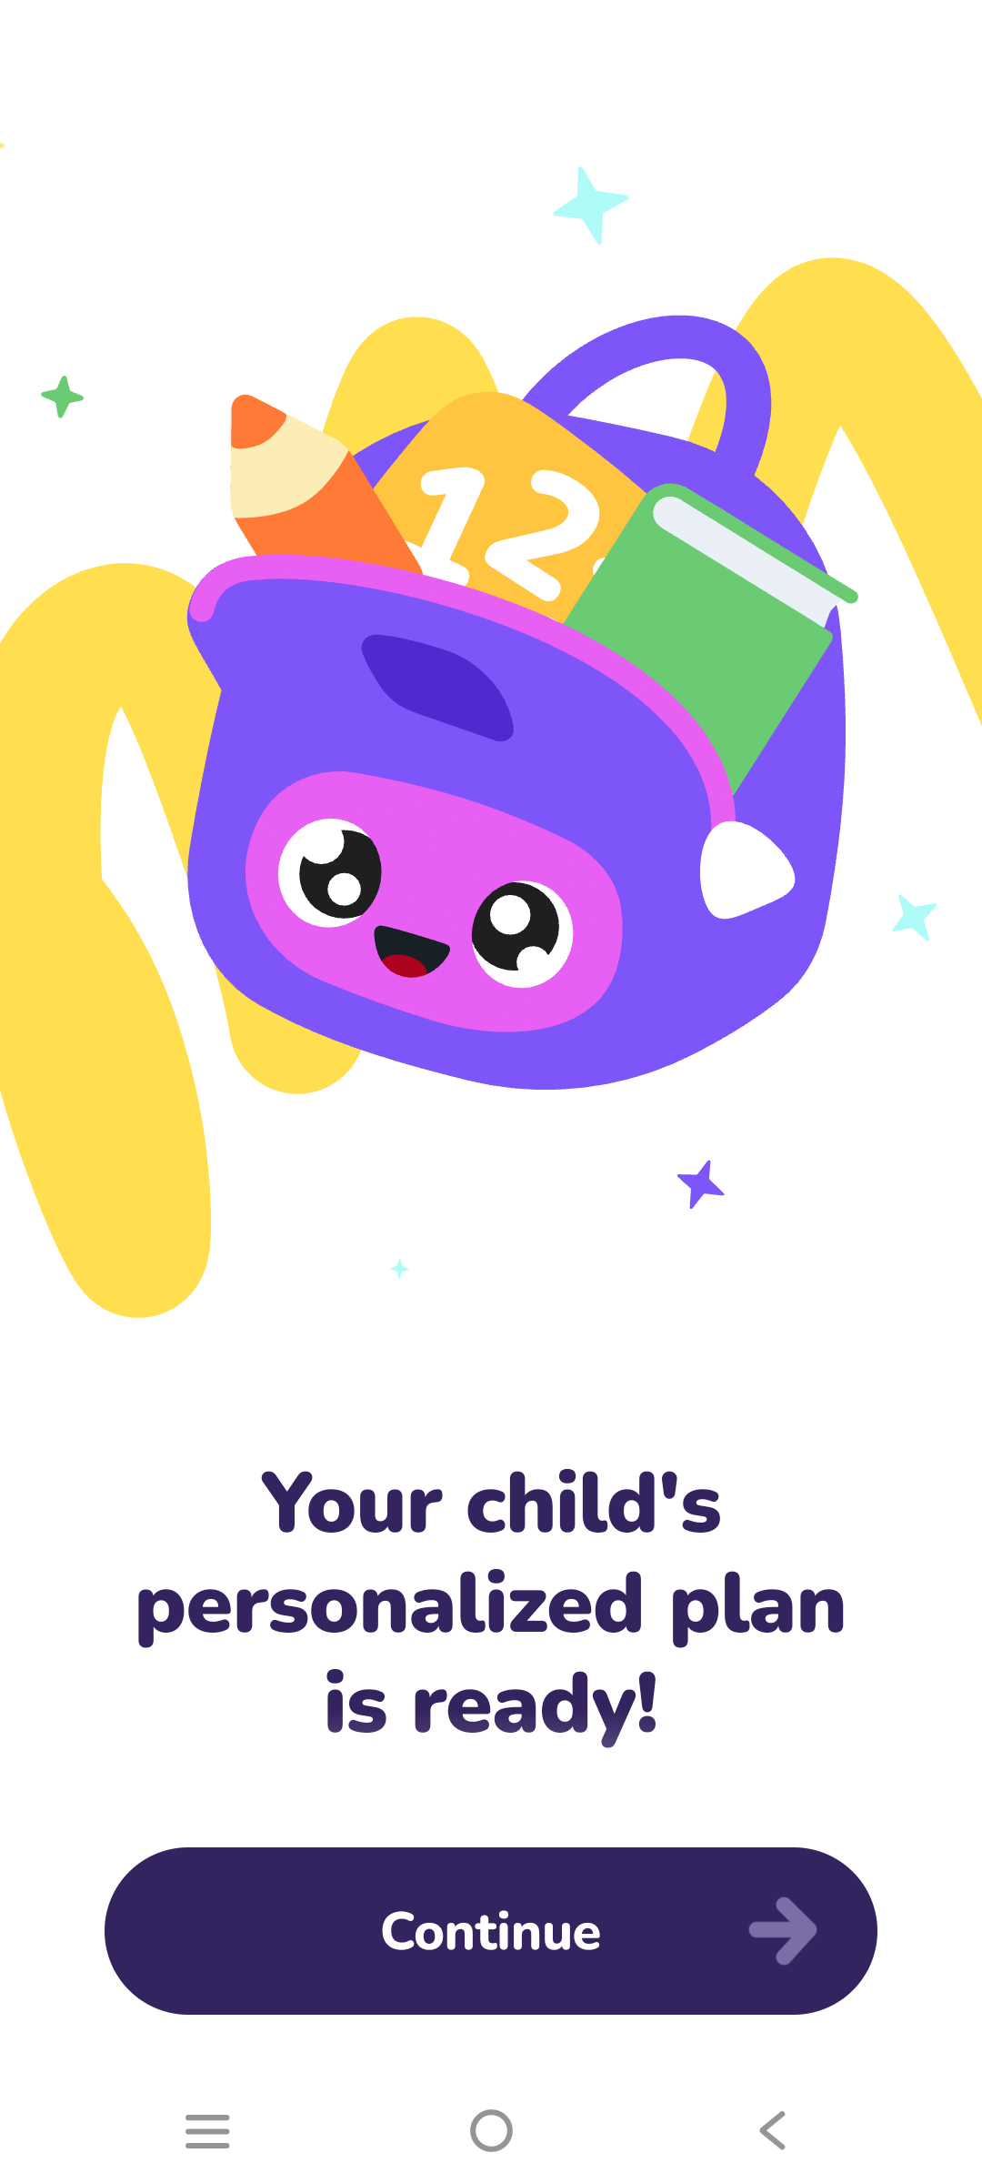
VISUAL EVIDENCE & STATUS
Screen Status Detail: Welcome Splash & Setup Onboarding
Image 01: Welcome Splash & Demonstration
Status: PASS (VERIFIED)
• Orientation: Portrait (1080×2400)
• UI Elements: Branded video demo, 'Get Started' primary button, 'Sign in' secondary button
• Technical Behavior: Loops high-resolution gameplay preview video seamlessly
• Audio State: Intro audio cues active with clear narration
• Stability: Zero launch crashes, instantaneous transition to onboarding
Image 02: Onboarding Setup Wizard
Status: PASS (ACTIVE WIZARD)
• Orientation: Portrait (1080×2400)
• UI Elements: Top progress bar with mascot icon, age selector chips, prominent 'Continue' button
• Interaction Flow: Single-tap age selection automatically activates the green Continue button
• Accessibility: High-contrast text and oversized interactive buttons for parental ease
• Navigation: Back arrow available at top-left for revising selections

Slide 4
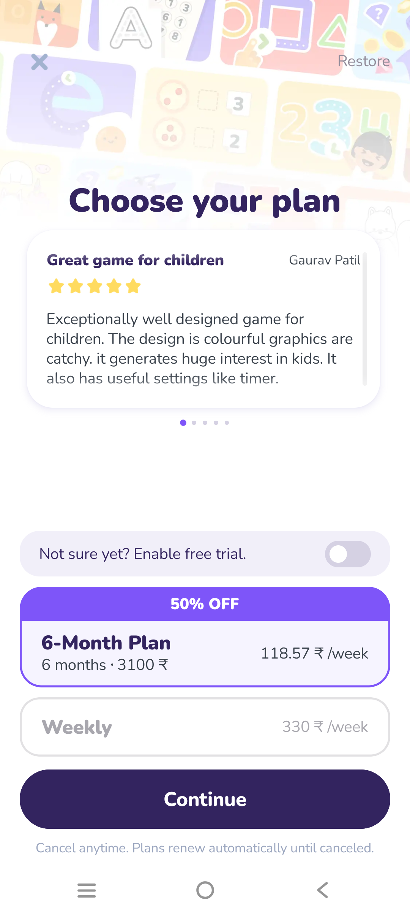
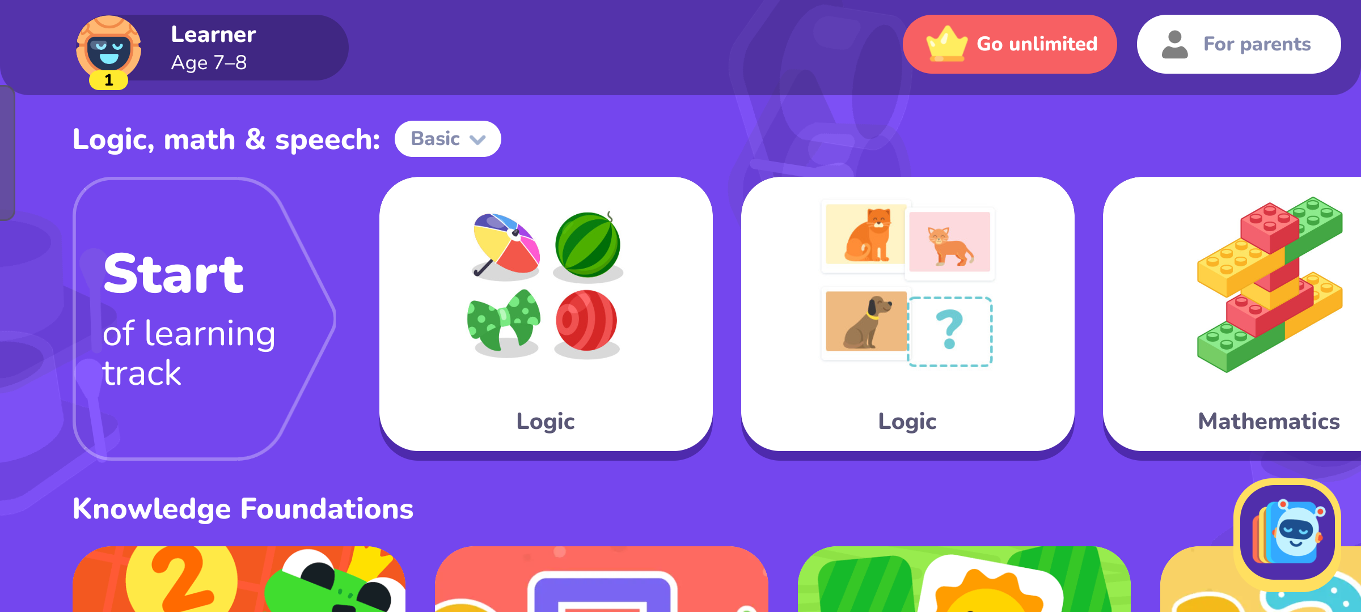
VISUAL EVIDENCE & STATUS
Screen Status Detail: Paywall Close 'X' & Landscape Course Hub
Image 03: Subscription Paywall Modal
Status: PASS (CLEAR DISMISS '✕')
• Orientation: Portrait (1080×2400) modal
• Dismiss Button: High-contrast circular '✕' button explicitly placed at top-left corner
• No Dark Pattern: User is never trapped; tapping '✕' instantly dismisses paywall to main hub
• UI Elements: Plan pricing cards, 'Start Free Trial' button, terms links
• Audio State: Background music continues softly in background
Image 04: Main Curriculum Track Hub
Status: PASS (LOCKED LANDSCAPE)
• Orientation: Landscape (2400×1080 locked)
• Rotation Trigger: Automatically rotates when exiting onboarding and entering learning tracks
• UI Elements: Course islands, star counter badge, chapter nodes, bottom navigation bar
• Ergonomics: Designed for two-handed tablet or smartphone landscape play
• Audio State: Gentle, repetitive logic puzzle soundtrack playing smoothly

Slide 5
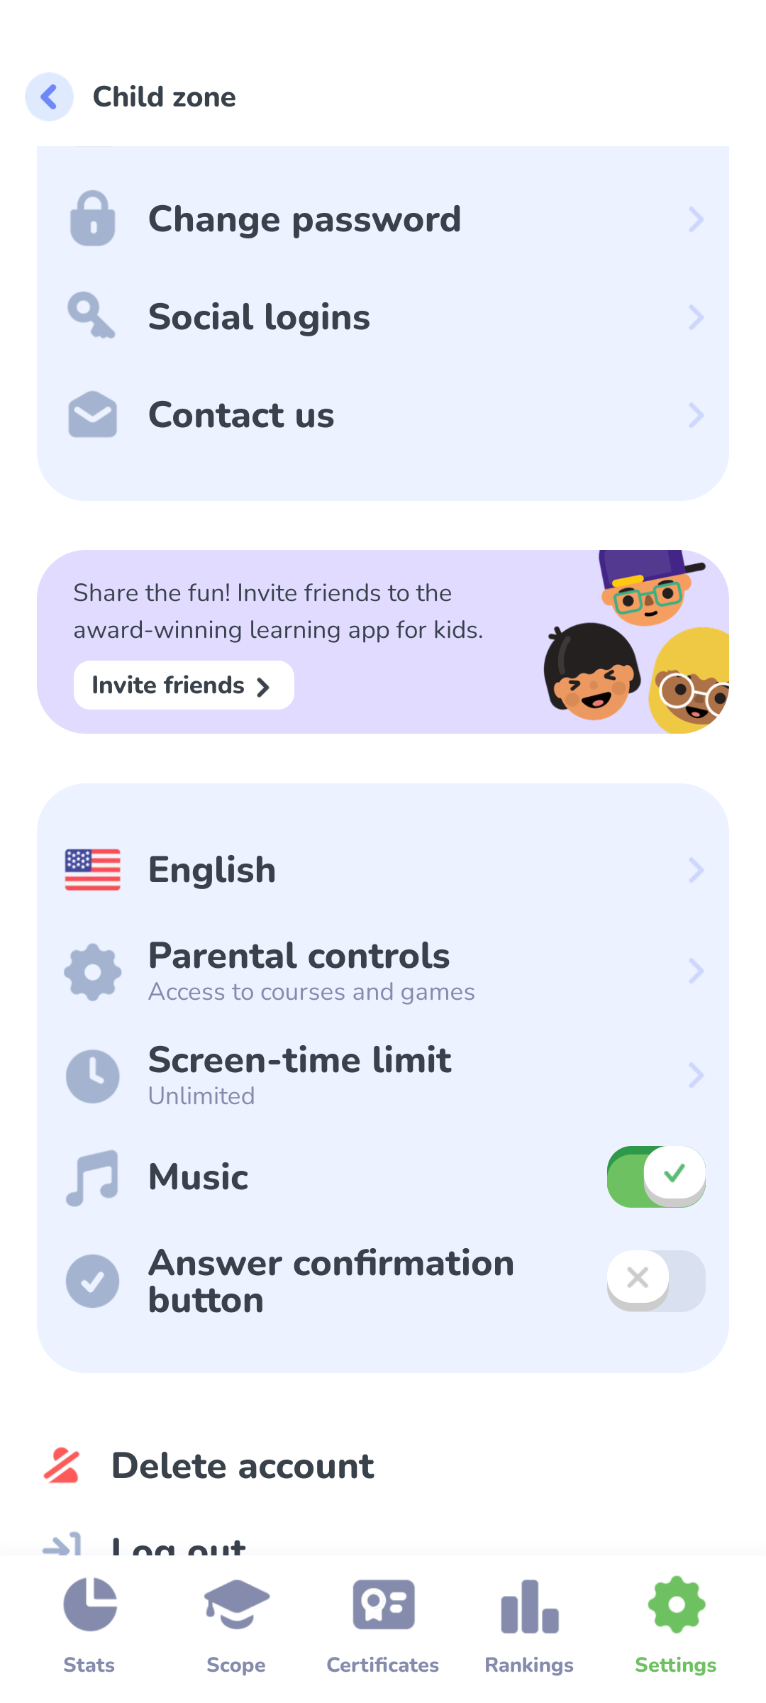
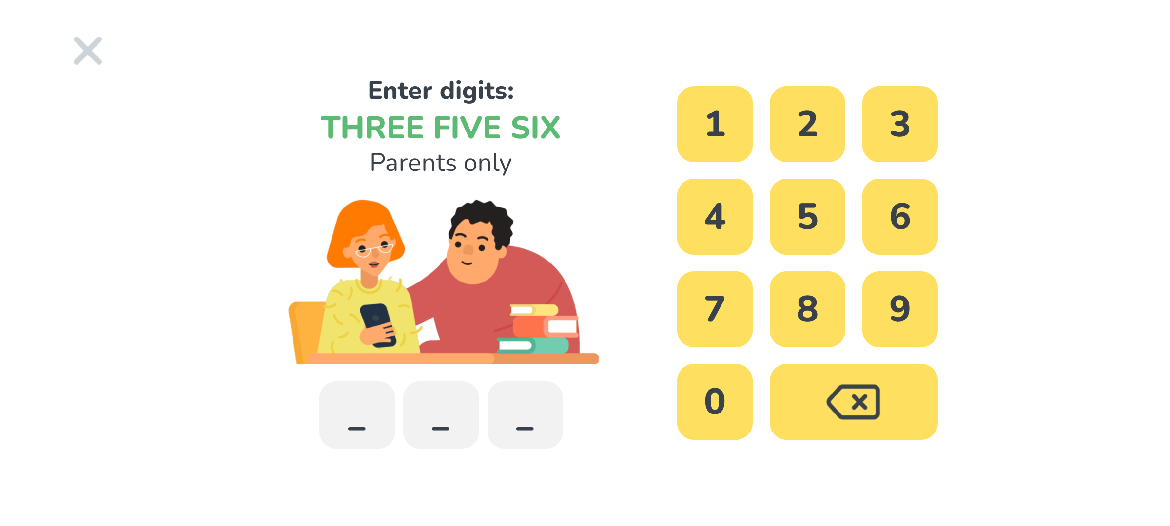
VISUAL EVIDENCE & STATUS
Screen Status Detail: Parental Word-PIN Gate & Music Settings
Image 05: Parental Word-PIN Security Gate
Status: PASS (SECURE PIN)
• Orientation: Portrait (1080×2400) overlay
• Security Mechanism: Written English word-digits challenge ('THREE FIVE SIX')
• UI Elements: Full 0–9 numeric keypad, Cancel button, 3 digit entry boxes
• Protection Scope: Protects Parent Zone, purchases, and account preferences from children
• Validation: Entering correct code (3-5-6) unlocks settings instantly; wrong entry clears
Image 06: Audio & Music Settings Menu
Status: AVAILABLE (TOGGLE ACTIVE)
• Location: Parent Settings > Sound Preferences (Portrait 1080×2400)
• Control Type: Dedicated 'Music' binary toggle switch (ON / OFF)
• Behavior: Disables background instrumental soundtrack globally across all activities
• Voice Independence: Voice instructions remain functional even when music is toggled off
• Persistence: Settings stored in app local database across restarts

Slide 6
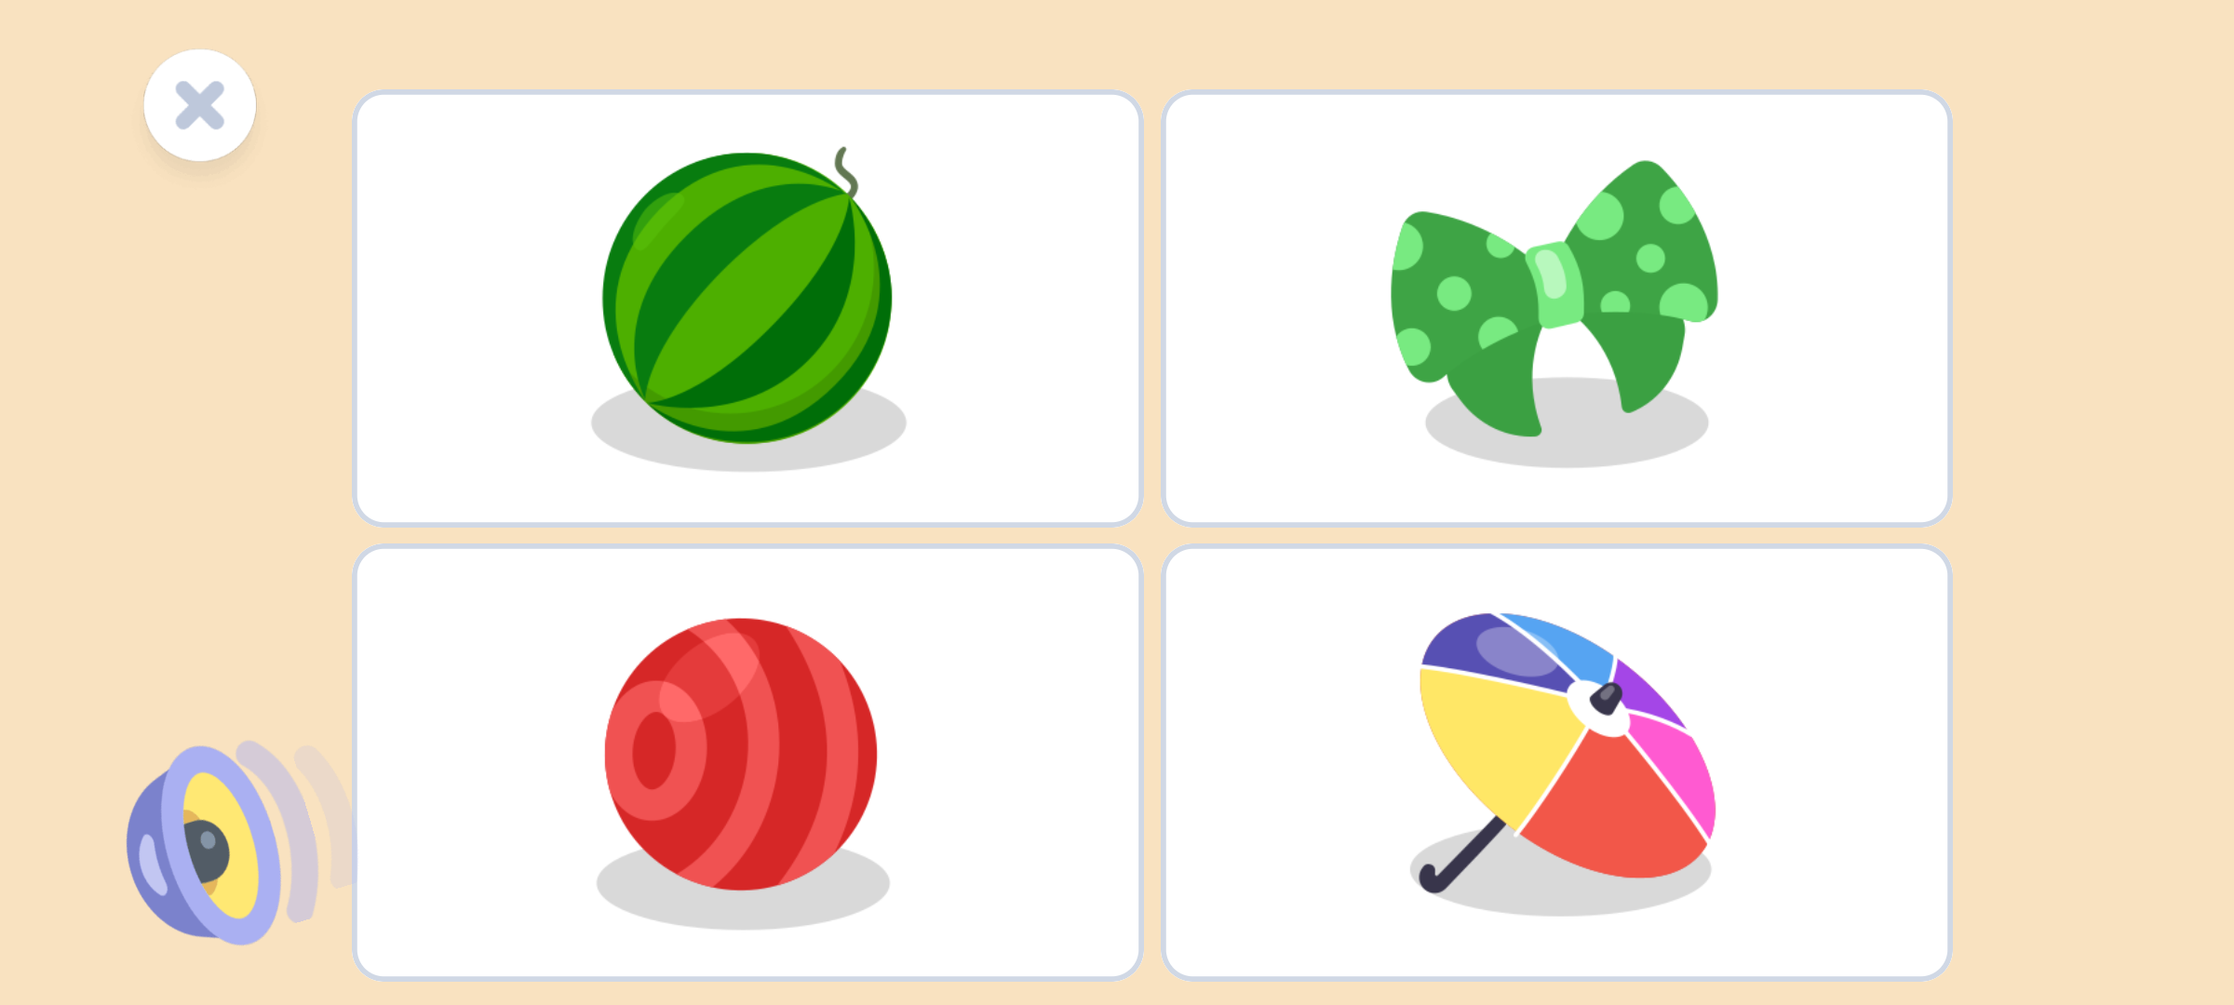
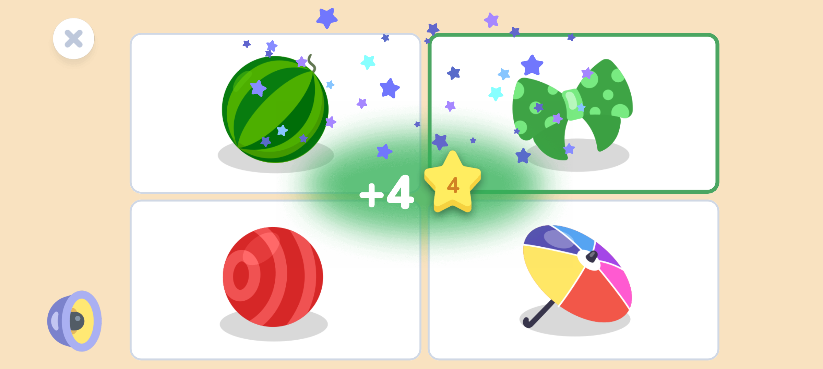
VISUAL EVIDENCE & STATUS
Screen Status Detail: Voice Replay & Star Confetti Particles
Image 07: Gameplay Voice Speaker & Close 'X'
Status: PASS (ACTIVE ASSISTANCE)
• Orientation: Landscape (2400×1080)
• Voice Speaker: Circular blue speaker icon in bottom-left re-reads puzzle prompt aloud
• Close Button: White circular '✕' button at top-left allows immediate exit from puzzle
• Accessibility: Allows pre-literate children to solve complex logic without adult help
• Responsiveness: Tapping speaker instantly replays clear verbal instruction
Image 08: Star Confetti Particles & Score Reward
Status: PASS (VERIFIED REWARD FX)
• Reward Type: Immediate numerical score boost ('+4 ⭐') with golden halo glow
• Particle Effect: Multi-colored animated star confetti shower (blue, yellow, purple, cyan)
• Audio Cue: Pleasant chime sound effect triggers upon correct solution
• No Failure Screen: Incorrect answers gently guide the child to re-try without penalty
• Visual Polish: Smooth 60fps physics-based confetti particle dispersal

Slide 7
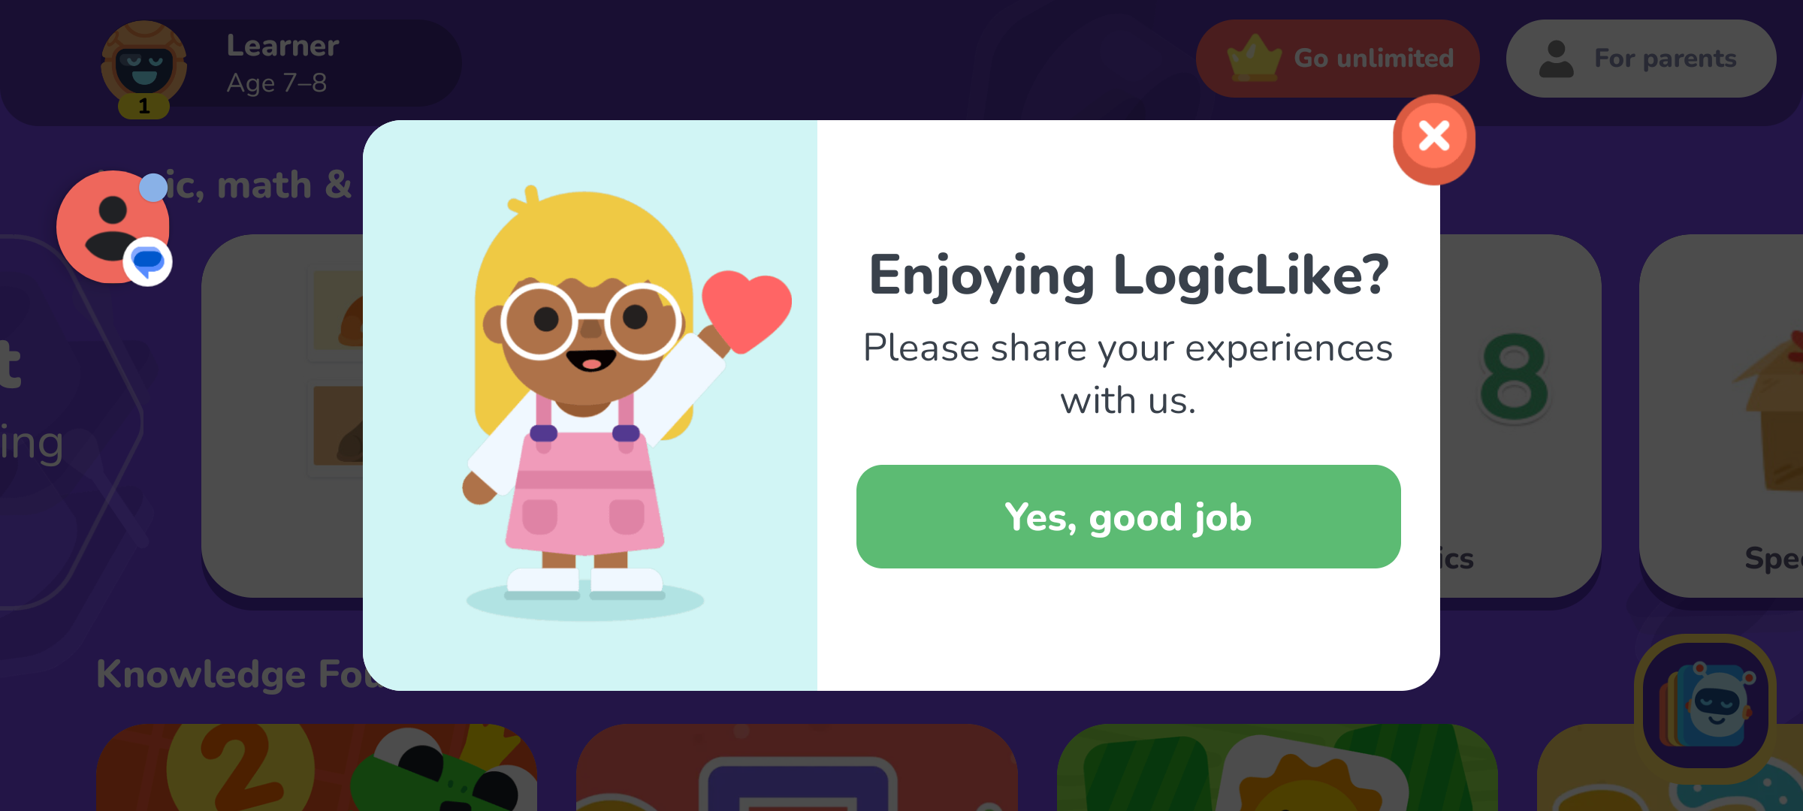
VISUAL EVIDENCE & STATUS
Screen Status Detail: Exit Modal & Navigation Feedback
LOGICLIKE: ABC & MATH — AUDIT SUMMARY
✔ Orientation Model: Adaptive Hybrid. Launch, onboarding, paywalls & settings run in Portrait (1080×2400). Main curriculum tracks and puzzles run in Landscape (2400×1080).
✔ Parental Security: Word-PIN challenge ('THREE FIVE SIX') successfully prevents child bypass into subscription or settings.
✔ Audio Architecture: Dedicated 'Music' toggle in settings; independent in-game voice replay speaker on all puzzles.
✔ Navigation Quality: Zero dark traps. Every overlay (paywall, puzzle, exit dialog) has an explicit '✕' button.
✔ Celebration FX: High-fidelity confetti particle shower and immediate +4 ⭐ reward feedback upon puzzle completion.
Image 09: Exit Confirmation & Feedback Modal
Status: PASS (FRIENDLY DISMISS)
• Orientation: Landscape (2400×1080) overlay
• Trigger: Tapping the top-left '✕' button during active gameplay
• UI Elements: Coral-red top-right '✕' button, feedback rating stars, 'Leave' action
• Safety Check: Prevents accidental loss of puzzle progress on unintended touches
• Dismissal: Tapping '✕' immediately returns child to active puzzle without state loss

