Slide 1
Continuous Profiling of
Go Applications
Monitor Go Applications using eBPF based profiling

Slide 2

About Me
Principal Software Engineer Red Hat
Developer Tools - GitOps Service / ArgoCD
https://www.linkedin.com/in/anand-francis-joseph-1063687
https://github.com/anandf/

Slide 3
Agenda
Introduction to Profiling
pprof tool and format
What is Continuous Profiling ?
Introduction to PARCA
Introduction to eBPF
Demo

Slide 4
Introduction to Profiling

Slide 5
Introduction to Profiling
Profiling is a dynamic analysis process that analyses a particular aspect of the execution of code.
Types based on profiling duration
Continuous Profiling
Ad-Hoc Profiling
Transaction based profiling
Types based on collection mechanism
Deterministic Profiler
also known as tracing profilers
prioritize accuracy over performance
tracks the flow and precise timing of requests as they pass through a system
Sampling Profiler (eg: PARCA)
also known as statistical profilers
Periodically observe function call stack and determine time/resources spent on a single function call ( eg: once in 10s)
Low overhead

Slide 6
Introduction to Profiling
Profiling data
CPU/GPU Usage (most common)
Memory Allocation
Heap Profiling
IO wait time (Network, Disk etc)
Number of Goroutines
Frequency and Duration of function calls

Slide 7
pprof format

Slide 8
pprof
Reads a collection of profiling samples
Open format specified by Google in profile.proto
Can be read from a local file or using http
Uses dot visualization (graphviz)
Lots of language supported - Go, Rust, Python, NodeJs, JVM

Slide 9
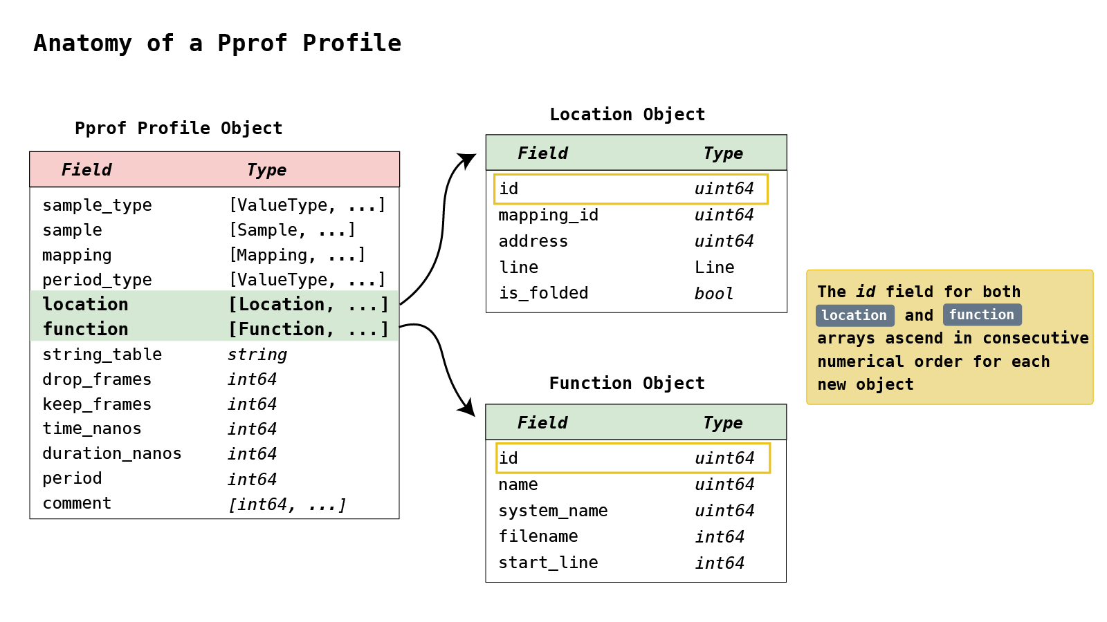
Anatomy of pprof struct
Source: https://pyroscope.io/blog/profile-continuous-profiler/

Slide 10
pprof tool - Shortcomings
Momentary
Captures resource usage at a particular moment.
Prior captures are not stored and no option to query data.
Manual
Profiling is triggered manually after detecting a problem.
Data when an incident is active is not captured.
Non Standard Workflows
Have to login to the production server to capture the profile data
Not automated, not auditable.

Slide 11
Continuous Profiling

Slide 12
What is Continuous Profiling
Sample profile applications often.
In a production environment, you never know at which point in time you are going to need profiling data, so its preferred to always collect at a low overhead.
Automatically scrape profiles rather than manually triggering it.
Advantages
Cost Optimization: Statistically significant insight into what code causes the most resources to be used, allows engineers to optimize those pieces and be confident, that resource usage will be lower after optimizing.
Compare Resource Usage: Always collecting data from all processes allows comparing why execution of code was different in time, across processes or even versions of code
Triaging Production incidents: Collecting data in the past allows us to understand incidents even after they have happened and without manual capturing of profiling data.

Slide 13
Introduction to eBPF

Slide 14
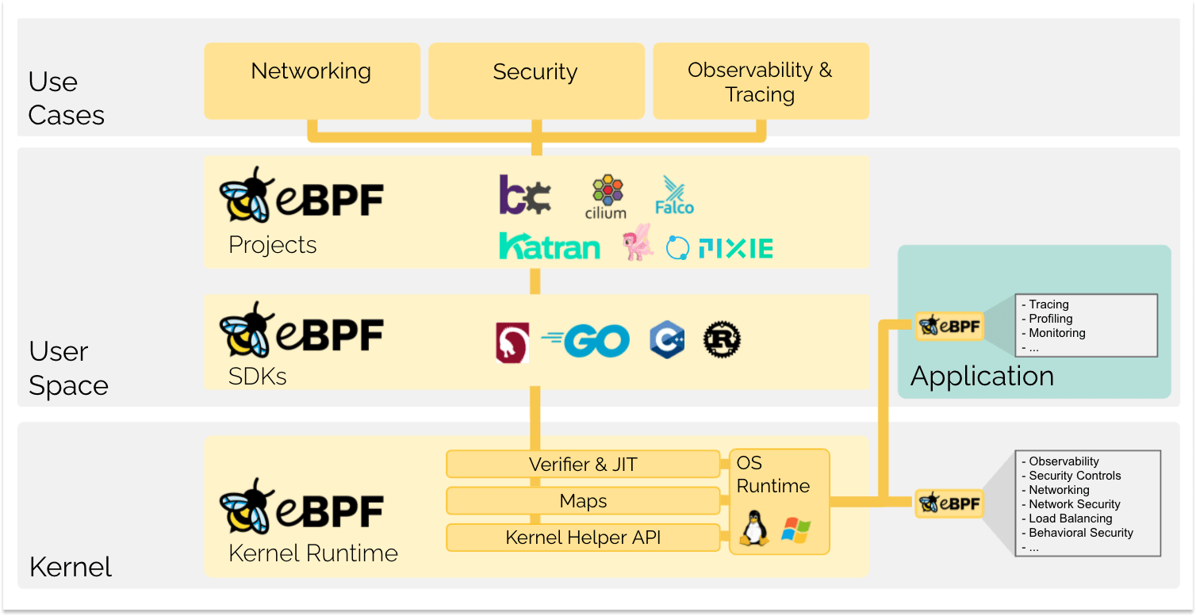
What is eBPF
Source: https://ebpf.io/what-is-ebpf/
eBPF is a revolutionary technology with origins in the Linux kernel that can run sandboxed programs in a privileged context such as the operating system kernel.
It is used to safely and efficiently extend the capabilities of the kernel without requiring to change kernel source code or load kernel modules.

Slide 15
Introduction to PARCA

Slide 16
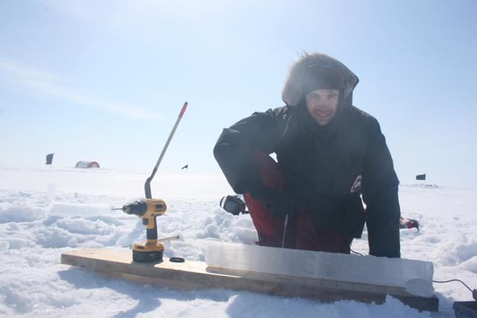
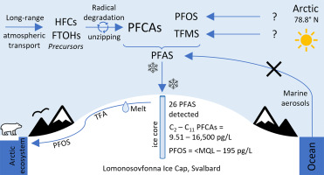
Introduction to PARCA
Source:
https://news.umanitoba.ca/climate-research-in-the-arctic-more-stories-from-the-arctic-science-partnership/
https://www.sciencedirect.com/science/article/pii/S004896972300445
PARCA stands for Program for Arctic Regional Climate Assessment (PARCA)
inspired by the ice core profiling technique used to study climate change.

Slide 17
Features of PARCA
Source:https://www.parca.dev/docs/overview/
Inspired by Prometheus
Super low overhead profiler (agent), powered by eBPF
A label-selector based query language
Query engine specifically designed for profiling data
Optimized, built-in storage (TSDB)
Support for pushing and pulling profiles from targets
Targets are discovered via service discovery or static configuration

Slide 18
Components of PARCA
Parca comprises two main components:
Parca Server
Optimized storage of profile data and metadata
Stores the ingestion configuration (push/pull modes)
Provides an UI interface for monitoring.
Parca Agent
Implements the sampling profiler which leverages eBPF to continuously collect raw profiling data
Covers both user-space and kernel-space applications.
It discovers targets to profile such as Kubernetes containers or systemd units.

Slide 19
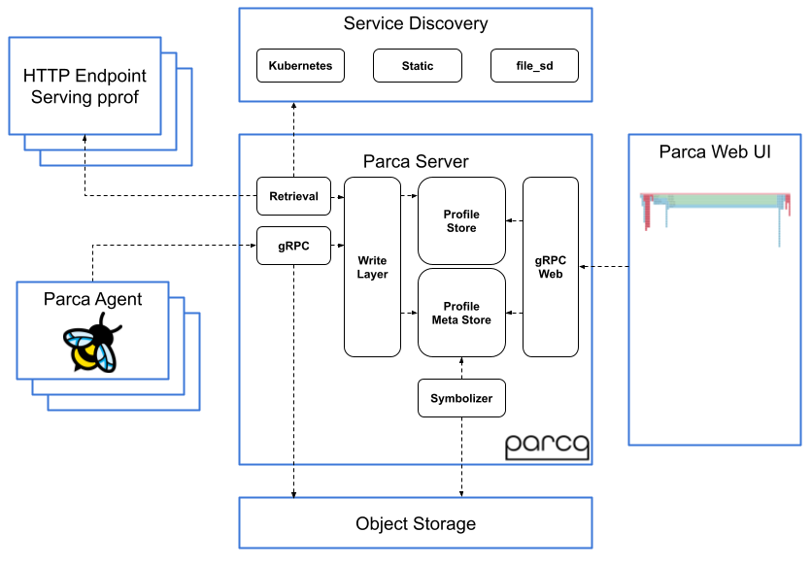
Architecture of PARCA
Source: https://www.parca.dev/docs/overview

Slide 20
Workflow of PARCA agent profiler
Source: https://www.parca.dev/docs/overview
Discover cgroups
Load and attach eBPF program to cgroup
Read BPF maps
Transform to pprof format
Extract Debug symbols
Send data to server
Clear BPF maps
Create profiler
per cgroup
Wait 10s
Wait 10s for BPF maps to be filled

Slide 21
Demo

Slide 22

Thank you!

