Slide 1
Five-Level Reduced-Switch-Count Boost PFC Rectifier with Multicarrier PWM

Slide 2
ABSTRACT
A reduced switch count 5-level boost PFC rectifier has been presented.
A simple controller has been implemented on the proposed converter to generate a constant voltage at the output while generating a five-level voltage waveform at the input without connecting the load to the neutral point of the DC bus capacitors.
Multicarrier PWM technique has been used to produce switching pulses from control signal.

Slide 3
LITERATURE SURVEY
Sl.No | Title & Author | Technique used | Advantages | Disadvantages
1. | Half-Bridge Based Multilevel Inverter Generating Higher Voltage and Power Hani Vahedi Kamal Al-Haddad | Half-Bridge Based Multilevel Inverter | Reduced harmonics Better efficiency | High cost Low performance
2. | Linear and Nonlinear Control Techniques for a Three-Phase Three-Level NPC Boost Rectifier Loubna Yacoubi, Kamal Al-Haddad | Linear, nonlinear, and nonlinear model reference adaptive control (MRAC) methods | Better accuracy High looping gain | High harmonic distortion High switching frequency

Slide 4
Cont…
Sl.No | Title & Author | Technique used | Advantages | Disadvantages
3. | A DSP-Based Implementation of a Nonlinear Model Reference Adaptive Control for a Three-Phase NPC Boost Rectifier Prototype Loubna Yacoubi, Kamal Al-Haddad | Model reference adaptive control (MRAC) | Fast settling time Low line current THD | High switching frequency High cost
4. | A New Five-Level Buck-Boost Active Rectifier Hani Vahedi, Philippe-Alexandre | Capacitor Tied Switches (CTS) | Does not need additional bulky filters More reliability | High cost Low performance

Slide 5
Cont…
Sl. No | Title & Author | Technique used | Advantages | Disadvantages
5. | Cascaded Multilevel Inverter with Multicarrier PWM Technique and Voltage Balancing Feature Hani Vahedi, Kamal Al-Haddad | Multicarrier PWM technique | Reduced number of switches Lower harmonic distortion | Low performance Require additional bulky filters
6. | Crossover Switches Cell (CSC): A New Multilevel Inverter Topology with Maximum Voltage Levels and Minimum DC Sources Hani Vahedi, Kamal Al-Haddad | PWM switching technique | Lower distortion Lower switching frequency | Low efficiency High cost

Slide 6
Conti…
Sl.No | Title & Author | Technique used | Advantages | Disadvantages
7. | Selective Harmonic Elimination Modulation Technique Applied on Four-Leg NPC Mohammad Sharifzade, Hani Vahedi | Selective harmonic elimination pulse width modulation (SHE-PWM) technique | Reducing switching losses Low harmonics | Require bulky filter High cost
8. | Medium-Voltage Multilevel Converters—State of the Art, Challenges, and Requirements in Industrial Applications Haitham Abu-Rub Joachim Holtz | Model predictive control | Very low switching frequency Minimum harmonic distortion | Low settling time Less efficient

Slide 7
Cont…
Sl.No | Title & Author | Technique used | Advantages | Disadvantages
9. | A Novel Hysteresis Bandwidth (NHB) Calculation To Fix the Switching Frequency Employed In Active Power Filter Hani Vahedi Abdolreza Sheikholeslami | Hysteresis current control method | Low switching frequency Low switching losses | Performance is low High cost
10. | High-power-factor single-phase switch clamped rectifier B:R. Lin and T.-L. Hung | Neutral point switch clamped scheme | High power factor Low current harmonic distortion | High switching frequency Low performance

Slide 8
EXISTING SYSTEM
Two-stage rectifiers in which the input AC voltage were rectified by a diode bridge and then a DC-DC chopper were used to change the DC voltage level at the second stage output.

Slide 9
DISADVATAGES
Requires bulky filters
High switching frequency
High switching losses
High harmonic distortion
Low performance
High cost

Slide 10
PROPOSED SYSTEM
A multilevel boost PFC (Power Factor Correction) rectifier is introduced in this project.
In this project multi level is used in the input side to reduce harmonics in the constant output voltage.
Bidirectional switch has been connected between leg b and midpoint of DC capacitors to provide different paths for current.
The bidirectional switch is made by four diodes and one active switch instead of using two active switches to shrink the rectifier size and to reduce the switching losses.

Slide 11
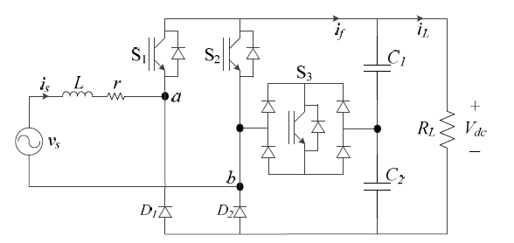
CIRCUIT DIAGRAM

Slide 12
Conti…
In a grid-connected application, the converter voltage imposes its harmonics into the current waveform.
Therefore, the proposed rectifier would have 5-level voltage waveform at the input so it will generate low harmonics affecting the grid current directly results in using smaller size filters compared to the conventional two-level or two-stage rectifiers.

Slide 13
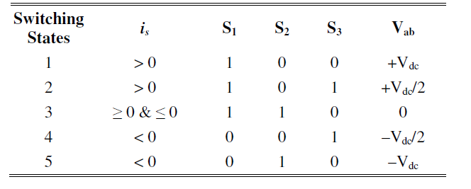
SWITCHING TABLE

Slide 14
ADVANTAGES
Low voltage stress
Low switching frequency
low harmonic distortion
High power conversion
High efficiency
Requires less number of filters

Slide 15
SOFTWARE REQUIREMENTS
MATLAB 7.0 AND ABOVE
MATLAB
MATLAB is a high-performance language for technical computing. It integrates computation, visualization, and programming in an easy-to-use environment where problems and solutions are expressed in familiar mathematical notation.

Slide 16
TYPICAL USES INCLUDE:
Math and computation
Algorithm development
Modeling, simulation.
Data analysis, exploration, and visualization
Scientific and engineering graphics
Application development, including Graphical User Interface building

Slide 17
STARTING SIMULINK
Simulink is a graphical extension to MATLAB for the modeling and simulation of systems.
In Simulink, systems are drawn on screen as block diagrams. Many elements of block diagrams are available (such as transfer functions, summing junctions, etc.), as well as virtual input devices (such as function generators) and output devices (such as oscilloscopes).
Simulink is integrated with MATLAB and data can be easily transferred between the programs.

