Slide 1
Social Media Analysis_MySql
Anand Kumar Giri

Slide 2
Agenda..
Problem Statement
Data Description
Objective Key Metrics
Insights & Visualizations
Conclusion

Slide 3
1.Problem Statement
Marketing teams want to leverage Instagram's user data to develop targeted marketing strategies to increase engagement, retention, and acquisition. Provide insights and recommendations to address the following objectives.

Slide 4
2. Data Description
We Are given a database that has 7 different relational tables that contains the record of users and their posts along with the likes, comments, followers and posts.
Dataset has no missing and NULL values
comments_id: unique identifier for each comment
comment_text: text content of a given comment
user_id: unique identifier for each user
photo_id: unique identifier for each photo
created_at: date of interaction in the form like, photos, tags
follower_id : user_id of the follower for a certain user
followee_id: user_id of followee for a certain user
tag_id: unique identifier for each tag
image_url: link to the image posted on the platform
username: username chosen by the user
Data Link: Link

Slide 5
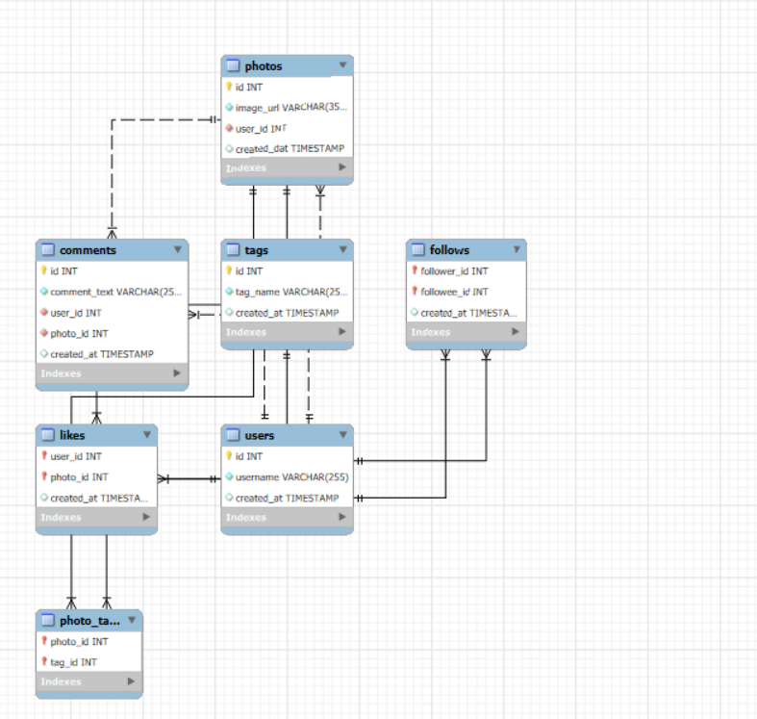
Database Schema

Slide 6
3. Objective & key metrices
Objective is to find the engagement of users on the platform. For gaining insights and recommendations for ad campaigns we have metrices like:
Likes
Comments
Follows
Posts
Hashtag
We will further calculate the total engagement, average engagement and many other things that will be needed for the analysis.
We will focus on the popularity of different hashtags, which will be our main metric for generating recommendations.

Slide 7
4.Insights & visualizations
USER ACTIVITY LEVELS
ACTIVE & INACTIVE USERS

Slide 8
Top Users by Engagement Rates

Slide 9
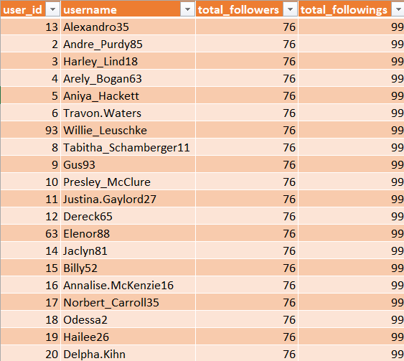
Users with the Most Followers and Followings:

Slide 10
AVERAGE ENGAGEMENT RATE PER USER(TOP 20)

Slide 11
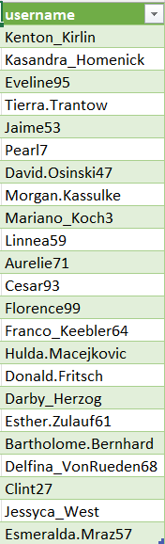
USERS WHO HAVE NEVER LIKED ANY POST
Query:
select u.id,u.username
from users u
left join likes l on u.id=l.user_id
where l.user_id is NULL;
Here total Of 23 Persons haven’t liked any post.

Slide 12
Hashtag Usage and Engagement
These are the popular hashtags In most of the posts.

Slide 13
AVERAGE OF LIKES PER HASHTAG

Slide 14
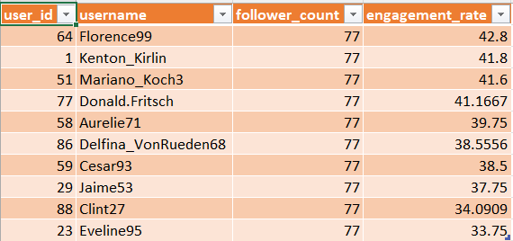
Suggested top 10 influencers based on followers and engagement rate
Florence99 (Engagement Rate: 42.8%)
Kenton_Kirlin (Engagement Rate: 41.8%)
Mariano_Koch3 (Engagement Rate: 41.6%)
Donald.Fritsch (Engagement Rate: 41.2%)

Slide 15
Correlations Between Engagement and Content Types
HERE WE CAN SEE THAT THE USERS WHO DO MORE POSTS GET MORE ENGAGEMENTS AND LIKES AS COMPARED TO THOSE WHO HAVE FEWER POSTS.

Slide 16
Strategies for Re-engaging Inactive Users
To re-engage inactive users and encourage them to start posting or interacting again, we could consider a few targeted strategies:
Send personalized notifications or emails Offering rewards, badges, or incentives for coming back to the platform, posting, or interacting with others.
Highlight their previous comments or popular posts they may have missed to make the experience.
Create limited-time challenges or contests that encourage users to post content, comment, or like others' posts.
Show off new features, updates, or trending content that the user might find interesting.
Provide content recommendations based on their past interests, like suggesting accounts to follow or posts they may like.

Slide 17
FUTURE RECOMMENDATIONS
Here are some future recommendations based on our analysis:
Use Popular Topics for Ads: Focus on trending tags like "smile," "beach," and "party" in ad campaigns to capture user interest.
Personalize Content: Show users content and ads based on what they engage with the most to keep them interested.
Encourage Engaging Content: Highlight or promote content that uses popular tags to attract more interaction.
Reward Active Users: Offer recognition or rewards to users with high engagement to motivate them to stay active.
Refresh Insights Regularly: Trends change quickly, so update these insights often to keep campaigns relevant.
These steps can boost engagement and make ads more effective

Slide 18
CONCLUSION
High Engagement Users: Certain users have high engagement rates with frequent likes and comments, showing active participation.
Trending Hashtags: Popular hashtags like "smile," "beach," and "party" can guide content creation toward trending themes.
Relevant Ad Campaigns: Aligning ads with popular user-generated content topics makes advertising more relevant and appealing.
Content Strategy Guidance: User data helps content teams focus on posts that resonate with the audience, boosting engagement.
Personalized Ad Strategies: Insights from user behavior can inform more targeted and personalized ad campaigns.

Slide 19


