Slide 1

ZOMATO RESTAURANTS ANALYSIS
Anand Kumar Giri

Slide 2
ROAD-MAP
Analysis
Understanding Objective and Dataset
Cleaning Of Data, Removing Unwanted Columns And Adding More for Better Insights
Understanding And Analyzing Data In Excel to Get Insights and information
Creation Of a Dashboard to visualize data and get better recommendations based On Insights

Slide 3
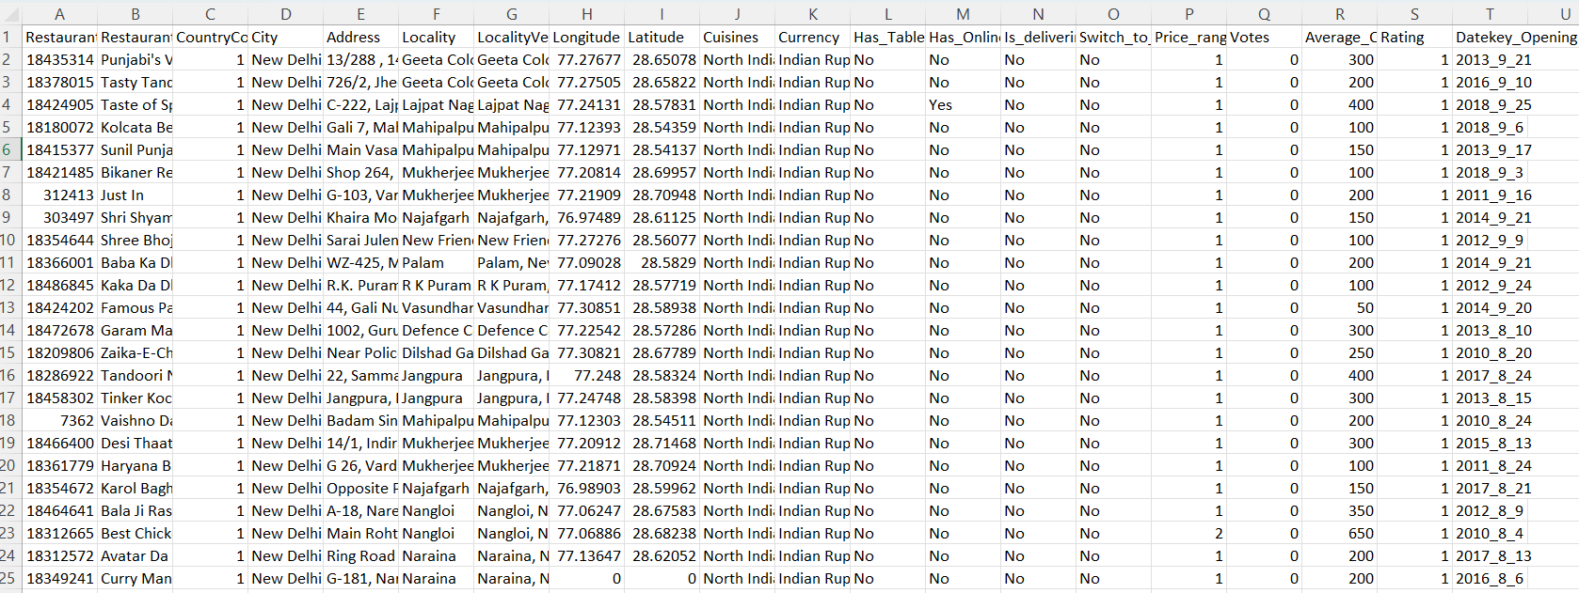
Problem Statement
You are hired as a consultant data analyst by zomato where the team is looking for expansion and opening restaurants. Your task is to come up with strategies/suggestions about opening newer restaurants.

Slide 4
Data Description
Restaurant ID: Unique identifier for each restaurant.
Restaurant Name: The name of the restaurant.
Country Code: Country code of the location where the restaurant is situated.
City: The city where the restaurant is located.
Address: The specific address of the restaurant.
Locality: The locality or neighborhood where the restaurant is situated.
Locality Verbose: Detailed information about the locality.
Longitude: The geographical longitude coordinate of the restaurant.
Latitude: The geographical latitude coordinate of the restaurant.
Cuisines: The type of cuisine offered by the restaurant.
Currency: The currency used for transactions in the restaurant.
Has_Table_booking: Indicates whether the restaurant has a table booking option (Yes/No).
Has_Online_delivery: Indicates whether the restaurant offers online delivery (Yes/No).
Is_delivering_now: Indicates whether the restaurant is currently delivering (Yes/No).
Switch_to_order_menu: Indicates whether users can switch to the order menu (Yes/No).
Price_range: A numeric value indicating the price range category of the restaurant.
Votes: The number of votes or ratings/(feedback) received by the restaurant.
Average_Cost_for_two: The average cost for two people dining at the restaurant.
Rating: The overall rating of the restaurant is based on user reviews.
Datekey_opening: The date when the restaurant was opened.

Slide 5
Data Cleaning
Data cleaning is fixing or removing incorrect, corrupted, incorrectly formatted, duplicate, or incomplete data within a dataset.
Data cleaning is performed on inconsistent data to obtain a consistent and better result.
In this dataset columns like locality verbose, longitude and latitude which are not used for fulfilling my goal set were removed.
Column name Country Name added with respective countries in which the restaurants are located using Vlookup function in country description worksheet.
In addition to the Country column I also added a column Average_Cost_for _two (INR) in which I converted different currency values to INR for the Average_Cost_for_two column for a better comparison of price globally.
The Datekey_Opening column has been formatted to date format to have accurate data.

Slide 6

Understanding And Analysing Data In Excel to Get Insights and information
Now we have Done with Our cleaning and manipulation part in dataset. We have to go through the data with various functions and aggregation of excel to get proper insights from the data. After that, we’ll put forward different insights that we acquired through the analysis

Slide 7
ANALYSIS
During Analysis I used functions Like Sum(), Count(), Counta().
I used count() to find the total number of restaurants in the dataset. The formula i used is =COUNT('Raw Data'!$A$2:$A$9543).
I also used count() with unique() to count the unique cities & countries.
To count the number of cuisines(only Unique value) I used =COUNTA(UNIQUE(FILTER('Raw Data'!H2:H9552,'Raw Data'!H2:H9552<>""))).
To count the number of unique cities I used =COUNTA(UNIQUE('Raw Data'!E2:E9543)).
Sum Function is used to calculate the total number of voters across all the countries. I.e., =SUM('Raw Data'!O2:O9543)
To get clarity in comparison of the Average Cost For Two, all the currencies were converted to INR.

Slide 8
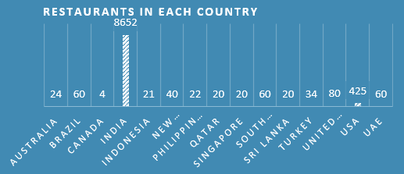
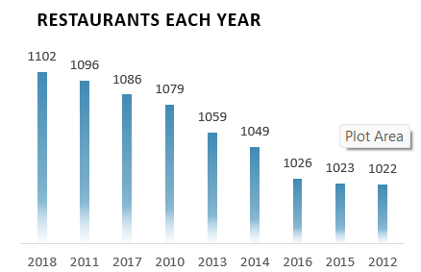
FINDING INSIGHTS
Analysing The trends in restaurants year and country-wise.
A Chart will illustrate the number of restaurants in each country presented in our dataset, revealing dining hot spots across the globe.
Total number of restaurants is 9542 globally. from which 8652 (89.51%) are located in India, following which USA has 425 and UK has 80 restaurants respectively. Canada has the least number of restaurants i.e. 4.
As we see years we find that most number of restaurants were opened in 2018(1102) followed by 2011(1096) and 2017(1086).

Slide 9
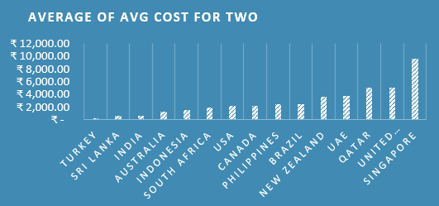
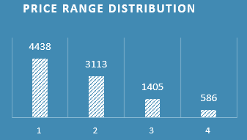
Cracking The price Dynamics Exploring Price Trends From Budget-Friendly to Luxury Experience:
Singapore has the highest average cost for two i.e., 9,687.65 INR and Turkey is least expensive with an Average cost for two i.e., 259.65 INR.
Here in the second chart, we can see that majority of restaurants i.e.,4438 are in the price range of 1. It shows that the majority of restaurants are pocket-friendly. Based On this data we can consider where to give more focus.

Slide 10
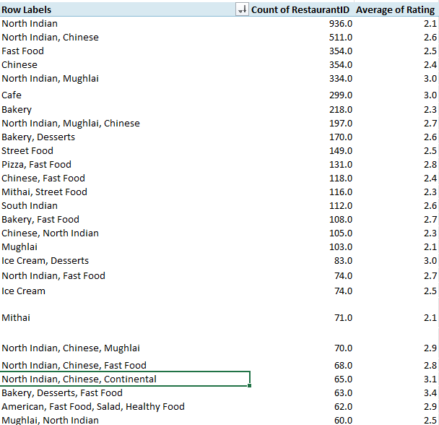
Analysing the trend of Cuisines
A pivot table can make us understand the majority of cuisines restaurants are having.
As we can see North India cuisine is the most popular cuisine and is available in 936 restaurants.
The most popular cuisines are form Indian restaurants as majority of restaurants are in India.
In the image, the average rating column can help us find the popular restaurants and cuisine distribution on the basis of Average rating.

Slide 11
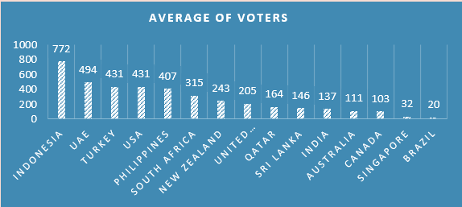
Global Contribution Of Customers
Average Number Of Voters Across Countries:
14,95,919 Total Voters we have.
We can see that Indonesia have the maximum average Voters i.e., 772 along with Brazil with the least Numbers i.e., 20
We can see instead of having most restaurants in India, the number of voters is less compared to other countries.

Slide 12
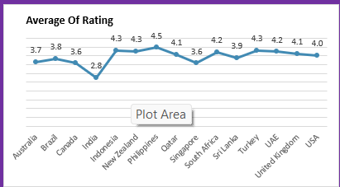
Global Contribution Of Customers
Average Of Rating Across Countries:
The Graph Shows us the Average of rating the restaurants have in each country.
We can see that India is residing very low in terms of rating. But the fact we have to remember is India has the most number of Restaurants.

Slide 13

Creation Of a Dashboard to visualize data and get better recommendations based On Insights.
So now we are done with our analysis, it’s time for using the findings and insights we gathered to make recommendations, and at last we’ll present our dashboard by which our organization can interact with and gain more insights needed.

Slide 14
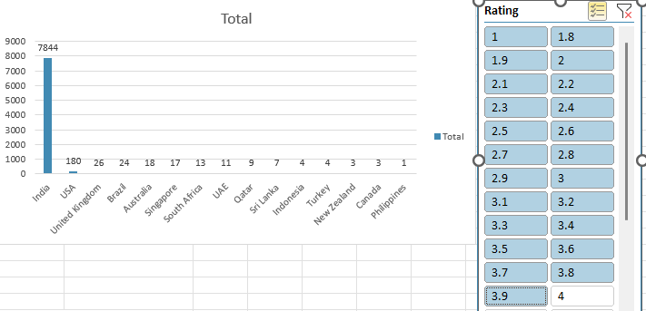
Recommendations
1.Recommended Countries:
Based On The Rating(Less Than 4) and lowest number Of restaurants from each country, I suggest Some of The countries where the Team can think Of opening Restaurants.
Suggested Countries:
1. Indonesia
2. Turkey
3. New Zealand
4. Canada
5. Philippines
6. Qatar
7. Sri Lanka
Here low rating indicates that people are not getting much options in Restaurants.

Slide 15
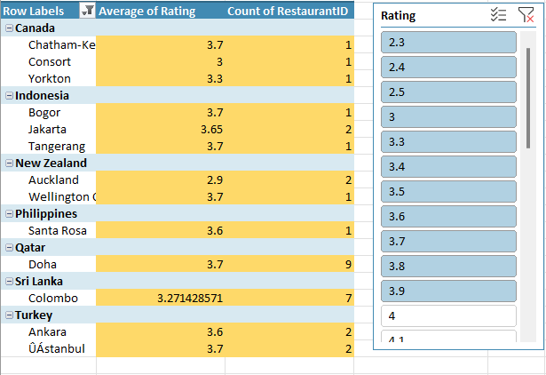
2.Recommended Cities
Some Cities Where the Team can open restaurants where they find lesser competition. These Cities Are Having Rating less than 4.
Canada: Chatham-Kent, Consort, Yorkton Indonesia: Bogor, Jakarta, Tangerang
New Zealand: Auckland, Wellington City
Philippines: Santa Rosa
Turkey: Ankara, Uastanbul
Sri Lanka: Colombo
Qatar: Doha

Slide 16
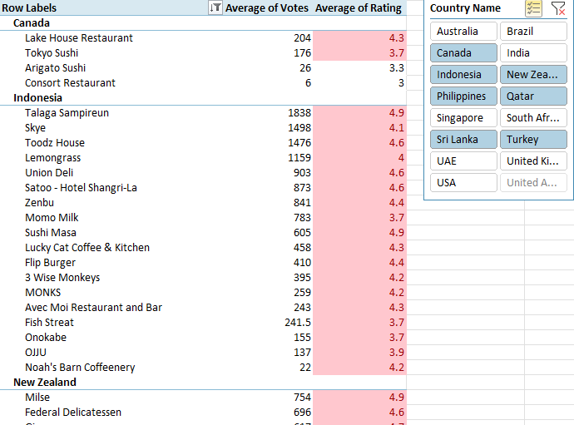
3. Biggest Competitors
Restaurants from Our Suggested Country that are the biggest competitors:
For our primary competitors, here is a pivot table I created for each restaurant by name in every location and nation. Restaurants with an average rating of more than 3.5 are considered to be our primary competitors.

Slide 17
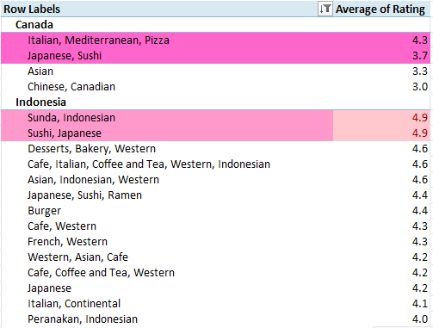
4. Recommended Cuisines
Given Pivot Table Provides The choices Of Cuisines For the recommended States.
These cuisines are based on an average rating of more than 3.5.
These are the most Rated Cusines From the recommended Countries.

Slide 18
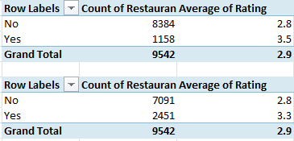
5. Recommendation For Services
Here in the above pivot table we can see that the rating varies with the services provided.
In order to gain customers and good ratings, team should think of providing these services in while opening restaurants.
It will provide our customers with more options for how they want to eat their meals, put us one step ahead of our competitors, and help us expand our customer base and business.

Slide 19
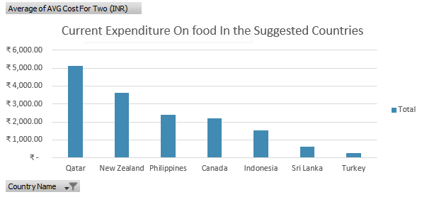
6. Recommended Price For Cuisines
As we can see, Qatar and New Zealand are having the highest Average Cost For two which we can compete with them by offering our meals at comparably cheaper pricing.
Comparatively we can increase the prices in Turkey, Sri Lanka and Indonesia to compete with restaurants that have higher prices.

Slide 20
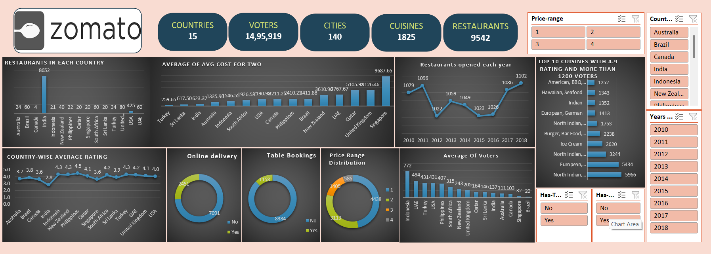
DASHBOARD

Slide 21
CONCLUSION
The analysis on the dataset shows countries having the greater number of restaurants, and the services provided by restaurants in different countries and cities like online delivery and table booking.
We identified the most popular cuisines in the area based on the number of restaurants and user ratings.
We examined the correlation between restaurant pricing and customer ratings and found that the correlation is 0.34 which means restaurant pricing and customer ratings are loosely correlated.
To sum up, Zomato restaurant data research may provide a thorough grasp of the regional eating scene, empowering businesses and other stakeholders to improve consumer experiences, make wise decisions, and take advantage of new trends.

Slide 22

Thank You!

