Slide 1
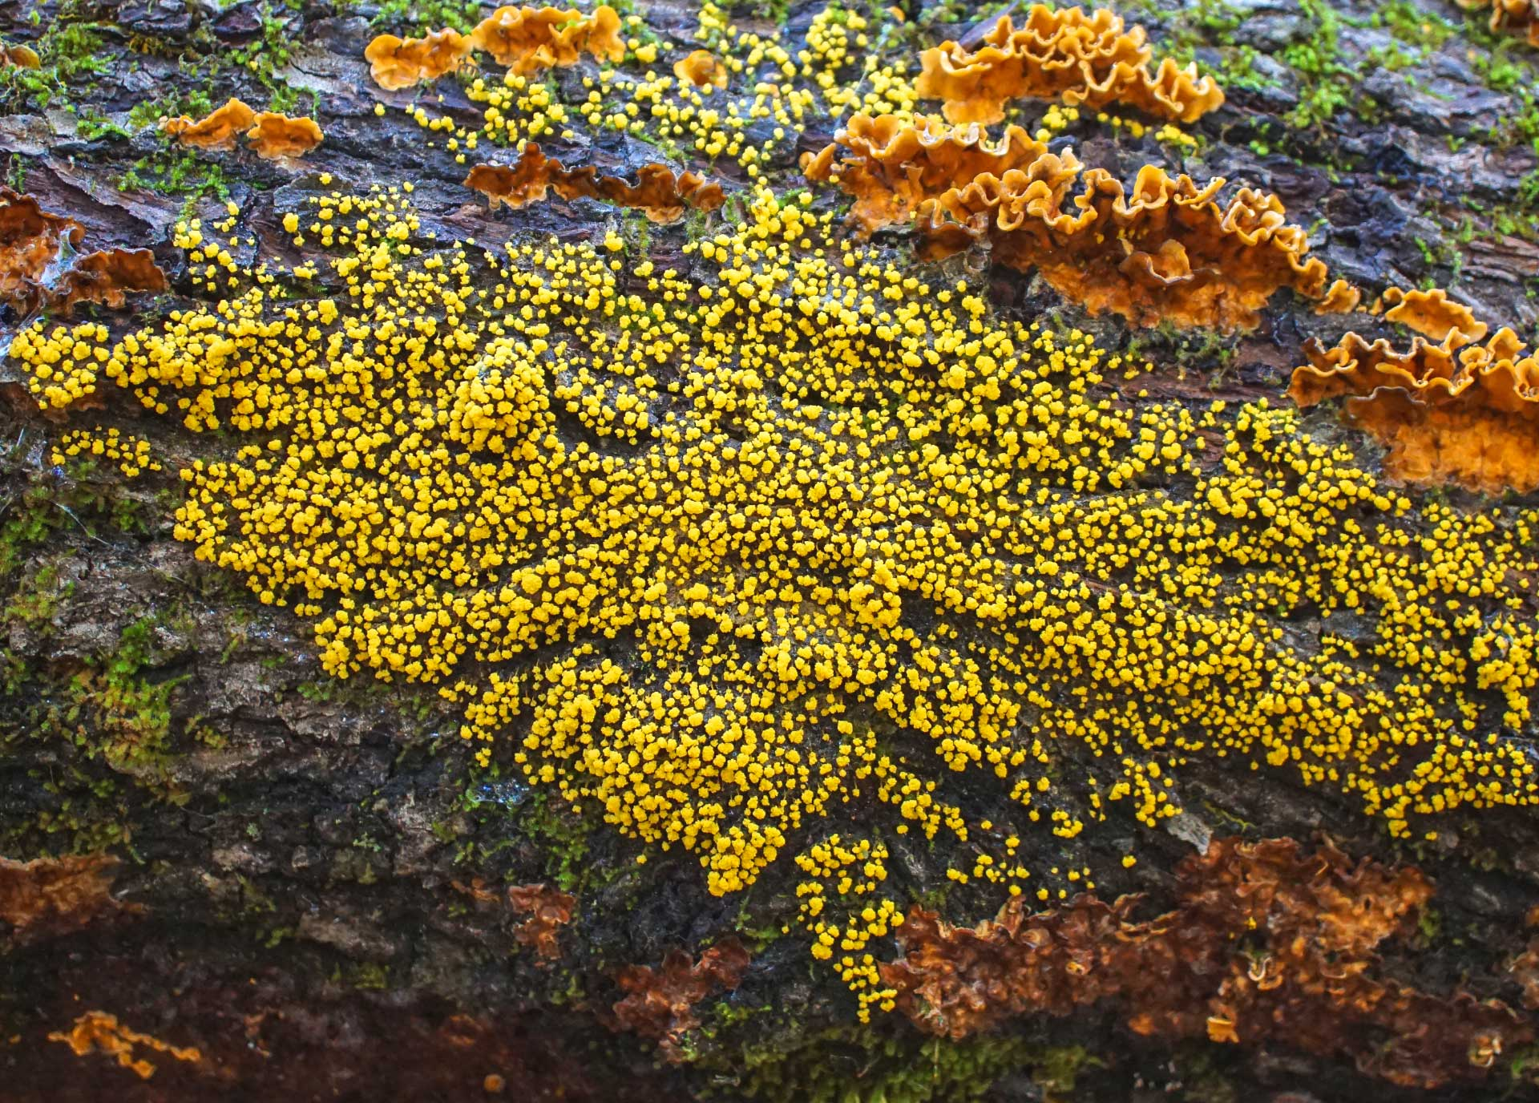
Harnessing the Slime Mould Algorithm: Optimizing Supply Chain Logistics
Course: SCH-MGMT 663
Presented by: Anand Gupta

Slide 2

What is a Cognitive Supply Chain?
Definition
An advanced supply chain system leveraging artificial intelligence (AI) and machine learning (ML) to enhance decision-making and efficiency.
Components
AI and ML Algorithms: Core technologies driving cognitive supply chains.
Data Integration: Combining data from various sources (IoT devices, ERP systems, etc.).
Real-time Analytics: Continuous analysis of data for real-time insights.
Automation: Streamlining processes through intelligent automation.
Benefits
Enhanced Decision-Making: AI provides actionable insights and predictive analytics.
Improved Efficiency: Optimized processes reduce time and cost.
Greater Agility: Rapid response to market changes and disruptions.
Increased Transparency: Better visibility across the supply chain.
Applications
Demand Forecasting: Predicting customer demand more accurately.
Inventory Management: Optimizing stock levels and reducing excess inventory.
Supply Chain Optimization: Streamlining operations for cost and time efficiency.
Risk Management: Identifying and mitigating potential risks.

Slide 3
Metaheuristics
Definition and Origin
Metaheuristics are high-level strategies for finding optimal or near-optimal solutions to complex problems. The word is derived from the Greek words "meta" (beyond) and "heuristic" (to find or discover), indicating strategies that go beyond traditional heuristics.
Key Characteristics
General-purpose, flexible, and efficient, balancing exploration and exploitation in the search process.
Popular Techniques
Genetic Algorithms, Simulated Annealing, Particle Swarm Optimization, and Ant Colony Optimization.
Applications in Supply Chain
Route optimization, inventory management, scheduling, and network design.

Slide 4
Slime Mould Algorithm (SMA)
Slime Moulds: Definition and Characteristics
Definition: Slime moulds are simple, single-celled organisms found in nature, capable of forming multicellular structures. They are known for their ability to efficiently navigate and connect different points in their environment to find food.
Characteristics: Slime moulds can move and spread out to explore their surroundings, creating networks that connect food sources in the shortest and most efficient way possible.
SMA Inspiration
The Slime Mould Algorithm is an optimization technique inspired by the foraging behavior of slime moulds. It mimics their natural ability to create efficient networks and find the shortest paths to food sources.
Key Characteristics
Uses dynamic adjustment of weights based on the concentration of food sources (or objectives), simulating the expansion and contraction behavior of slime moulds.
Capable of escaping local optima and finding global optimal solutions by effectively exploring and exploiting the search space.
Applications in Supply Chain
Route Optimization: Finding the most efficient paths for logistics and transportation.
Network Design: Creating optimal supply chain networks with minimal costs and high efficiency.
Resource Allocation: Efficiently distributing resources to meet demand and minimize waste.

Slide 5
Slime Mould doing something Incredible !!!

Slide 6
How SMA Works?
Slime Mould Behavior: Inspiration
Observation: Slime moulds explore their environment by expanding and contracting, forming efficient networks to connect food sources.
Mechanism: They adjust their growth direction based on nutrient concentration, demonstrating an efficient problem-solving capability.
Weight Adjustment
Dynamic Weights: SMA simulates the slime mould's behavior by adjusting weights that influence the movement of agents (representing the mould).
Attraction to Food: Weights are increased towards regions with higher objective values (analogous to nutrient concentration), guiding agents to optimal solutions.
Exploration and Exploitation
Exploration Phase: Agents spread out to explore the search space, avoiding premature convergence to local optima.
Exploitation Phase: Agents converge towards promising regions, refining the search around optimal solutions.
Balancing Act: The algorithm dynamically balances between exploration (finding new areas) and exploitation (focusing on known good areas).

Slide 7
The Algorithm
1. Problem Definition
We start by defining the problem we want to solve, such as finding the shortest path in a network or optimizing a function.
2. Initialization
Imagine a grid where slime mold can move.
Place food sources (targets) on the grid, representing the goal.
Spread out slime mold initially at random positions.
3. Movement Rules
The slime mold moves towards the food sources by following simple rules:
Chemotaxis: Moves towards areas with higher concentration of food (chemical signals).
Oscillation: Moves back and forth slightly to explore new paths.
Decay: If it doesn't find food, it gradually retracts to save energy.
4. Path Formation
As the slime mold moves, it leaves behind a trail (path) that reinforces the best routes to the food.
Over time, inefficient paths are abandoned, and only the optimal paths remain.
5. Convergence
The algorithm iterates through these steps until the slime mold consistently finds the best path to the food sources.
The result is an optimized solution to the problem.
6. Application
The optimized paths or solutions can be used for real-world applications like network design, logistics, or function optimization.

Slide 8
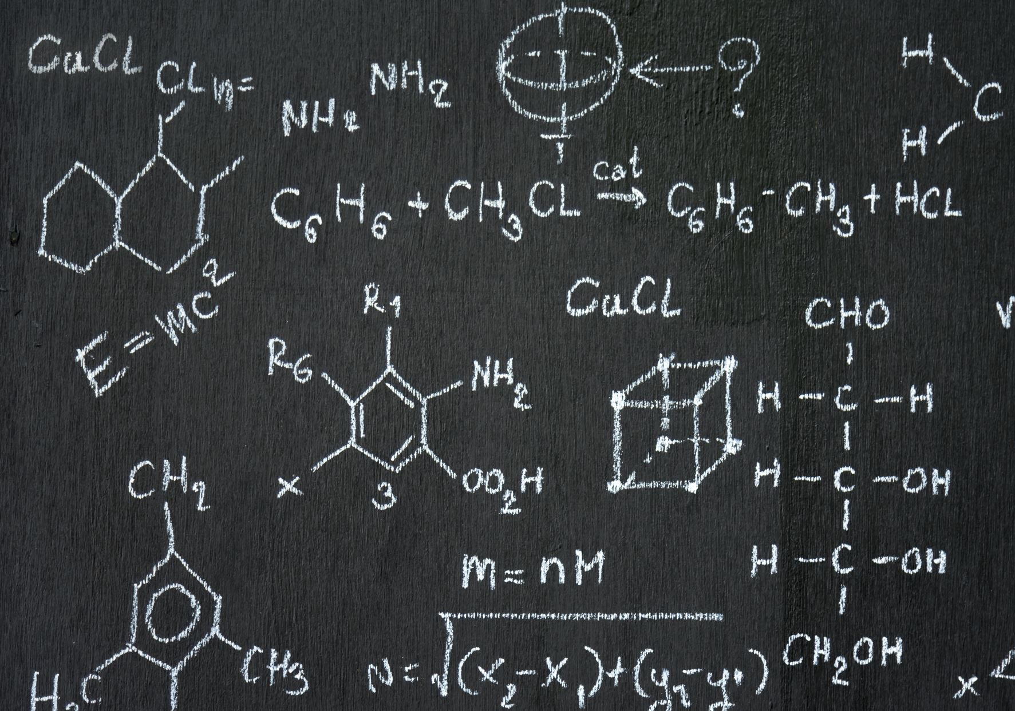
The Slime Mould Algorithm (SMA) Formula
Position_{i}^{(t+1)} = Position_{i}^{t} + β ( Σ [ Food_{j}​ / Distance_{ij}²​ ] - δ × Decay_{i}​ )
Position_{i}^{(t+1)} : The new position of the slime mold at iteration t+1.
Position_{i}^{t} : The current position of the slime mold at iteration t.
t: The current iteration or time step in the algorithm.
β: A constant representing the movement strength.
Food_{j}​​ : The amount of food (attraction) at position j.
Distance_{ij} : The distance between the slime mold at position i and the food at position j.
δ: A constant representing the decay rate.
Decay_{i} ​: The decay factor for the slime mold at position i.

Slide 9
Benefits of SMA in Supply Chains
Optimal routes
Reduced travel time
Lower fuel costs
Inventory optimization
Minimized holding costs
Optimal layout
Enhanced connectivity
Cost minimization
Efficiency maximization
Dynamic adjustments
Demand fluctuations
Disruption handling
Exploration and exploitation
Robust solutions
Efficient distribution
Resource optimization
Waste reduction
High service levels
Customer satisfaction

Slide 10
Case Studies
Case Study 1: Tokyo Rail Network
Efficient Design: Slime molds create nutrient-channeling networks similar to Tokyo's rail system.
Research: Oat flakes arranged as cities; slime mold mimicked rail network layout.
Implications: Potential for designing efficient, adaptable networks.
Case Study 2: Optimizing Urban Transport Networks
Urban Planning: SMA models urban transport networks based on slime mold behavior.
Tokyo Model: Slime mold replicated Tokyo’s rail system, identifying efficient routes.
Global Efficiency: Compared 14 countries' motorways; Belgium, Canada, China most efficient.
Supply Chain Benefits: Optimizes logistics, reduces congestion, improves efficiency.
Case Study 3: Dynamic Traffic Management
Adaptive SMA: Adapts to disruptions like road crashes and flooding.
Simulation: Salt used to simulate disruptions; slime mold rerouted around affected areas.
Resilience: Helps maintain goods flow during disruptions, strengthens supply chain.
Case Study 4: Predictive Adaptation to Regular Events
Predictive Behavior: Slime molds anticipate and adapt to regular changes.
Experiment: Exposed to low temperatures and dry air; slowed growth in anticipation.
Applications: Models rush hours, seasonal demand, optimizes inventory and distribution.
Case Study 5: Food Delivery Optimization
Route Optimization: SMA improved delivery routes.
Results: Reduced delivery time by 20%, decreased fuel costs by 15%.
Other Application Areas
Urban Water Demand: Optimized neural networks for water demand prediction.
Solar PV Parameters: Estimated parameters for solar cells.
COVID-19 X-ray Analysis: Integrated with other solvers for image analysis.
Solar PV Panels: Solved optimal model parameters.
SVR Prediction: Combined with chaos for clustering and prediction.

Slide 11
Conclusion
SMA stands at the forefront of supply chain innovation, offering a powerful, nature-inspired solution to complex logistical challenges. Its ability to adapt and optimize in a constantly changing environment makes it an invaluable tool for achieving unparalleled efficiency and resilience in supply chain management.
‘The future of logistics is here, and it’s inspired by nature’s own ingenuity.’

