Slide 1
ONCO-TWIN
A leak-free digital twin that flags severe chemotherapy toxicity and shows what waiting costs the tumor
Breast cancer · EHR + wearable data fusion · Clinical decision support · Synthetic data only
Team Aurora
Anandha Lakshmi RM (solo entry) · The Apollo University
Happiest Health Digital Twin Challenge 2026 · Phase 1: Prototype & Code Submission
Notes:
Introduce yourself and ONCO-TWIN: a virtual patient that combines a medical record with wearable data to flag a dangerous neutrophil drop and show the cost of delaying chemotherapy. All data is synthetic and the oncologist always decides.

Slide 2
The problem: chemotherapy toxicity is caught after it happens
Retrospective
Blind between visits
Population averages
Severe neutropenia is usually found at scheduled lab checks, after it has already happened.
The patient's real-time condition goes unseen between visits, when marrow strain builds.
Schedules follow population averages, not how resilient this patient is today.
Our question Can a continuously updated virtual patient flag a severe neutrophil drop early, and show what delaying the dose costs in tumor control?
Notes:
Three gaps: care is retrospective, blind between visits, and based on population averages. Our question is whether a continuously updated virtual patient can flag severe neutropenia early while still showing what waiting costs in tumor control.

Slide 3
Why breast cancer: the most common cancer in Indian women
28.2%
200,000+
1 in 28
> 50%
of all female cancer diagnoses in India
new breast cancer cases each year
projected lifetime risk for Indian women
present at locally advanced stages
Chosen cancer type
Why it fits
Breast cancer (invasive ductal carcinoma, Stage II-IV) on myelosuppressive regimens such as doxorubicin + cyclophosphamide or paclitaxel.
Long-term, prevalent in India, and its chemotherapy causes a measurable adverse event: grade 3+ neutropenia (ANC below 1.0 ×10⁹/L).
Source: ICMR-NCRP report 2020-2025; Mathur et al., JCO Global Oncology 2020.
Notes:
Cancer is recognized as a leading noncommunicable disease needing long-term monitoring. In India breast cancer is the largest burden among women and many present late, needing intensive chemotherapy that often causes severe neutropenia. Source: ICMR-NCRP and Mathur et al., JCO Global Oncology 2020.

Slide 4
The solution: one virtual patient, two outputs
Static / historical
Main: toxicity risk flag
Simulated EHR: demographics, stage, biomarkers, ECOG, baseline labs, treatment history
Probability of grade 3+ neutropenia after a dose, scored for each candidate dosing day (+0, +3, +7, +14).
Digital twin state
Everything known up to day D, re-scored every morning
→
→
Dynamic / real-time
Simulated wearables: HRV, resting heart rate, step count, sleep
Support: cost of delay
Patient-specific Gompertz tumor regrowth for each delay, with a 90% band.
The oncologist sees the safety-versus-tumor-control trade-off and decides.
Notes:
Static record plus wearables feed one twin state frozen at decision day D. The main output is the toxicity risk flag for each candidate dosing day. The supporting output is the tumor cost of delay, so the clinician sees both sides.

Slide 5
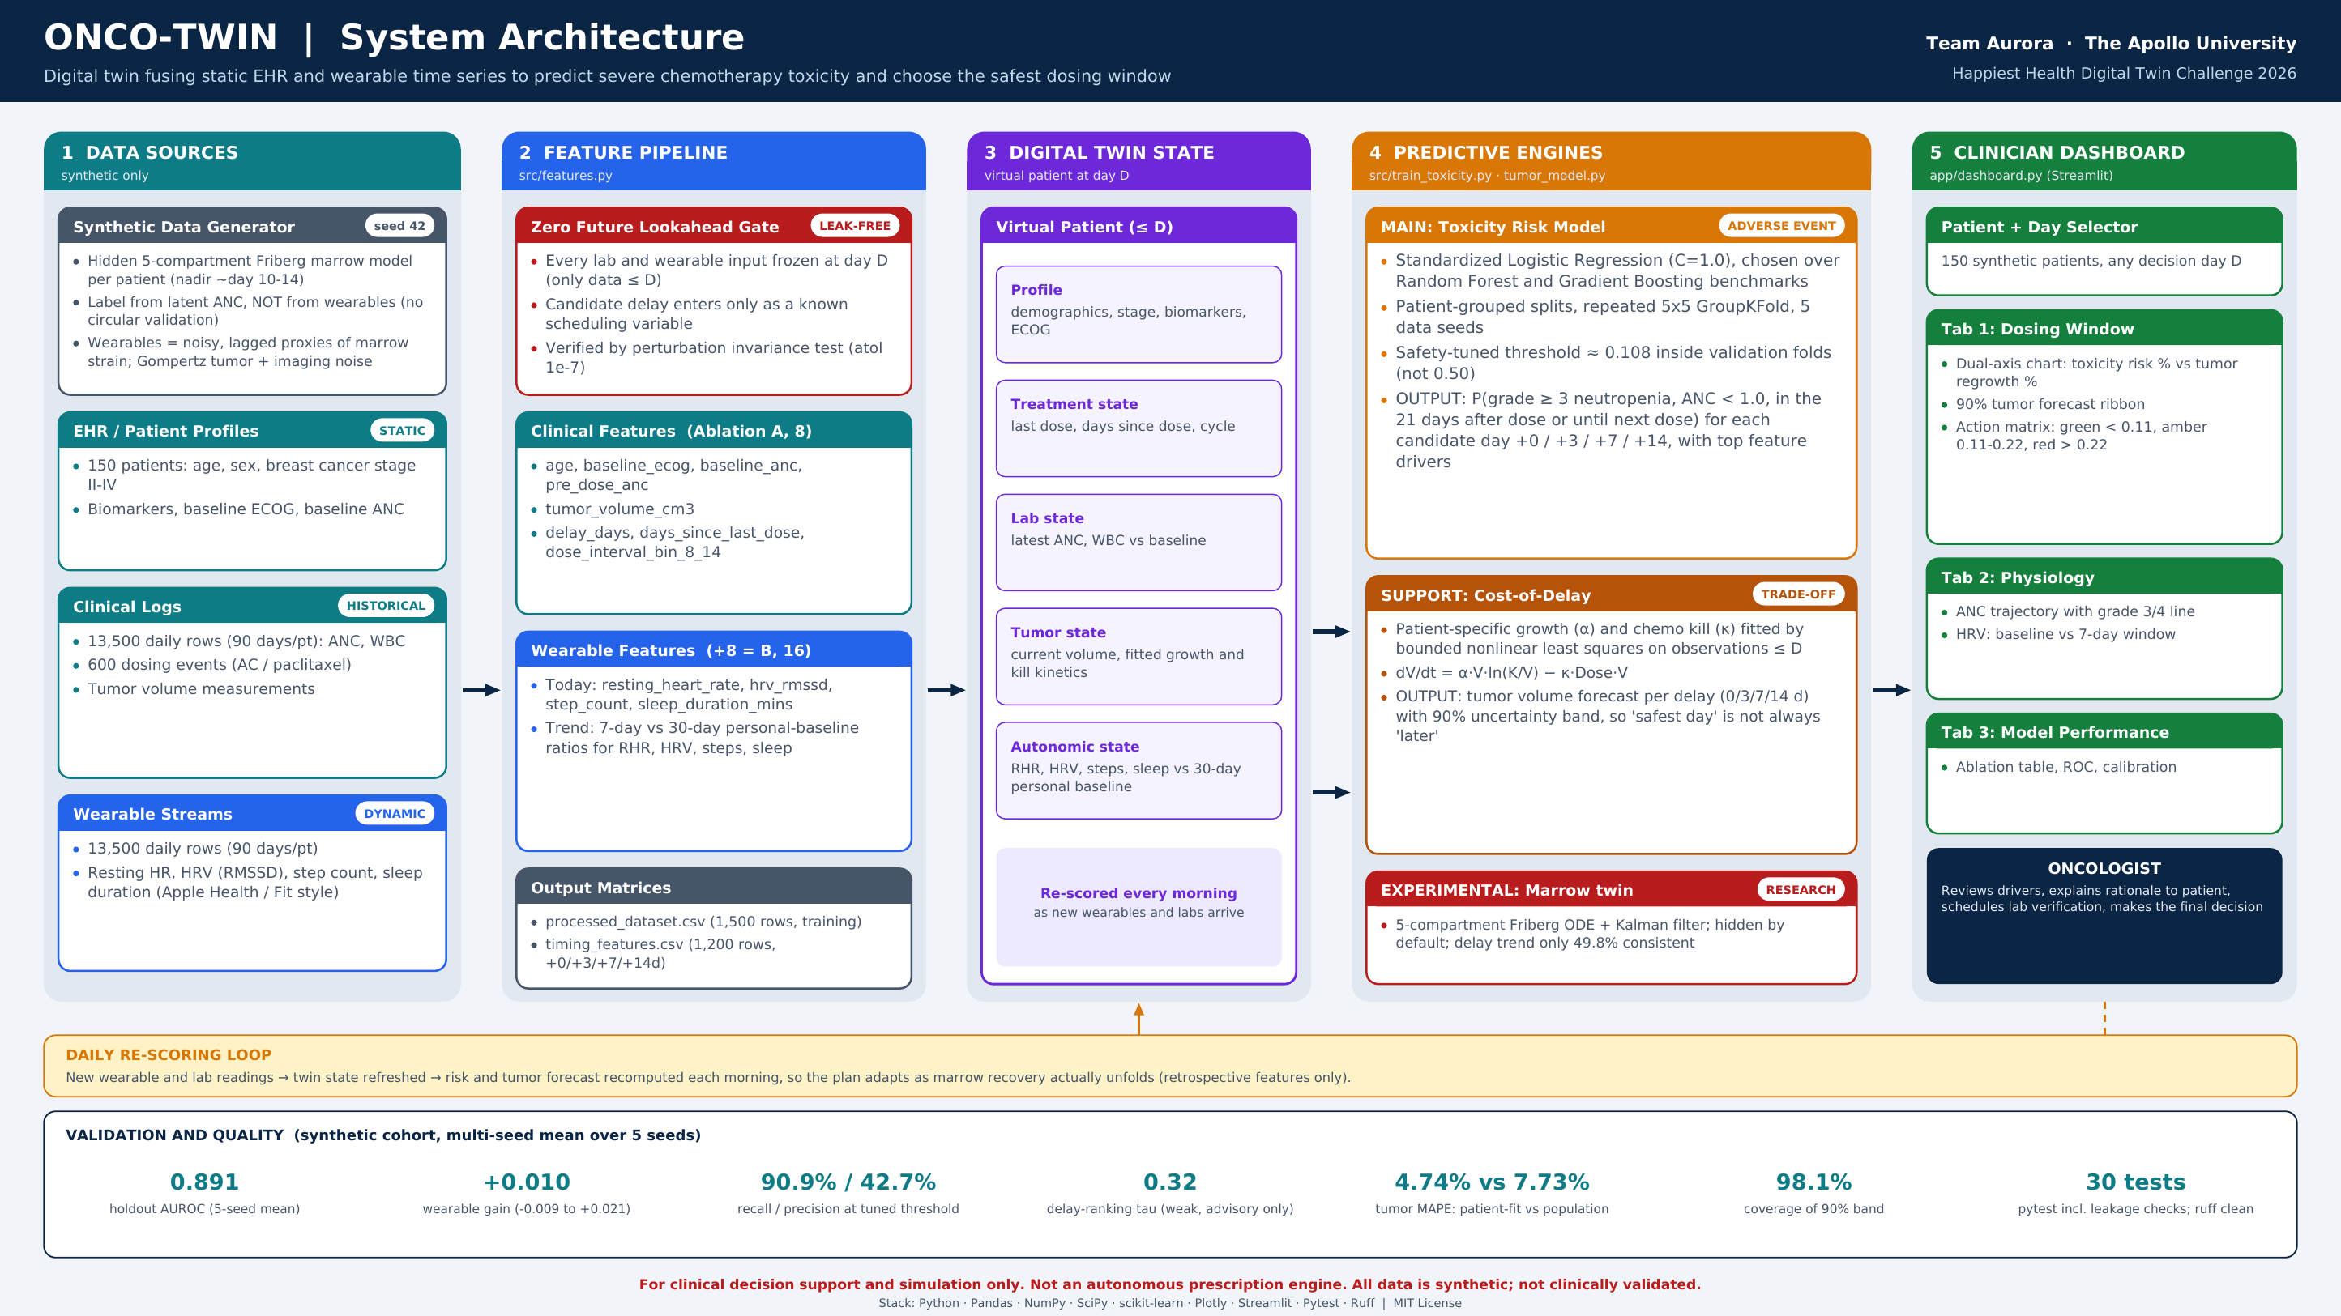
Notes:
Left to right: synthetic data, a leak-free feature pipeline, the twin state, the main toxicity model and the tumor cost-of-delay model, and the dashboard. The red box is the experimental marrow module, hidden by default. The bottom strip shows validation results.

Slide 6
Data: synthetic, and built so labels never come from wearables
File | Rows | Role
patient_profiles | 150 | Static demographics, stage, baseline biology
clinical_logs | 13,500 | Daily ANC, WBC, 600 doses, tumor volume
wearable_streams | 13,500 | Daily RHR, HRV, steps, sleep (90 days/patient)
timing_eval | 1,200 | Counterfactual outcomes (+0/+3/+7/+14 d)
processed_dataset | 1,500 | Engineered training samples
timing_features | 1,200 | Candidate-delay feature matrix at day D
How the generator is built
Hidden 5-compartment Friberg marrow model per patient (nadir about day 10-14)
Label: hidden ANC below 1.0, never computed from wearables
Wearables respond to upstream marrow depletion, noisy and lagged; strength set by coupling κ
Sleep has independent noise
Gompertz tumor with imaging noise
Caveat: generator and experimental twin share one ODE family
Notes:
We use synthetic data as the sandbox rules require. Labels come from a hidden marrow model, not from wearable features. Wearable signals are generated from the hidden marrow state with a coupling strength we can turn up or down, which the stress test uses.

Slide 7
Zero future lookahead: the twin never peeks past decision day D
The rule
The invariance test
Labs and wearables use only data up to day D
A delay enters only as known scheduling variables
Label window: the 21 days after a dose, or until the next dose
Evaluation is grouped by patient, so no patient is in both train and test
The twin re-scores every morning as new data arrives
Overwrite every value after D with extremes:
ANC = 0.05 RHR = 180 HRV = 5
Predictions for every candidate delay stay identical (tolerance 1e-7).
Automated in tests/test_features_and_models.py
Notes:
Every lab and wearable value is frozen at day D. The delay enters only as scheduling variables. A test overwrites all later data with extreme values and checks that predictions do not change.

Slide 8
Model: do wearables add anything beyond the clinical record?
Ablation A: clinical only (8)
Ablation B: + wearables (16)
age, baseline ECOG, baseline ANC, pre-dose ANC, tumor volume, delay_days, days_since_last_dose, interval bin
Everything in A, plus resting HR, HRV, steps, sleep, and 7-day vs 30-day ratios for each
Main model: standardized logistic regression
Benchmarked against random forest and gradient boosting. Patient-grouped splits and repeated 5×5 cross-validation, run on 5 independent data seeds. The threshold is tuned inside validation folds, not left at 0.50.
Notes:
We ran an ablation. A has 8 clinical features. B adds 8 wearable features: today's values plus 7-day versus 30-day personal baseline ratios. Logistic regression was the main model, with random forest and gradient boosting as benchmarks.

Slide 9
Results: a useful risk flag, with a modest and assumption-dependent wearable gain
0.891
holdout AUROC, 5-seed mean (0.774 to 0.953)
+0.010
wearable gain, 5-seed mean (-0.009 to +0.021)
90.9% / 42.7%
recall / precision: about 6 in 10 alerts are false alarms
Seed 42 is the hardest split: holdout AUROC 0.774, precision 26%. Trees lose accuracy with wearables, so logistic regression is the main model.
Notes:
Chart: seed 42 cross-validation. Logistic regression gains from wearables; the tree models do not. Right: five-seed means. Be direct about the limits: the wearable gain is small and one seed was negative, and precision means about six in ten alerts are false alarms. Seed 42 was the hardest split.

Slide 10
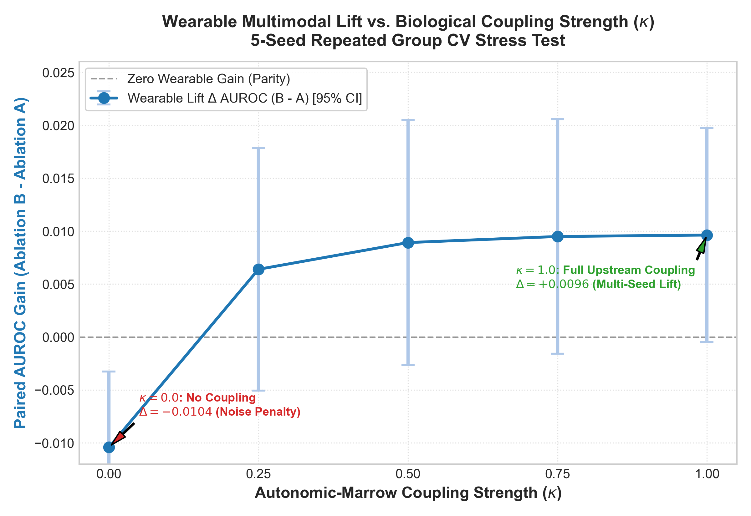
Stress test: how much of the wearable gain depends on our assumption?
What we tested
Insert plot: docs/figures/coupling_sensitivity_stress_test.png
Wearable signals are generated from the hidden marrow state
Coupling κ is varied from 0 to 1 across 5 seeds
At κ = 0 there is no real signal, so the gain is about zero
At κ = 1 the mean gain is +0.010 AUROC
Takeaway: wearables help only if they truly track marrow reserve; real wearable data must test this
Notes:
The generator ties wearables to hidden marrow depletion with a coupling strength kappa. We swept kappa from 0 to 1 over all five seeds. With no coupling there is no real signal and the gain disappears; at full coupling the gain is about plus 0.010. So the benefit exists only if real wearables track marrow reserve, which real data must test.

Slide 11
Cost of delay: what does waiting do to the tumor?
dV/dt = α · V · ln(K/V) − κ · Dose · V
Growth α and chemo kill κ are fitted per patient on observations up to day D.
-39%
98.1%
forecast error vs population average
empirical coverage of the 90% band
Caveat
Validated on synthetic data from the same Gompertz family, so treat the accuracy as optimistic. The band is conservative: wider than nominal.
Notes:
Without this module the safest day is always the latest day. A patient-specific Gompertz model, fitted only on data up to D, forecasts regrowth per delay with a conservative 90 percent band. Fitting per patient cuts forecast error by about 39 percent.

Slide 12
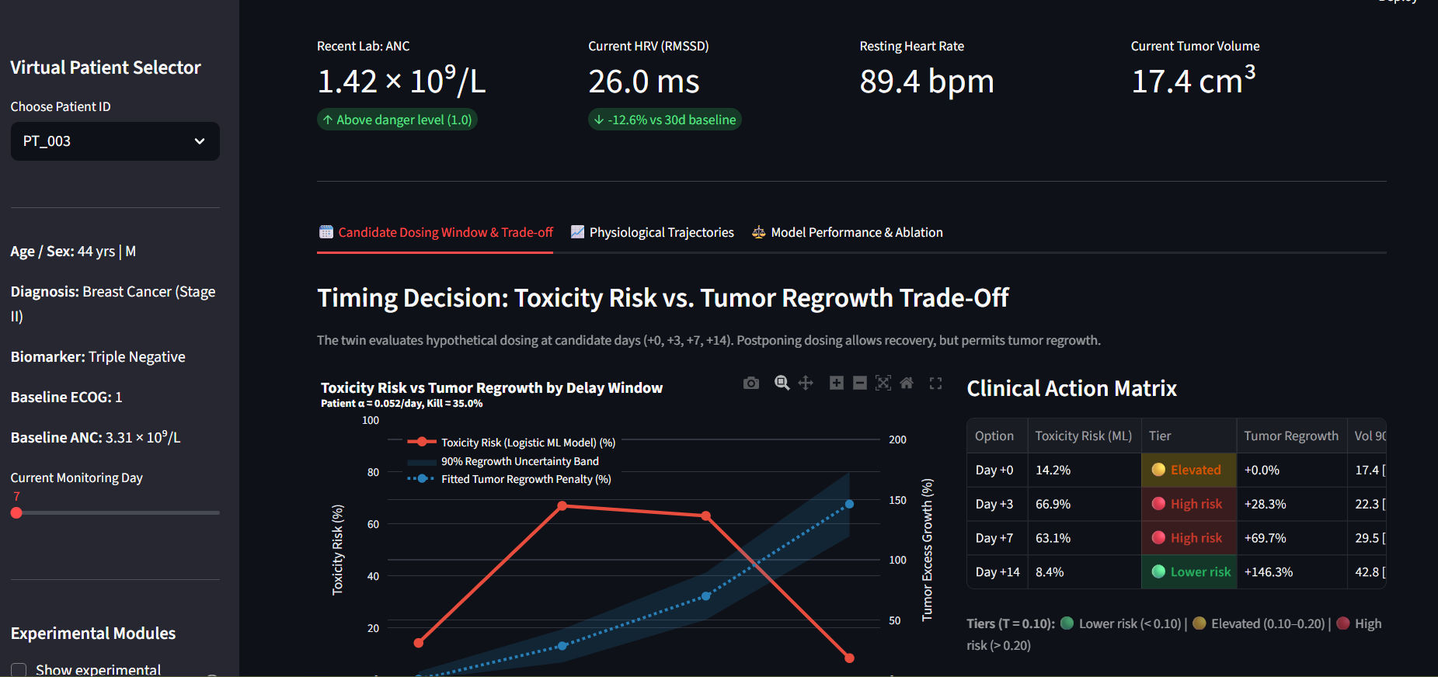
Doctor dashboard: how an oncologist interacts with the twin
Insert screenshot: dashboard Tab 1 (experimental toggle OFF)
Trade-off chart
Toxicity risk vs tumor regrowth for +0/+3/+7/+14 days, with 90% band
Action matrix
Risk tiers built on the tuned threshold, plus tumor volume CI
Safety banner
Decision support only; oncologist review and lab check required
Tab 2: ANC and HRV trajectories. Tab 3: multi-seed benchmark first, seed 42 as an example. Sidebar: Experimental marrow toggle (off by default).
Notes:
This is the Streamlit app. By default it shows the ML risk and tumor regrowth with the action matrix. The marrow module is behind an Experimental checkbox. Tab 3 leads with the multi-seed table, with seed 42 shown as one example run.

Slide 13
Experimental extension: a mechanistic marrow twin
What it does
Our own audit
5-compartment Friberg model of neutrophil production
Fitted per patient (transit time, feedback, drug sensitivity)
Kalman filter updates the hidden state with each new lab
Simulates what-if dosing delays from the current state
96.7% of fitted parameters sit inside their bounds
Nadir rises with delay in only 49.8% of cases (target 95%)
Delay-ranking tau 0.40
Shares one ODE family with the generator: a self-consistency check, not accuracy
Verdict: shown as a research extension, hidden by default. Next step: a better-matched model and real-data validation.
Notes:
We went further toward a full twin: a five-compartment marrow model fitted to each patient and updated with a Kalman filter. Our own audit says it is not reliable yet: nadir rises with delay only about half the time, and it shares equations with the generator. So it is hidden by default and presented as research.

Slide 14
Limitations: what this prototype does and does not show
Synthetic only
Wearable assumption
Weak delay ranking
All results come from simulated data; not clinically validated.
The gain exists only if wearables track marrow reserve (see stress test).
Tau 0.32 means no reliable 'best day'; the flag is advisory.
False alarms
Seed variability
Marrow twin unvalidated
Precision 42.7%: about 6 in 10 alerts do not become severe events.
Holdout AUROC 0.77 to 0.95 and gain -0.009 to +0.021 across seeds.
Experimental; shares equations with the generator.
Next: real-data validation, better marrow model, prospective study, regulatory clearance (DPDP Act, HIPAA, FDA SaMD).
Notes:
Be upfront. Everything is synthetic, the wearable gain depends on our coupling assumption, delay ranking is weak, and about six in ten alerts are false alarms. Real use needs real-data validation and regulatory clearance.

Slide 15
Stack, reproducibility and summary
Tech stack
Reproducible
Challenge fit
Python 3.10+, Pandas, NumPy, SciPy
scikit-learn, Joblib
Plotly, Matplotlib, Seaborn
Streamlit dashboard
Pytest, Ruff
30 passing tests incl. leakage checks
Ruff clean
scripts/ reproduce the 5-seed benchmark and stress test
MIT license, public repo
EHR + wearable streams fused
Predicts an adverse event ahead of time
Doctor-facing dashboard
Synthetic data only
ONCO-TWIN: flag severe toxicity early, show what waiting costs the tumor, keep the clinician in control.
Team Aurora · The Apollo University · anandhalakshmi005@gmail.com
Notes:
Close by restating the value: a leak-free risk flag, a personalized cost-of-delay model, an honest stress test, and an experimental marrow twin, with the clinician in control. Everything is reproducible with the scripts in the repo.

