Slide 1
SINGLE POINT
One place for every request in a gated community — raised, routed, resolved, and paid.
Stakeholder briefing

Slide 2
THE PROBLEM
Community operations run on group chats and spreadsheets
1
Requests get lost A leak reported in a WhatsApp group scrolls away. No reference, no owner, no due date.
2
No accountability Residents can't see progress. Admins can't prove SLAs. Vendors aren't rated.
3
No money trail, no data Cash changes hands off-book. Nobody can answer “how many tickets last month?”
Single Point · stakeholder briefing
2

Slide 3
THE SOLUTION
One platform. Every request, resolved.
For residents & staff
For vendors
For the operator
Mobile app
Verified marketplace
Web console
Raise a ticket in under a minute, track it to closure, rate the vendor, redeem offers, manage your household and your data. Resident, Admin and Provider each get their own app.
Super-Admin-verified providers with KYC and tiers. Targeted offers to a community, a group, or named residents. Online or cash payment with receipts.
Onboard communities and vendors, run plans and billing, review the audit trail and platform analytics, export data, watch backups.
Single Point · stakeholder briefing
3

Slide 4
WHO IT SERVES
Four roles, one system
1
Resident / Individual Raises and tracks requests, books verified vendors, redeems offers, manages household and account. Works with or without a community.
2
Community Admin Triages the queue, manages members, flats and locations, enrols vendors, sends announcements, owns the community's plan. Can run several communities.
3
Service Provider Accepts assigned jobs, records payment, keeps KYC current, submits offers for approval.
4
Super Admin Runs the platform: community and vendor onboarding, plans, taxonomy, audit, analytics, exports, backups.
Single Point · stakeholder briefing
4

Slide 5
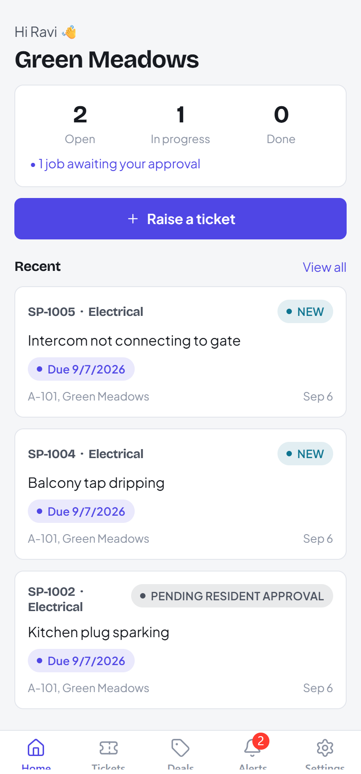
EXPERIENCE · RESIDENT
From “something's broken” to “fixed and rated”
Raise with a category, photo and the exact spot — flat pre-filled.
One timeline: acknowledged → assigned → in progress → resolved.
Close with a 1–5 star rating; reopen if it isn't right.
Deals tab: redeem targeted offers, leave feedback.
Alerts inbox with an unread badge for every update.
Own your data — download it, or delete your account.
Single Point · stakeholder briefing
5

Slide 6
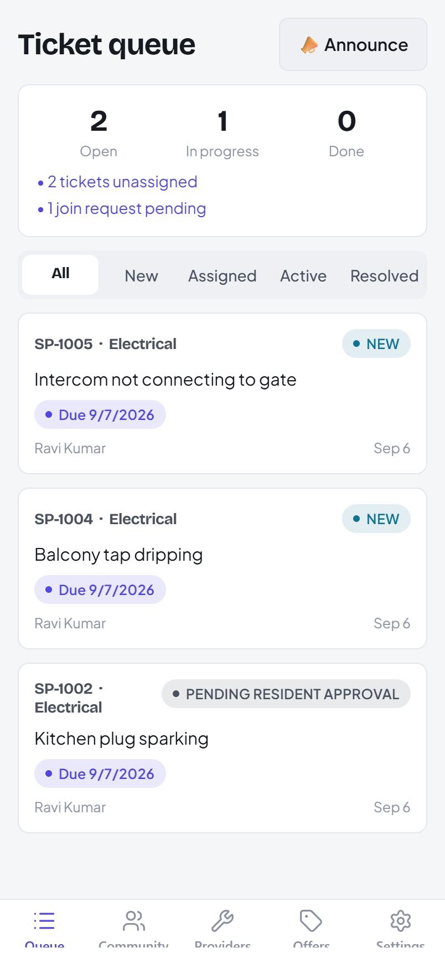
EXPERIENCE · COMMUNITY ADMIN
A queue that tells you what needs you
Every ticket in one list with New / Assigned / Active / Resolved filters.
Action items surfaced: unassigned, SLA-breached, join requests.
Acknowledge, assign to a verified vendor, reroute, or resolve in-house.
Members with a hard bill / open-ticket check before removal.
Announcements — now or scheduled, with a cooldown and daily cap.
Billing: plan, usage vs limits, upgrade, pay an invoice.
Single Point · stakeholder briefing
6

Slide 7
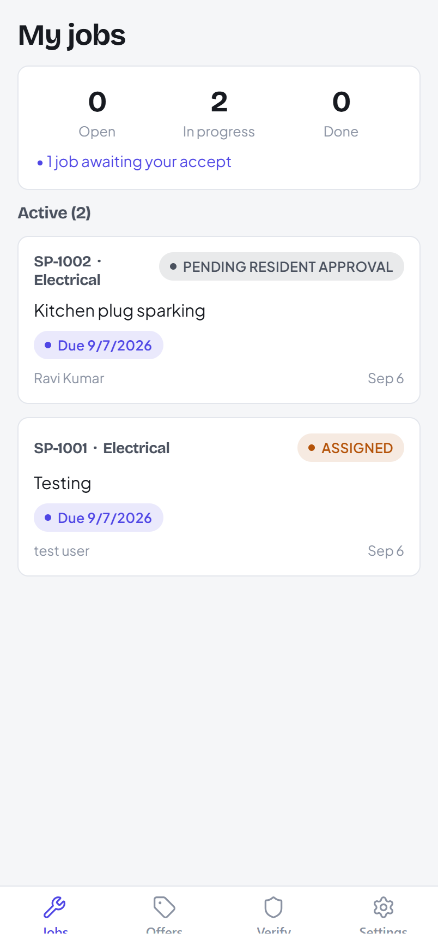
EXPERIENCE · SERVICE PROVIDER
Accept, do the work, get paid
Jobs arrive as assigned with a push; accept or decline.
Progress it: en route → in progress → resolved with notes.
Payment: a card link the resident pays, or a cash one-time-code handshake.
A receipt is issued automatically on settlement.
KYC documents tracked Pending → Accepted; availability and categories self-served.
Submit offers for Super Admin approval.
Single Point · stakeholder briefing
7

Slide 8
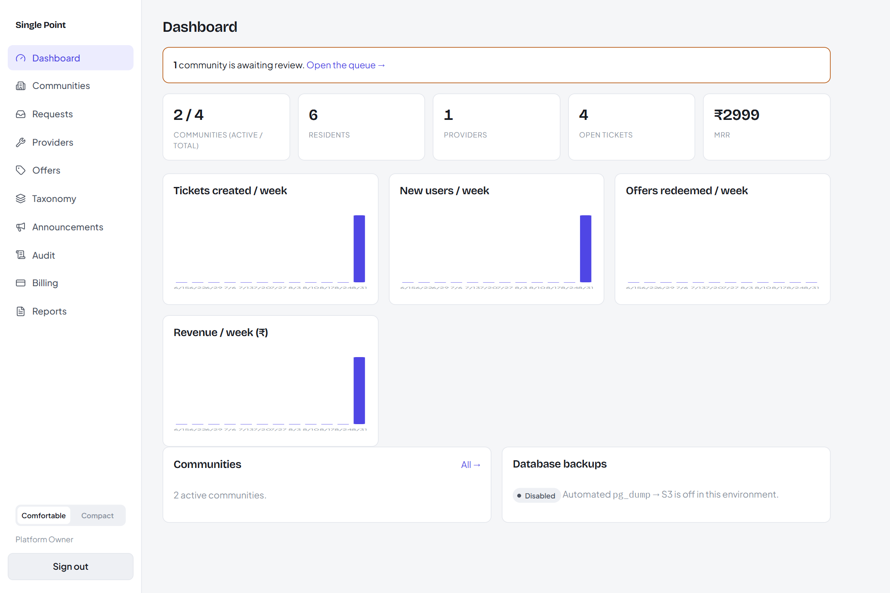
PLATFORM CONTROL
The operator sees and steers everything
Approve community self-onboarding; the requester becomes its admin.
Verify vendors, review KYC, set tiers.
Create plans and entitlements; comp, cancel, reconcile invoices.
Filterable audit log of every privileged action and PII read.
Platform analytics: tickets, offers, users, revenue, MRR.
CSV exports and a live database-backup status.
Single Point · stakeholder briefing
8

Slide 9
REVENUE ENGINE · MARKETPLACE
Verified vendors and offers that actually land
Trust
Targeting
Reach
Verified + KYC + tiers
The right residents
Push + WhatsApp
Only Super-Admin-verified vendors are assignable. FEATURED vendors surface first. Every job is rated, feeding a running score.
Offer to one community, a set of communities, named residents by phone, or everyone — with a global redemption cap and per-resident feedback.
Promo offers can go to WhatsApp for residents who opt in, gated by the community's entitlement and a weekly cap.
Single Point · stakeholder briefing
9

Slide 10
REVENUE ENGINE · BILLING
Subscription billing, built in
Plans
Auto-charge
Fair changes
PER COMMUNITY, PER VENDOR, PER RESIDENT — WITH NUMERIC ENTITLEMENT LIMITS
RAZORPAY SUBSCRIPTIONS MANDATE; THE GATEWAY DRIVES RENEWAL
MID-CYCLE UPGRADES PRORATED; PAST-DUE DUNNING AT DAY 1 / 3 / 6
Every screen already shows a “recurring” state, a next-charge date, and due invoices. MRR is a first-class dashboard metric.
Single Point · stakeholder briefing
10

Slide 11
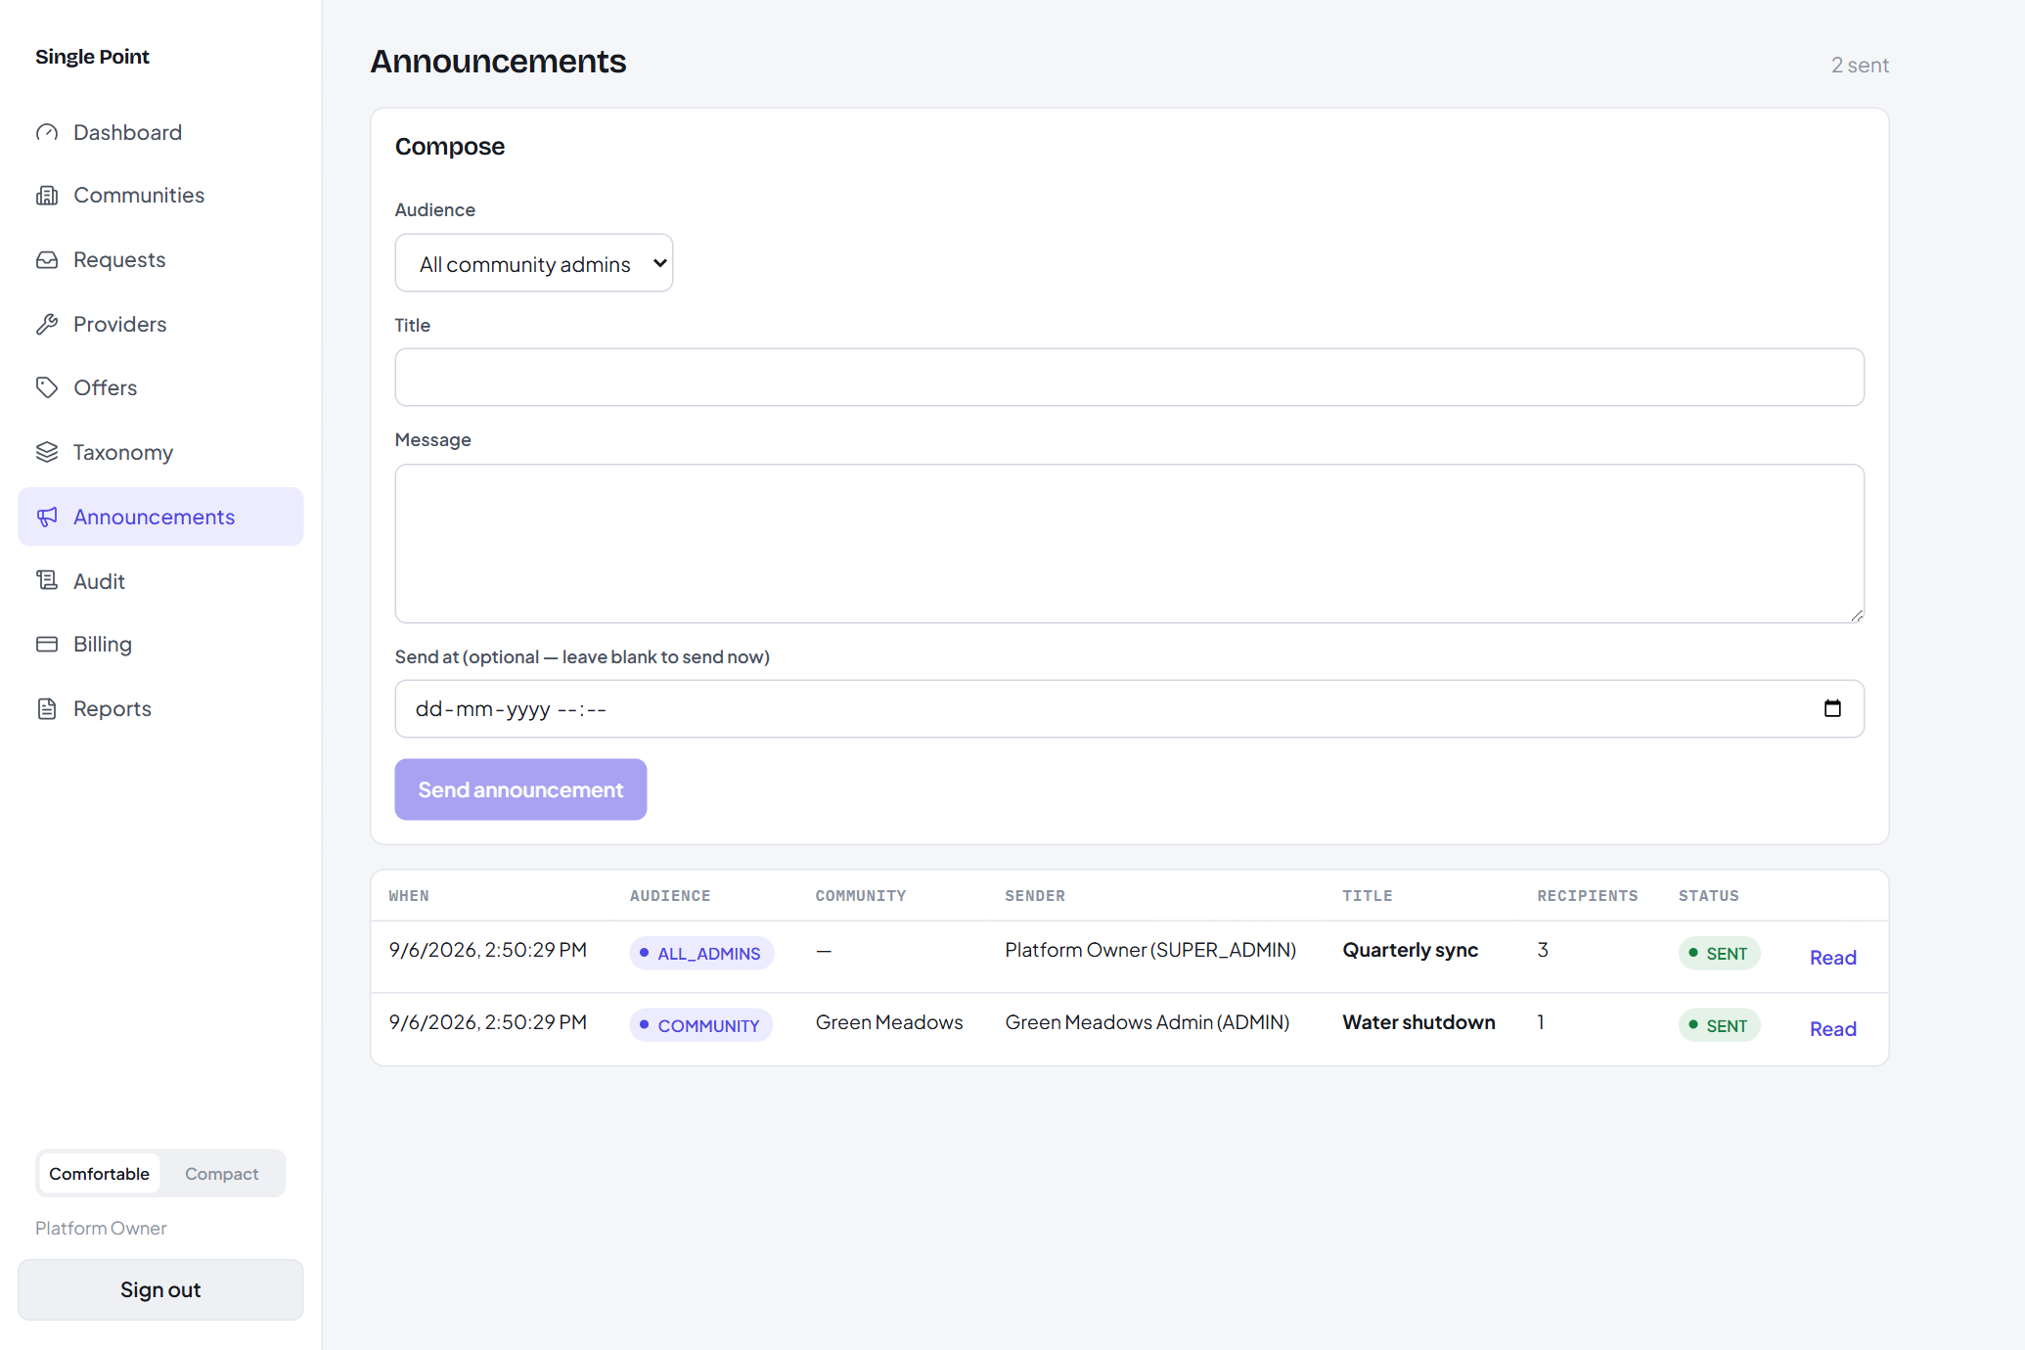
ENGAGEMENT
One notification pipeline, four ways out
A transactional outbox — nothing is lost if a channel is down.
In-app inbox with unread counts on every screen.
Push (Expo) for real-time updates.
WhatsApp for opt-in promo offers, entitlement-gated.
Broadcasts to a community, all admins, or all users — send now or schedule, with cancel.
Single Point · stakeholder briefing
11

Slide 12
TRUST & COMPLIANCE
Built for many communities on one system
Tenant isolation
Field encryption
Key rotation
PostgreSQL row-level security on every sensitive table; policies fail closed.
PII and free-text encrypted at rest (AES-GCM), searchable by hash.
Versioned keyring; re-wrap job rotates keys with no downtime or migration.
Audit trail
Device control
Data rights + backups
Append-only record of every privileged action and PII read.
See every signed-in device; revoke one or all others.
Self-serve data export and account deletion; scheduled pg_dump → S3.
Single Point · stakeholder briefing
12

Slide 13
WHERE IT STANDS
Built and proven
13
183
36
3
DELIVERY MILESTONES
SHIPPED END-TO-END
AUTOMATED BACKEND
INTEGRATION TESTS, GREEN
VERSIONED DATABASE
MIGRATIONS
APPS ON ONE API
(IOS · ANDROID · WEB)
Every decision is recorded in 41 architecture decision records; the API is documented in OpenAPI and a runnable Postman collection.
Single Point · stakeholder briefing
13

Slide 14
UNDER THE HOOD
Simple, boring, dependable
Mobile app Resident · Admin · Provider · Super
REST API Spring Boot · JWT + OTP
method-level authorization
PostgreSQL Row-level security
per community
Web console Super Admin
Integrations behind interfaces: Razorpay (payments + subscriptions) · S3 (files + backups) · Expo (push) · WhatsApp / SMS
Single Point · stakeholder briefing
14

Slide 15
WHAT'S NEXT
The near-term roadmap
1
Community lifestyle Amenity bookings, visitor passes, notices board, polls — the resident-engagement layer.
2
Sellable resident plans The billing subject and free plan already ship; turn on a paid tier with a pricing config.
3
Native builds + push Store builds for iOS / Android with real push registration; biometric unlock hardened.
4
Localisation & regions Currency, phone and language beyond the current India defaults.
Single Point · stakeholder briefing
15

Slide 16
Let's run a pilot
2–3 communities for a 60-day pilot — onboarding, tickets, one vendor, billing on.
A named admin per community and 2–3 vendors to verify.
Agreement on the success metrics: time-to-resolve, resident activation, vendor rating.
Single Point · stakeholder briefing

