Slide 1
Java

Slide 2
Java Architecture
Java Architecture can be explained by using the following steps:
There is a process of compilation and interpretation in Java.
Java compiler converts the Java code into byte code.
After that, the JVM converts the byte code into machine code.
The machine code is then executed by the machine.

Slide 3
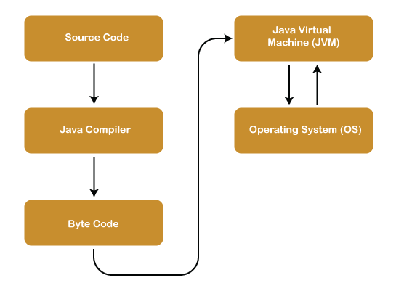
Program Structure

Slide 4
Source Code
In simple, we can say source code is a set of instructions/commands and statements which is written by a programmer by using a computer programming language like C, C++, Java, Python, Assembly language, etc.

Slide 5
Java Complier
The javac tool reads class and interface definitions, written in the Java programming language, and compiles them into bytecode class files. It can also process annotations in Java source files and classes.

Slide 6
Byte Code
Byte Code can be defined as an intermediate code generated by the compiler after the compilation of source code(JAVA Program). This intermediate code makes Java a platform-independent language

Slide 7
JVM (Java Virtual Machine)
A specification where working of Java Virtual Machine is specified. But implementation provider is independent to choose the algorithm. Its implementation has been provided by Oracle and other companies.
An implementation Its implementation is known as JRE (Java Runtime Environment).
Runtime Instance Whenever you write java command on the command prompt to run the java class, an instance of JVM is created.

Slide 8
operating System
JavaOS is an operating system based on a Java virtual machine and predominantly used on SIM cards to run applications on behalf of operators and security services. It was originally developed by Sun Microsystems.

