Slide 1



Futures & Options Trading, Volatility and Settlement Management Database System
Database Management System Project
Presented by: Anand Bhausaheb Harak Roll No.: P06
Class: T.Y. B.Tech CSE (Data Science) Subject: Database Management Systems
RDBMS: MySQL Academic Year: 2026–27
A relational database to manage F&O contracts, prices, volatility and settlement workflows using NSE datasets. Data cleaned with Python; loaded and analyzed in MySQL.
Notes:
1

Slide 2
Problem Statement & Objectives
Problem
Objectives
Bottom line
NSE F&O datasets contain raw prices, contracts, trading activity and volatility metrics that need structured processing before analysis.
  Clean raw F&O data using Python pipelines
  Design normalized MySQL schema (fno_tae2_db)
  Load data into four related tables with constraints
  Implement views, procedures, triggers and optimized queries
Raw Data →
Clean Data →
Relational Database →
SQL Analysis →
Optimization
  Heterogeneous raw data needing cleaning & standardization
  Multiple related datasets must map to normalized tables
  Integrity, performance and maintainability are essential
Notes:
2

Slide 3
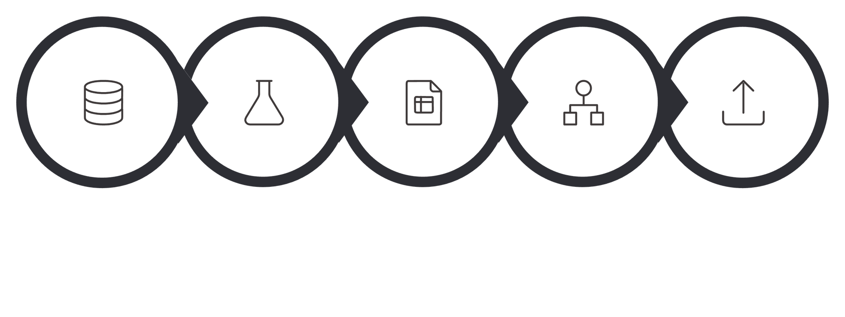
Project Workflow — From Raw Dataset to Database
Schema Design
Raw Data
Python Clean
Clean CSV
Data Load
This pipeline ensures reproducible ingestion, validated relational modeling and performance-tuned analysis for F&O research and reporting.
Notes:
3

Slide 4
Data Cleaning Using Python
The Python cleaning script converts noisy NSE F&O raw files into structured CSVs ready for SQL ingestion. Emphasis: correctness and auditability — no fabricated market values.
Output artifacts
Principle
Cleaned CSVs, validation logs, and populate.py which emits data.sql for MySQL load.
No imputation of missing market values; keep data provenance traceable.
  Header & value trimming; standardized column names
  Consistent missing-value tokens (NaN/NULL/N/A/- → NULL)
  Date standardization: EXP_DATE → YYYY-MM-DD
  Numeric validation for prices, OI, trade counts and values
  Drop records missing SYMBOL or EXP_DATE; remove duplicates
  OHLC sanity checks (Open ≤ High, Low ≤ Close where applicable)
Notes:
4

Slide 5

Database Design & Schema
Integrity constraints: PRIMARY KEY, FOREIGN KEY (with CASCADE where appropriate), NOT NULL, UNIQUE and CHECK for volatility ranges.
Four core tables with enforced referential integrity
data1 — Price Data
data2 — Volatility Metrics
Underlying & futures price records; primary key data1_id.
Calculated volatility values linked to data1_id (one-to-one).
data3 — Contract & Trading
data4 — Derivative OHLC
Derivative contract details, trade counts, trade_value; primary key data3_id.
OHLC pricing per contract linked to data3_id (one-to-one) with audit trail support.
Notes:
5

Slide 6

Normalization: 1NF → 2NF → 3NF
01
02
03
1NF — Atomicity
2NF — Eliminate Partial Dependencies
3NF — Remove Transitive Dependencies
Each column holds single (atomic) values: one symbol / trade date / OHLC per row.
Non-key attributes stored with the table whose primary key they depend on (data2 linked to data1_id; data4 linked to data3_id).
No attribute depends on non-key attributes; facts separated into data1–data4 to reduce redundancy and improve integrity.
Result: compact schema, easier maintenance, and reliable joins for analytics.
Notes:
6

Slide 7
Data Population & SQL Operations
After cleaning, populate.py generates data.sql which inserts records into the MySQL schema.
SQL Features Implemented
  DDL:
CREATE DATABASE/TABLE + constraints
  DML:
INSERT / UPDATE / DELETE
  DQL:
SELECT with ORDER BY / LIMIT
  DCL / TCL:
GRANT, TRANSACTIONS, SAVEPOINTS, ROLLBACK
Table | Records
data1 | 220
data2 | 220
data3 | 638
data4 | 638
Notes:
7

Slide 8

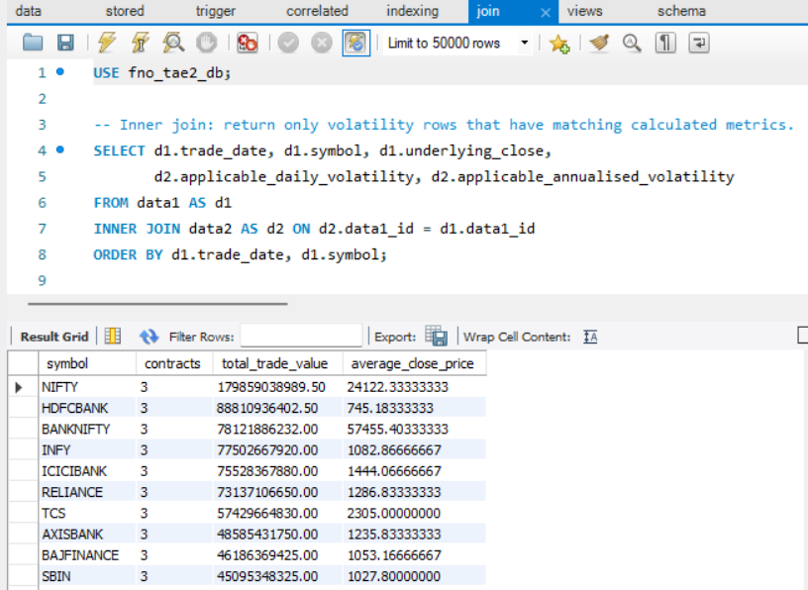

Advanced SQL: JOINs & Correlated Subqueries
Use JOINs to combine related entities; use correlated subqueries to compare individual rows against group-level metrics for richer analytics.
JOIN Patterns
  INNER JOIN data1 ↔ data2 (price + volatility)
  INNER JOIN data3 ↔ data4 (contract + OHLC)
  LEFT / RIGHT / UNION used to emulate FULL OUTER JOIN
  SELF JOIN data3 vs data3 to compare expiries
Correlated Subqueries
Per-record comparisons (e.g., contract trade_value vs average trade_value for same symbol; annualised volatility vs trade-date average).
Notes:
8

Slide 9

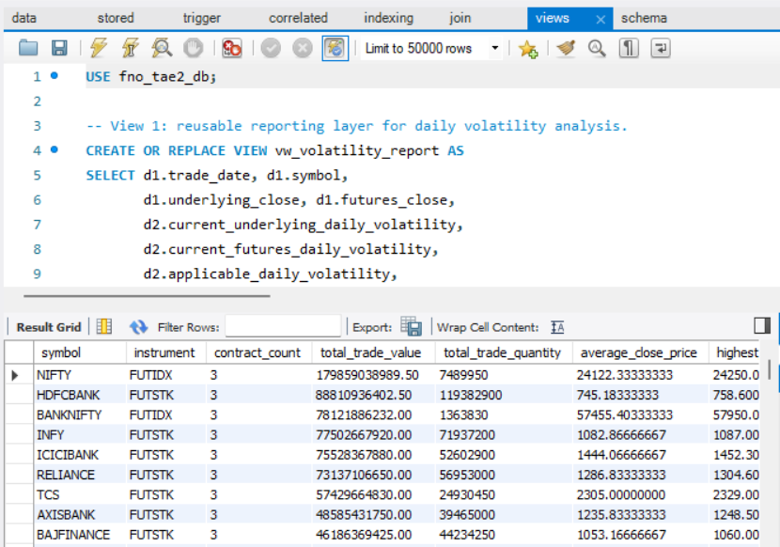

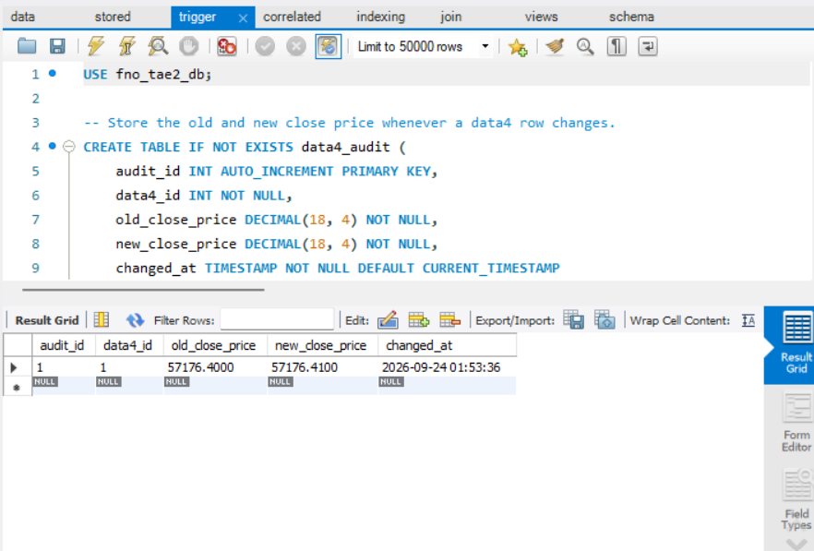
Views, Stored Procedure & Trigger
These constructs improve reusability, encapsulate business rules, and provide automated auditability for price updates.
Views
Stored Procedure
vw_volatility_report (data1 + data2): reusable volatility dataset.
vw_derivative_summary (data3 + data4): grouped summaries with COUNT, SUM, AVG.
sp_symbol_report(p_symbol): returns contract count, first/last expiry, total trade value and average close for a given symbol (e.g., CALL sp_symbol_report('BANKNIFTY')).
Trigger
trg_data4_price_audit: AFTER UPDATE on data4; when close_price changes, inserts an audit row into data4_audit with old/new values and timestamp.
Notes:
9

Slide 10
Indexing & Query Optimization — Key Outcomes
Targeted indexes were created on commonly filtered and joined columns to reduce scan costs and accelerate analytics.
Optimization Workflow
  Add indexes on JOIN / WHERE columns
  Run EXPLAIN to inspect access methods and estimated rows
  Iteratively refine queries and indexes to reduce execution cost
Index | Purpose
idx_data1_symbol_date (data1.symbol, trade_date) | Fast symbol-date lookups
idx_data2_annualised_volatility (data2.annualised_volatility) | Volatility filters
idx_data3_symbol_expiry (data3.symbol, expiry_date) | Expiry & contract searches
idx_data3_trade_value (data3.trade_value) | High trade-value queries
Key Point
Proper indexing dramatically reduces scanned rows and improves response time for analytical queries.
Notes:
10

Slide 11

Conclusion
What the project demonstrates?
Raw NSE F&O datasets are cleaned and converted into a normalized MySQL database. The implementation then demonstrates relational queries, reusable views, a stored procedure, an audit trigger, indexing and verification.
Thank You!!
Main SQL features
JOIN • correlated queries • views • procedure • trigger
• indexes
Database
MySQL 8.x Database: fno_tae2_db
Core tables
  data1 • data2
• data3 • data4

