Slide 1
AWS Static Website Hosting Project
By Anandhu Vijayan

Slide 2
Project Overview
Create a simple static website using HTML & CSS
Host it on AWS S3 using Free Tier
Configure bucket for public access
Enable Static Website Hosting
Upload project to GitHub

Slide 3
Folder Structure
aws-static-website/
├── index.html
└── style.css

Slide 4
Step 1: Test Locally
Create index.html and style.css
Open index.html in browser
Check if website loads correctly

Slide 5
Step 2: Upload to AWS S3
Log in to AWS Console
Create S3 bucket
Disable 'Block all public access'
Upload index.html and style.css

Slide 6
Step 3: Enable Static Website Hosting
Go to Bucket → Properties
Enable Static Website Hosting
Set index document: index.html
Copy Website Endpoint URL:http://anandhu-static-website.s3-website.ap-south-1.amazonaws.com

Slide 7
Step 4: Make Bucket Public
Add bucket policy:
{
"Version": "2012-10-17",
"Statement": [
{
"Sid": "PublicReadGetObject",
"Effect": "Allow",
"Principal": "*",
"Action": "s3:GetObject",
"Resource": "arn:aws:s3:::anandhu-static-website/*"
}
]
}

Slide 8
Step 5: Upload to GitHub
Create a GitHub repository
Run commands:
git init
git add .
git commit -m "My first AWS static website"
git branch -M main
git remote add origin: https://github.com/anandhuvijayan2002/aws- static-website.git
git push -u origin main

Slide 9
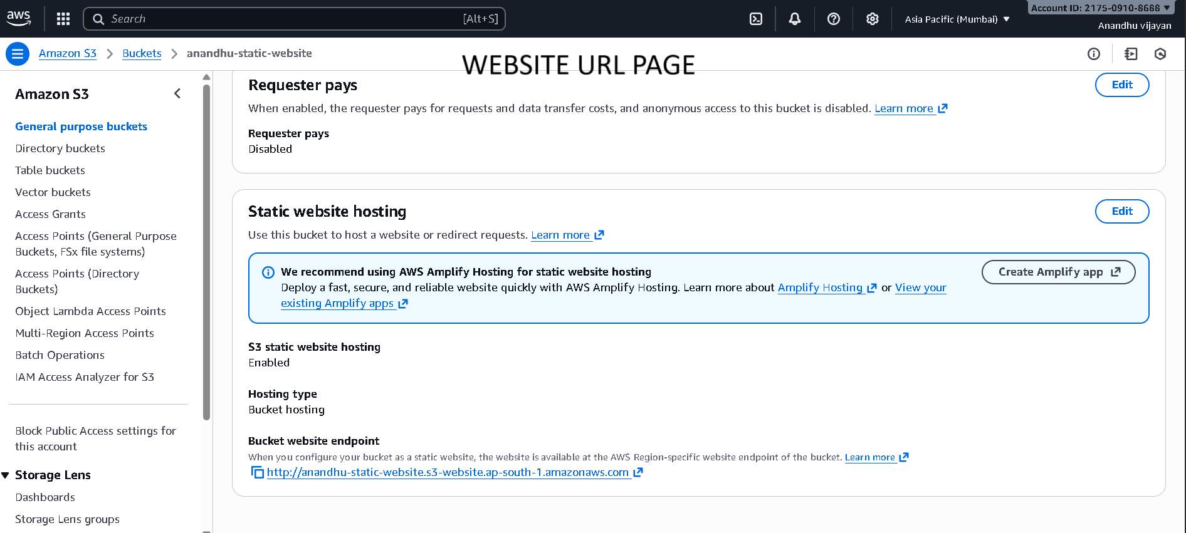
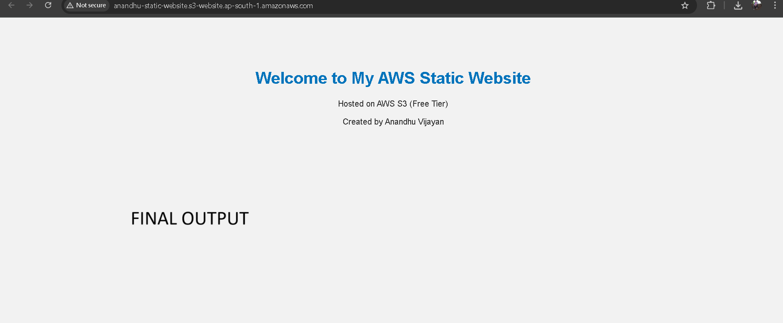
Conclusion
Website successfully hosted on AWS S3

