Slide 1

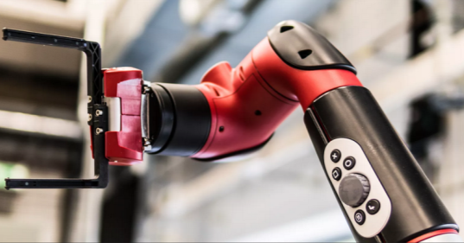
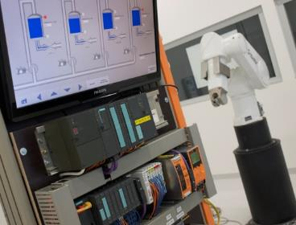
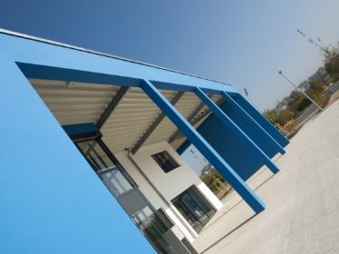
Intelligent Robotics Lab
Octo-Bouncer Master Thesis
Student: Anandhu Vijayan
Supervisor: Prof. Dr. Dmitrii Dobriborsci

Slide 2
Problem definition
Octo-Bouncer Master Thesis – Complete Execution Plan
One of the most challenging problems in a control system is balancing a system. The Octa-Bouncer is a multi-actuated dynamic manipulation system that uses camera-based ball tracking and closed-loop control to generate corrective platform motions that stabilize and influence a bouncing ball.
Problem statement
To develop a real-time robotic platform that can track, predict, and control the motion of a bouncing ball using multiple actuators and visual feedback, ensuring continuous and stable bouncing through closed-loop control.
This thesis is relevant because it addresses the challenge of controlling fast, unpredictable dynamic objects using real-time feedback. The system demonstrates important modern robotics skills in computer vision, control, and embedded systems.
2

Slide 3
Problem definition
Scope
Design and build a multi-actuated platform to control a bouncing ball
Implement camera-based ball tracking and real-time closed-loop control
Integrate embedded hardware, actuators, and computer vision
Evaluate system performance through experiments
Deliverables
Functional hardware platform
Embedded control firmware
vision tracking software [if time constraints allows]
Control algorithm (e.g., PID) with experimental results
Documentation (thesis, CAD, code, and BOM)
Limitations
No multi-ball manipulation or juggling
No advanced AI/ML control unless specified
Limited operation in controlled indoor conditions only
3

Slide 4
Thesis goal
Main objective
The objective is to build a platform that can automatically keep a ball bouncing by tracking its motion with a camera and adjusting the platform in real time.
Sub-objectives
Build the hardware platform
Implement camera-based ball tracking
Develop and tune a closed-loop control algorithm
Integrate sensing and actuation in real time
Evaluate system performance through experiments
4

Slide 5
Plan
Plan for the last 2 weeks
Hardware Planning & Ordering
Finalize Bill of Materials (BOM)
Choose microcontroller, motors, drivers, camera, PSU
Compare suppliers within Germany/EU
Place all hardware orders
Finding papers of similar projects
5

Slide 6
Progress
Work completed
Completed tasks
Bill of Materials (BOM) completed
Motor , drivers, power Supply and Camera has not yet decided as there is a confusion for that I am seeking help.
Found a few papers of similar projects for referencing.
Work NOT completed
Purchasing has not yet made
Reasons:
Decision regarding the components has not yet confirmed
6

Slide 7
Plan for the next 2 weeks
Upcoming tasks:
Confirming the hardware components.
Placing orders
Learn basics of microcontroller, PID theory, Stepper basics
Expected outcomes:
Components purchased
Basics learned
Starts working on the project
Milestone:
End of the above tasks, will be able to start working on the Prototype.
7

Slide 8
Questions, needs & support
Help required in confirming the hardware components.
8

Slide 9
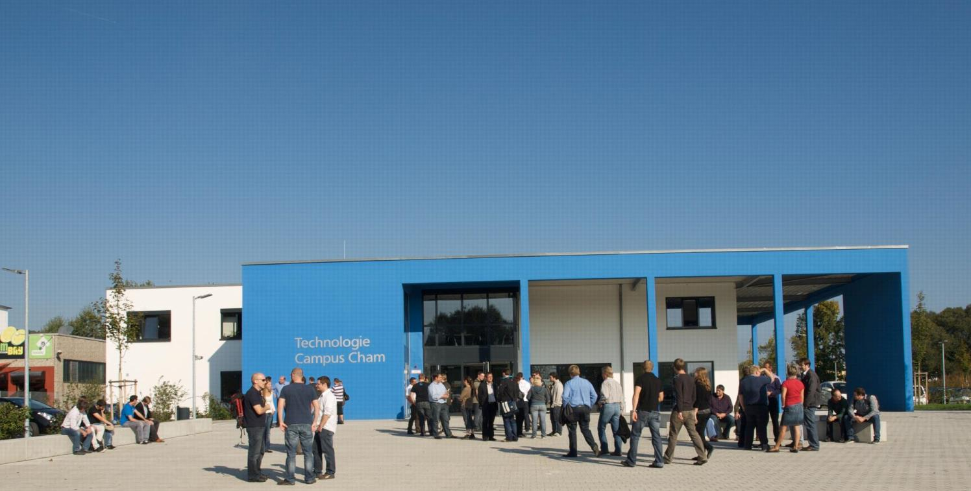
KONTAKT
Herzlichen Dank für Ihr Interesse!
Technologie
Campus Cham
Badstraße 21
93413 Cham
www.tc-cham.de
Prof. Dr. Dmitrii Dobriborsci
Dmitrii.dobriborsci@th-deg.de

