Slide 1

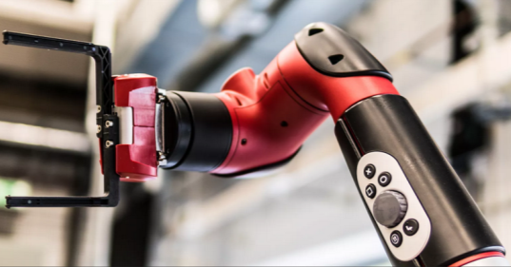
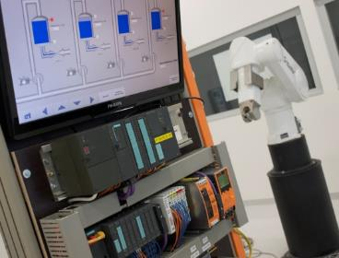
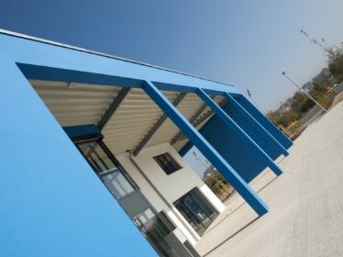
Intelligent Robotics Lab
Octo-Bouncer : Development of a multi-actuated platform for dynamic object
Student: Anandhu Vijayan
Submission date: September 16 (approx)
Supervisor: Prof. Dr. Dmitrii Dobriborsci

Slide 2
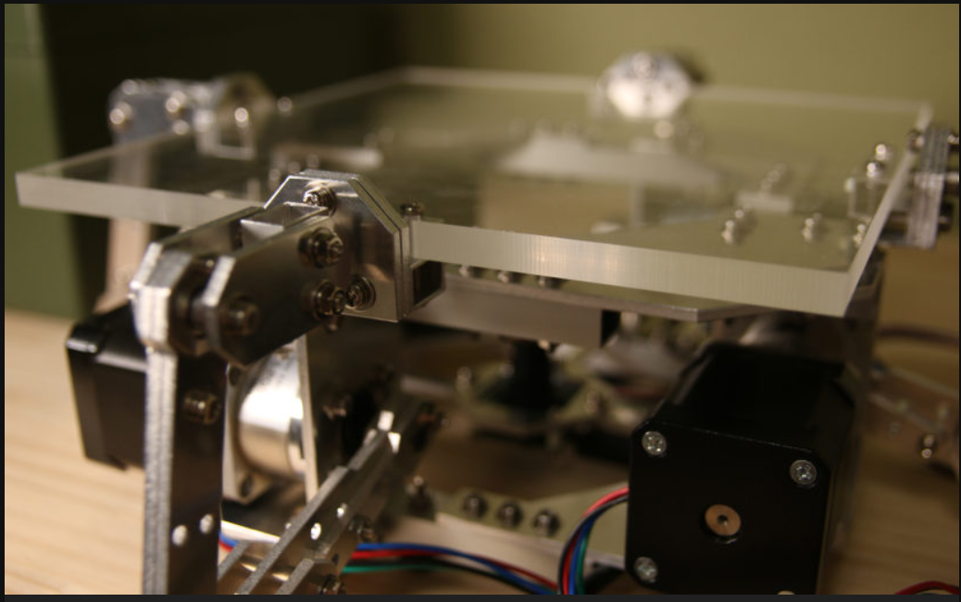
Problem definition
Octo-Bouncer
One of the most challenging problems in a control system is balancing a system. The Octa-Bouncer is a multi-actuated dynamic manipulation system that uses camera-based ball tracking and closed-loop control to generate corrective platform motions that stabilize and influence a bouncing ball.
Problem statement
To develop a real-time robotic platform that can track, predict, and control the motion of a bouncing ball using multiple actuators and visual feedback, ensuring continuous and stable bouncing through closed-loop control.
This thesis is relevant because it addresses the challenge of controlling fast, unpredictable dynamic objects using real-time feedback. The system demonstrates important modern robotics skills in computer vision, control, and embedded systems.
2

Slide 3
Problem definition
Scope
Design and build a multi-actuated platform to control a bouncing ball
Implement camera-based ball tracking and real-time closed-loop control
Integrate embedded hardware, actuators, and computer vision
Evaluate system performance through experiments
Deliverables
Functional hardware platform
Embedded control firmware
vision tracking software [if time constraints allows]
Control algorithm (e.g., PID) with experimental results
Documentation (thesis, CAD, code, and BOM)
Limitations
No multi-ball manipulation or juggling
No advanced AI/ML control unless specified
Limited operation in controlled indoor conditions only
3

Slide 4
Thesis goal
Main objective
The objective is to build a platform that can automatically keep a ball bouncing by tracking its motion with a camera and adjusting the platform in real time.
Sub-objectives
Build the hardware platform
Implement camera-based ball tracking
Develop and tune a closed-loop control algorithm
Integrate sensing and actuation in real time
Evaluate system performance through experiments
4

Slide 5
Plan
Plan for the last 2 weeks
Learn microcontroller, PID theory, Stepper basics.
Move motor with step commands.
Begin logging motor response.
Implement simple PID for one actuator.
5

Slide 6
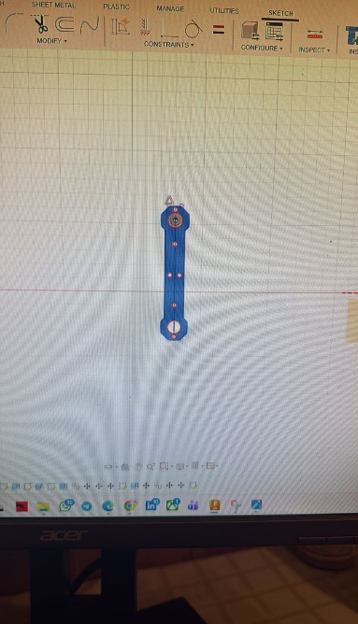
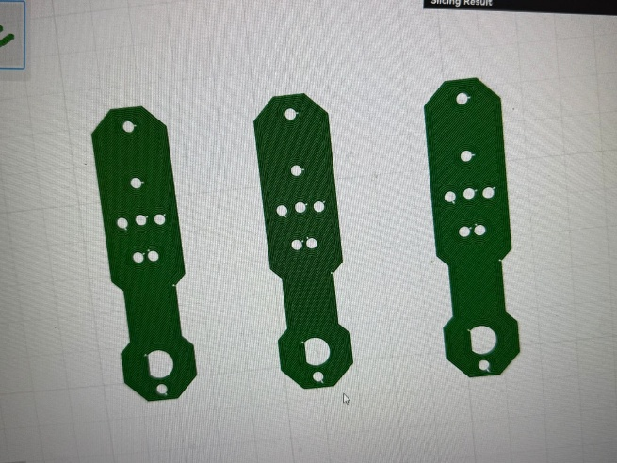
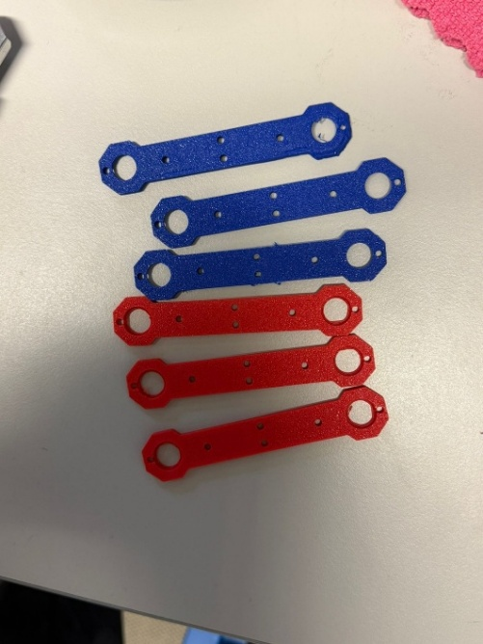
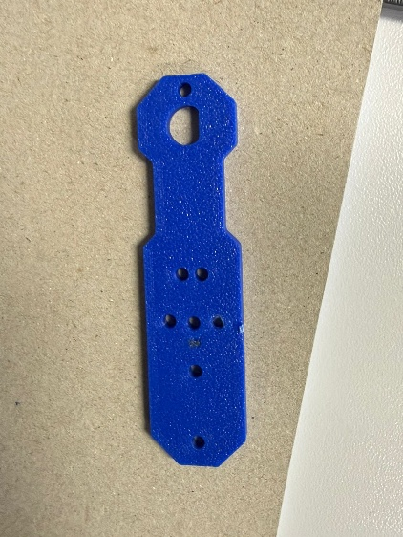
Progress
Work completed
Completed tasks
The basics of stepper motor and microcontroller is still on the learning.
Achieved the step command movement of single motor.
Designing of the arms and links finished and started to 3d print it.
Work not completed
Implementation of simple PID for one actuator.(Later understood that is not required since the PID implementation is on the lilt plate).
6

Slide 7
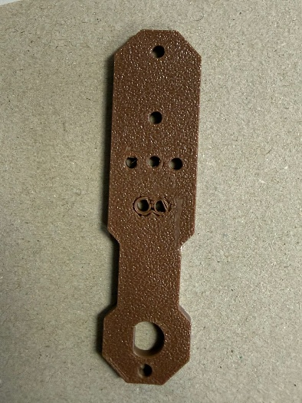
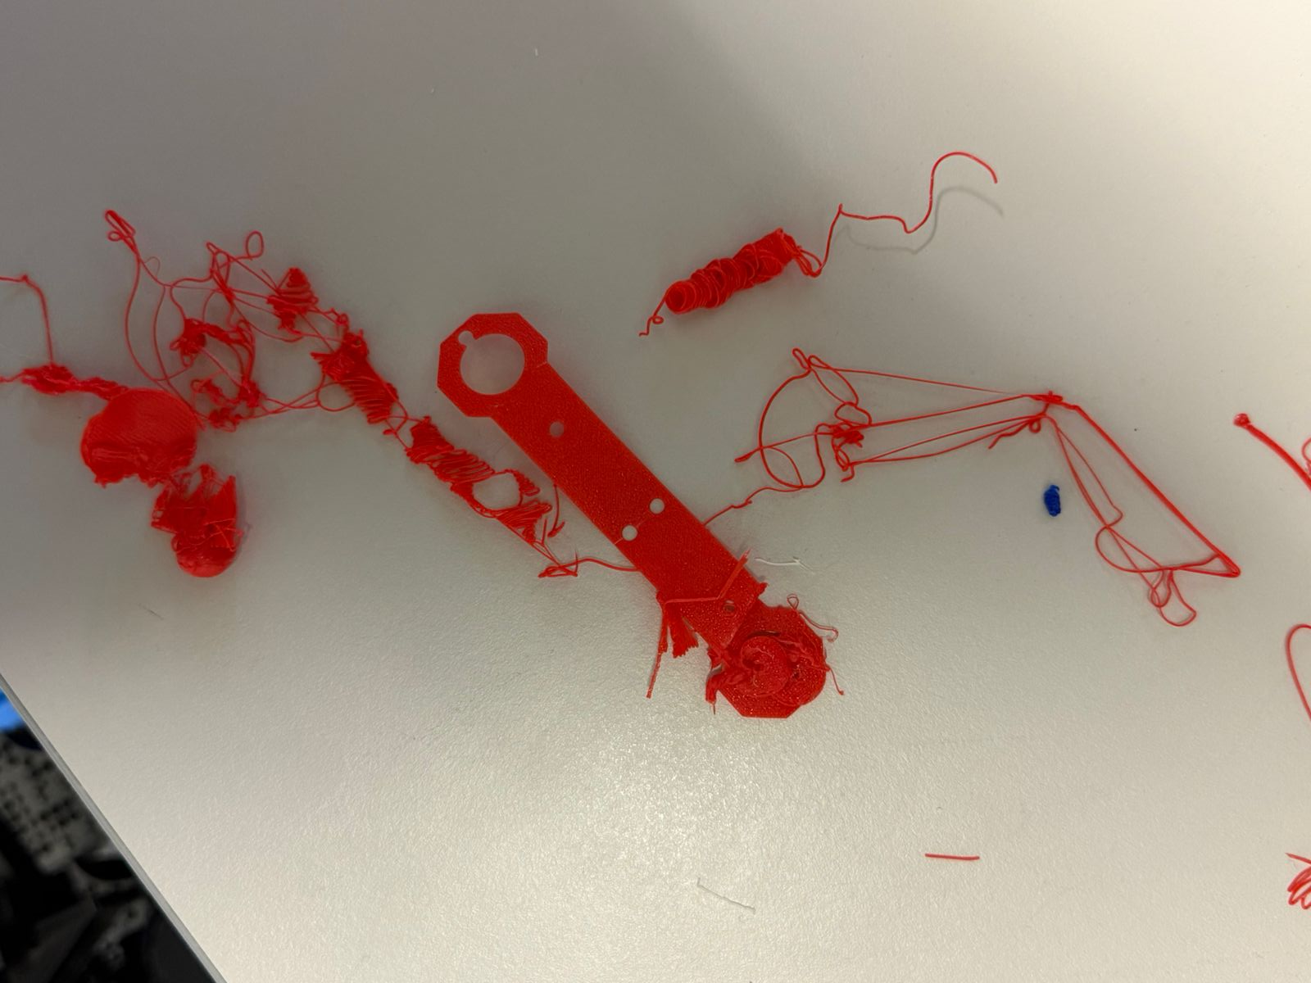
Problems Faced:
Initially the 3D printed arm was having imperfection near the holes
While 3 D printing some components, were not printing properly even after calibrating and cleaning the nozzle still it is a problem.
Problem Solved :
By increasing the wall loop, infill density and changing the pattern. This has been solved.
Second problem arise when 3 d printing multiple components in a single plate among that one component was facing the problem which was the print was ripping off from the build platform.
7

Slide 8
Plan for the next 2 weeks
Upcoming tasks:
3D print all the components.
Setup the camera.
Begin detection of ball with camera feed and make step movements.
Expected outcomes:
All components are 3D printed.
Will be able to track the ball on the camera frame.
8

Slide 9
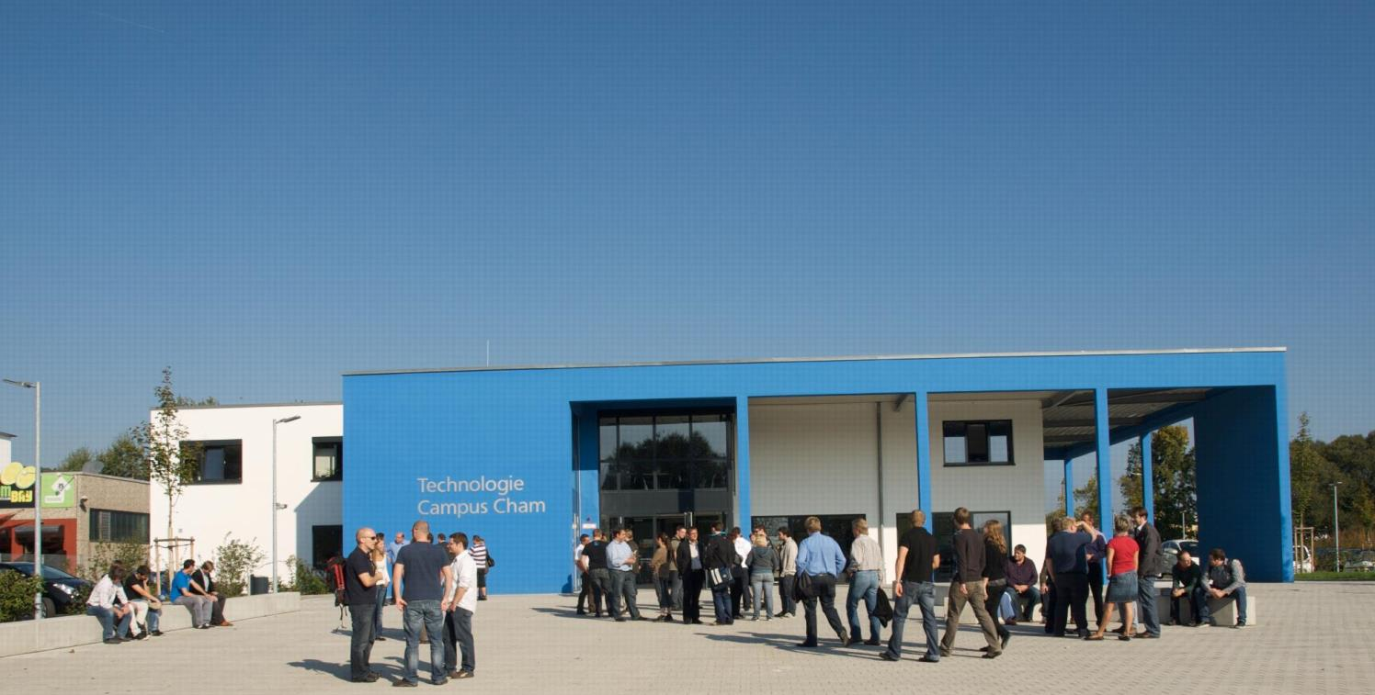
KONTAKT
Herzlichen Dank für Ihr Interesse!
Technologie
Campus Cham
Badstraße 21
93413 Cham
www.tc-cham.de
Prof. Dr. Dmitrii Dobriborsci
Dmitrii.dobriborsci@th-deg.de

