Slide 1

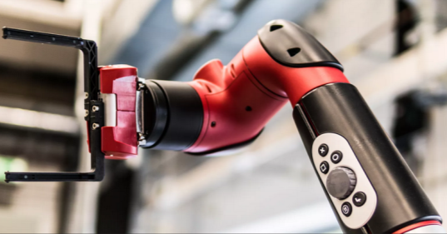
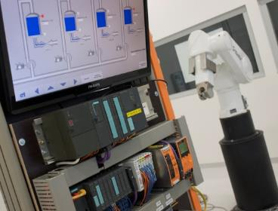
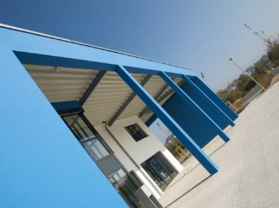
Intelligent Robotics Lab
Octo-Bouncer : Development of a multi-actuated platform for dynamic object
Student: Anandhu Vijayan
Submission date: September 16 (approx)
Supervisor: Prof. Dr. Dmitrii Dobriborsci

Slide 2
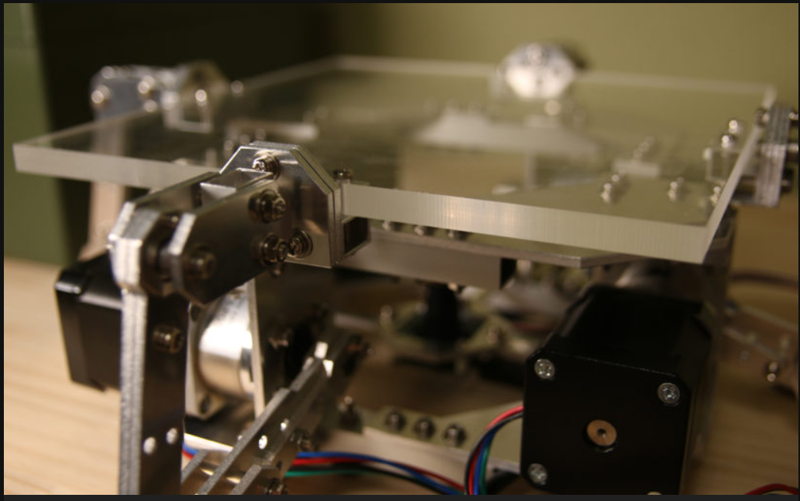
Problem definition
Octo-Bouncer
One of the most challenging problems in a control system is balancing a system. The Octa-Bouncer is a multi-actuated dynamic manipulation system that uses camera-based ball tracking and closed-loop control to generate corrective platform motions that stabilize and influence a bouncing ball.
Problem statement
To develop a real-time robotic platform that can track, predict, and control the motion of a bouncing ball using multiple actuators and visual feedback, ensuring continuous and stable bouncing through closed-loop control.
This thesis is relevant because it addresses the challenge of controlling fast, unpredictable dynamic objects using real-time feedback. The system demonstrates important modern robotics skills in computer vision, control, and embedded systems.
2

Slide 3
Problem definition
Scope
Design and build a multi-actuated platform to control a bouncing ball
Implement camera-based ball tracking and real-time closed-loop control
Integrate embedded hardware, actuators, and computer vision
Evaluate system performance through experiments
Deliverables
Functional hardware platform
Embedded control firmware
vision tracking software [if time constraints allows]
Control algorithm (e.g., PID) with experimental results
Documentation (thesis, CAD, code, and BOM)
Limitations
No multi-ball manipulation or juggling
No advanced AI/ML control unless specified
Limited operation in controlled indoor conditions only
3

Slide 4
Thesis goal
Main objective
The objective is to build a platform that can automatically keep a ball bouncing by tracking its motion with a camera and adjusting the platform in real time.
Sub-objectives
Build the hardware platform
Implement camera-based ball tracking
Develop and tune a closed-loop control algorithm
Integrate sensing and actuation in real time
Evaluate system performance through experiments
4

Slide 5
Plan
Plan for the last 2 weeks
3D print all the components.
Setup the camera.
Begin detection of ball with camera feed and make step movements.
5

Slide 6
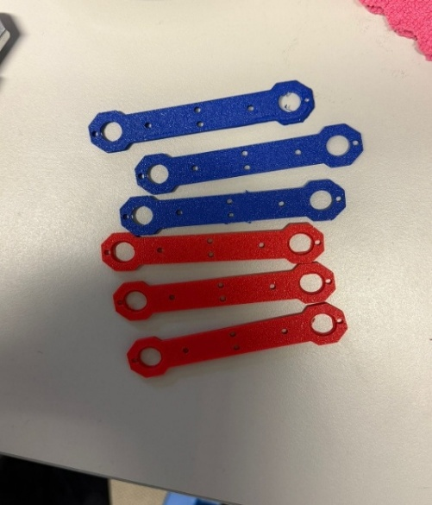
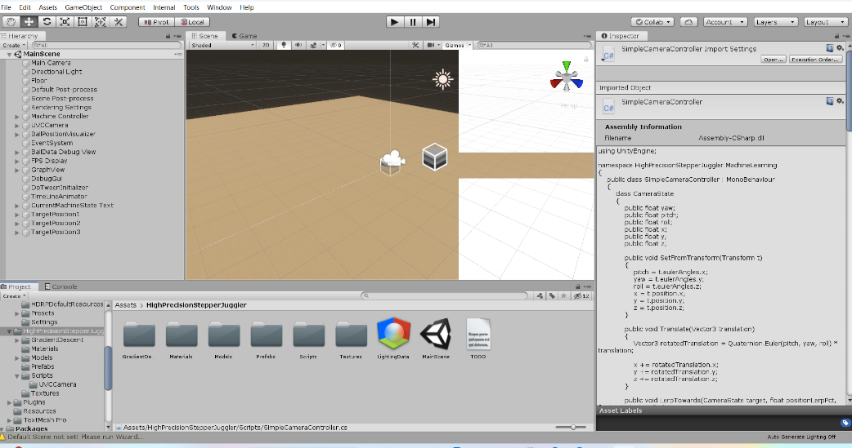
Progress
Work completed
Completed tasks
Almost completed the 3 D printing.
Work not completed
While setting up the camera with the unity, the Unity is crashing, showing runtime error.
6

Slide 7
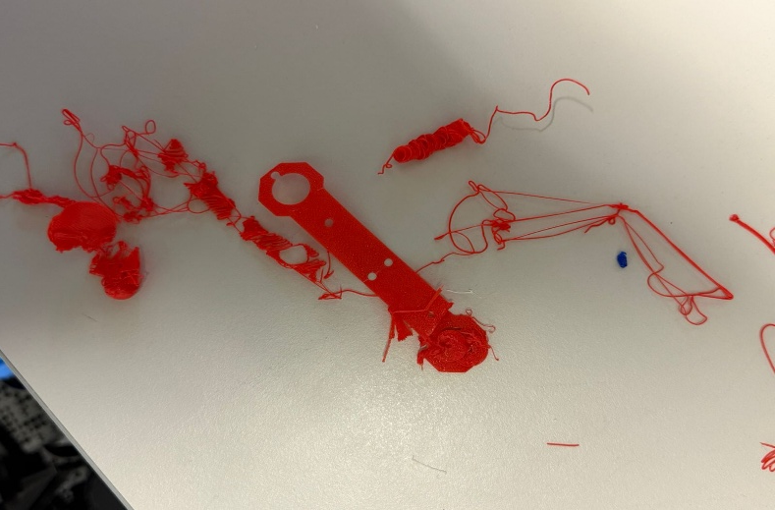
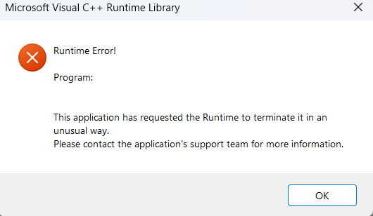
Plan for the next 2 weeks
Problems Faced:
3 D printer was having some malfunctions, so printing took more time than anticipated.
While setting up camera with the unity, Unity was crashing, it is still a problem, But I think it is because of some communication issue.
Problem Solved :
Cleaned the printers nozzle and the plate, think it was because of the fingerprints in the build platform.
7

Slide 8
Plan for the next 2 weeks
Upcoming tasks:
Setup the camera.
Begin detection of ball with camera feed and make step movements.
Assembling the printed parts
Expected outcomes:
Will be able to track the ball on the camera frame.
8

Slide 9
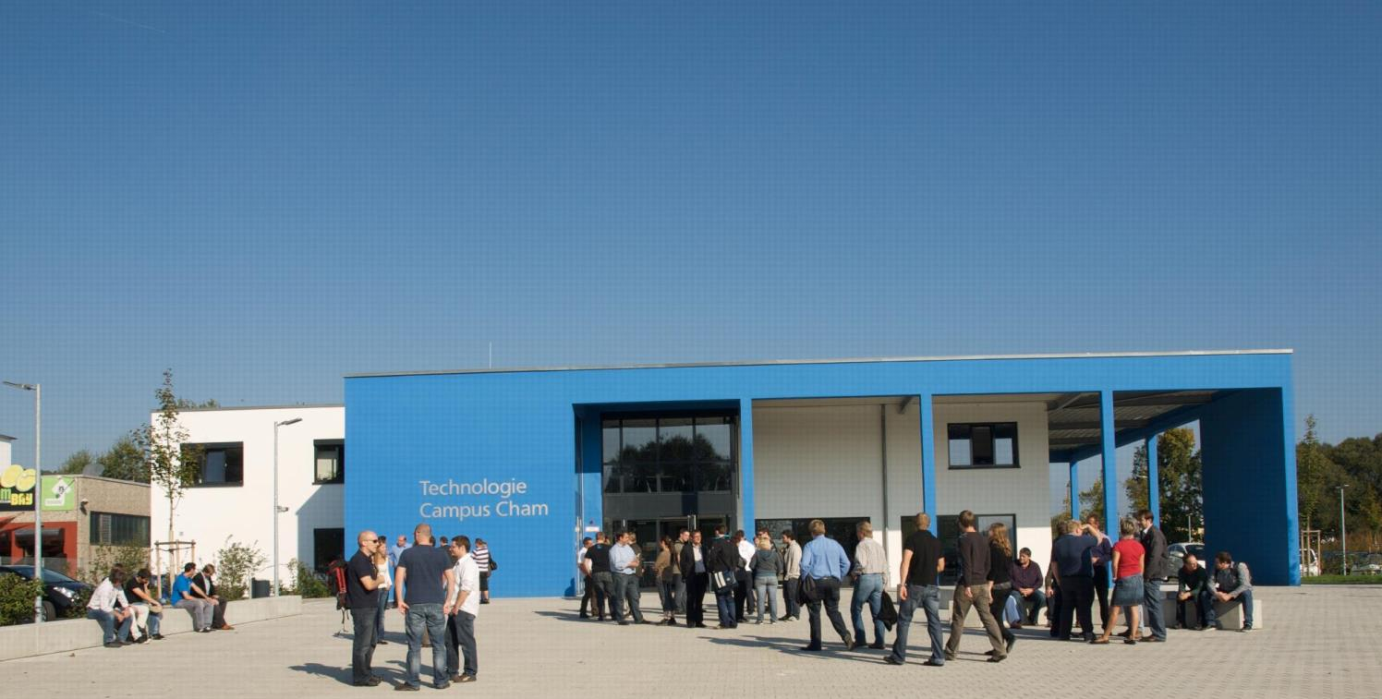
KONTAKT
Herzlichen Dank für Ihr Interesse!
Technologie
Campus Cham
Badstraße 21
93413 Cham
www.tc-cham.de
Prof. Dr. Dmitrii Dobriborsci
Dmitrii.dobriborsci@th-deg.de

