Slide 1

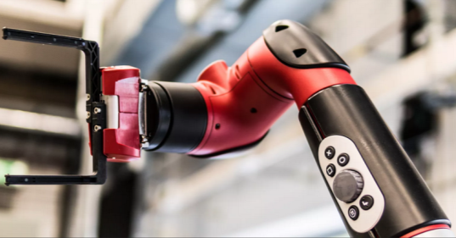
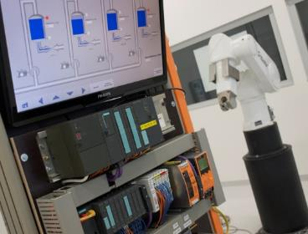
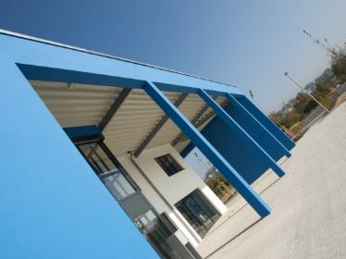
Intelligent Robotics Lab
Octo-Bouncer : Development of a multi-actuated platform for dynamic object
Student: Anandhu Vijayan
Supervisor: Prof. Dr. Dmitrii Dobriborsci

Slide 2
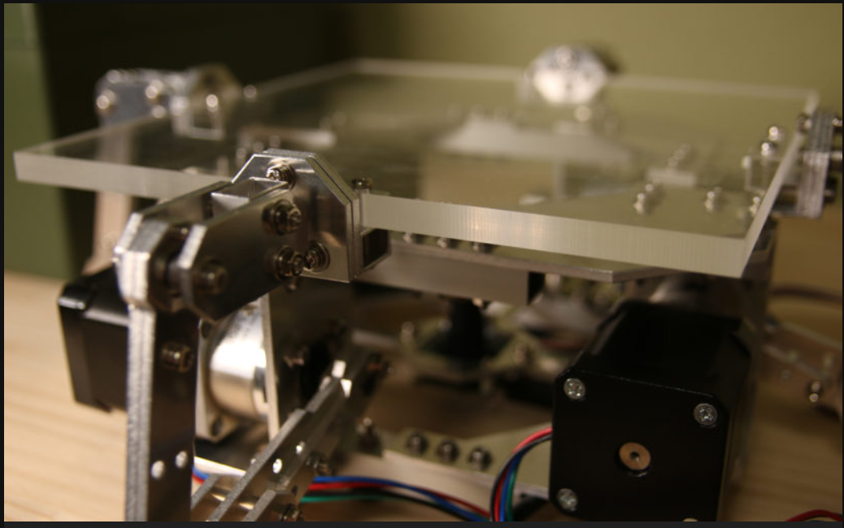
Problem definition
Octo-Bouncer
One of the most challenging problems in a control system is balancing a system. The Octa-Bouncer is a multi-actuated dynamic manipulation system that uses camera-based ball tracking and closed-loop control to generate corrective platform motions that stabilize and influence a bouncing ball.
Problem statement
To develop a real-time robotic platform that can track, predict, and control the motion of a bouncing ball using multiple actuators and visual feedback, ensuring continuous and stable bouncing through closed-loop control.
This thesis is relevant because it addresses the challenge of controlling fast, unpredictable dynamic objects using real-time feedback. The system demonstrates important modern robotics skills in computer vision, control, and embedded systems.
2

Slide 3
Problem definition
Scope
Design and build a multi-actuated platform to control a bouncing ball
Implement camera-based ball tracking and real-time closed-loop control
Integrate embedded hardware, actuators, and computer vision
Evaluate system performance through experiments
Deliverables
Functional hardware platform
Embedded control firmware
vision tracking software [if time constraints allows]
Control algorithm (e.g., PID) with experimental results
Documentation (thesis, CAD, code, and BOM)
Limitations
No multi-ball manipulation or juggling
No advanced AI/ML control unless specified
Limited operation in controlled indoor conditions only
3

Slide 4
Thesis goal
Main objective
The objective is to build a platform that can automatically keep a ball bouncing by tracking its motion with a camera and adjusting the platform in real time.
Sub-objectives
Build the hardware platform
Implement camera-based ball tracking
Develop and tune a closed-loop control algorithm
Integrate sensing and actuation in real time
Evaluate system performance through experiments
4

Slide 5
Plan
Plan for the last 2 weeks
Confirming the hardware components.
Placing orders
Learn basics of microcontroller, PID theory, Stepper basics
5

Slide 6
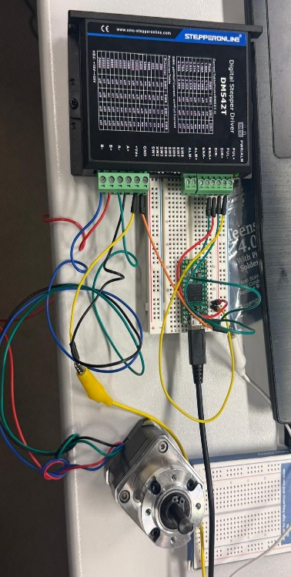
Progress
Work completed
Completed tasks
Confirmed the hardware components.
Purchased the components we weren’t having on the lab.
The basics of stepper motor and microcontroller is still on the learning phase.
Started the basic hardware testing. (Wired the teensy to the stepper driver and a single stepper motor)
6

Slide 7
Plan for the next 2 weeks
Upcoming tasks:
Learn microcontroller, PID theory, Stepper basics
Move motor with step commands
Begin logging motor response
Implement simple PID for one actuator
Expected outcomes:
A working actuator test setup
More lessons learned in controlling the motor
Milestone:
Will be able to start controlling an actuator.
7

Slide 8
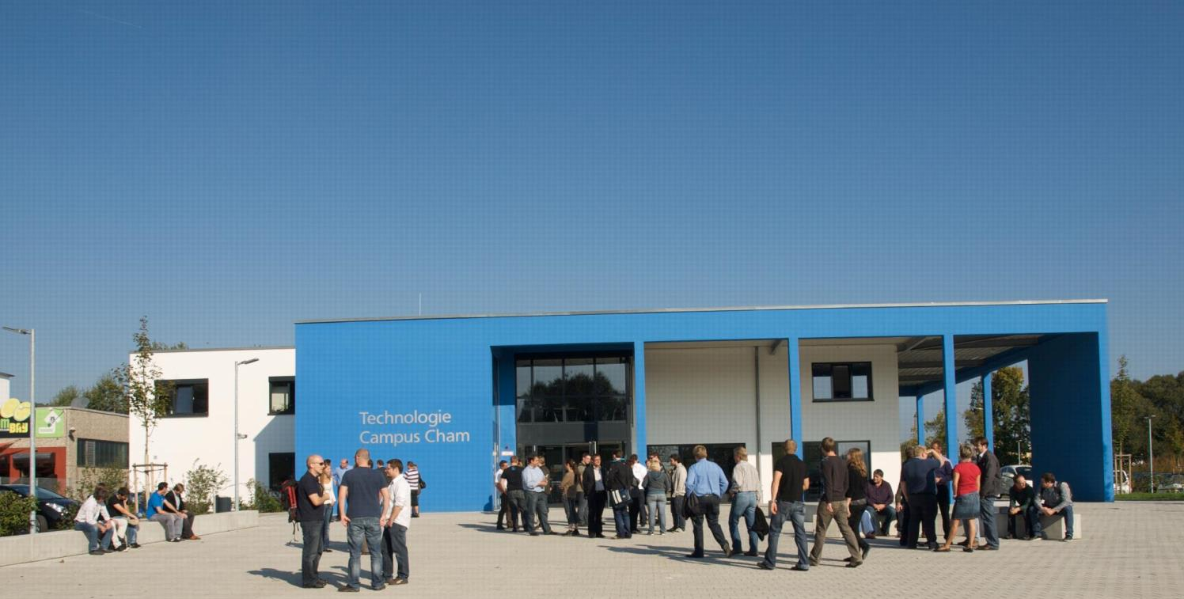
KONTAKT
Herzlichen Dank für Ihr Interesse!
Technologie
Campus Cham
Badstraße 21
93413 Cham
www.tc-cham.de
Prof. Dr. Dmitrii Dobriborsci
Dmitrii.dobriborsci@th-deg.de

