Slide 1

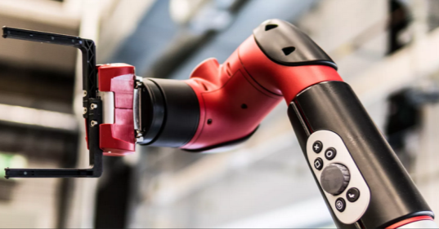
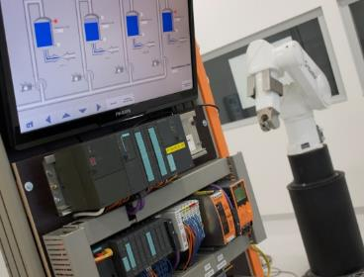
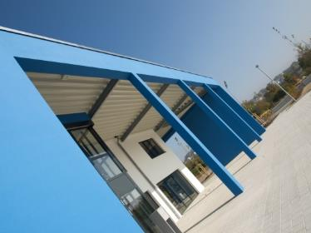
Intelligent Robotics Lab
Octo-Bouncer : Development of a multi-actuated platform for dynamic object
Student: Anandhu Vijayan
Submission date: September 13
Supervisor: Prof. Dr. Dmitrii Dobriborsci

Slide 2
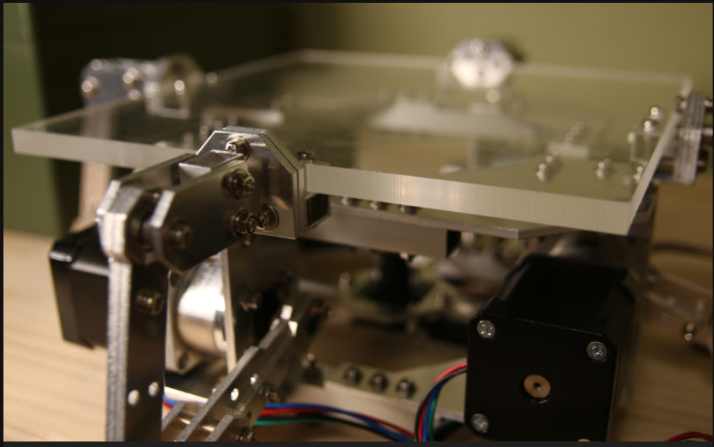
Problem definition
Octo-Bouncer
One of the most challenging problems in a control system is balancing a system. The Octa-Bouncer is a multi-actuated dynamic manipulation system that uses camera-based ball tracking and closed-loop control to generate corrective platform motions that stabilize and influence a bouncing ball.
Problem statement
  To develop a real-time robotic platform that can track, predict, and control the motion of a bouncing ball using multiple actuators and visual feedback, ensuring continuous and stable bouncing through closed-loop control.
  This thesis is relevant because it addresses the challenge of controlling fast, unpredictable dynamic objects using real-time feedback. The system demonstrates important modern robotics skills in computer vision, control, and embedded systems.
2

Slide 3
Problem definition
  Scope
    Design and build a multi-actuated platform to control a bouncing ball
    Implement camera-based ball tracking and real-time closed-loop control
    Integrate embedded hardware, actuators, and computer vision
    Evaluate system performance through experiments
  Deliverables
    Functional hardware platform
    Embedded control firmware
    vision tracking software [if time constraints allows]
    Control algorithm (e.g., PID) with experimental results
    Documentation (thesis, CAD, code, and BOM)
  Limitations
    No multi-ball manipulation or juggling
    No advanced AI/ML control unless specified
    Limited operation in controlled indoor conditions only
3

Slide 4
Thesis goal
Main objective
The objective is to build a platform that can automatically keep a ball bouncing by tracking its motion with a camera and adjusting the platform in real time.
Sub-objectives
  Build the hardware platform
  Implement camera-based ball tracking
  Develop and tune a closed-loop control algorithm
  Integrate sensing and actuation in real time
  Evaluate system performance through experiments
4

Slide 5
Plan
Plan for the last 2 weeks
  Requested support for solving the camera issue
  Connect all the motors to the teensy.
5

Slide 6
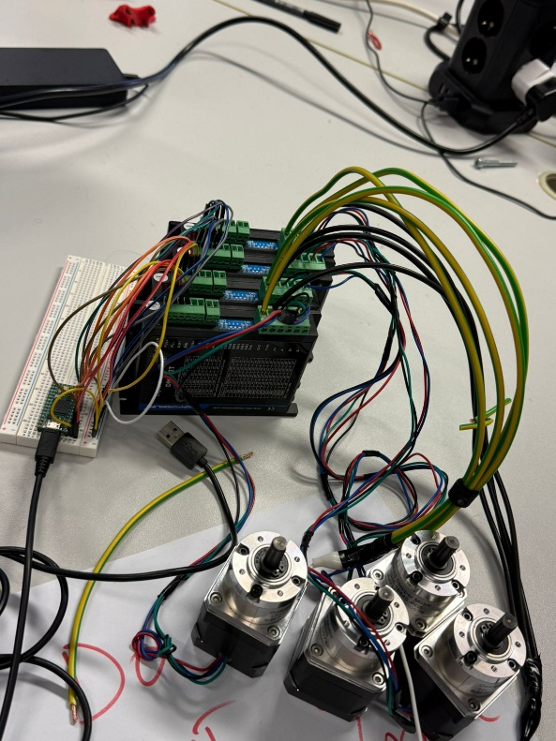
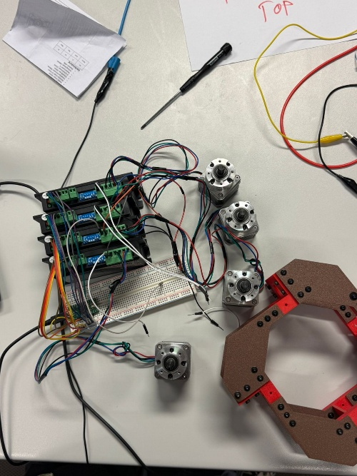
Progress
Work completed
Completed tasks
  Got the suggestion to find a new lens since the one that I have is not usable.(Order is placed)
  Connected all the motors to the teensy.
6

Slide 7
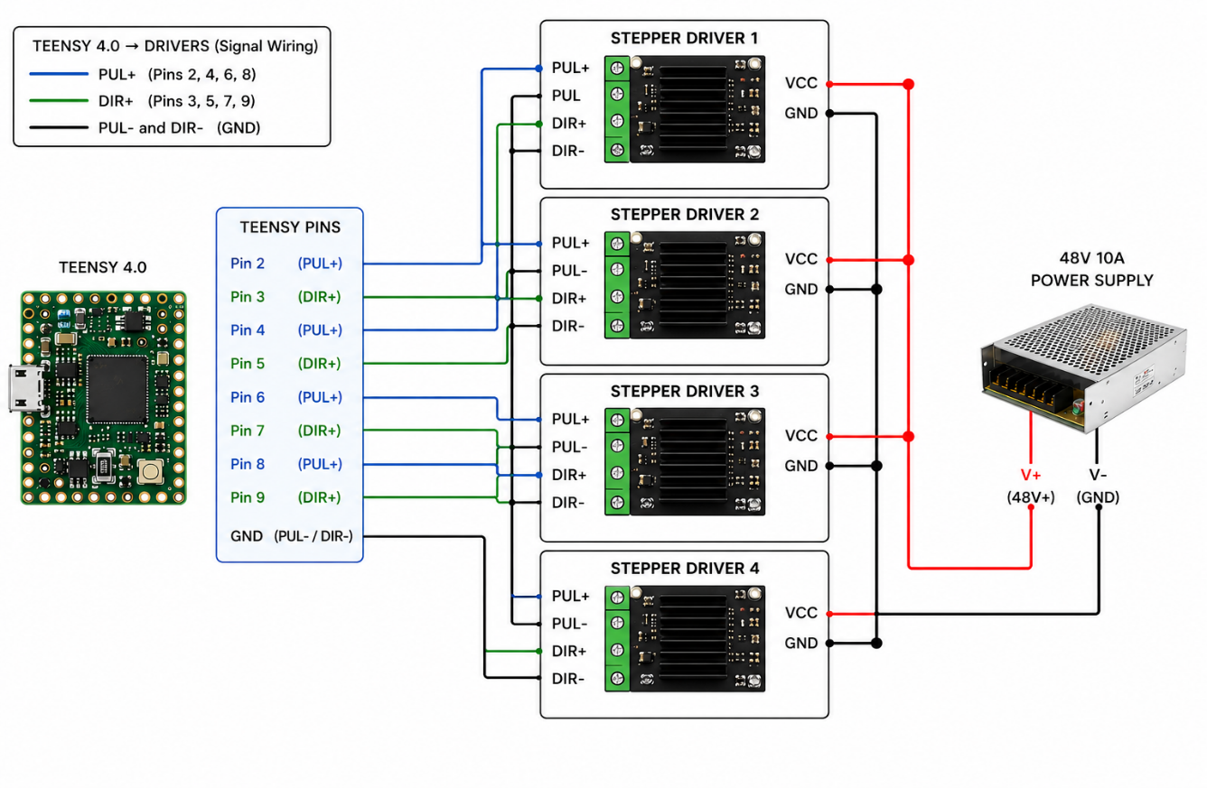
Plan for the next 2 weeks
Problems Faced:
  While making the connection the teensy got fried,
  Conducted the continuity test and check the voltmeter reading , everything is fine.
Connection diagram (which fried the controller)
7

Slide 8
Plan for the next 2 weeks
Upcoming tasks:
  Need to find the reason for the short circuit.
  Rewire everything.
  Successfully make the connection.
  After the lens is delivered, need to configure that and make ball detection
Expected outcomes:
  Successful connection, ball detection using open CV will be able to start.
8

Slide 9
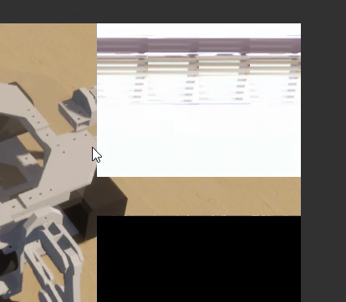
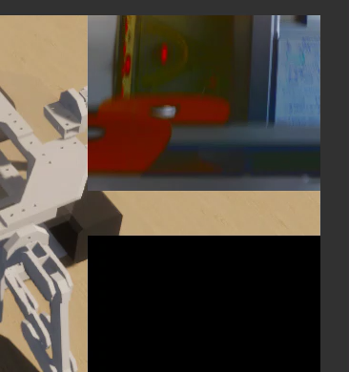
Extra
The feed inside unity after fixing
The feed inside the Unity
9

Slide 10
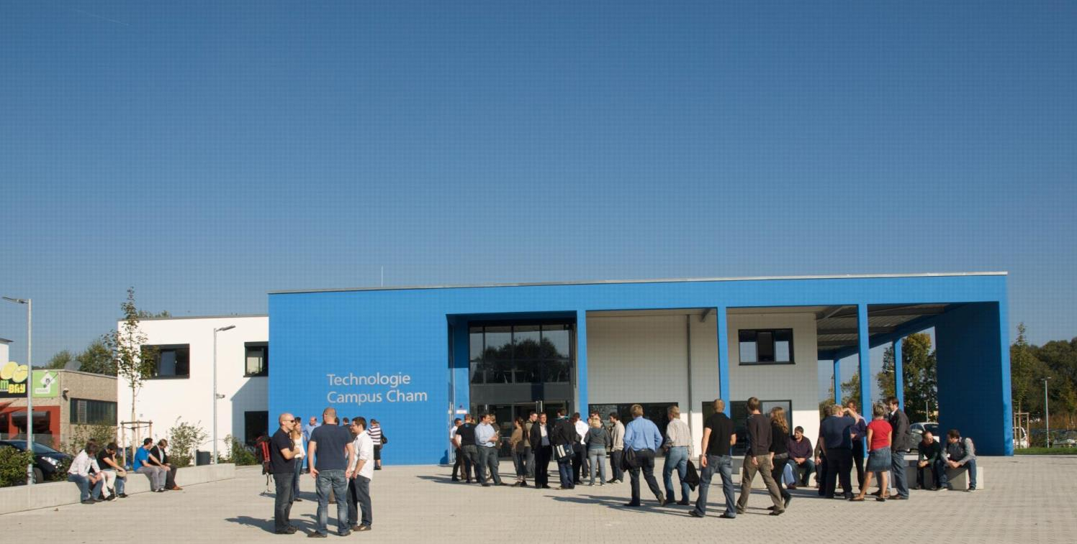
KONTAKT
Herzlichen Dank für Ihr Interesse!
Technologie
Campus Cham
Badstraße 21
93413 Cham
www.tc-cham.de
Prof. Dr. Dmitrii Dobriborsci
Dmitrii.dobriborsci@th-deg.de

