Slide 1


Slide 2

CS-311
Data Communication
Simulink
Presented by-
170101010-Anand Kumar
170101011-Animesh Ranjan
170101015-G. Hemanth Varma
Course Instructor:- Dr. Thejaswini M

Slide 3
Simulink
Simulink is a MATLAB-based graphical programming environment for modeling, simulating and analyzing multidomain dynamical systems. Its primary interface is a graphical block diagramming tool and a customizable set of block libraries.
Simulink offers tight integration with the rest of the MATLAB environment and can either drive MATLAB or be scripted from it. Simulink is widely used in automatic control and digital signal processing for multidomain simulation and model-based design.

Slide 4
Application of Simulink
Biotechnology, Pharmaceutical, and Medical.
Communication And Aerospace System.
Financial Modelling and Analysis.
Automatic control and digital signal processing for multidomain simulation and Model-Based Design.

Slide 5
Advantages of Simulink
One of the main advantages of Simulink is the ability to model a nonlinear system, which a transfer function is unable to do.
Another advantage of Simulink is the ability to take on initial conditions.
Simulink is integrated with MATLAB and data can be easily transfered between the programs.
Simulink is supported on Unix, Macintosh, and Windows environments.

Slide 6
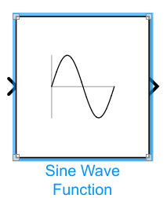
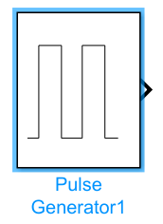
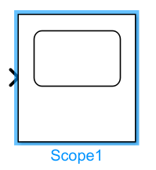

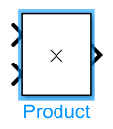
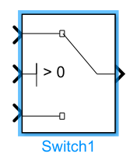
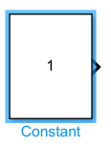
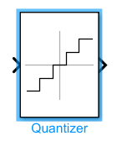
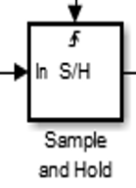
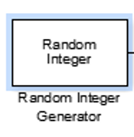

Simulink Library
MUX
Adder

Slide 7
ASK (Amplitude Shift Keying)
Amplitude-shift keying (ASK) is a form of amplitude modulation that represents digital data as variations in the amplitude of a carrier wave.
In an ASK system, the binary symbol 1 is represented by transmitting a fixed-amplitude carrier wave and fixed frequency for a bit duration of T seconds. If the signal value is 1 then the carrier signal will be transmitted; otherwise, a signal value of 0 will be transmitted.

Slide 8
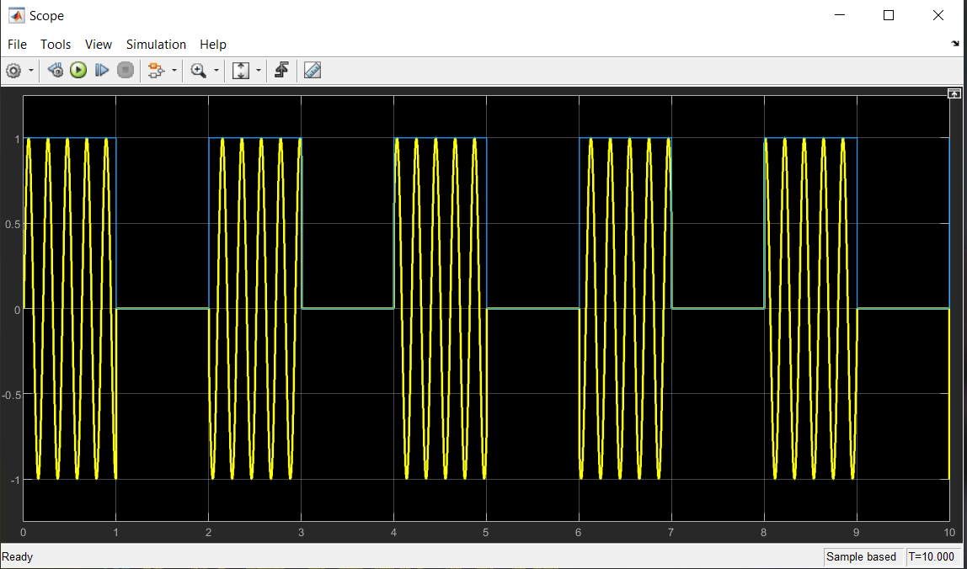
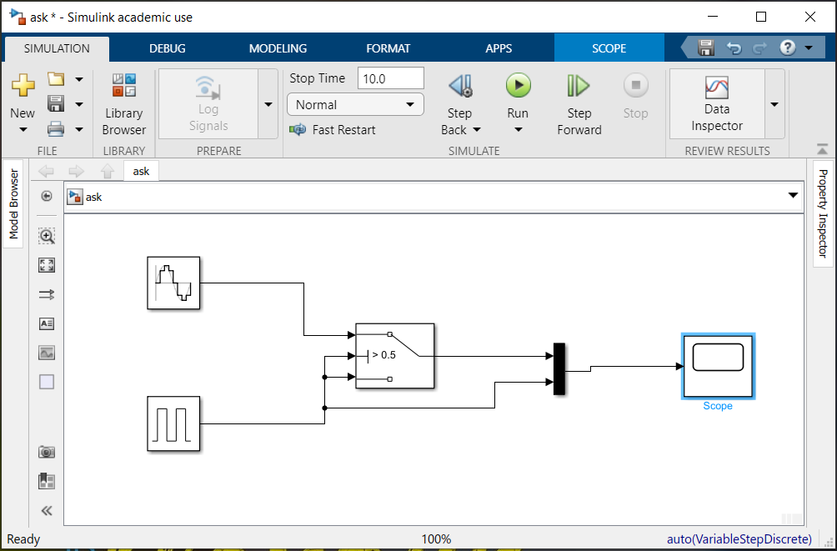
Snapshot of ASK

Slide 9
PSK (Phase Shift Keying)
Phase-shift keying (PSK) is a digital modulation process which conveys data by changing (modulating) the phase of a constant frequency reference signal (the carrier wave). The modulation is accomplished by varying the sine and cosine inputs at a precise time. It is widely used for wireless LAN’s, RFID and Bluetooth communication.
PSK uses a finite number of phases, each assigned a unique pattern of binary digits. Usually, each phase encodes an equal number of bits. Each pattern of bits forms the symbol that is represented by the particular phase.

Slide 10
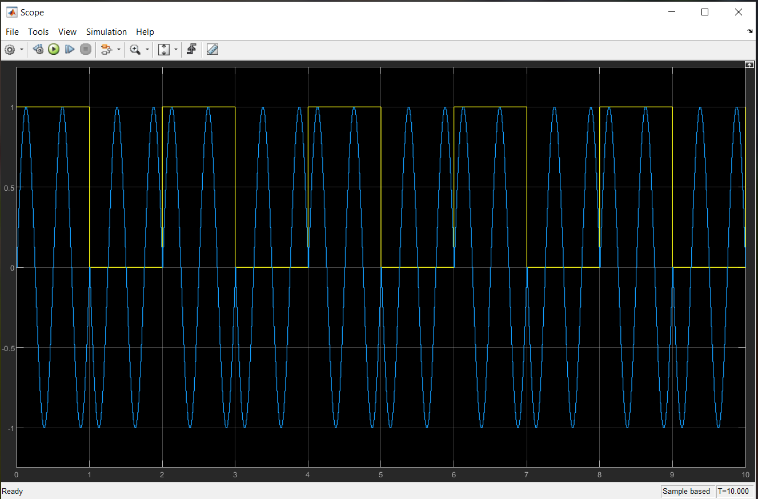
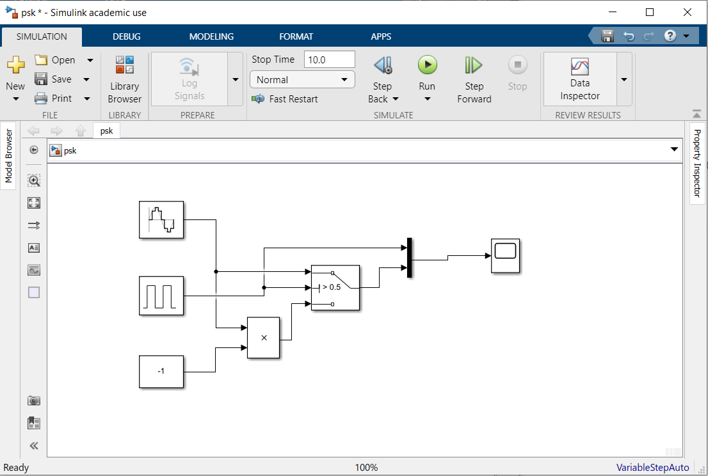
Snapshot of PSK

Slide 11
FSK (Frequency Shift Keying)
Frequency-shift keying (FSK) is a frequency modulation scheme in which digital information is transmitted through discrete frequency changes of a carrier signal. The technology is used for communication systems such as telemetry, weather balloon radiosondes, caller ID, garage door openers, and low frequency radio transmission in the VLF and ELF bands.
The simplest FSK is binary FSK (BFSK). BFSK uses a pair of discrete frequencies to transmit binary
(0’s and 1’s) information . With this scheme, the "1" is called the mark frequency and the "0" is
called the space frequency.

Slide 12
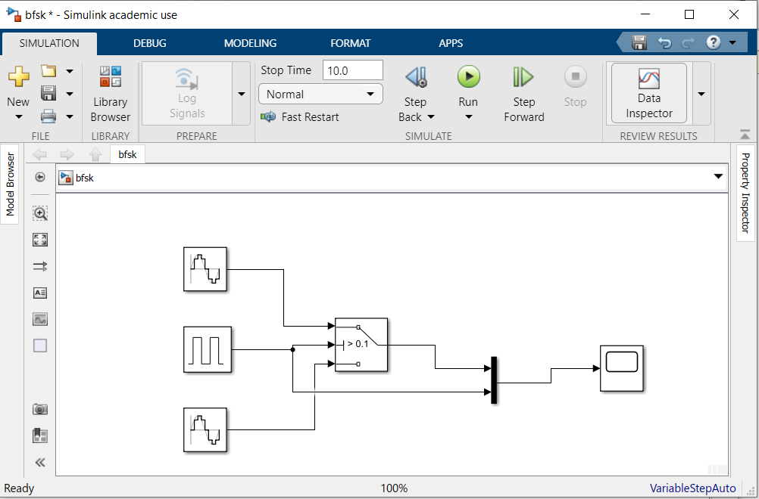
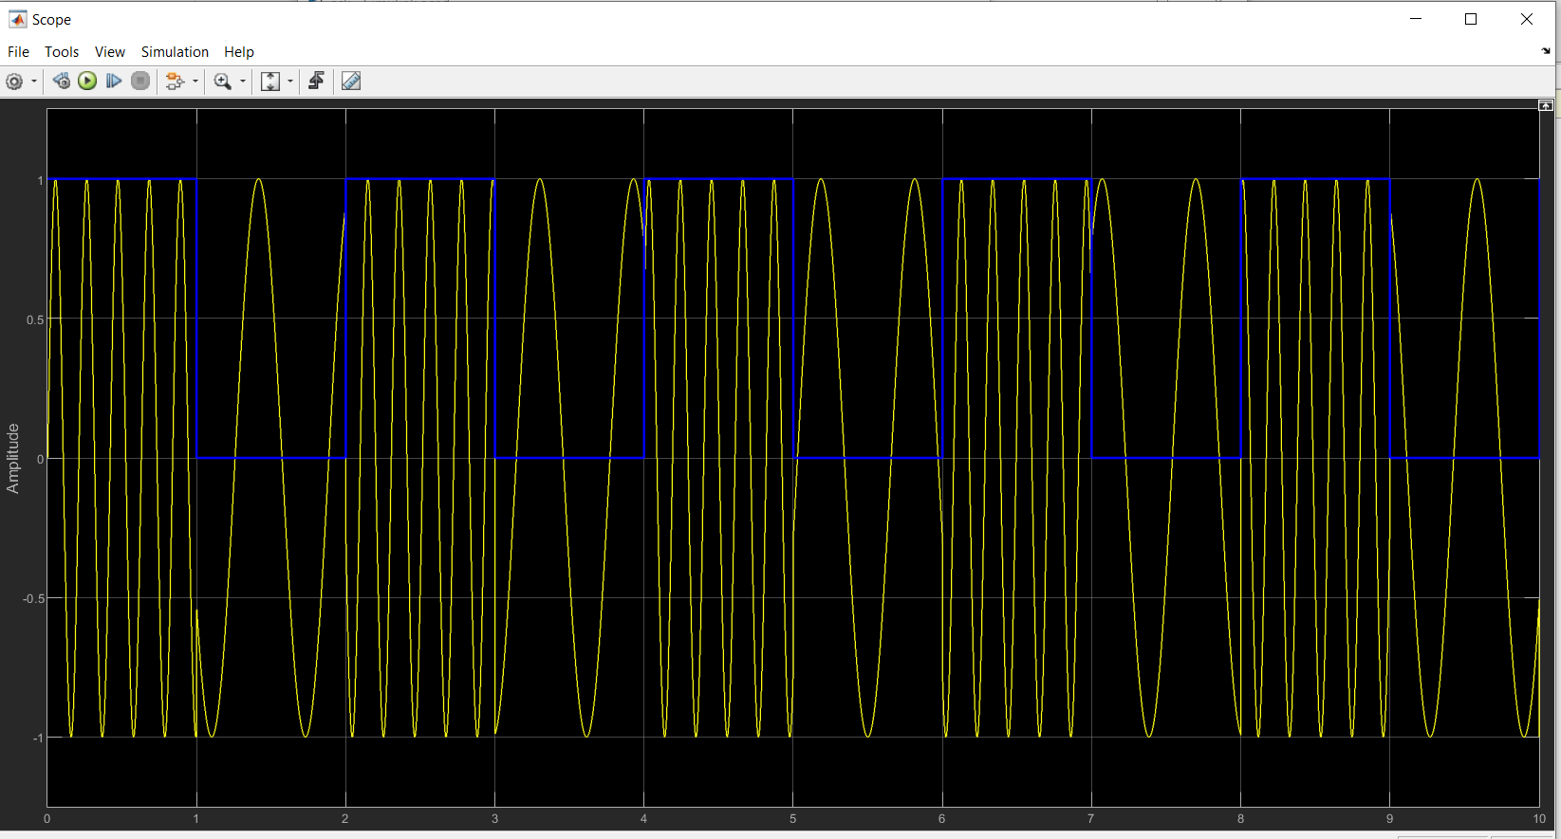
Snapshot of FSK

Slide 13
Polar RZ (Return-to-Zero)
Return-to-zero (RZ or RTZ) describes a line code used in telecommunications signals in which the signal drops (returns) to zero between each pulse. This takes place even if a number of consecutive 0s or 1s occur in the signal.
The signal is self-clocking. This means that a separate clock does not need to be sent alongside the signal, but suffers from using twice the bandwidth to achieve the same data-rate as compared to non-return-to-zero format.

Slide 14
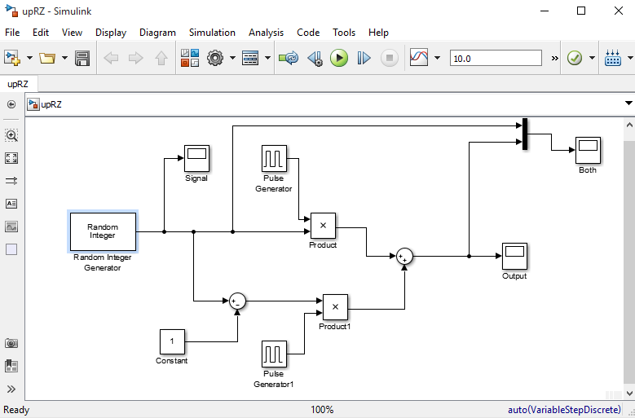
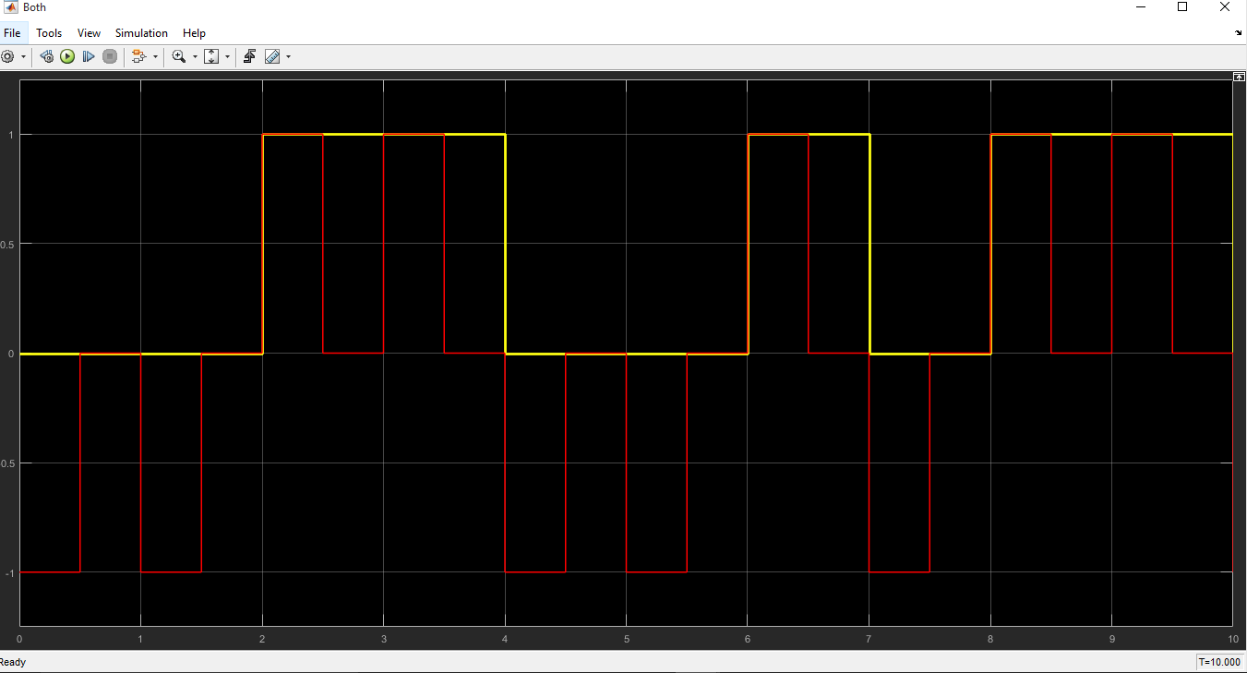
Snapshot of Polar RZ

Slide 15
Polar NRZ-L
In polar NRZ encoding, we use two levels of voltage amplitude. We can have two versionsof polar NRZ: NRZ-L and NRZ-I
NRZ-L : Non-Return-to-Zero Level
In NRZ-L the level of the voltage determines the value of the bit.
If there is a long sequence of 0s or 1s in NRZ-L, the average signal power becomes skewed.

Slide 16
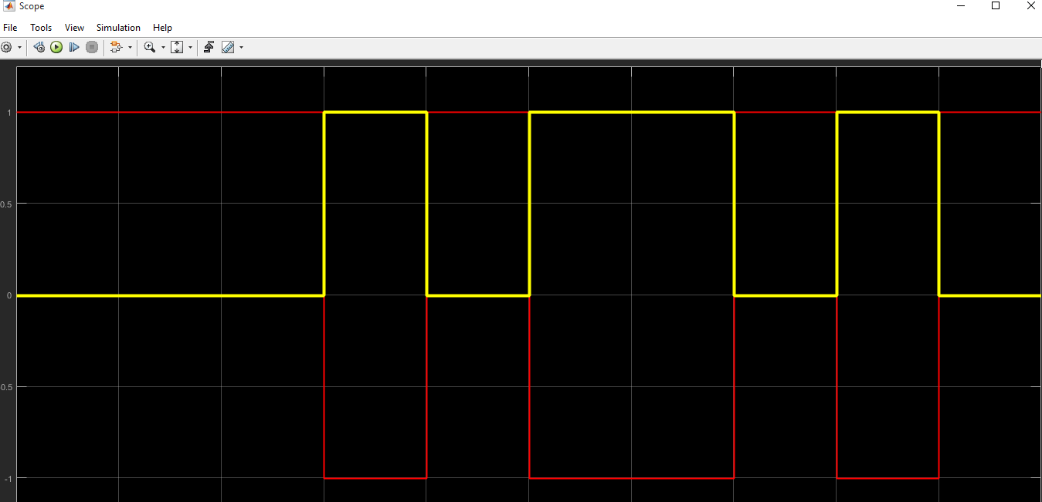
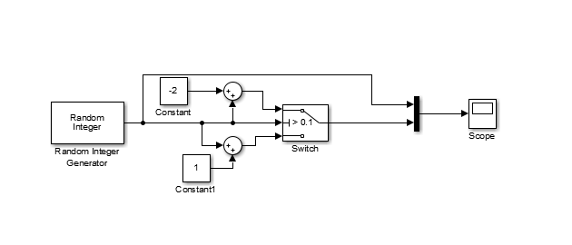
Screenshot of Polar NRZ-L

Slide 17
PCM (Pulse Code Modulation)
Pulse code modulation (PCM) is a digital representation of an analog signal that takes samples of the amplitude of the analog signal at regular intervals. The sampled analog data is changed to, and then represented by, binary data.
PCM requires a very accurate clock. The number of samples per second, ranging from 8,000 to 192,000, is usually several times the maximum frequency of the analog waveform in Hertz (Hz), or cycles per second, which ranges from 8 to 192 KHz.

Slide 18
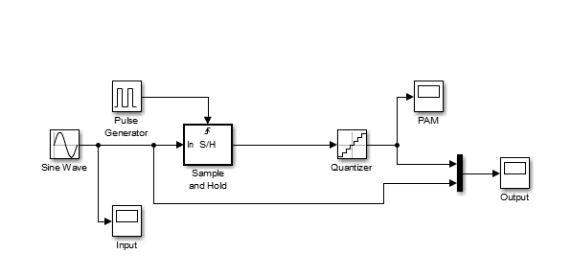
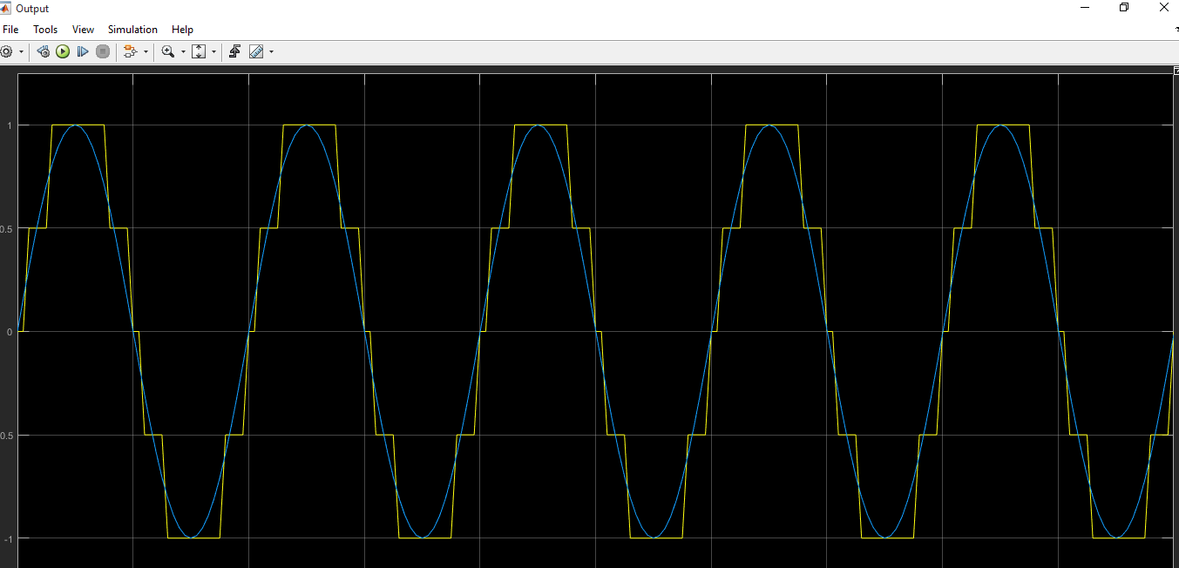
Snapshot of PCM

Slide 19
Delta Modulation
A delta modulation (DM or Δ-modulation) is an analog-to-digital and digital-to-analog signal conversion technique used for transmission of voice information where quality is not of primary importance.
DM is the simplest form of differential pulse-code modulation (DPCM) where the difference between successive samples are encoded into n-bit data streams. In delta modulation, the transmitted data are reduced to a 1-bit data stream.

Slide 20
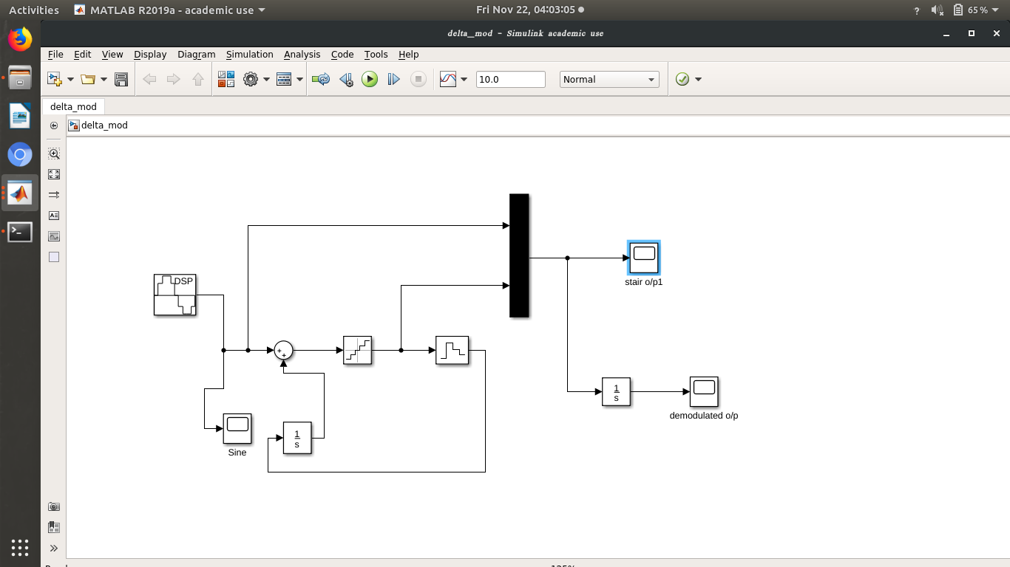
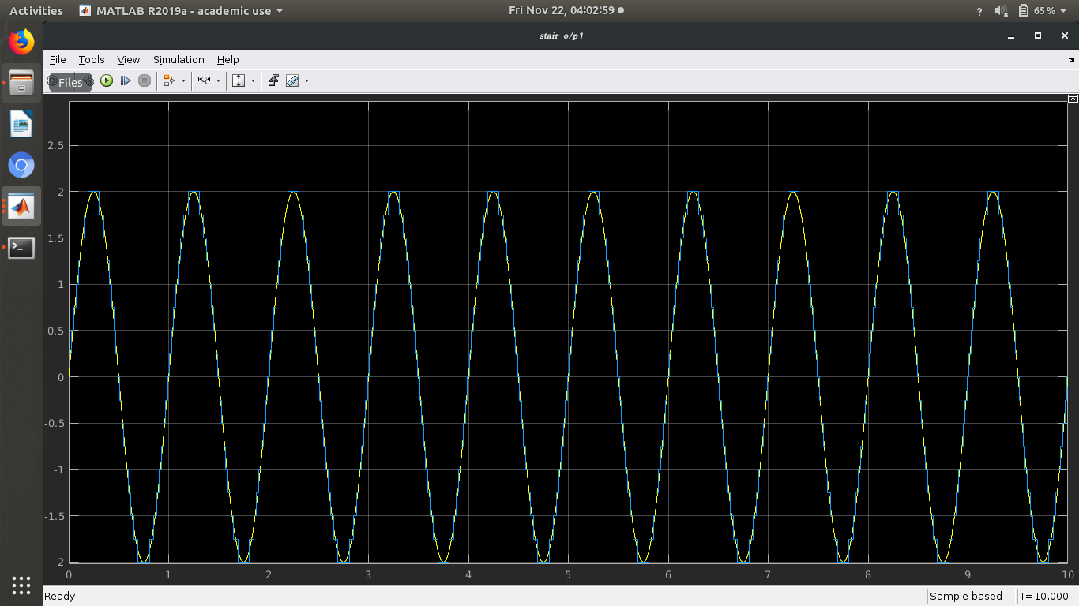
Snapshot of Delta Modulation

Slide 21
Conclusion
We have learned how to constuct a simple Simulink design.
As a conclusion, we can say that this sofware offers strong possibilities.
The utilisation is pretty easy for complex problem.
The components we use can be configured and it has components that allow for mathematical operations.
We can easily convert the model to c, c++, matlab etc.. Codes.

Slide 22
THANK YOU

