Slide 1
Interactive Sales Dashboard for Business Stakeholders
Designed using Tableau
By- Anandita Choudhary
05-06-2025

Slide 2
Objective & Dataset
Objective:
Design an interactive dashboard to help stakeholders monitor key business metrics and make informed decisions.
Dataset Used:
Superstore Sales Dataset (includes Order Date, Sales, Profit, Category, Region, etc.)

Slide 3
KPIs Selected
Key Performance Indicators (KPIs):
Total Sales
Total Profit
Profit Margin (%)
Sales Trend Over Time
Filters for Region, Category
These were chosen to provide a comprehensive view of sales performance and profitability.

Slide 4
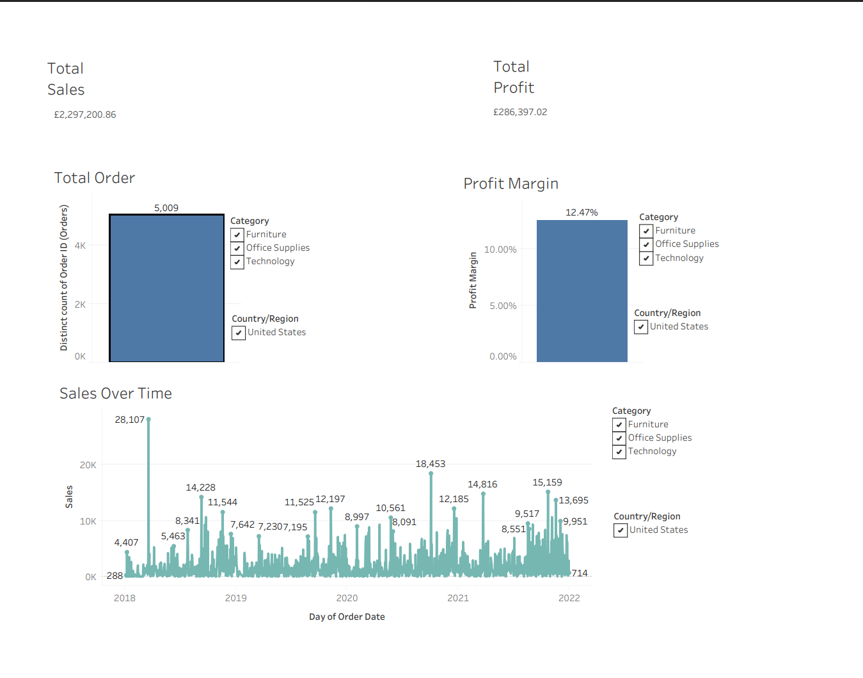
Dashboard Screenshot

Slide 5
Key Insights
Example Insights:
Sales steadily increased from 2020 to 2022.
The Technology category shows the highest profit margin.
East region had the highest total sales.
A slight dip in profit was observed in Q3 2021.

Slide 6
Filters & Interactivity
Filters Applied in Dashboard:
Region
Product Category
Time (by Year/Month)
Interactive Features:
Users can slice the data using filters.
Hover tooltips reveal details.
All KPIs and charts update based on filter selection.

Slide 7
Conclusion & Recommendations
Conclusion:
This interactive dashboard allows business stakeholders to track key metrics in real time and identify trends or issues quickly.
Recommendations:
Use this dashboard in monthly review meetings.
Extend KPIs by including Customer Segments or Discount analysis.
Embed dashboard in internal portals using Tableau Public or Server.

