Slide 1

Concurrency in Go
Part 3 of the Go Series
Anand Iyer

Slide 2
Topics
Goroutines
Concurrency vs Parallelism
Channels
Concurrency Patterns
Race detection
Deadlock
Visualization of Concurrency in go

Slide 3
Goroutines
It's an independently executing function, launched by a go statement.
It has its own call stack, which grows and shrinks as required.
It's very cheap. It's practical to have thousands, even hundreds of thousands of goroutines.
It's not a thread.

Slide 4
Concurrency vs Parallelism
Concurrency is not parallelism, although it enables parallelism.
If you have only one processor, your program can still be concurrent but it cannot be parallel.

Slide 5
Channels
Type safe message queues that have the intelligence to control the behavior of any goroutine attempting to receive or send on it
In-built synchronization
A type-safe pipe for communicating between different parts of your program
Don't communicate by sharing memory; share memory by communicating.

Slide 6
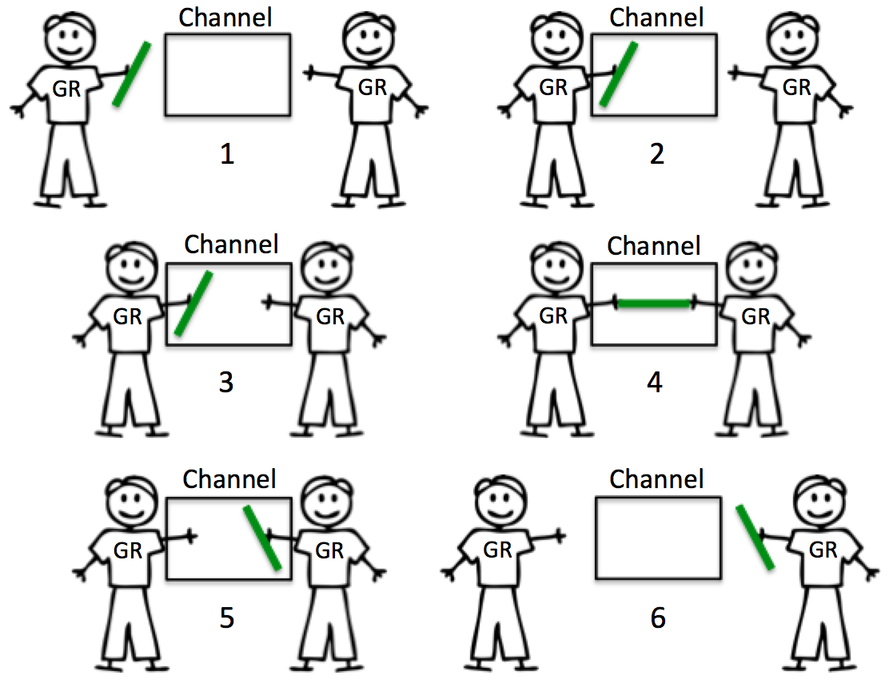
Unbufferred Channels

Slide 7
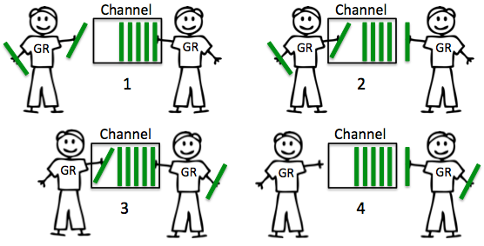
Bufferred Channels

Slide 8
Concurrency Patterns
Channels
Fan-In
Fan-Out/Workers
Servers(Handlers)
Concurrent Prime Sieve
Futures
Generators
Pipelines and Cancellations
Context

Slide 9
Race detection

Slide 10
Deadlock

Slide 11
Visualization Concurrency
http://divan.github.io/posts/go_concurrency_visualize/

Slide 12
References
https://www.goinggo.net/
https://blog.golang.org/concurrency-is-not-parallelism
https://blog.golang.org/advanced-go-concurrency-patterns
https://blog.golang.org/race-detector
http://divan.github.io/posts/go_concurrency_visualize/

Slide 13
Thank You
Gophers

