Slide 1

Introduction to Go
Go Kick Off
Anand Iyer

Slide 2
What is Go
Go (often referred to as golang) is a free and open source programming language created at Google in 2007.
Creators
Robert Griesemer
Rob Pike
Ken Thompson.

Slide 3
History of Go
Robert Griesemer, Rob Pike and Ken Thompson started sketching the goals for a new language on the white board on September 21, 2007.
By January 2008, Ken had started work on a compiler with which to explore ideas; it generated C code as its output. By mid-year the language had become a full-time project and had settled enough to attempt a production compiler.
In May 2008, Ian Taylor independently started on a GCC front end for Go using the draft specification.
Russ Cox joined in late 2008 and helped move the language and libraries from prototype to reality.
Go became a public open source project on November 10, 2009. Many people from the community have contributed ideas, discussions, and code.

Slide 4
Why Go
Go takes care of concurrency by default.
Go is compiled to machine code and is executed directly.
Stand-alone executables, with no external dependencies unless you specify them.
Simple & powerful primitives
Low Memory footprint
Go programs can talk to external C libraries or make native system calls.
Finally, none of the above comes at the cost of being able to talk to the underlying system.

Slide 5
Go is choice for
Cloud & microservices
Web servers
Systems utilities
Databases
Networking
Monitoring tools

Slide 6
Design Principles
Support for environment adopting patterns similar to dynamic languages.
Compilation time is fast.
InBuilt concurrency support: light-weight processes (via goroutines), channels, select statement.
Conciseness, Simplicity, and Safety
Support for Interfaces and Type embedding
Production of statically linked native binaries without external dependencies

Slide 7
Features excluded intentionally
No support for type inheritance
No support for method or operator overloading
No support for circular dependencies among packages
No support for pointer arithmetic
No support for assertions
No support for generic programming

Slide 8
Go vs Node.js
Maturity
Performance
Concurrency
Scalability
Ease of Development
Frontend & Backend
Packages & Tooling

Slide 9
Go vs Java
JVM
Memory Management
OOP (No Classes and Inheritence!)
Pointers
Concurrency
Generics
Exception Handling (Panic!)

Slide 10
Setting up Environment

Slide 11
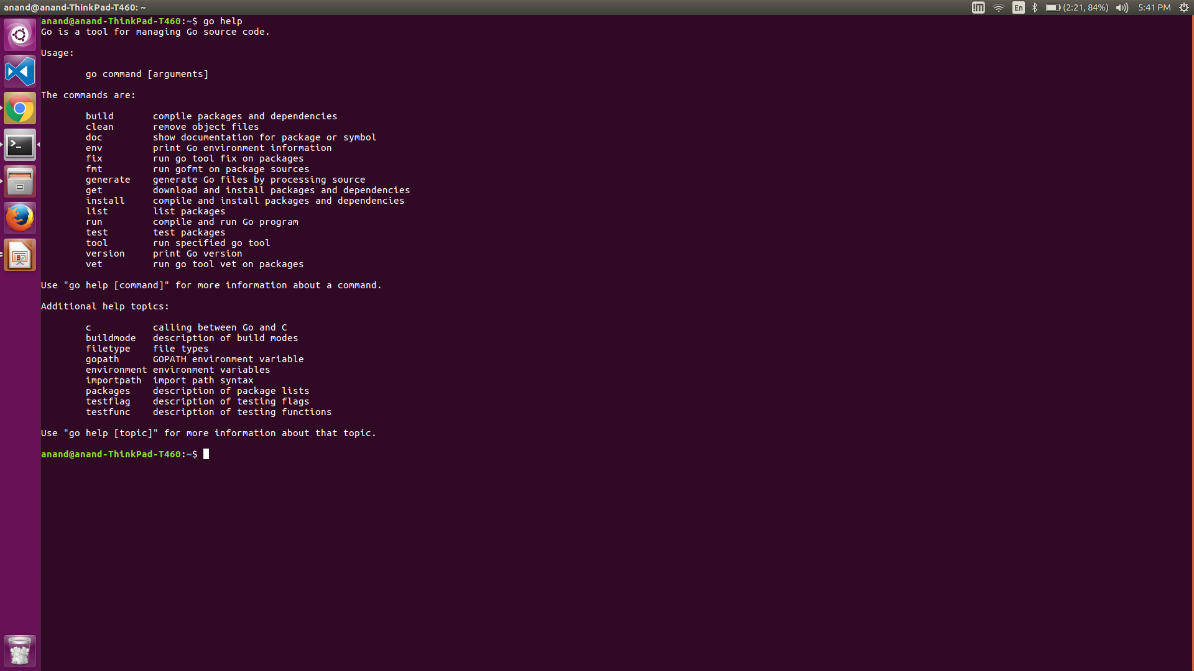
Go Command line

Slide 12
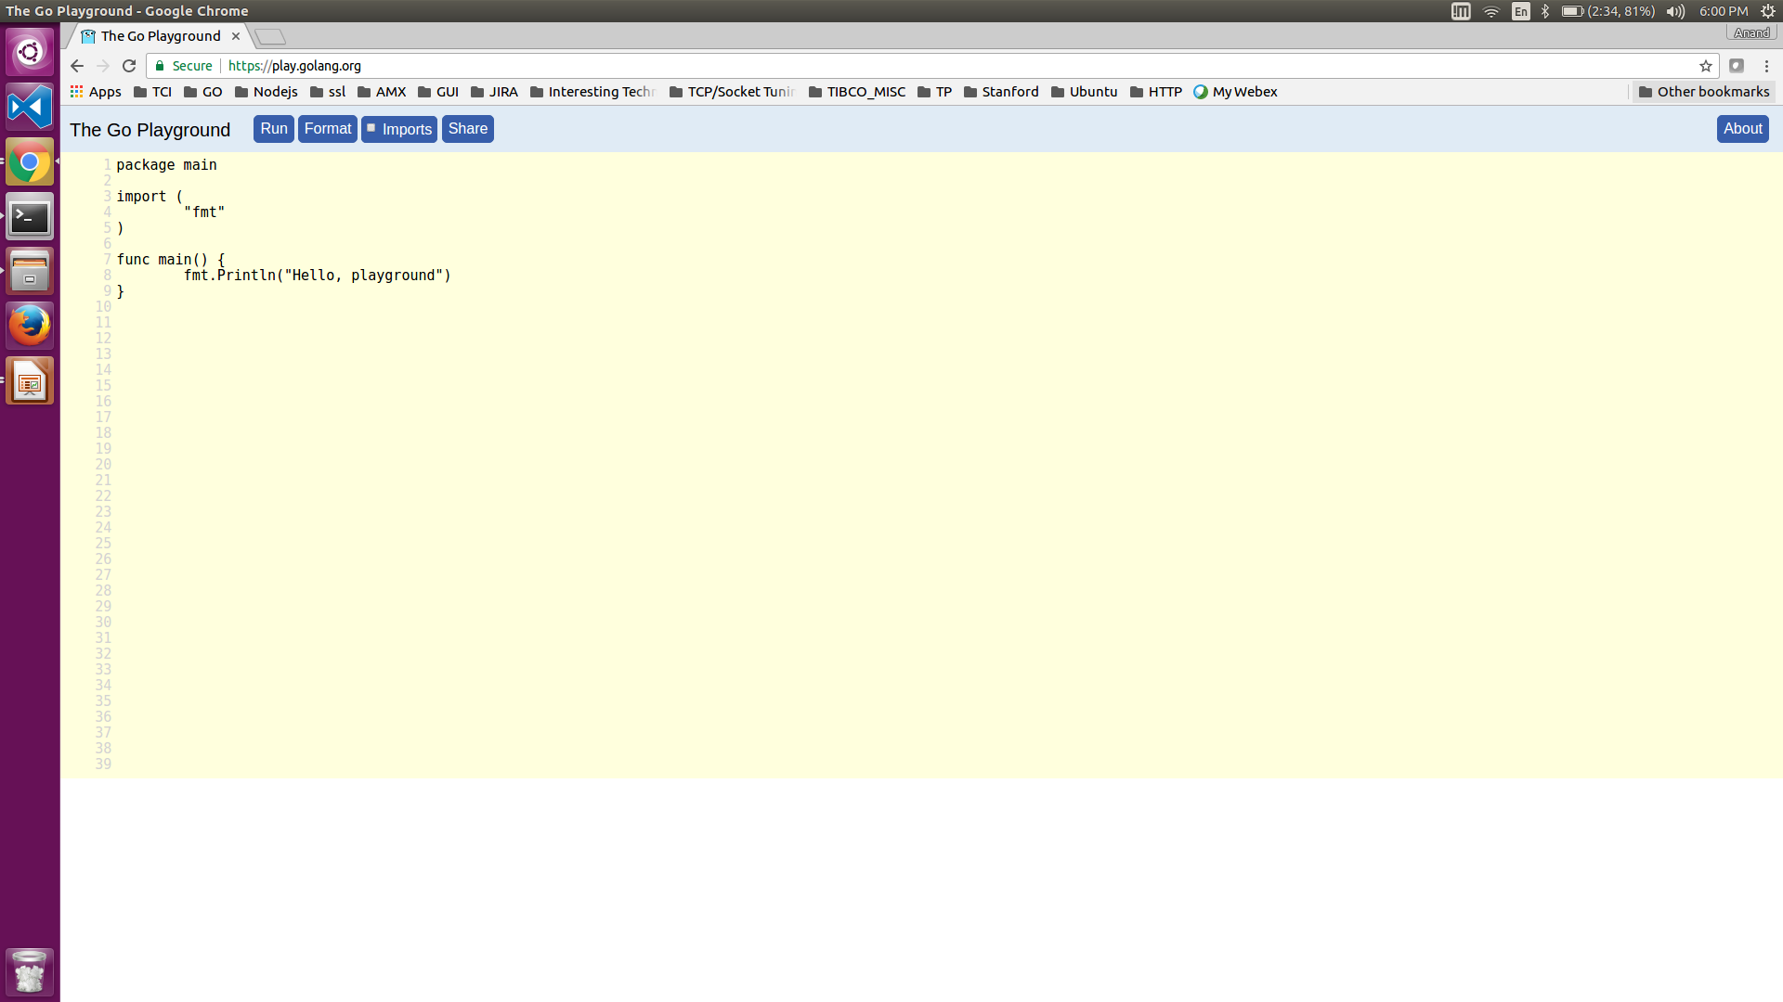
Go Playground
The online editor allows to write, build, run and also share it. Very popular editor in the stackoverflow for answers!

Slide 13
Concepts
Tokens
Line Separator
Data Types
Variables
Constants
Operators
Decision Making
Loops
Functions
Functions
Pointers
Arrays & Slice
Range & Maps
Make() and new()
Web Server

Slide 14
Functions
Function as value(on the fly)
Fucntion closures
Inline Fucntions
Fucntions with multiple return types

Slide 15
Pointers
Why we need it ?
Reasons why you would want to pass by reference as opposed to by value ?
Why you want to actually modify the receiver (“read/write” as opposed to just “read”) ?
Tip
If some of the methods on the struct have pointer receivers, the rest should too. This allows predictability of behavior

Slide 16
Memory Management
The Go runtime is statically linked into the application.
Memory is allocated and deallocated automatically
Use make() or new() to initalize
New():- Allocates but does not initialize memory.
Make():-Alocates and initializes memory
Whatever is out of scope or set to nil are eligible for GC. 1.5 has been re-written for low latency.

Slide 17
Lets Get Started

Slide 18
Thank You
Gophers

