Slide 1
Non-Blocking K-Ary Search Tree
Under the guidance of : Dr. Binoy Ravindran
Presented by : Himanshu Bedi
Anand Bangad

Slide 2
Agenda
Problem Statement
Project Objectives
Background - K-ary Search Tree
Related Work
Insertion and Deletion Algorithms
Experimental Analysis and validation
Results
References

Slide 3
Problem Statement
Design and implement a concurrent Non-Blocking K-ary Search Tree which supports the three basic operations, INSERT, SEARCH and DELETE.
Extend this implementation to work without Garbage Collector by using the concept of thread local pool of pre-allocated nodes.

Slide 4
Project Obectives
Implementation of a K-ary Search Tree Abstract Data Type
Implementation of a Non Blocking K-ay Search Tree
Implementation of Non Blocking K-ary Search Tree with Manual Memory Management

Slide 5
K-Ary Search Tree
32
63
84
8
17
23
33
42
51
71
78
91
97
37
39
44
45
48
4-Ary Search Tree

Slide 6
Initialization Of Tree
Root
∞
∞
∞
∞
∞
∞
Null
Null
Null
Null
Null
Null
Null

Slide 7
41
Simple Insertion
32
63
84
8
17
23
33
42
51
71
78
91
97
37
39
41
37
39
44
45
48
New Leaf Node
Old Leaf Node

Slide 8
49
Sprouting Insertion
32
63
84
8
17
23
33
42
51
71
78
91
97
37
39
44
45
48
45
48
49
44
45
48
49

Slide 10
Simple Deletion
Search
Delete(39)
32
63
84
8
17
23
33
42
51
71
78
91
97
37
37
39
44
45
48
New Leaf
Old Leaf

Slide 11
Sprouting Deletion
Search
Delete(37)
32
63
84
8
17
23
33
42
51
71
78
91
97
37
44
45
48

Slide 12
41
Search
Concurrent Simple Insertion
Thread (Insertion 50)
32
63
84
Parent
8
17
23
33
42
51
71
78
91
97
CAS
37
39
41
37
39
44
45
48
New Leaf Node
Old Leaf Node

Slide 13
49
Sprouting Insertion
Insert(49)
32
63
84
Parent
8
17
23
33
42
51
71
78
91
97
CAS
37
39
44
45
48
45
48
49
44
45
48
49

Slide 14
Second Thread
Search
Simple Deletion
GrandParent
32
63
84
CAS
Delete(39)
CAS
Parent
8
17
23
33
42
51
71
78
91
97
CAS
37
37
39
44
45
48
New Leaf
Old Leaf

Slide 15
Concurrent Pruning Deletion
Second Thread
Search
Delete(37)
GrandParent
32
63
84
CAS
CAS
CAS
Parent
8
17
23
33
42
51
71
78
91
97
37
44
45
48
Old Leaf

Slide 16
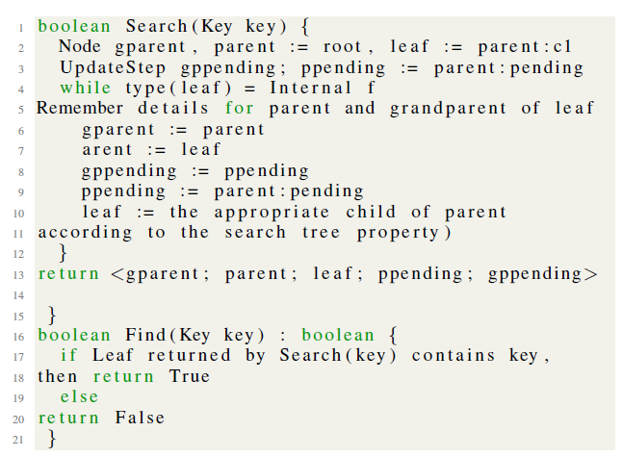
Pseudo Code Search

Slide 17
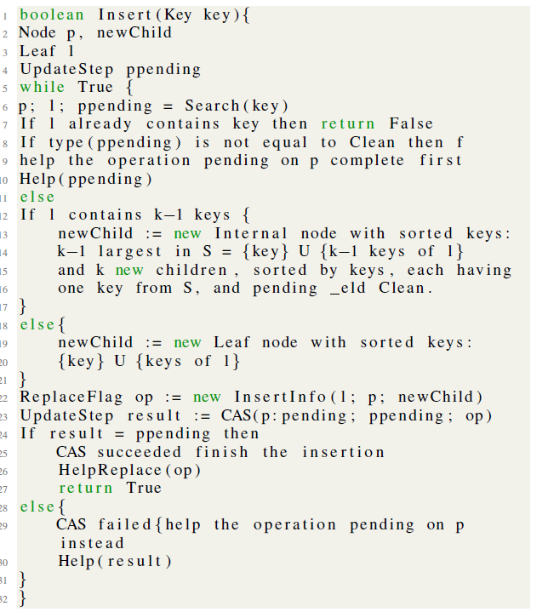
Pseudo Code Insertion

Slide 18
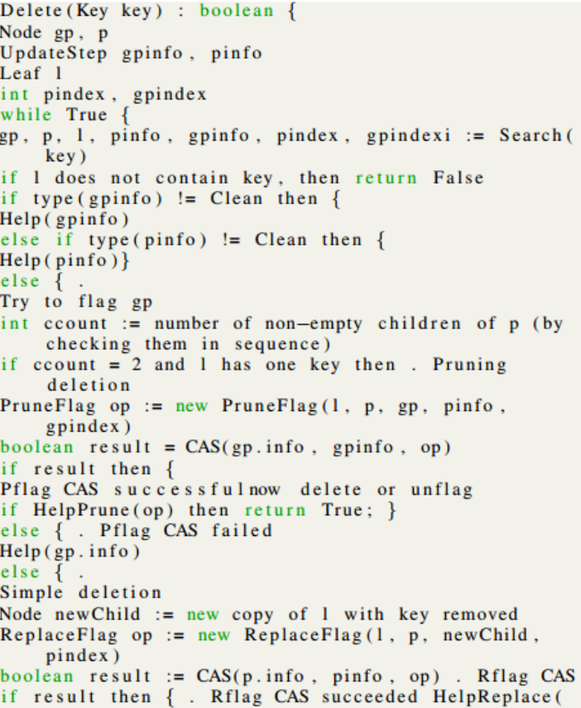
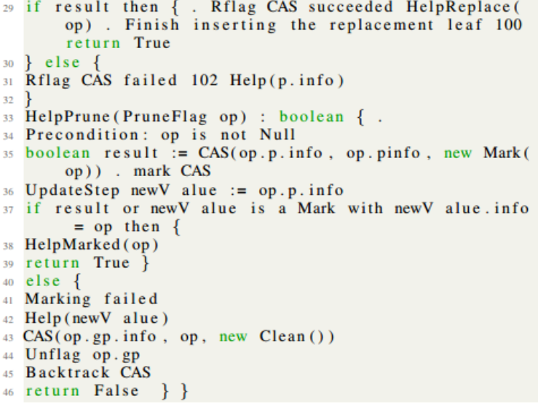
Delete – Pseudo Code

Slide 19
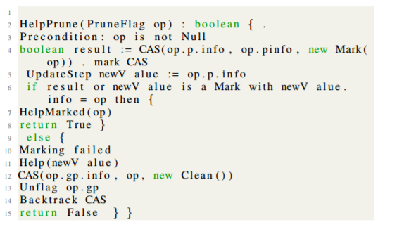
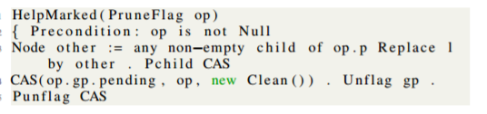
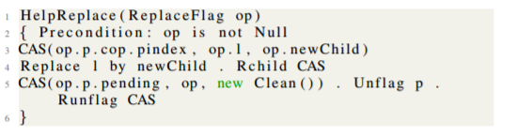
HelpMarked – Pseudo Code
HelpPrune – Pseudo Code
HelpReplace – Pseudo Code

Slide 20
Manual Memory Management
As seen from the previous slides the old leaf and the old internal node which were collected by garbage collector will now be stored in a thread local pool.
For creation of a new node it would be checked in the thread local pol, if it’s not available then we create a new node

Slide 21
ABA Problem Discussed
Sees already flagged
Insert(45)
Thread wakes up
CAS
Delete(45)
Offers help
Thread gets
descheduled
32
63
84
Insert Flag Raised
Does it’s own operation of delete
CAS
CAS
31
45
31
71
78
91
97
Unexpected Behaviour
Thread
Local Pool 1
Thread
Local Pool 2

Slide 22
Experimental Analysis
Performance analysis was calculated based on Throughput (op/sec) for each of our implementations.
Throughput = (InsertOperations + RemoveOperations +ContainOperations)/timeElapsed
Number of add and remove operations are varied in proportion with number of contains operations.
Experiments Performed:
Throughput vs Number of threads (for Fixed Contains Ratio)
Throughput vs Contains Ratio (for Fixed number of Threads)
Throughput vs Threads(for Varying k)
Throughput vs Number Of Threads(for Manual Memory Management)

Slide 23
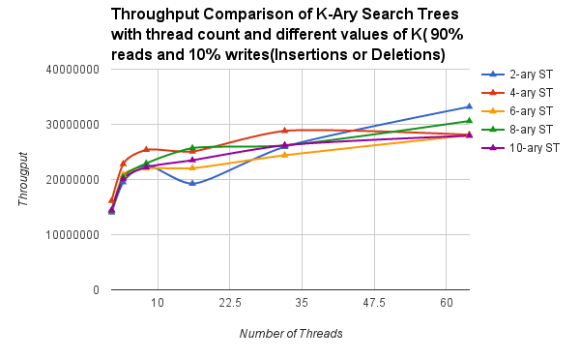
From this analysis we observe that throughput increases with increase in number of threads.
We get the best performance upto 42 threads when k = 4.
After 42 threads as value of k increases performance reduces.

Slide 24
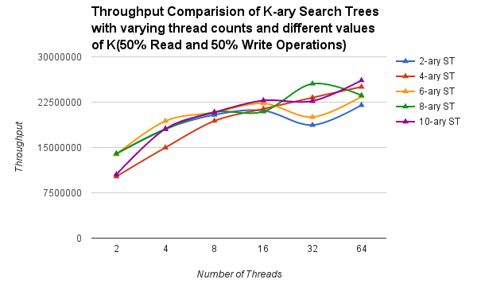
In this we have 25% Insert, 25% Delete and 50% Find.
With increase in number of threads throughput increases
The value of throughput increases with increase in value of k.

Slide 25
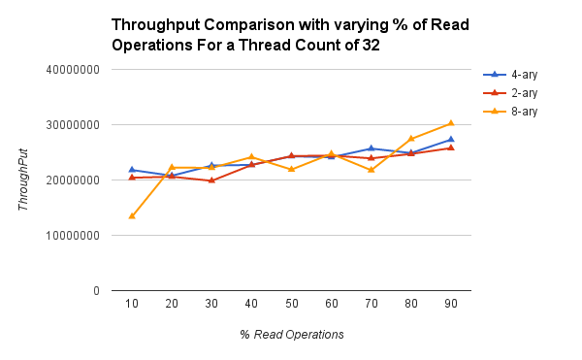
With increase in percentage of conatins throughput rises for increase in value of k

Slide 26
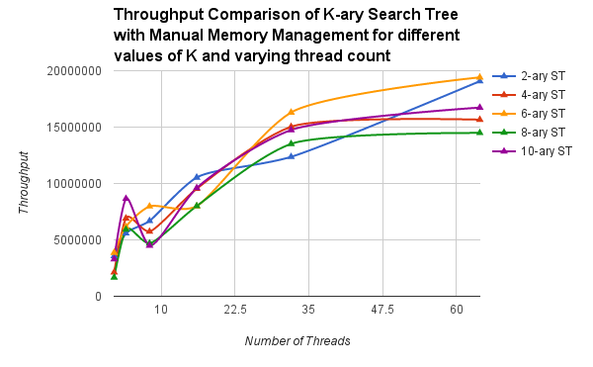

Slide 27
Thank You
Hope You enjoyed listening to it as much as we enjoyed doing the Project

