Slide 1
Online Shopping Mart Support Assistant
Retrieval-Augmented Generation (RAG) Architecture utilizing Snowflake Cortex AI
Technical Overview & Validation Results

Slide 2
The Business Challenge
E-Commerce support faces significant challenges:
  1. High Volume Queries: Support agents are overwhelmed with repetitive policy questions (shipping, returns, price matching).
  2. LLM Hallucinations: Standard generative AI cannot reliably answer company-specific policies without making up incorrect warranty or refund rules.
  3. Data Privacy: Enterprise CMS data cannot be leaked to public AI APIs.

Slide 3
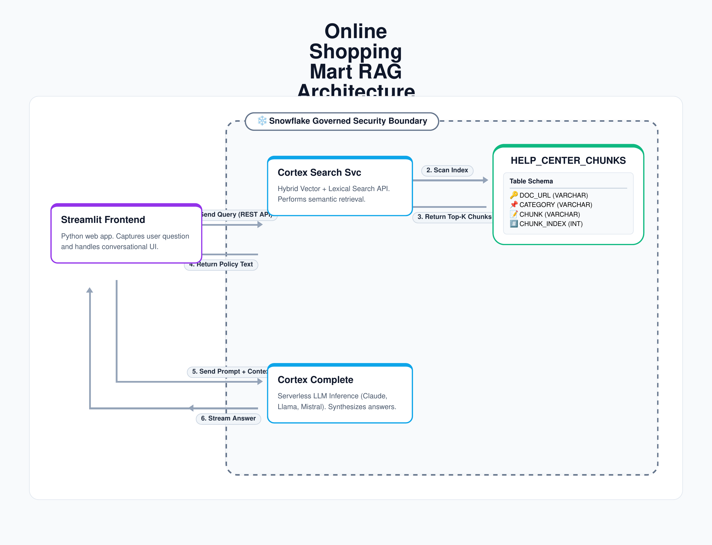

Slide 4
