Slide 1

DADI INSTITUTE OF ENGINEERING & TECHNOLOGY
TRANSPORTATION DEMAND PREDICTION
A
Proposed Project Power Point Presentation
Submitted in partial fulfilment of the requirements for the degree of
BACHELOR OF TECHNOLOGY
in
COMPUTER SCIENCE & ENGINEERING
By
Ella Kumar swamy (21U41A0510)
Kona Anand (21U41A0523)
Dosuru Sravanthi (22U45A0501)
Villuri Sasi Vardhan(22U45A0513)
Under the Supervision of
T.Santhoshi lakshmi , Assistant Professor, Department
Dadi Institute of Engineering & Technology
DEPARTMENT OF COMPUTER SCIENCE & ENGINEERING
DADI INSTITUTE OF ENGINEERING & TECHNOLOGY
(AN AUTONOMOUS INSTITUTE)
ANAKAPALLE - 531002, VISAKHAPATNAM, A.P.
MARCH - 2024

Slide 2
CONTENTS
ABSTRACT
INTRODUCTION
PROBLEM DEFINITION
EXISTING MODEL
SYSTEM STUDY
METHODOLOGY
SYSTEM DESIGN
RESULTS
CONCLUSION
D
I
E
T

Slide 3
ABSTRACT
Transportation demand prediction is a critical component for effective urban planning and infrastructure management. Accurate forecasting of transportation needs allows for optimized resource allocation, improved service delivery, and enhanced sustainability . DA4PT (Data Analytics for Public Transport), for discovering the factors that influence travelers in booking and purchasing bus tickets and analyzing transportation data to inform planning decisions, Transportation Demand Prediction uses machine learning and statistical modeling, to predict future transportation demand. Random Forest Regression model is used to examine correlations between factors and ticket sales using historical booking data and also offers a reliable foundation for forecasting ticket sales by MAE,MSE,RMSPE and by various statistical metrics . Deploying the model with Random Forest Regressor with the parameters with 3 fold cross validation. I found that for training data there is a R2 score of 61.11% which means the model has predicted well on the datapoints.This leads to low bias. Also the model has a R2 score of 61.54%. The variance in model is also low. The ticket booking platform can enhance revenue by utilizing these insights to optimize methods and generate additional revenue streams by incorporating these data into their business plan.
KEYWORDS: Transportation, Travel Time Analysis , Random Forest Regression , Revenue Sales Prediction
D
I
E
T

Slide 4
INTRODUCTION
The project " Transportation Demand Prediction " addresses the growing need for efficient and intelligent ticket management systems across various industries, such as airlines, railways, and entertainment. Ticket booking trends are influenced by numerous factors, including seasonal variations, special events, pricing strategies, and customer behavior. Traditional methods of managing ticket allocation often fall short in accurately predicting demand, leading to either overbooking or underutilization of resources. This project leverages the power of regression analysis to develop a predictive model that optimizes ticket booking and enhances overall operational efficiency
The motivation for this project stems from the challenges faced by businesses and organizations in accurately forecasting ticket bookings. In the competitive travel and entertainment industries, precise demand predictions are crucial for optimizing inventory, pricing strategies, and resource allocation. Traditional methods often fall short in accuracy and efficiency, leading to overbooking or underbooking issues
D
I
E
T

Slide 5
Problem Definition
The primary problem addressed by this project is the lack of accurate and reliable forecasting for ticket bookings. Current systems may rely on simplistic or outdated methods that fail to account for complex patterns and trends in booking data. This can lead to inefficiencies in inventory management, revenue optimization, and customer satisfaction.
Specifically, the problems include:
Inaccurate Predictions: Existing methods may not capture the intricacies of booking trends, leading to unreliable forecasts.
Inefficient Resource Allocation: Poor predictions can result in either overbooking or underbooking, affecting operational efficiency and customer satisfaction.
Limited Data Utilization: Traditional systems may not fully leverage historical data or external factors that influence booking patterns
D
I
E
T

Slide 6
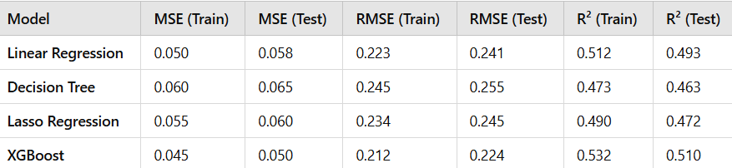
EXISTING SYSTEM
DA4PT (Data Analytics for Public Transport)is a widely used model in transportation planning. DA4PT, for discovering the factors that influence travelers in booking and purchasing bus tickets. DA4PT focuses on analyzing transportation data to inform planning decisions. DA4PT uses XGBoost for the model implementation with R2(0.51%)
Models Used in existing systems:
Models Used in existing systems:
Drawbacks of DA4PT:
1.Limited to small data
2. Less accuracy
3.Not adaptable
4. Less suitable for long term prediction
D
I
E
T

Slide 7
METHODOLOGY
1.Data Preprocessing: Collected data from relevant sources will be cleaned and preprocessed to remove any inconsistencies or missing values. Feature engineering techniques will be applied to create meaningful features that capture the essence of booking patterns based on date, time, price, special events, holidays, and customer demographics.
2.Model Implementation: Developing multiple regression models to capture the relationship between the features and ticket bookings. This involves training models using the historical data and tuning hyperparameters to optimize performance.
3.Model Evaluation: Evaluating the models using metrics such as Mean Absolute Error (MAE), Mean Squared Error (MSE), and R-squared. Cross-validation techniques will be used to ensure the robustness of the models.
4.Prediction and Analysis: Using the optimized model [Random Forest CV]to predict future ticket bookings. The predictions will be analyzed to identify trends and provide actionable insights for decision-making.
5.User Interface Development: Creating an interactive interface that allows users to input new data, view predictions, and generate reports. The interface will be designed to be intuitive and user-friendly, enabling stakeholders to make informed decisions.[Python-Streamlit]
D
I
E
T

Slide 8
Frontend Technologies:
Web Framework (Optional, if full-stack): Streamlit (Python-based, quick to build interactive ML dashboards)
Visualization Libraries: Plotly, Matplotlib, Seaborn for graphsV
Backend Technologies:
Data Acquisition, Collection & Handling:pandas, numpy for preprocessing and temporal/spatial enrichmentgeopandas for spatial data
Data Analysis & Feature Engineering:
Processing:pandas, dask (for large datasets)
                Feature Engineering:scikit-learn, Feature-engine, tsfresh (for temporal/spatial features)
                Model Training:
                Machine Learning/Regression:
                scikit-learn (regression, pipeline models)
                Randomforest, XGBoost, LightGBM (if advanced performance needed)
D
I
E
T

Slide 9
Integration & Deployment Tools:
                Docker (containerization)
                GitHub Actions or Jenkins (CI/CD)
                AWS/GCP/Azure for cloud deployment
                Heroku or Render for simpler deployment
D
I
E
T

Slide 10
SYSTEM STUDY
Data Collection: Gather data on transportation modes, routes, volumes, and patterns from mobiticket App.
Data Analysis: Examine data to identify trends, patterns, and correlations.
Route Choice Modeling: Study how people choose routes.
Market Segmentation: Divide the market into segments based on demographics, travel behavior, and other factors.
Travel Demand Modeling: Use models to forecast travel demand based on factors like population growth, land use, and transportation infrastructure.
Validation: Model cross-validation is a technique used to evaluate the performance of a machine learning model by training and testing it on multiple subsets of the data. This helps to ensure that the model is not overfitting or underfitting and provides a more accurate estimate of its performance.
By conducting a system study for transportation demand prediction, planners and policymakers can make informed decisions about infrastructure investments, transportation services, and policies to manage demand and reduce congestion
D
I
E
T

Slide 11
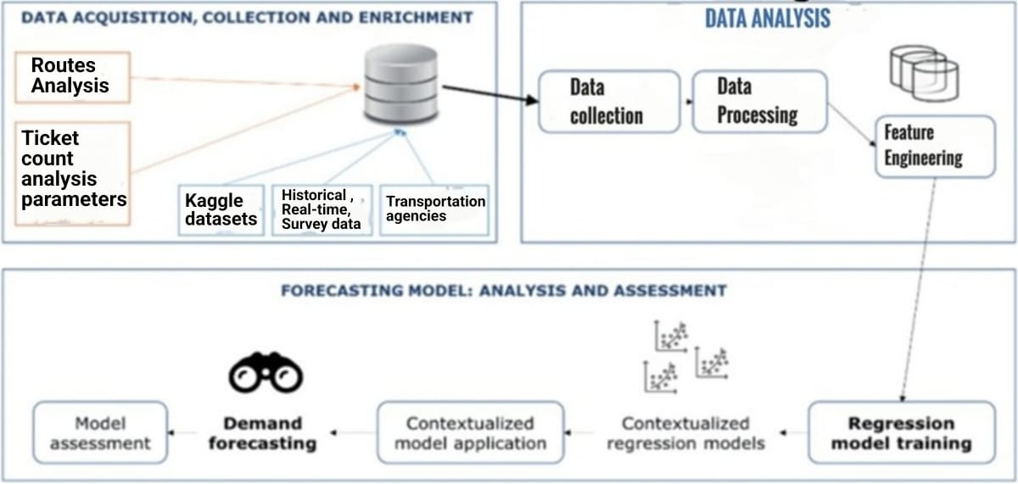
SYSTEM DESIGN
.
:
:
:
:
:
TRANSPORTATION DEMAND PREDCTION DESIGN
D
I
E
T

Slide 12
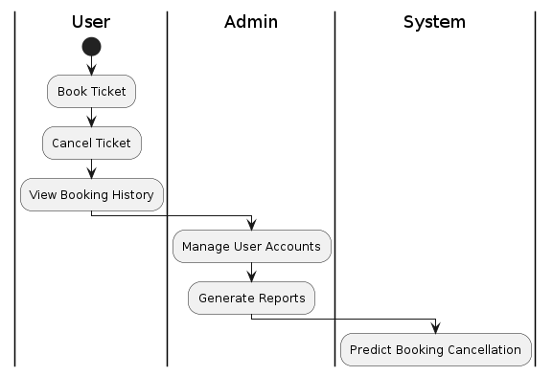
UML DIAGRAMS(USE CASE DIAGRAM):
D
I
E
T

Slide 13
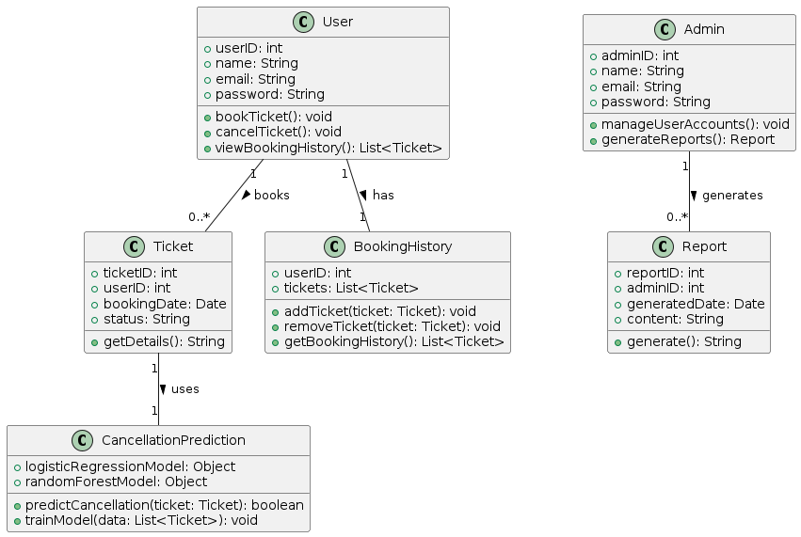
UML DIAGRAMS(CLASS DIAGRAM):
D
I
E
T

Slide 14
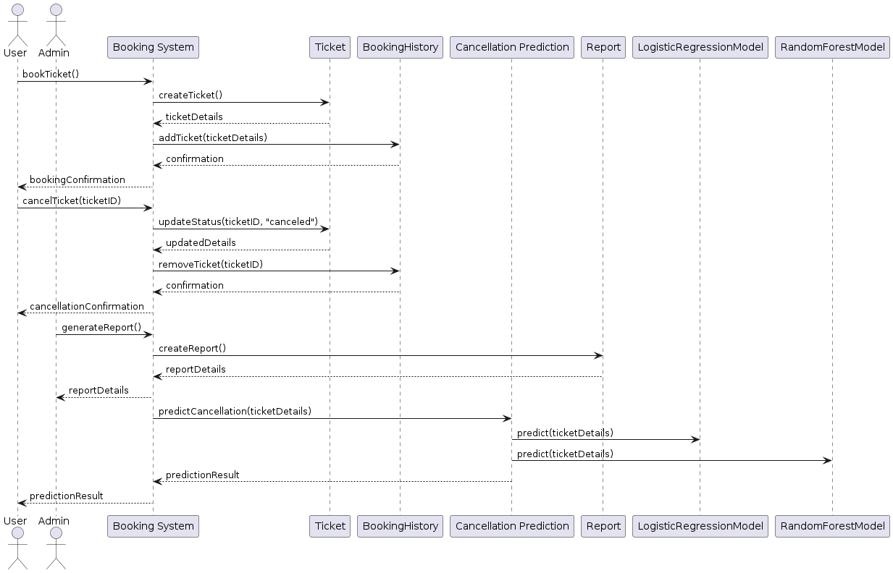
UML DIAGRAMS(SEQUENCE DIAGRAM):
D
I
E
T

Slide 15
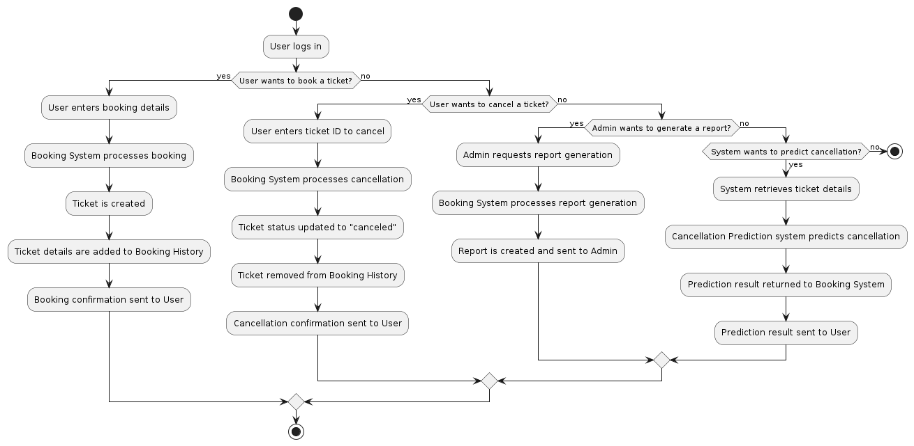
UML DIAGRAMS(ACTIVITY DIAGRAM):
D
I
E
T

Slide 16
TEST CASES:
Test Case ID | Module | Test Description | Expected Result | Status
TC001 | Data Collection | Verify data ingestion from CSV file | Data is correctly ingested and stored in the database | Pass
TC002 | Data Preprocessing | Test handling of missing values | Missing values are filled or removed appropriately | Pass
TC003 | Prediction Model | Validate model training with historical data | Model trains without errors and performs as expected | Pass
TC004 | Prediction Model | Check model prediction accuracy | Predictions match expected values with acceptable error | Pass
TC005 | Web Interface | Test data input form submission | Form data is correctly processed and results are displayed | Pass
TC006 | Web Interface | Verify result display and visualizations | Results and visualizations are displayed correctly | Pass
TC007 | Performance | Measure system response time for predictions | Response time is within the acceptable limit (e.g., 5 seconds) | Pass
TC008 | Security | Test user authentication and authorization | Access is restricted based on user roles and credentials | Pass
TC009 | Usability | Assess ease of navigation and form usability | Interface is intuitive and easy to navigate | Pass
TC010 | Integration | Check data flow between modules | Data flows correctly between data collection, preprocessing, and prediction modules | Pass
D
I
E
T

Slide 17
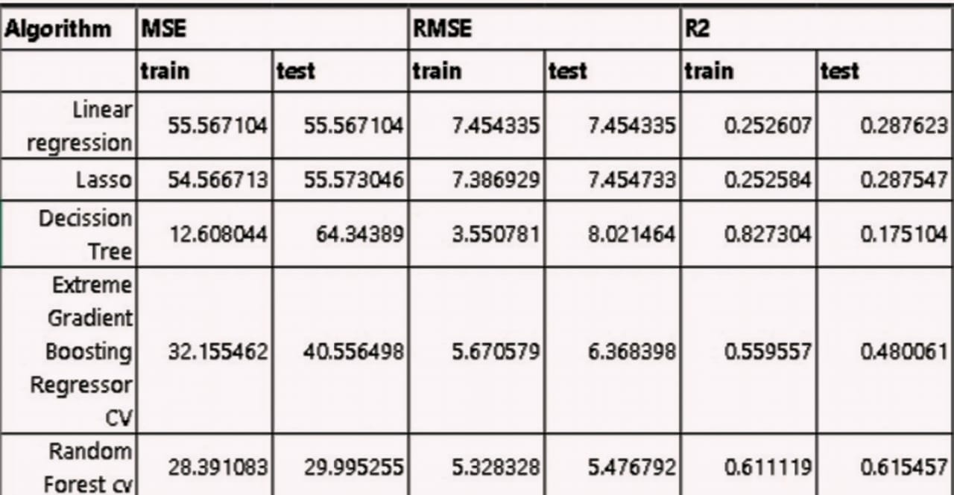
RESULTS
CLASSIFICATION OF ALGORITHMS
The model has predicted well at training. I found that for training data there is a R2 score of 61.11% which means the model has predicted well on the datapoints. Which means low bias. Also the model has a R2 score of 61.54%. The variance in model is also low. This is the best performing model I have found.
D
I
E
T

Slide 18
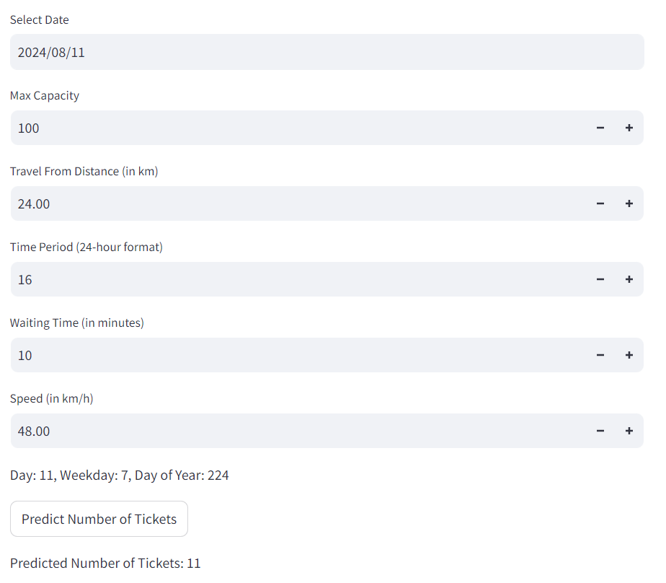
OUTPUT 1
D
I
E
T

Slide 19
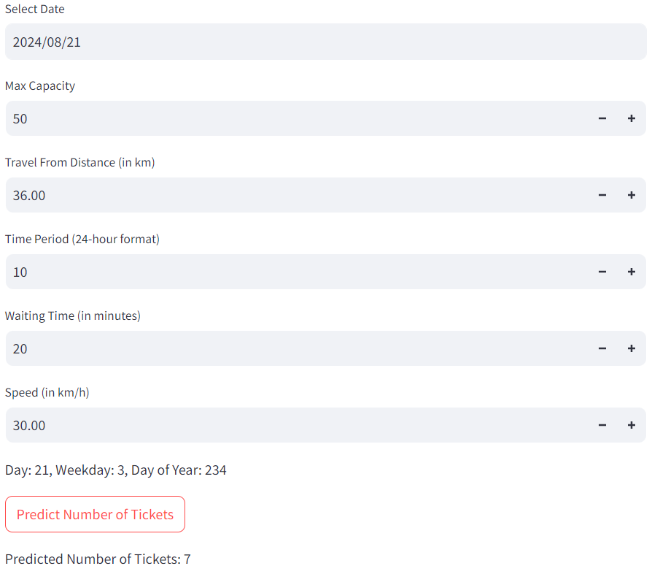
OUTPUT 2
D
I
E
T

Slide 20
CONCLUSION
The " Transportation Demand Prediction " project leverages predictive modeling to forecast ticket bookings based on historical data. By implementing various regression algorithms and integrating them into a user-friendly web interface, the project aims to provide accurate predictions and valuable insights for booking management. The project includes extensive testing, such as unit, integration, functional, performance, usability, security, regression, and acceptance testing, to guarantee dependability, performance, and usability. Future improvements could include enhanced modeling techniques, real-time data processing, mobile support, and advanced analytics. With a clear focus on robust system design, effective data handling, and user-friendly interactions, the project aims to deliver a reliable and insightful ticket booking prediction tool that meets the needs of its users and stakeholders.
D
I
E
T

Slide 21
THANK YOU
D
I
E
T

