Slide 1

DADI INSTITUTE OF ENGINEERING & TECHNOLOGY
TRANSPORTATION DEMAND FORECASTING
By
ELLA KUMAR SWAMY (21U41A0510)
KONA ANAND (21U41A0523)
DOSURU SRAVANTHI (22U45A0501)
VILLURI SASI VARDHAN (22U45A0513)
Under the Supervision of
Mrs. T.SANTOSHI LAKSMHI
Assistant professor, CSE
Dadi Institute of Engineering & Technology
DEPARTMENT OF ELECTRONICS & COMMUNICATION ENGINEERING
DADI INSTITUTE OF ENGINEERING & TECHNOLOGY
(AN AUTONOMOUS INSTITUTE)
ANAKAPALLE - 531002, VISAKHAPATNAM, A.P.
MARCH - 2024

Slide 2
Abstract
Transportation demand prediction is a critical component for effective urban planning and infrastructure management. Accurate forecasting of transportation needs allows for optimized resource allocation, improved service delivery, and enhanced sustainability . DA4PT (Data Analytics for Public Transport), for discovering the factors that influence travelers in booking and purchasing bus tickets. DA4PT focuses on analyzing transportation data to inform planning decisions, Transportation Demand Prediction uses machine learning and statistical modeling, to predict future transportation demand. Random Forest Regression model is used to examine correlations between factors and ticket sales using historical booking data.Refined Random Forest Regression model offers a reliable foundation for forecasting ticket sales by Mean Absolute Error ,Mean Squared Error, R-squared value of , RMSPE and by various statistical metrics . Deploying the model with Random Forest Regressor with the parameters with 3 fold cross validation. I found that for training data there is a R2 score of 63.46% which means the model has predicted well on the datapoints.This leads to low bias. Also the model has a R2 score of 63.93%. The variance in model is also low. The ticket booking platform can enhance revenue by utilizing these insights to optimize methods and generate additional revenue streams by incorporating these data into their business plan.
KEYWORDS: Transportation, Travel Time Analysis , Random Forest Regression , Revenue Sales Prediction

Slide 3
Introduction
The project "Ticket Booking Using Regression" addresses the growing need for efficient and intelligent ticket management systems across various industries, such as airlines, railways, and entertainment. Ticket booking trends are influenced by numerous factors, including seasonal variations, special events, pricing strategies, and customer behavior. Traditional methods of managing ticket allocation often fall short in accurately predicting demand, leading to either overbooking or underutilization of resources. This project leverages the power of regression analysis to develop a predictive model that optimizes ticket booking and enhances overall operational efficiency.

Slide 4
Problem Definition
The primary problem addressed by this project is the lack of accurate and reliable forecasting for ticket bookings. Current systems may rely on simplistic or outdated methods that fail to account for complex patterns and trends in booking data. This can lead to inefficiencies in inventory management, revenue optimization, and customer satisfaction.
Specifically, the problems include:
Inaccurate Predictions: Existing methods may not capture the intricacies of booking trends, leading to unreliable forecasts.
Inefficient Resource Allocation: Poor predictions can result in either overbooking or underbooking, affecting operational efficiency and customer satisfaction.
Limited Data Utilization: Traditional systems may not fully leverage historical data or external factors that influence booking patterns.

Slide 5
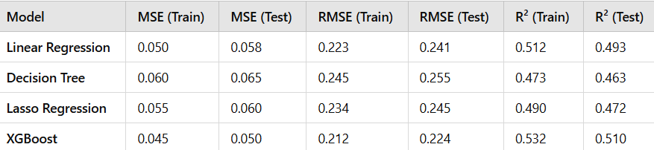
Existing System
DA4PT (Data Analytics for Public Transport)is a widely used model in transportation planning. DA4PT, for
discovering the factors that influence travelers in booking and purchasing bus tickets. DA4PT focuses on
analyzing transportation data to inform planning decisions.
Models Used in existing systems:
Drawbacks of DA4PT:
1.Limited to small data
2. Less accuracy ,
3.Not adaptable
4. Less suitable for long term prediction

Slide 6
System Study
Data Collection: Gather data on transportation modes, routes, volumes, and patterns.
Data Analysis: Examine data to identify trends, patterns, and correlations.
Route Choice Modeling: Study how people choose routes.
Market Segmentation: Divide the market into segments based on demographics, travel behavior, and other factors.
Travel Demand Modeling: Use models to forecast travel demand based on factors like population growth, land use, and transportation infrastructure.
Validation: Model cross-validation is a technique used to evaluate the performance of a machine learning model by training and testing it on multiple subsets of the data. This helps to ensure that the model is not overfitting or underfitting and provides a more accurate estimate of its performance.
By conducting a system study for transportation demand prediction, planners and policymakers can make informed decisions about infrastructure investments, transportation services, and policies to manage demand and reduce congestion

Slide 7
Methodology
Regression Model :
Regression models are a type of supervised learning algorithm that predict a continuous output variable based on one or more input features.
Random Forest :
Random Forest is a popular supervised learning algorithm that uses an ensemble of decision trees to predict outputs.
Decision Tree :
Decision Tree is a supervised learning algorithm that uses a tree-like structure to classify data or predict continuous values.
XGBoost :
XGBoost (Extreme Gradient Boosting) is a popular machine learning algorithm that uses gradient boosting to build predictive models. It's particularly well-suited for structured or tabular data.

Slide 8
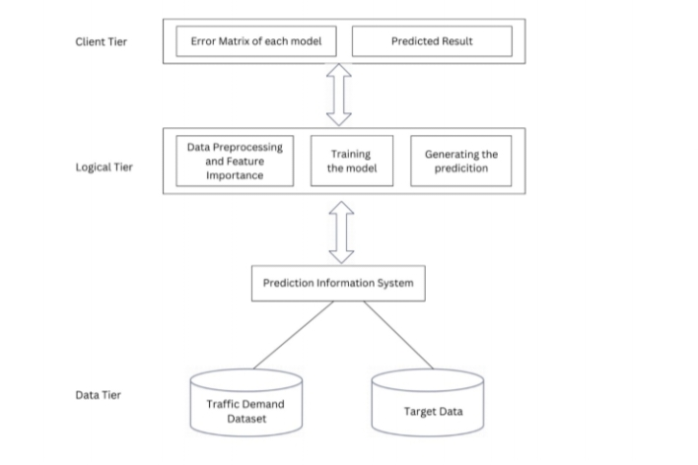
System Design
TRANSPORTATION DEMAND PREDCTION DESIGN

Slide 9
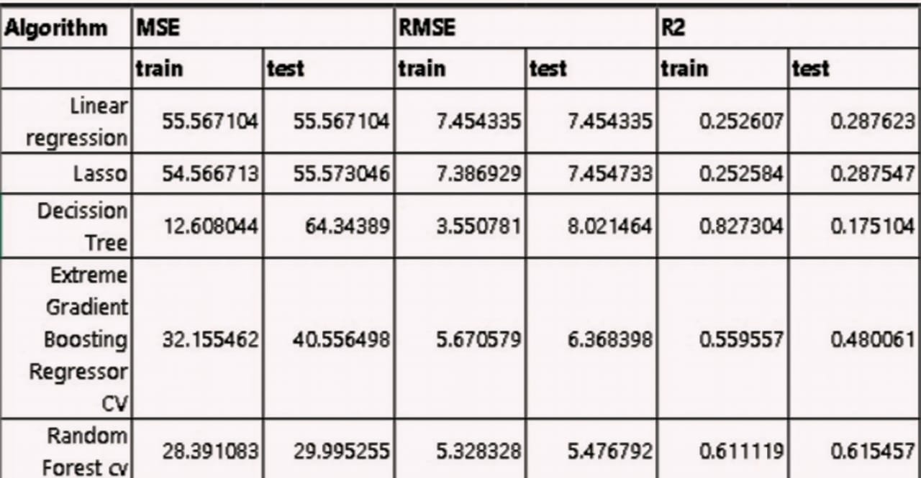
Results:
The model has predicted well at training. I found that for training data there is a R2 score of 63.46% which means the model has predicted well on the datapoints. Which means low bias. Also the model has a R2 score of 63.93%. The variance in model is also low. This is the best performing model I have found.

Slide 10
Conclusion
The "Ticket Booking Using Regression" project leverages predictive modeling to forecast ticket bookings based on historical data. By implementing various regression algorithms and integrating them into a user-friendly web interface, the project aims to provide accurate predictions and valuable insights for booking management. The project includes extensive testing, such as unit, integration, functional, performance, usability, security, regression, and acceptance testing, to guarantee dependability, performance, and usability. Future improvements could include enhanced modeling techniques, real-time data processing, mobile support, and advanced analytics. With a clear focus on robust system design, effective data handling, and user-friendly interactions, the project aims to deliver a reliable and insightful ticket booking prediction tool that meets the needs of its users and stakeholders.

Slide 11
THANK YOU

