Slide 1
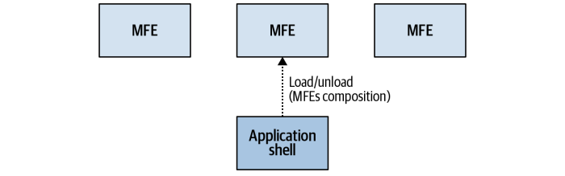
MICRO-FRONT-END
Git: https://github.com/anandkrvermamisc/MFADEMO

Slide 2
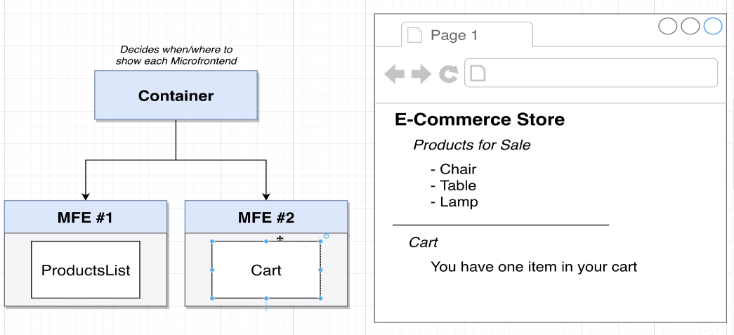
Scenario For MFE

Slide 3
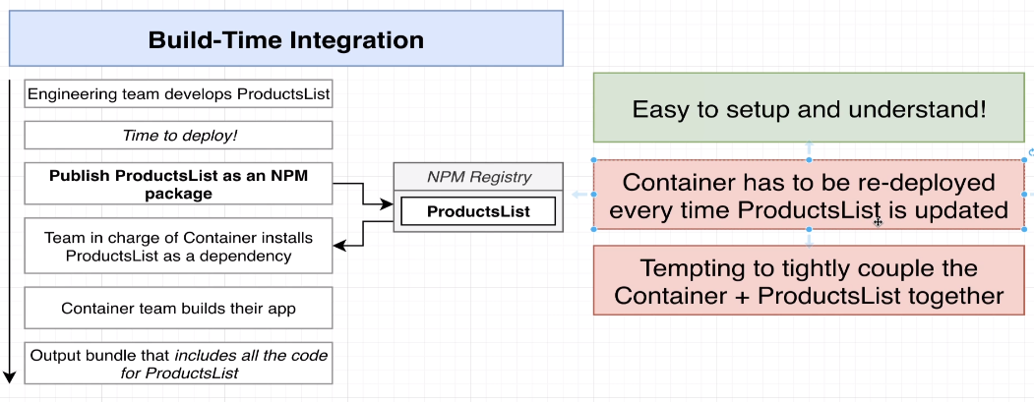
Build Time Integration

Slide 4
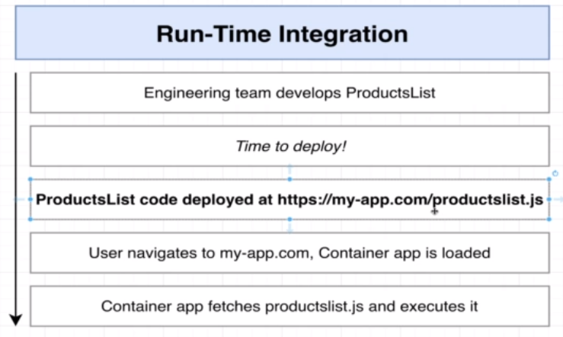
Run Time Integration

Slide 5
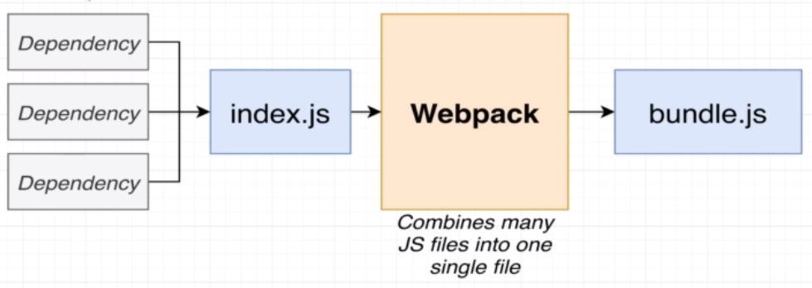
Role Of Webpack

Slide 6
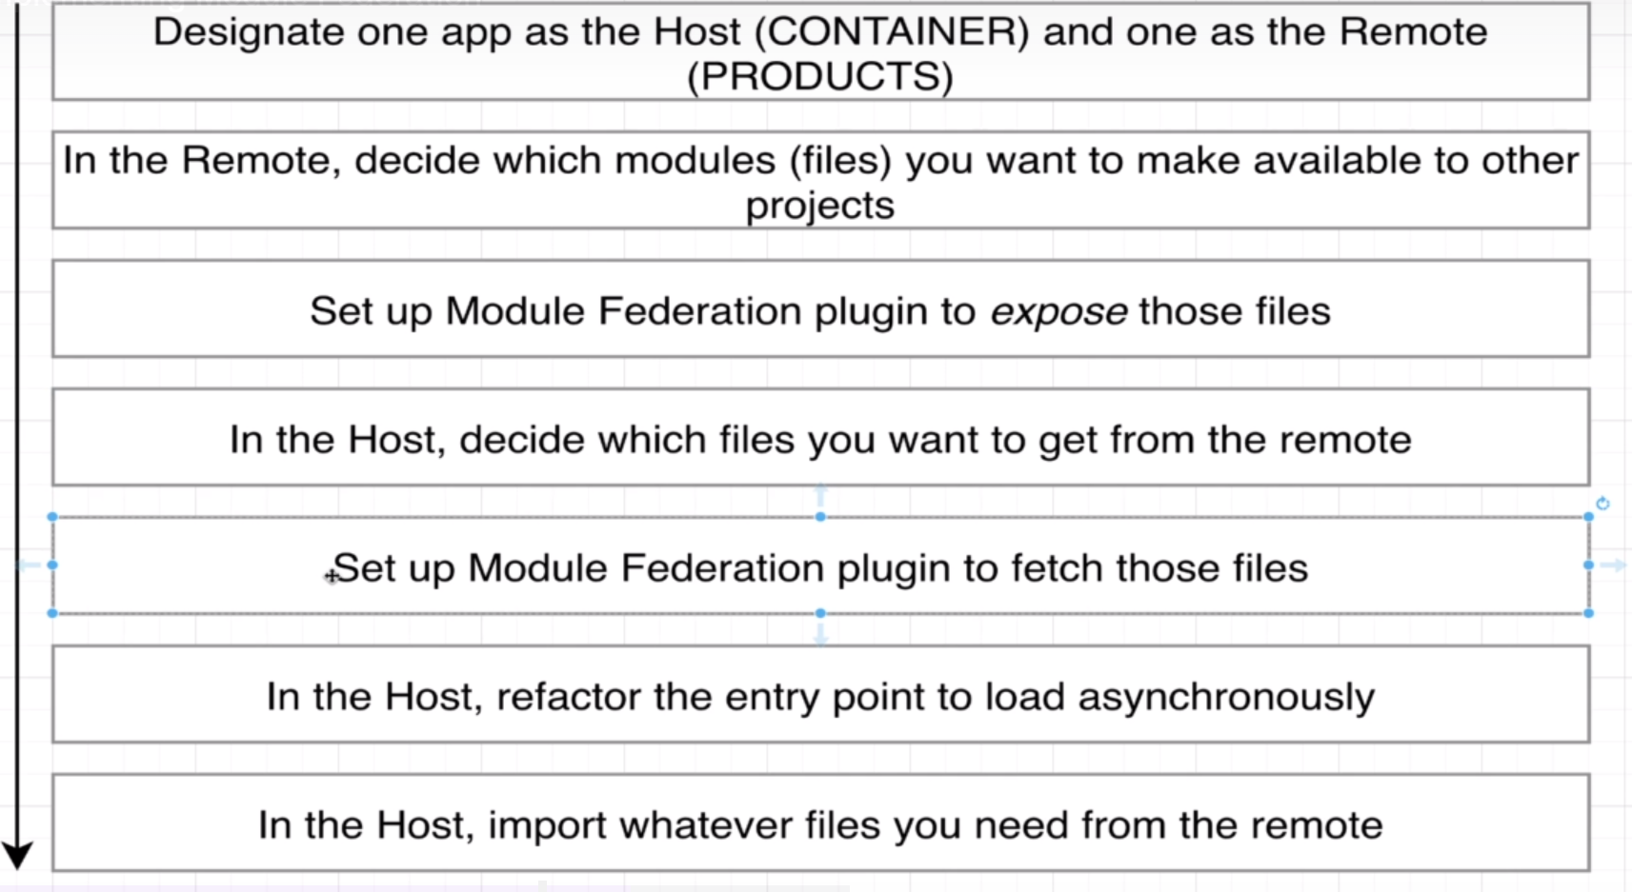
Federation between HOST and MFA-CHILD

Slide 7
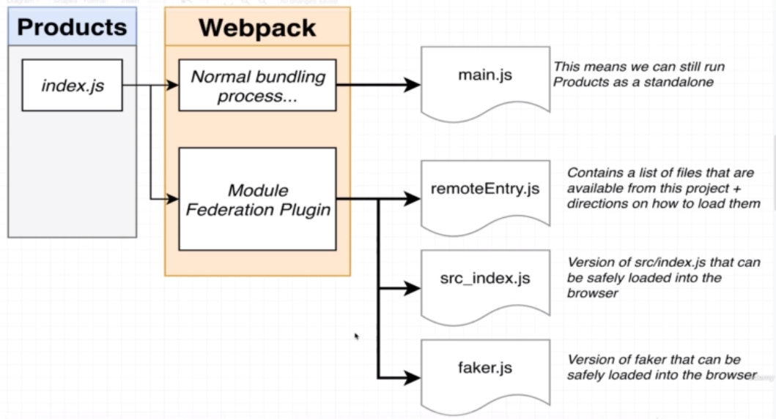
Webpack Federation output from Child APP

Slide 8
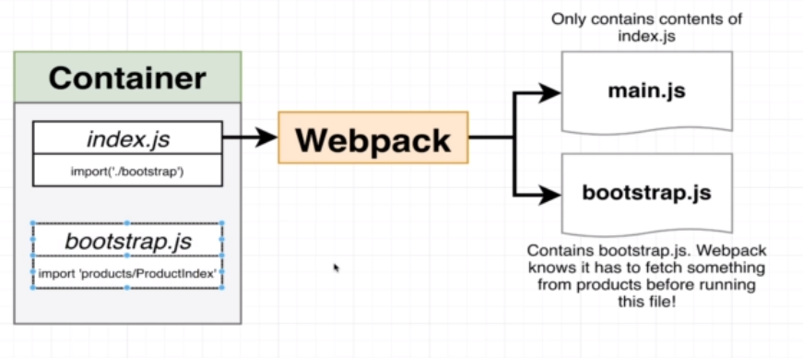
Webpack Federation on Container

Slide 9
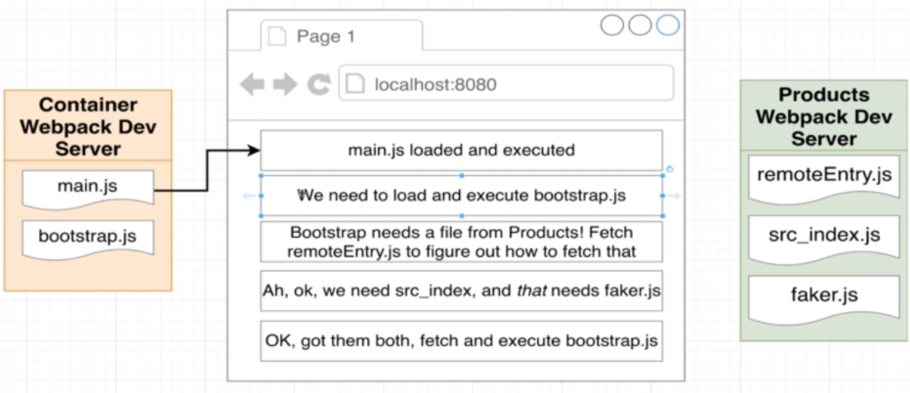
Federated Execution

Slide 10
Demo

Slide 11
Key Challenges to Solve
How to Handle when one of Child App is down.
Provide Navigation specific to Child app
Concrete solution for Routing
Expose Multiple type of components (JSX/.JS) for Composite views
Limitation
Only JavaScript and CSS can be shared via common top level folders
Shared components can’t be maintained in separate folder as there is no context of node_modules in separate context folder
Name space conflicts can occur for CSS between MFE apps

