Slide 1

Welcome

Slide 2
Title
Echo
The Echo is a Music player Application which is based on the Android Platform.

Slide 3
Aim To Develop this music player Application
The purpose to develop a music player application is to develop a smart music player application that provided smart feature Shake to change song’.
basically it an offline music player. The app should be able to fetch and play .mp3(formally MPEG-1 Audio Layer III) and .wav files.

Slide 4
TECHNOLOGIES USED : -
FRONT END :UI of android aplication by Using XML
BACK END: kotlin
Database:saving data in sql database and SQLite operation
.IDE used to Develop Echo Music player app is Android
studio version 3.5.3.
.Application run on android os Ice Cream Sandwich 4.00 to higher version

Slide 5
PERT:
A PERT chart is a project management tool that provides a graphical representation of a project's timeline. The Program Evaluation Review Technique (PERT) breaks down the individual tasks of a project for analysis
PERT chart for ECho music player application

Slide 6
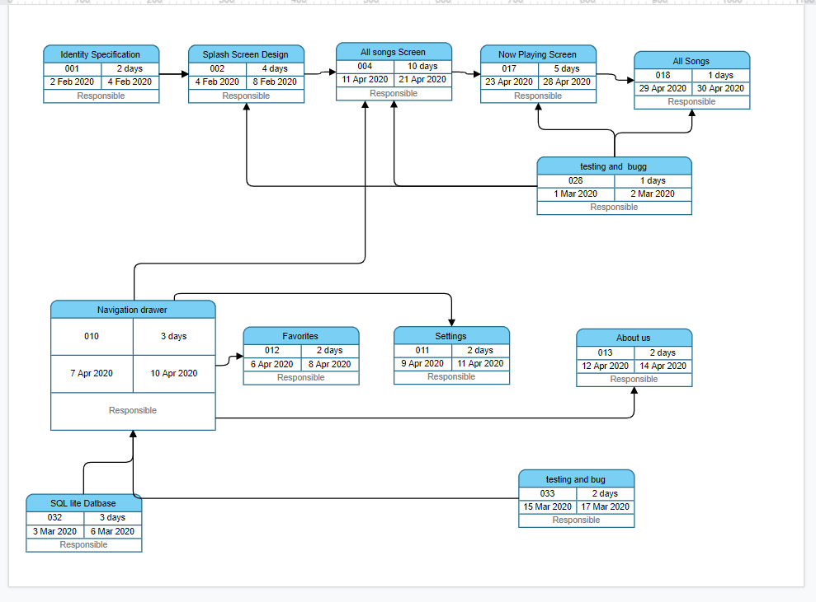
12feb 2020
22 feb 20
24 feb 20
29 feb 20
23 feb 2020
8 feb 2020
7 March 20
9 march 20
10 March 20
12 March 20
12 March 20
15 March 20
11 feb 2020

Slide 7
Planned activity
1. A Splash screen (gradient background and app logo in center)
2. A Navigation drawer with app logo section at the top along with links to ‘All Songs’, ‘Favorites’, ‘Settings’ and ‘About Us’.
3. An ‘All songs’ screen (where of list all the tracks fetched from offline storage are displayed and user can sort the tracks by name or recently added). This will the home screen of the app.
This designer pencil demo works, focusing on the production of high-end design husk designer pencil demo works, focusing on

Slide 8
4. The app should be able to fetch and play .mp3 and .wav files.
5. A ‘Favorites’ screen (where list of all the favorite songs are displayed)
6. A ‘Settings’ screen (where the ‘Shake to change song’ feature can be enabled or disabled)
7. An ‘About us’ screen (where we will display information about the app developer and the app version)

Slide 9
8. A ‘Now playing’ screen with following features:
a. Track title and track artist
b. Play / Pause button
c. Next button
d. Previous button
e. Shuffle button
f. Loop button
g. Seek bar
h. Mark track as favorite or unfavorite it
i. Third party visualiser in upper half background

Slide 10
j. A ‘Back to list’ button in the header which should take the user to the screen he came from (kind of like back button behaviour).
k. Shake to change song
9. A ‘Now playing’ bar at the bottom with name of the track playing and play or pause feature. This would appear if the user has moved from ‘Now playing’ screen to ‘All songs’ screen or ‘Favorites’ screen without pausing the track.

Slide 11
10. Background play. The app will continue playing the track if the app gets closed (not killed) without the music being paused.

Slide 12
Completed activity
1. A Splash screen (gradient background and app logo in center)
2. A Navigation drawer with app logo section at the top along with links to ‘All Songs’, ‘Favorites’, ‘Settings’ and ‘About Us’.
3. An ‘All songs’ screen (where of list all the tracks fetched from offline storage are displayed and user can sort the tracks by name or recently added). This will the home screen of the app.

Slide 13
1. A Splash screen (gradient background and app logo in center)
Splash screen:
This would be the first screen that gets displayed when a user opens the app. It would have a linear gradient background and the app logo in the center of the screen. The user will see the screen for 1 second and then the home screen will pop up.

Slide 14
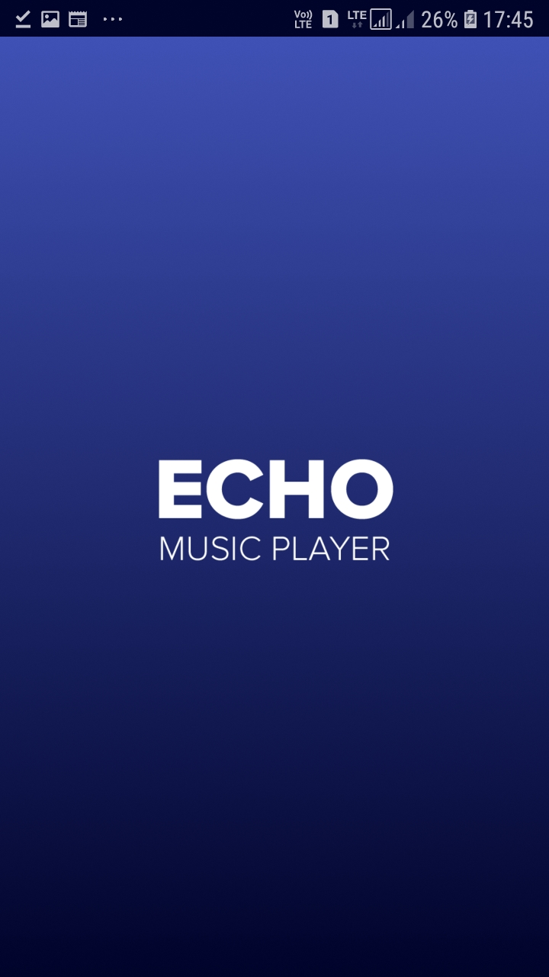
output
Gradient
background
APP logo

Slide 15
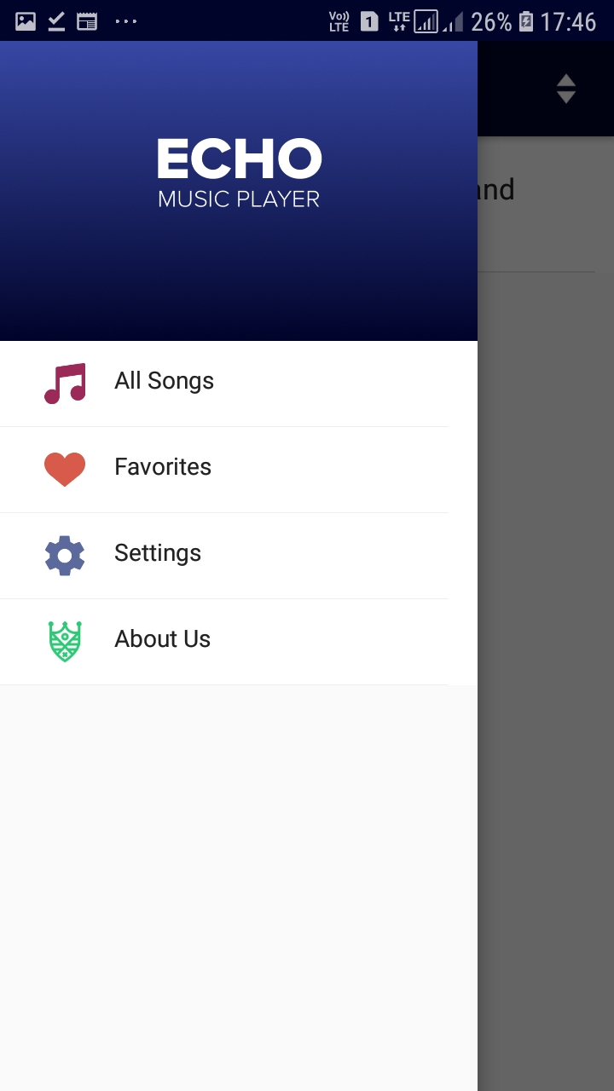

2. A Navigation drawer with app logo section at the top along with links to ‘All Songs’, ‘Favorites’, ‘Settings’ and ‘About Us’.
App logo
Section
All songe screen link
Favorites Screen lnks
About Us Screen link
Setting Screen link

Slide 16
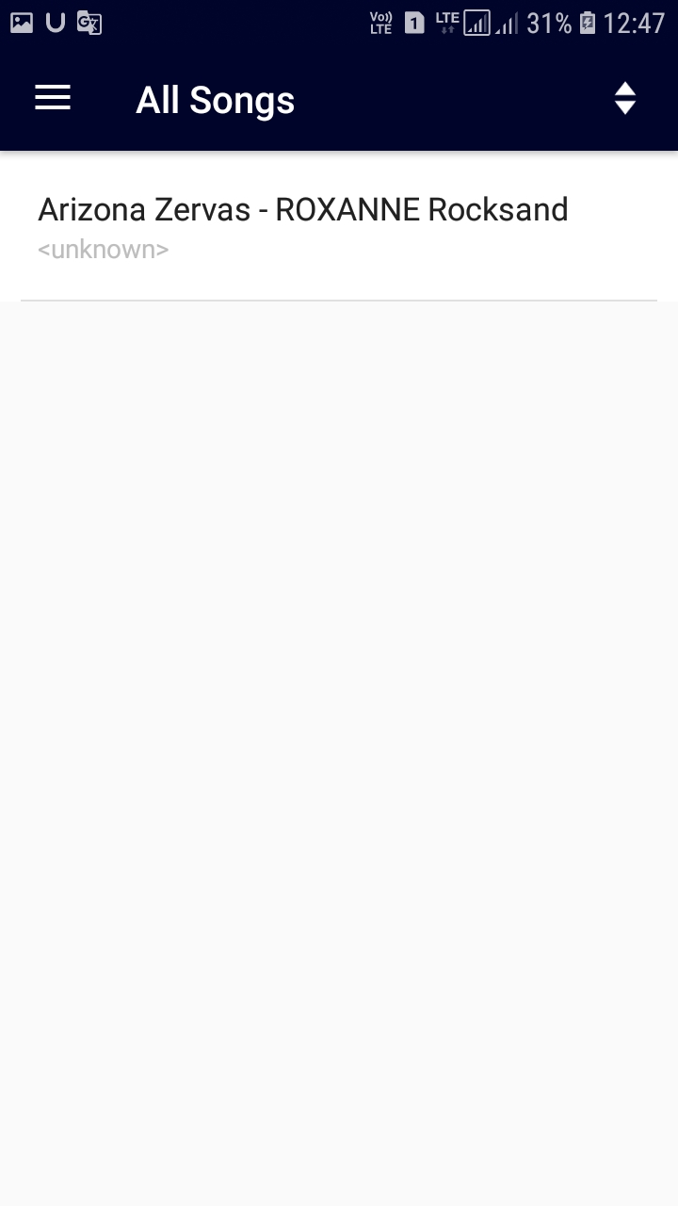
3. An ‘All songs’ screen (where of list all the tracks fetched from offline storage are displayed and user can sort the tracks by name or recently added). This will the home screen of the app.
sort feature
Track Title
Track artist

Slide 17
4.Sort feature: The ‘All songs’ screen will have a Sort feature. Using the Sort feature, the user should be able to sort the tracks by name or by recently added. A sort icon will be there on the right side of the header, when clicked on, then a dropdown will appear with two options:
By recently added
By name

Slide 18
5. ‘Favorites’ screen
The ‘Favorites’ screen resembles the ‘All songs’ screen. It will display all the tracks that have been marked favorite by the user. The user would be able to mark a track favorite or unfavorite it only on the ‘Now playing’ screen. Ensure that if the user marks a track favorite and then later deletes it from the offline storage, the track shouldn’t appear on the ‘Favorites’ screen.
If the user has no favorite tracks, there would be a message in the center on the screen saying, “You haven’t got any favorites yet!”.

Slide 19
6. ‘Settings’ screen
The ‘Settings’ screen will have the option to enable or disable ‘Shake to change song’ feature using the toggle button. The default state of ‘Shake to change song’ feature would be ‘disabled’. If the user enables the ‘Shake to change song’ feature, the app should remember it, so when the user kills the app and launches it again, the ‘Shake to change song’ should stay enabled.

Slide 20
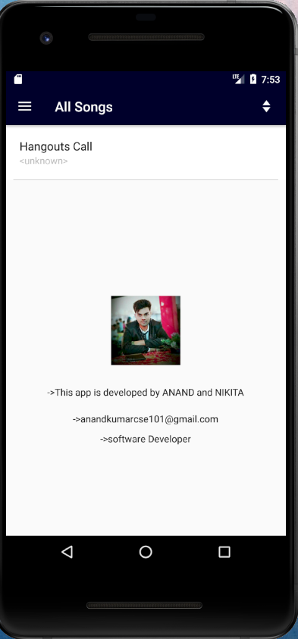
7.About us Screen:The ‘About us’ screen will display the information about the app developer and the app version. As part of the app developer information, there would developer’s photograph and a few lines about him/her.

Slide 21
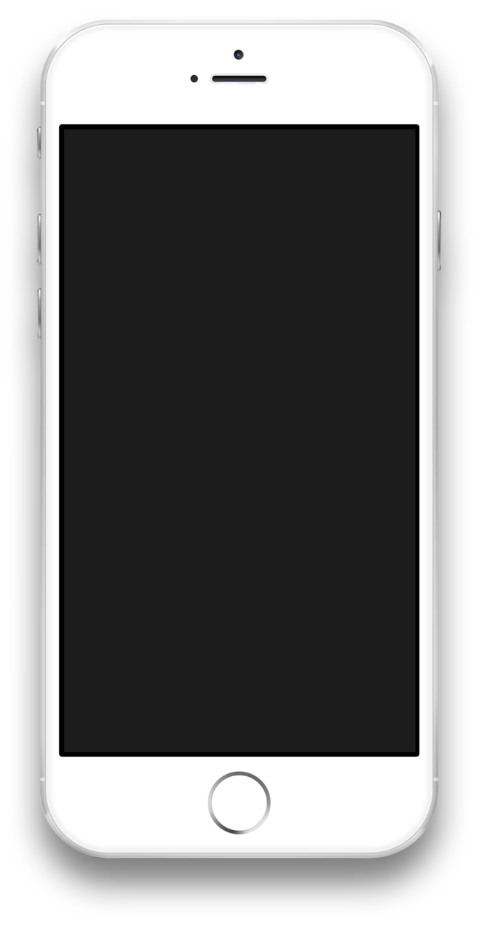

Responsibility of each member of the Group
NIkita
Anand Kumar
The responsibility of Nikita to build the user interface of music player
The responsibility of Anand Kumar is to develop back end code of music player.

Slide 22
Action Plan
Action Plans are simple lists of all of the tasks that you need to finish to meet an objective. They differ from To-Do Lists in that they focus on the achievement of a single goal. Action Plans are useful, because they give you a framework for thinking about how you'll complete a project efficiently.

Slide 23
OutCome of the Project:Working Sample.

Slide 24
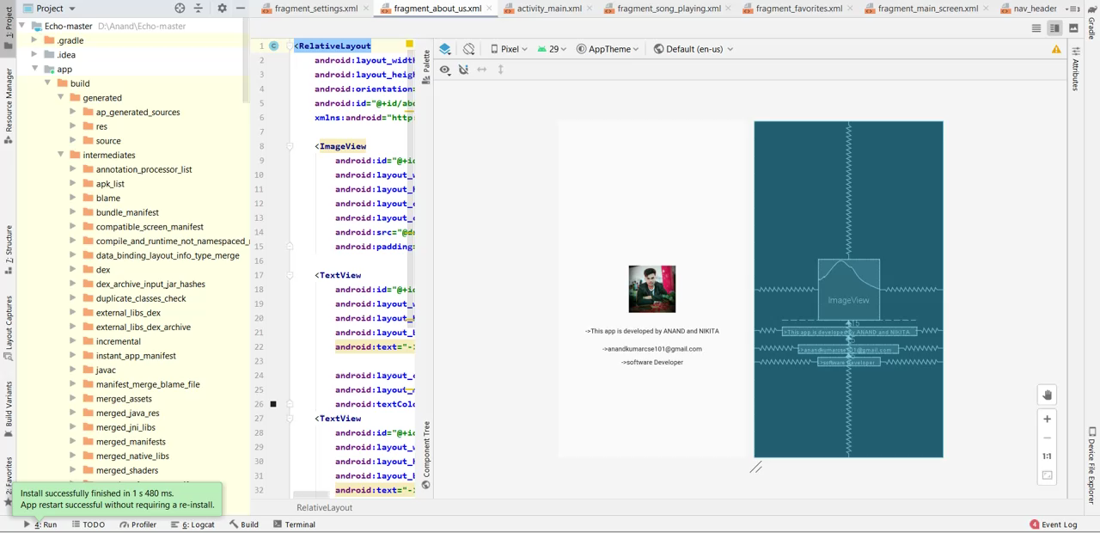

Slide 25
Out come of the Project:
The out come of the project is a Music Player application which will run on android operating system
The android music player application have smart feature shake to change the music .
It will also provide feature to add your favorites songs .
The music player application did not requried any internet connetion to play they music .
Music player will play the song which is present in mobile device/mobile storage.

Slide 26
THANK YOU

