Slide 1


Welcome

Slide 2
Name Of The Project Title
‘ETL & Dashboard Development’

Slide 3
Aim To Develop this ETL & Dashboard
It is the IT process from which data from difference sources can be put in one place to programmatically analyze and discover business insights.
It aims to provide interactive visualizations and business intelligence capabilities with an interface simple enough for end users to create their own reports and dashboards

Slide 4
Software Use To Develop ETL and Dashboard
2). Software Specifications
FOR DASHBOARD | PowerBI
ETL or SSIS | SQL SERVER DATA TOOLS FOR VISUAL STUDIO(SSDT)
SERVER (DATA WAREHOUSE) | SQL SERVER express
To manage SQL server Database | Microsoft SQL SERVER Management Studio(SSMS)

Slide 5
CONTENTS
01.
02.
ETL(Extract,Transform,Load)
Dashboard

Slide 6

ETL
PART ONE
ETL(Extract Transform and Load)

Slide 7

Data from one or more sources is extracted and then copied to the data warehouse. When dealing with large volumes of data and multiple source systems, the data is consolidated. ETL is used to migrate data from one database to another, and is often the specific process required to load data to and from data marts and data warehouses, but is a process that is also used to to large convert (transform) databases from one format or type to another.

Slide 8
Implimentation Of ETL
Steps-1
Sample Of data ,It may be any company data or another organization and the data may present in the form of Excel,ADO NET,CDC,FlAT FILE,ODBC,OLE DB,RAW FILE,XML etc
So, I have my source sample data is Excel.
We need tools says SQL SERVER DATA TOOLS FOR VISUAL STUDIO(SSDT) which is provides SSIS (SQL server integration services) or ETL tools
Steps-2
Create new project on SSTD select Integration Services
Steps-3
Select Data Flow Task locked into SSIS Toolbox and on Data Flow Task double click and select the EDIT.

Slide 9
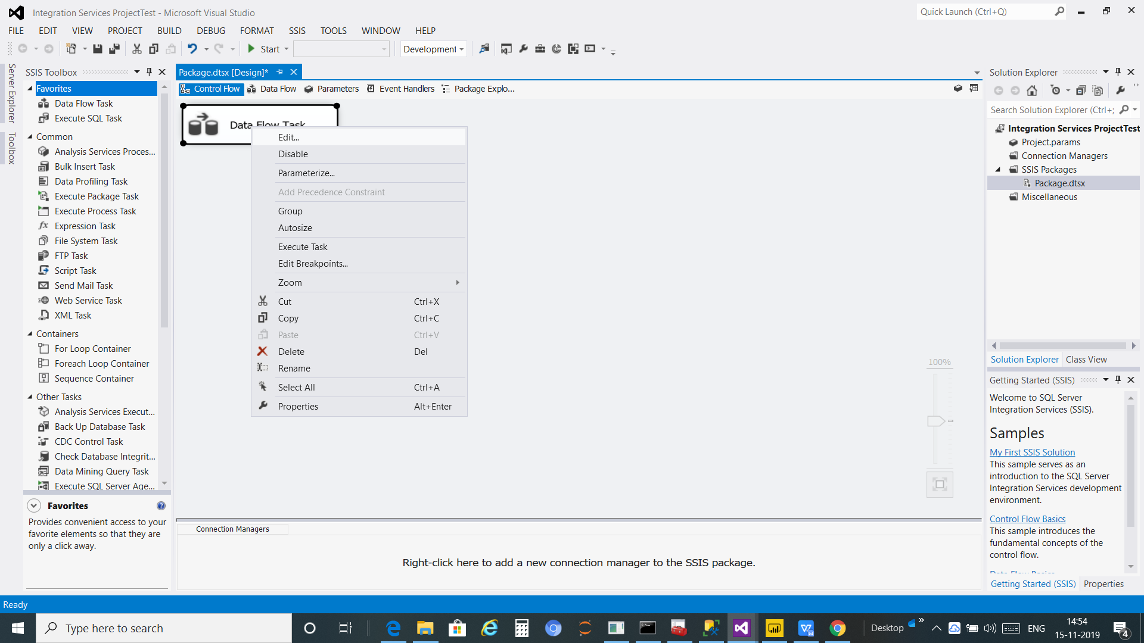

Slide 10
Step-4
Select the Sources File within one
ADO NET source
CDC Source
Excel Source
Flat File Source
ODBC source
OLE DB source
RAW File Source

Slide 11
I have selected Excel Source and Edit it and configure the properties that enable the Data Flow task to obtain data from Excel provider.
It will need to established connection to the source file like that

Slide 12
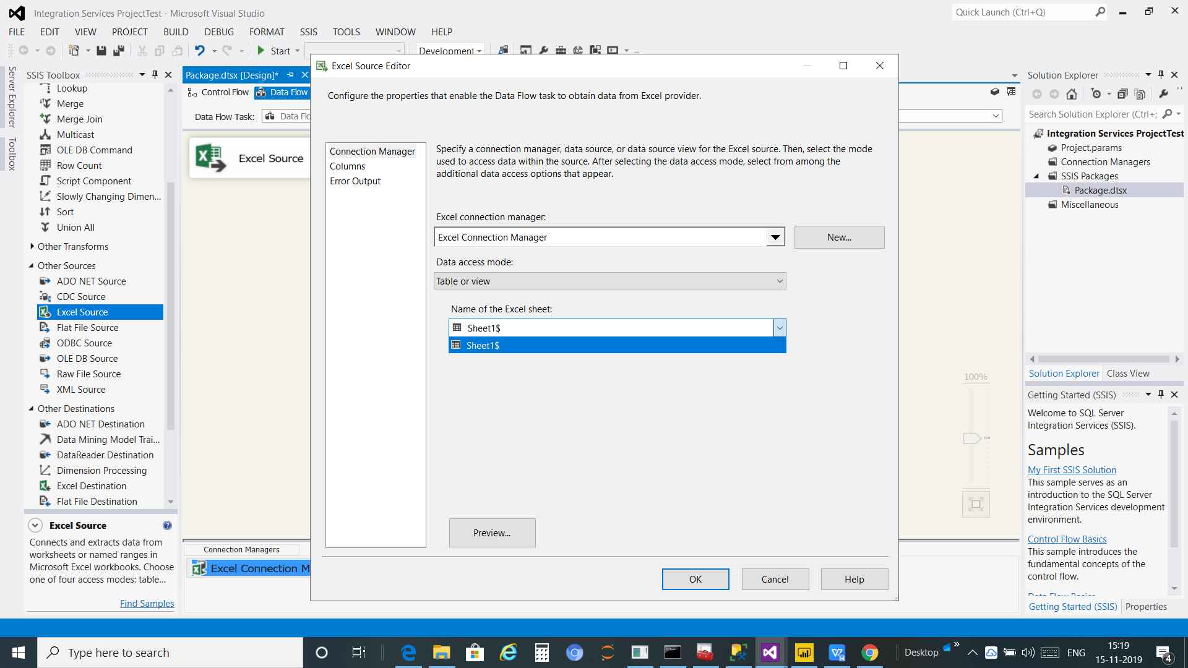

Slide 13
Step 5:
so the above step identify the connection established to the source file and now we need to make connection to the destination
And the destination may be
ADO NET Destination
Data Mining Model
Data Reader Destination
Excel Destination

Slide 14
OLE DB Destination
I have selected OLE DB destination ,Now It need to established connection to configure the properties use to insert data into a relation database using an OLE DB provide

Slide 15
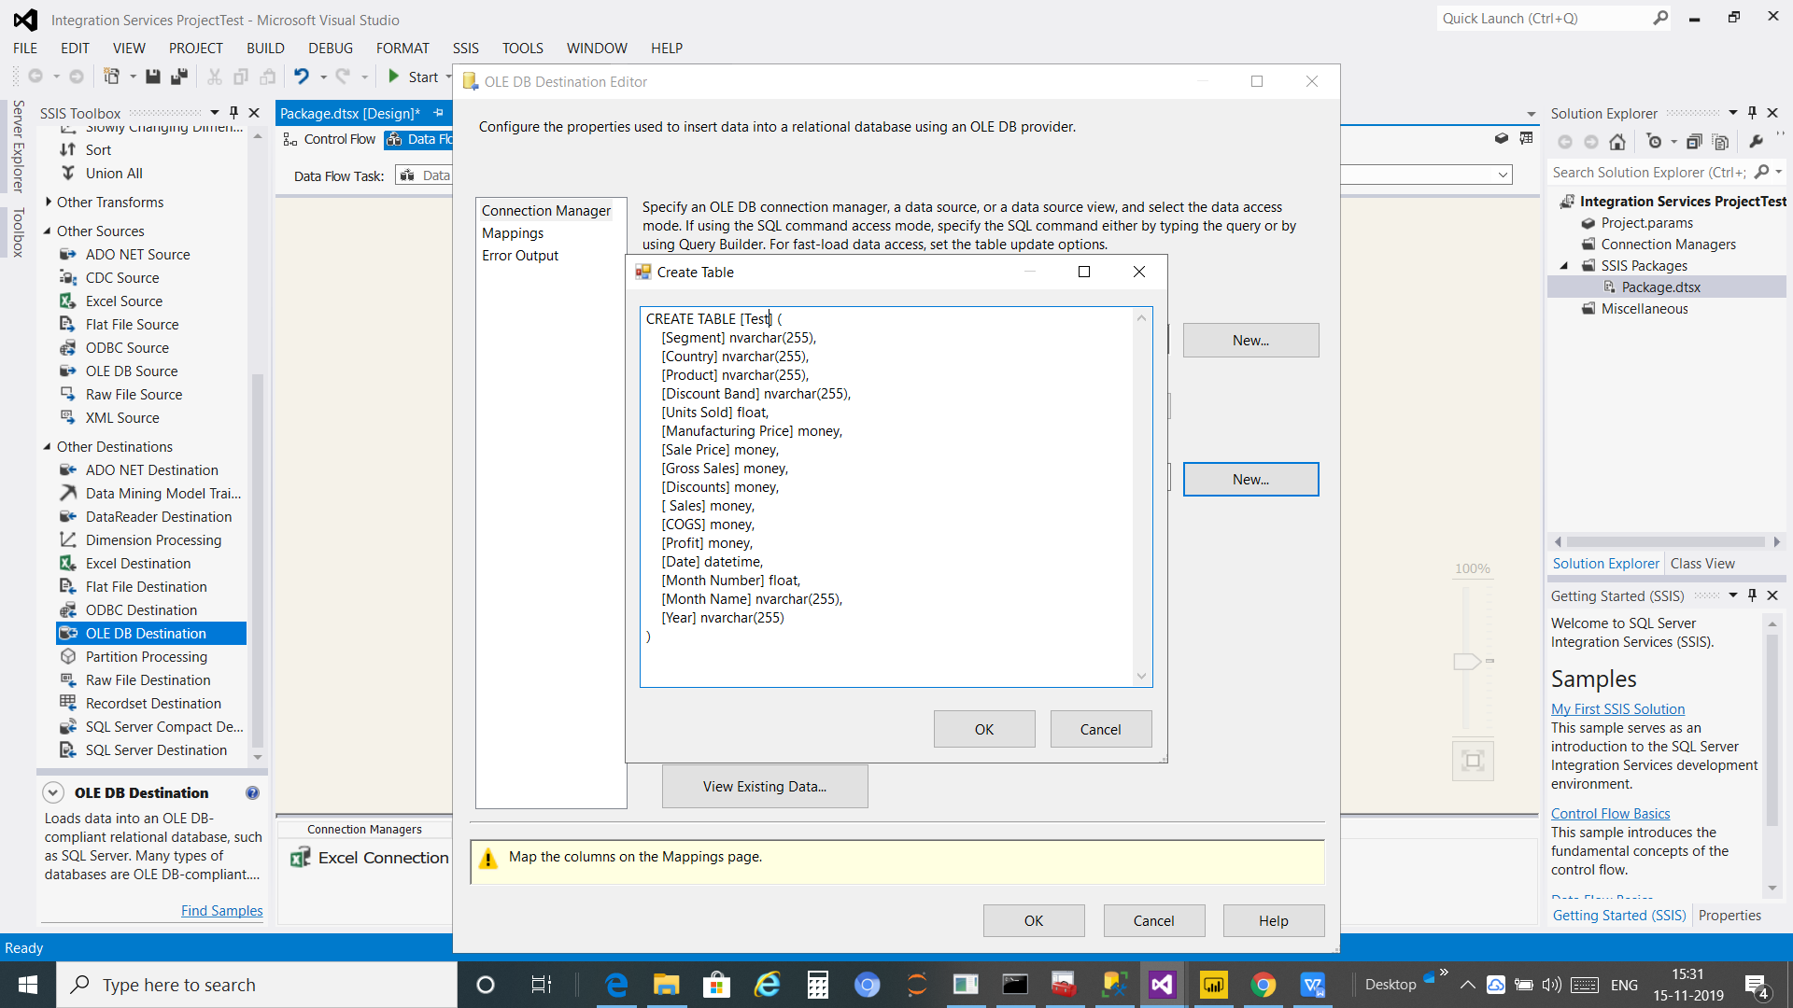

Slide 16
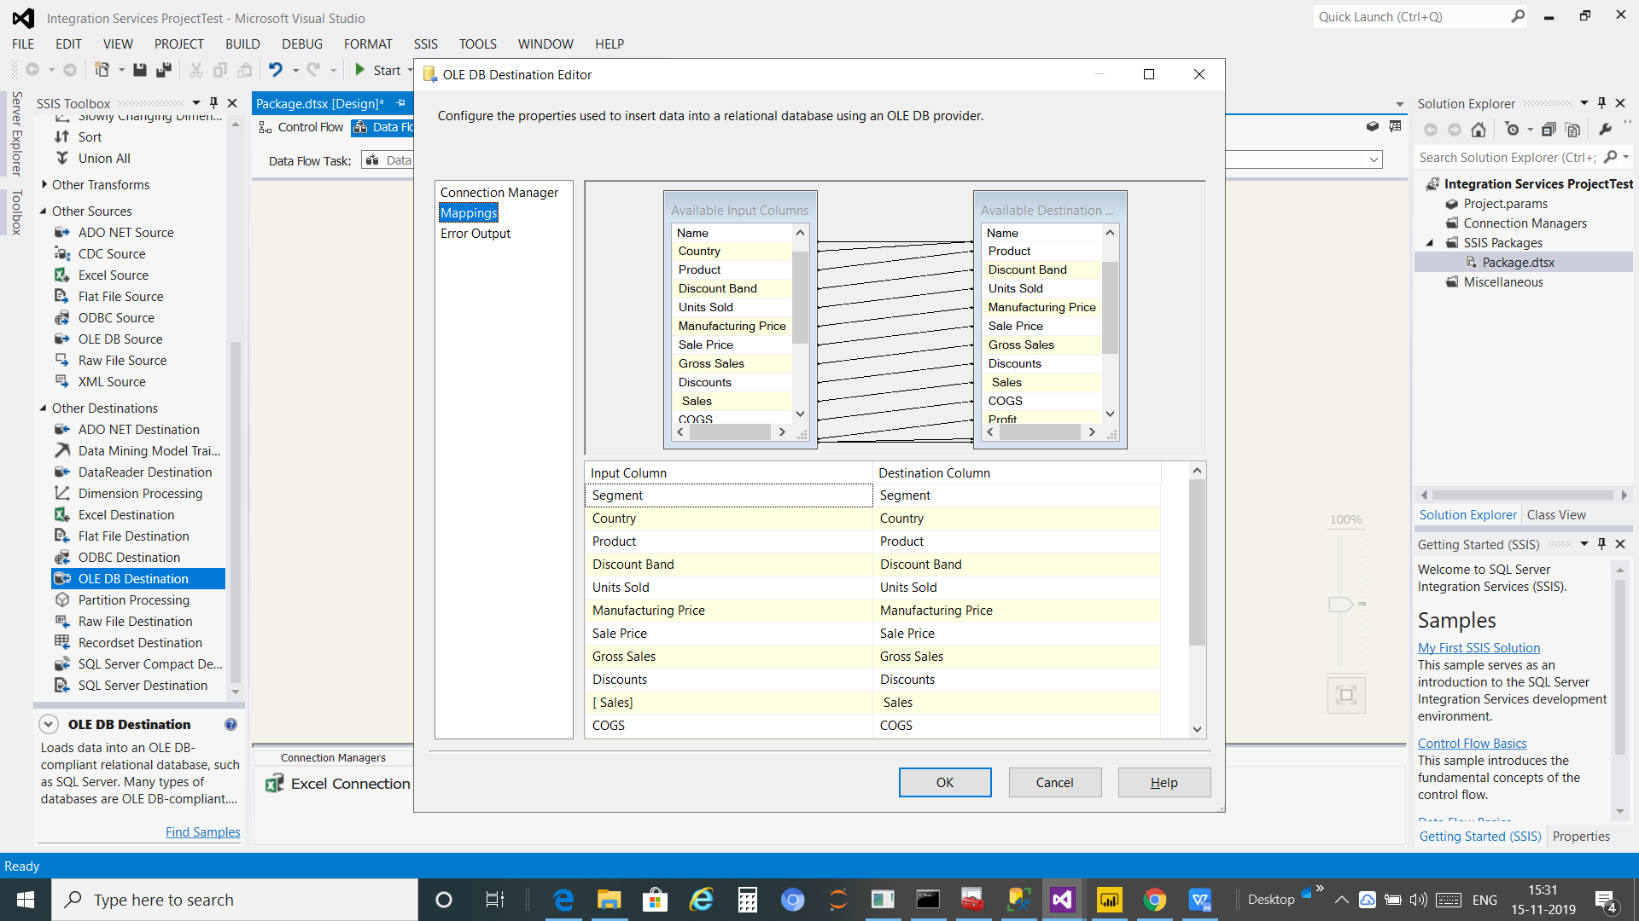
Also need to mapping the source data table to the destination data table

Slide 17
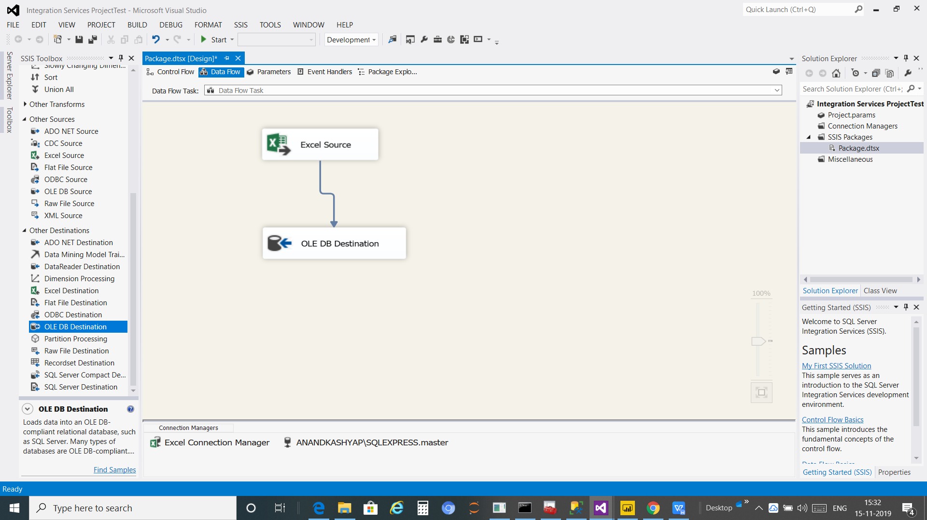
Step 5 Connect the Excel Source TO the OLE DB Destination

Slide 18
Step 6
Start the SSIS Tools and then It will Extract ,transform and Load the data on destination data warehouse says OLE DB

Slide 19
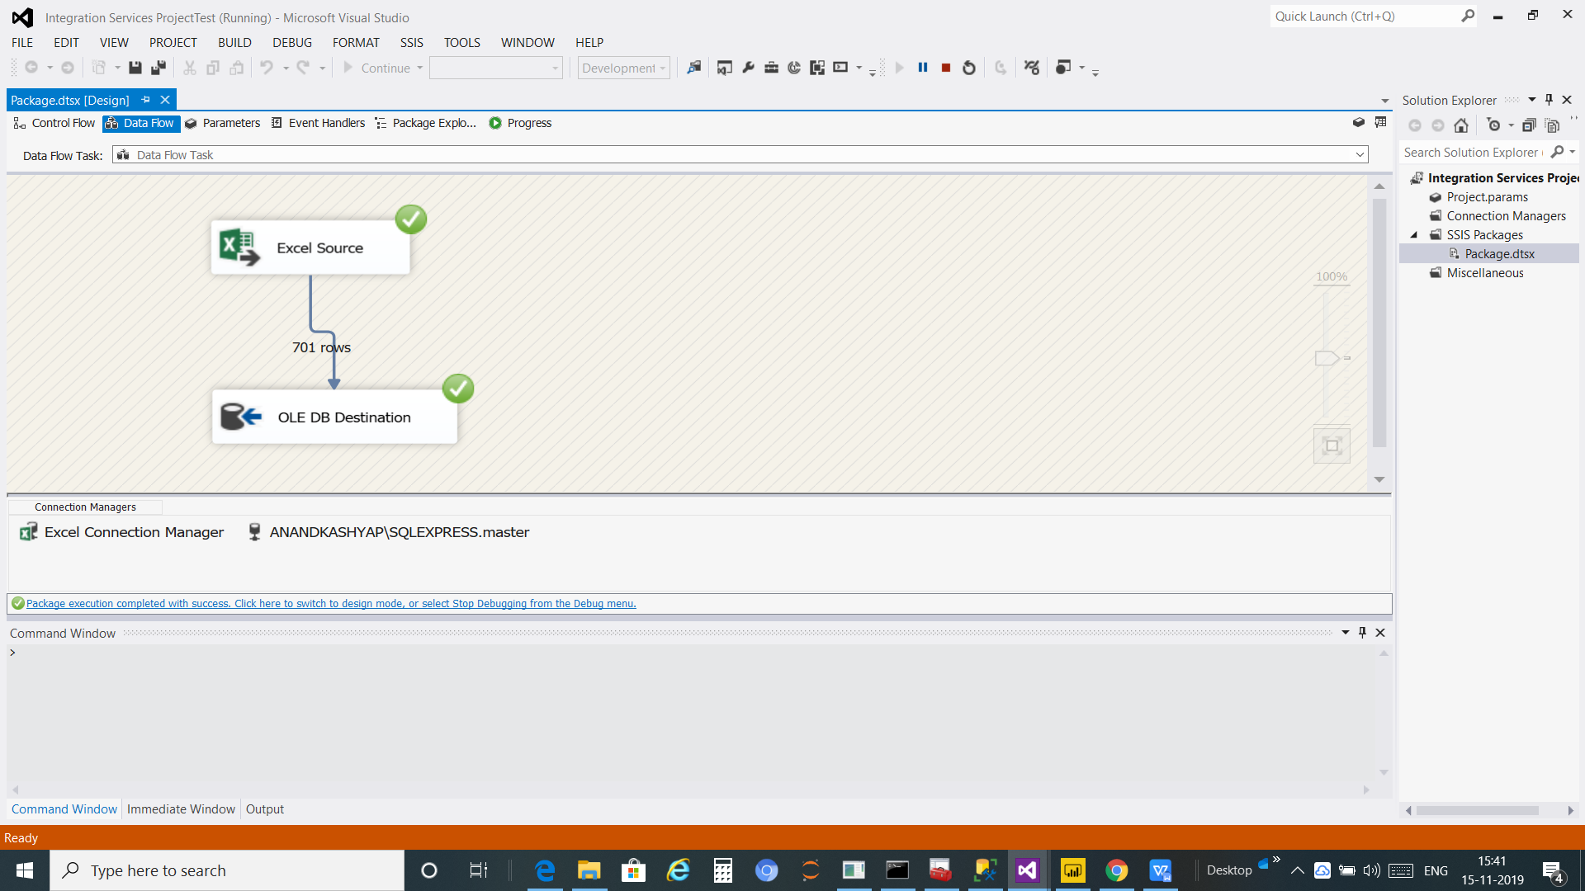
Output of ETL

Slide 20

PART TWO
Dashboard

Slide 21

SQL SERVER
(DATA warhouse)
A
B
ETL
Dashboard

Slide 22
SSMS(SQL server Management Studio):
SQL Server is the tool which is used to modified the data in data warehouse(SQL server)
We can remove and modified ,implement on and many more on our data For business Intelligence. By use SQL query.

Slide 23
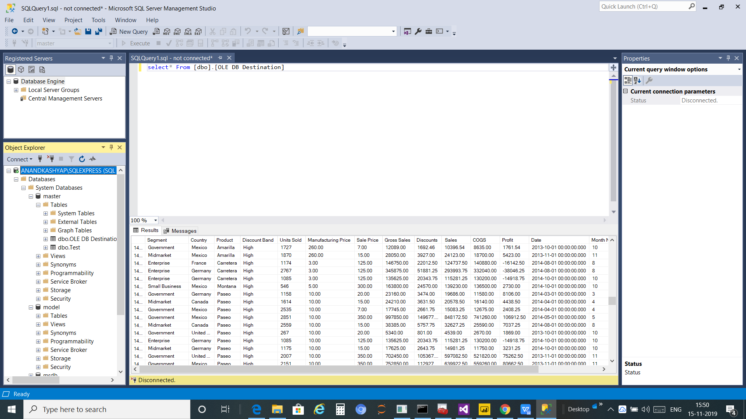

Slide 24
Dashboard:
It will need tools says PowerBI ,Power BI is a business Analytic service by Microsoft. It aims to provide interactive visualizations and business intelligence capabilities with an interface simple enough for end users to create their own reports and dashboards
Step-1
Get the data from data warehouse(OLE DB) in the powerBI
Step -2 connect to the sql server to get the data for interacive visualization and Business intelligence and create report and dashboards

Slide 25

Output of Dashboard

Slide 26
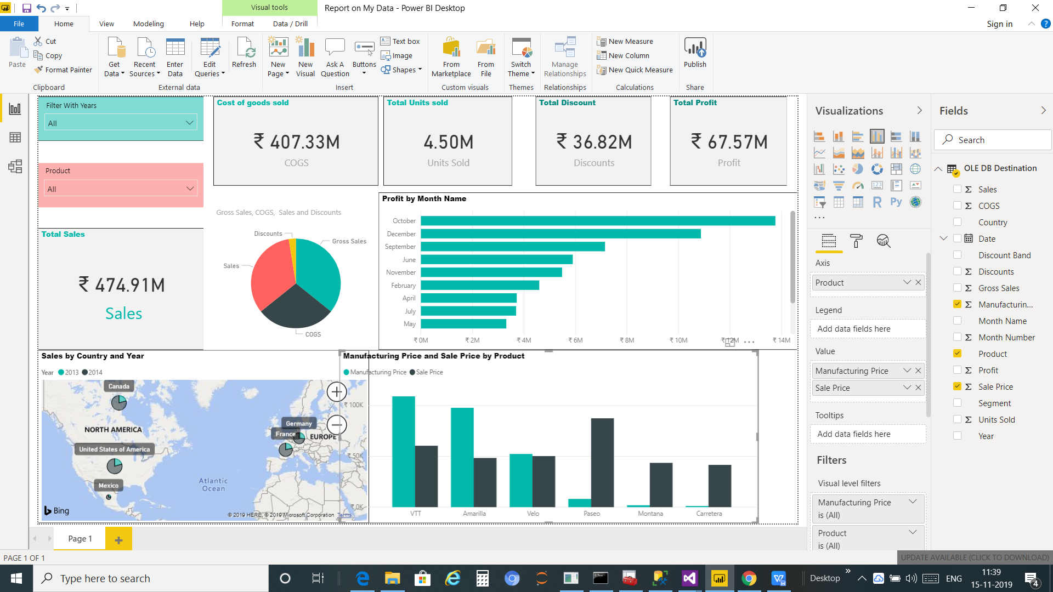

Slide 27



Developed BY Anand Kumar
Branch : Computer Science Engineering
Semester : 7th
Guided By : Mr.Rakesh Kumar (Project Manager /supervisor)
LiquidHub Analytics pvt. Ltd.
(Formerly known as “Annik Technology Services Pvt. Ltd.”)

Slide 28

ETL
Sucessfull with output
SQL Server (Data warehouse)
Sucessfull with output
Dashboard
sucessfull with output

Slide 29
THANKS

