Slide 1


Feature Extraction from
Medical Journals
By:
Anandakrishnan k v

Slide 2
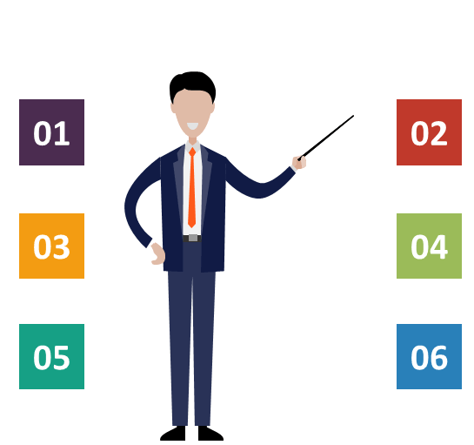

Contents
Project overview & Scope
Objectives and Constraints
CRISP-ML(Q) Methodology
Technical Stack
Project Architecture
Success Criteria
07
Data Understanding
08
Model Description
09
Model Output

Slide 3
Project Overview & Scope
The project focuses on extracting the important features from medical journals
It has been observed that many important medical datas are availed in unstructured text format. So easy analysis purpose need to convert this datas in more understandable structured format and stored those for future references
Manual extraction of features from medical journal is difficult and time consuming. Named Entity Recognition algorithms make this task simple by easily understanding different types of drugs names, their compositions, dosage and even strength in medical fields. And it will helps to prescribe the exact medicine with dosage for different diseases in future

Slide 4

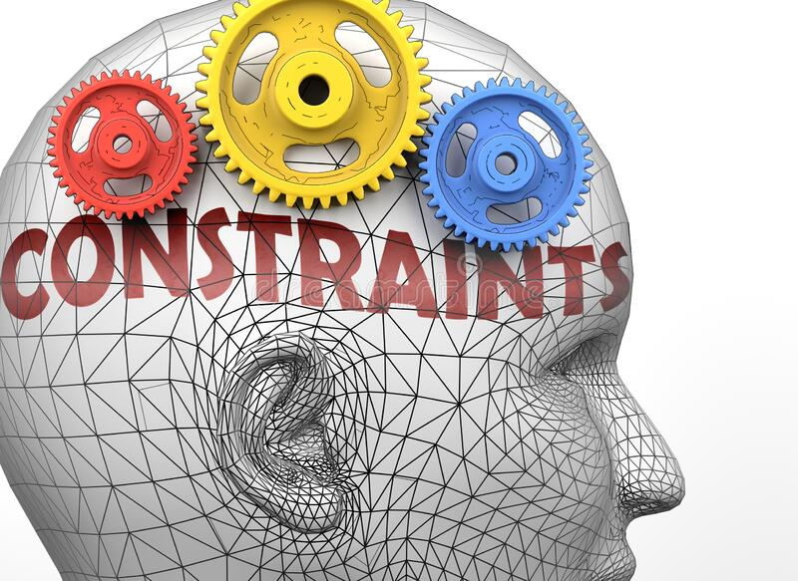
Project Goal
Increasing maximum number of Features by using NER model.
By using this model training and testing data entities can be diagnosed.
Increasing maximum number of Features by using NER model.
By using this model training and testing data entities can Increasing maximum number of Features by using NER model.
By using this model training and testing data entities can be diagnosed.
Detection of medical terms such as finding drug names and their composition.
Prediction of future drug names can be shown.
By using this model training and testing data entities can be diagnosed.
Detection of medical terms such as finding drug names and their composition.
Prediction of future drug names can be shown.
Objectives:
Constraints:
Increasing maximum number of Features by using NER model
Detection of medical terms such as finding drug names and their composition
Extracting drug names with its exact subsidiary features
Error reduction with 80% of accuracy

Slide 5
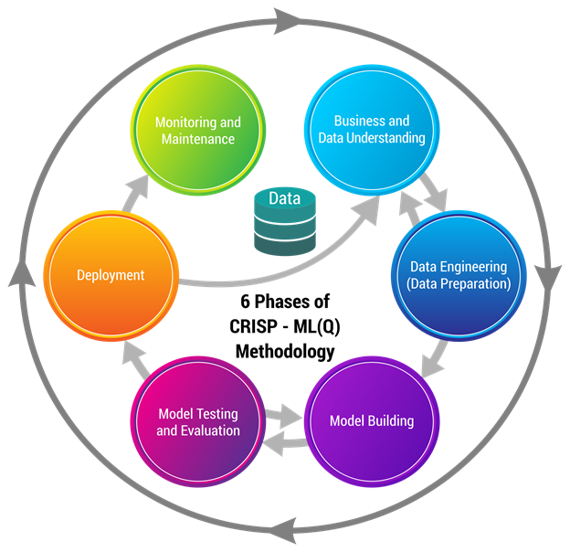
CRISP-ML(Q) Methodology

Slide 6




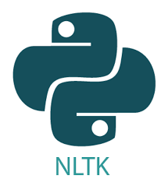


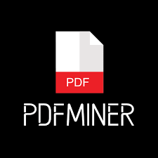
Technical Stacks

Slide 7
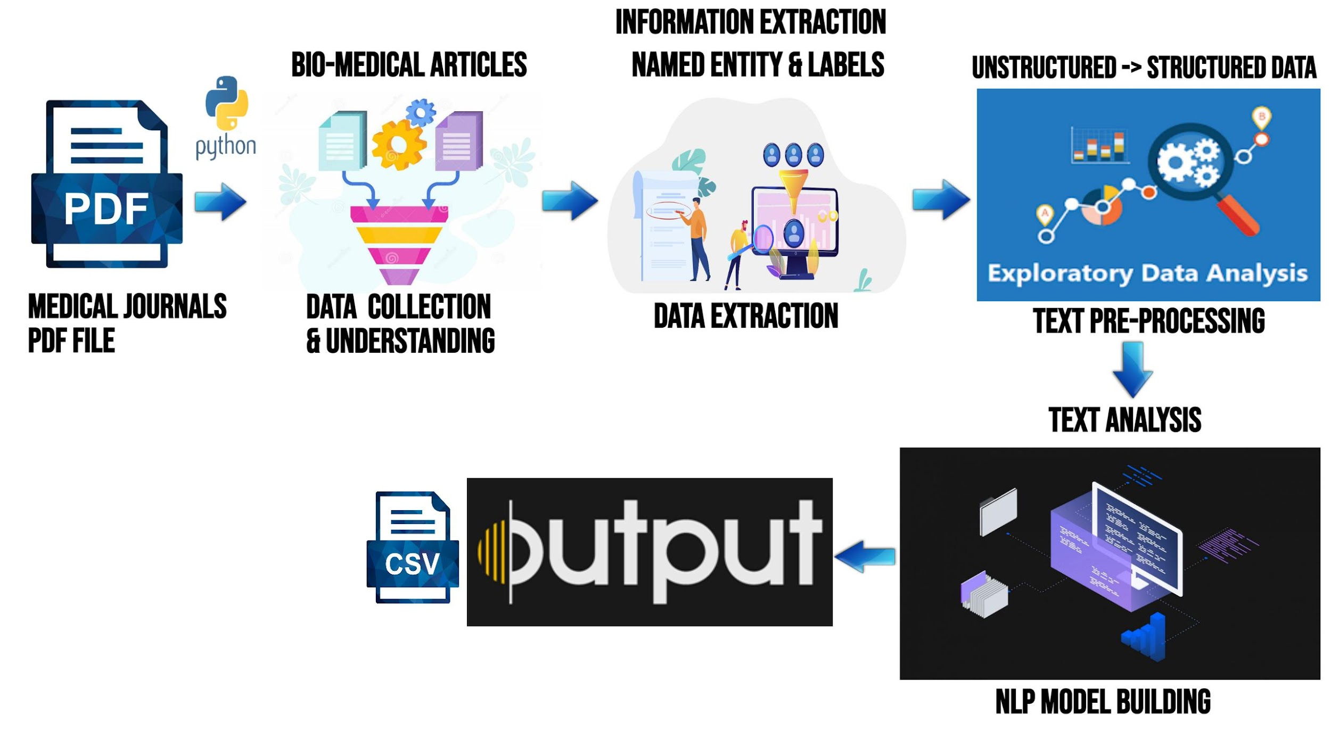
Project Architecture

Slide 8

Success Criteria
Extracting the Entities with its subsidiary features and stored it in structured data format will helps have the better understanding about different diseases and its severity
Extracting of drugs names along with their exact compositions, dosage and even strength for different diseases would helps to prescribe the medicine for different diseases in future

Slide 9

Data Understanding
Raw data available in unstructured text form as a number of medical journals in pdf format contains the information about important medical entities along with their subsidiary features
The model given importance to extract the drug names along with their subsidiary features like, strength and dosage with the help of medical NER Spacy library in transferable clinical NLP Med7 model

Slide 10
Model Description
Model Used:
Here used transferable clinical NLP Med7 (en-core-med7-trf) model, trained on MIMIC-III dataset
Med7 model able to recognise seven medication-related concepts like drug names, dosage, duration, form, frequency, route of administration and strength
Important Libraries:
Pdfminer is used to merge all the medical journals
Pdfminer is used to extract text from the pdf files
Spacy is used to build NLP model to extract features

Slide 11
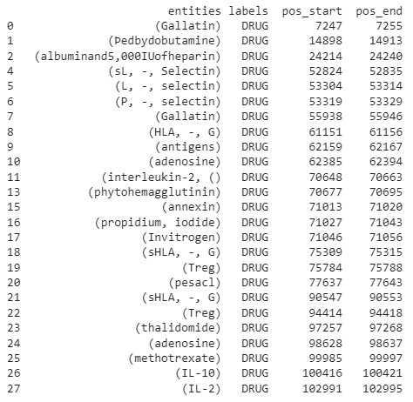
Model Output

Slide 12


