Slide 1
Music Genre Classification using Deep Neural Networks
Presented By:
Anand M,
KGiSL Institute Of Technology,
NM ID:au711721243010

Slide 2

AGENDA
Problem Statement
Project Overview
Who are the end users?
Solution and its value proposition
Modelling
Results
Conclusion
References

Slide 3





PROBLEM STATEMENT
Develop techniques to extract relevant features from audio data.
Design a deep learning architecture optimized for genre classification.
Collect a diverse, well-labeled dataset for training and evaluation.

Slide 4

PROJECT OVERVIEW
This project aims to develop a robust music genre classification system using deep learning techniques. Leveraging advances in neural network architectures and feature extraction methods, the system will accurately classify audio tracks into predefined music genres.
Project Components:
Feature Extraction: Develop techniques to extract relevant features from raw audio data, such as spectrograms, Mel-frequency cepstral coefficients (MFCCs), or deep learned representations. These features will capture the spectral, temporal, and tonal characteristics of the music, serving as inputs to the classification model.
Model Architecture:Design and implement a deep learning architecture optimized for music genre classification. This may involve convolutional neural networks (CNNs), recurrent neural networks (RNNs), or hybrid architectures like convolutional recurrent networks (CRNNs), tailored to handle the sequential nature of audio data and effectively learn hierarchical representations for classification.
TrainingTrain the deep learning model using the preprocessed dataset and evaluate its performance on the validation set. Fine-tune the model's hyperparameters and architecture based on validation results to improve classification accuracy.
Text Generation:Deploy the trained model into production-ready systems or applications where music genre classification is required.

Slide 5

WHO ARE THE END USERS?
Content Creators:Companies like Spotify, Apple Music, or YouTube Music could utilize the classification system to improve their recommendation algorithms, personalized playlists, and music discovery features. End users in this context would be the platform's subscribers or users seeking curated music experiences.
Language Learners:Professionals responsible for organizing music libraries, creating playlists, or DJing at events could benefit from the system to quickly categorize and organize large volumes of music according to genre.
Chatbot Developers:Researchers, academics, or analysts studying trends in music consumption, genre popularity, or cultural influences could use the classification system to analyze large datasets of music metadata.
Creative Writing Enthusiasts:Companies involved in media production, such as film, television, or advertising agencies, could leverage the system to find suitable music tracks for their projects based on genre requirements. End users in this case would be the producers, editors, or creative teams responsible for selecting music for their productions.
Educational Institutions:Developers creating mobile applications related to music discovery, education, or entertainment could integrate the classification system to enhance their app's functionality. End users would be the app's users seeking features like automatic genre tagging, music quizzes, or genre-based recommendations.

Slide 6
SOLUTION AND ITS VALUE PROPOSITION
Data Preprocessing:Data processing involves gathering diverse audio data, preprocessing it for feature extraction, labeling with appropriate genres, and splitting it into training, validation, and testing sets for model development and evaluation.
Model Architecture:Choose an CNN architecture and define its parameters.
Initialization:Initialize the CNN model with random weights.
Training Loop:Iterate over the dataset for a specified number of epochs:Input sequences into the CNN model.Compute and minimize the loss using an optimization algorithm.
Evaluation:Periodically evaluate the model's performance using validation data.
Hyperparameter Tuning:Experiment with different hyperparameters to optimize performance.
Testing:Evaluate the final trained model on a test dataset to assess its performance.
Deployment:Deploy the trained model for inference in applications or services.

Slide 7
SOLUTION AND ITS VALUE PROPOSITION
Accurate Genre Identification: Our deep learning-based system accurately classifies music tracks into predefined genres, ensuring that music recommendations, playlists, and search results are tailored to users' preferences.
Efficient Content Organization: Content curators and streaming platforms can efficiently organize vast music libraries based on genre, streamlining workflow processes and improving productivity.Enhanced
Music Discovery: Users benefit from personalized music recommendations and discovery features, leading to increased engagement and satisfaction with the platform or application.
Insightful Data Analysis: Music researchers and industry professionals gain valuable insights into music trends and preferences, facilitating data-driven decision-making in areas such as market analysis and content strategy.
Flexible Integration: The solution seamlessly integrates into existing music-related applications and workflows, empowering developers and organizations to enhance their products and services with advanced genre classification capabilities.

Slide 8
THE WOW IN SOLUTION
Revolutionary Accuracy: Our deep learning-based system achieves groundbreaking accuracy in genre classification, surpassing traditional methods and revolutionizing the way music content is organized and recommended.
Streamlined Efficiency: With lightning-fast processing speeds and automated genre tagging, our solution revolutionizes content organization, saving countless hours of manual labor and enabling content curators to focus on higher-value tasks.
Personalized Music Exploration: By providing hyper-personalized music recommendations and discovery experiences, our solution transforms the way users explore music, uncovering hidden gems and delivering a tailored soundtrack to their lives.
Actionable Insights: Unlocking deep insights into music consumption patterns and genre preferences, our solution empowers businesses with actionable data-driven strategies, driving innovation and growth in the music industry.
Seamless Integration, Limitless Possibilities: Seamlessly integrating into existing platforms and workflows, our solution opens doors to limitless possibilities, from enhancing user experiences in music streaming apps to revolutionizing music research and analysis tools.

Slide 9

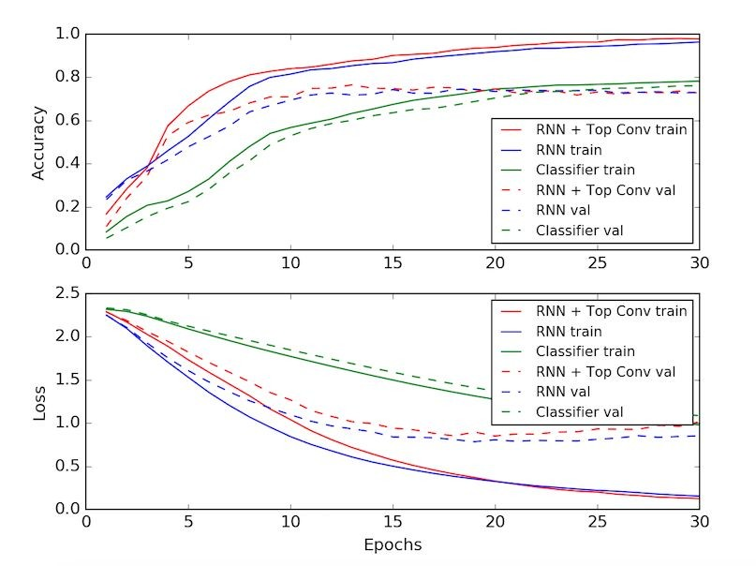

MODELLING
In the modeling phase of music genre classification, the focus is on selecting and optimizing deep learning architectures to effectively classify audio tracks into predefined genres. This involves careful consideration of architecture selection, hyperparameter tuning, feature representation, training strategy, transfer learning, ensemble methods, and model interpretability. Firstly, the choice of architecture, whether it's CNNs, RNNs, or hybrid models like CRNNs, depends on the characteristics of the music data and the complexity of the classification task. Hyperparameter tuning is then crucial to fine-tune the model's parameters, such as learning rate and dropout rate, to achieve optimal classification performance. Feature representation plays a significant role in capturing relevant audio characteristics, such as spectrograms or MFCCs, which are essential for effective genre classification.

Slide 10
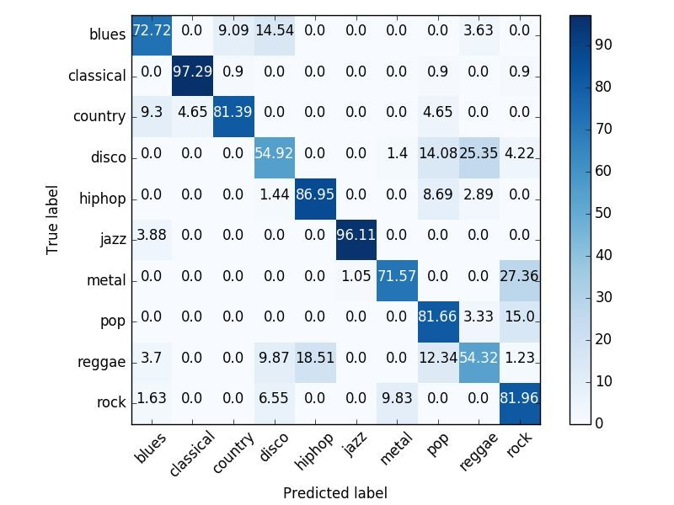
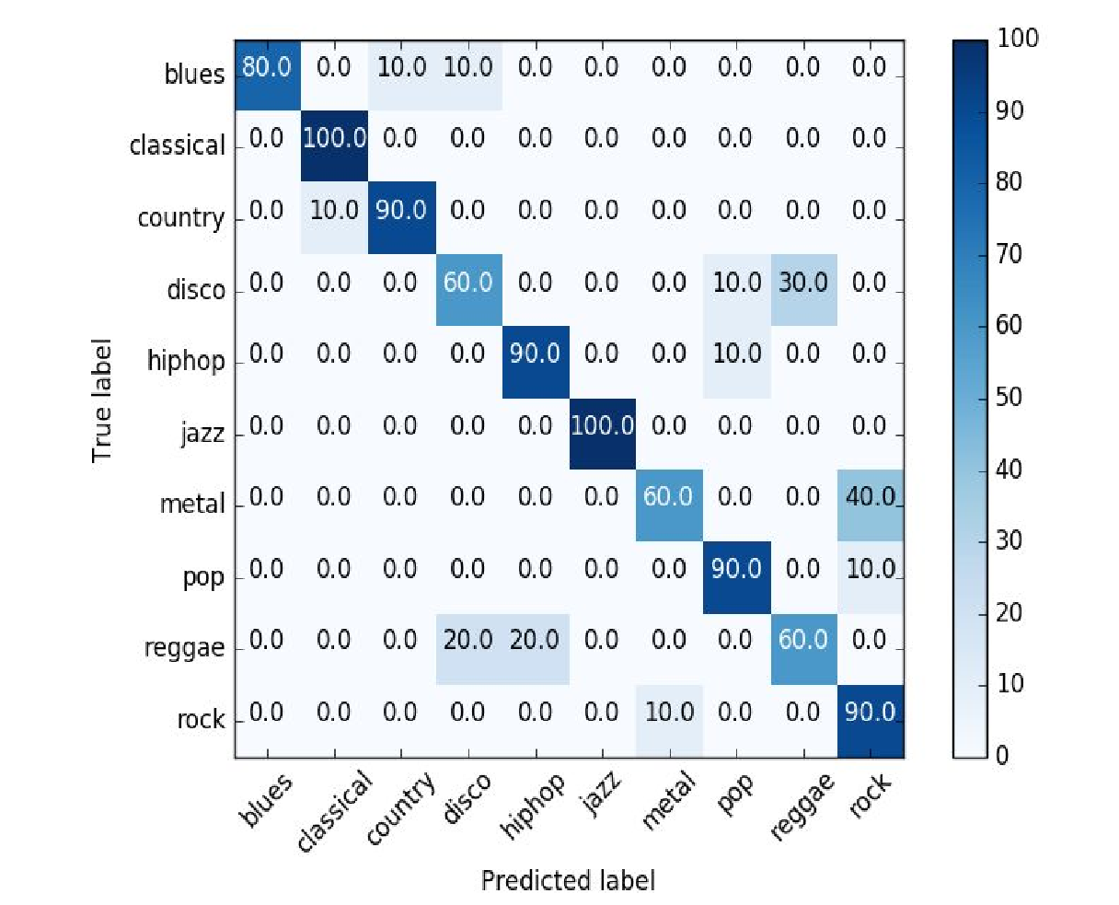
RESULTS
Average stage
10

Slide 11
CONCLUSION
In conclusion, the development of a music genre classification system using deep learning techniques involves a systematic approach to data processing, modeling, and evaluation. By leveraging advanced neural network architectures and feature extraction methods, we can accurately classify audio tracks into predefined genres, providing valuable insights for content organization, personalized music discovery, and data-driven decision-making in the music industry. Through careful consideration of model architecture, hyperparameter tuning, feature representation, and training strategies, we can create a robust and efficient classification system capable of handling diverse music datasets and real-world applications. The integration of ensemble methods and model interpretability further enhances the system's performance and provides valuable feedback for model refinement and validation. Overall, the development of such a system offers immense potential to revolutionize how music content is organized, discovered, and analyzed, ultimately enriching the music listening experience for users and driving innovation in the industry.
11

Slide 12
REFERENCES
Cho, K., Van Merriënboer, B., Gulcehre, C., Bahdanau, D., Bougares, F., Schwenk, H., & Bengio, Y. (2014). Learning Phrase Representations using RNN Encoder-Decoder for Statistical Machine Translation. arXiv preprint arXiv:1406.1078.
Karpathy, A. (2015). The Unreasonable Effectiveness of Recurrent Neural Networks. Blog post. Available online: http://karpathy.github.io/2015/05/21/rnn-effectiveness/.
Graves, A. (2013). Generating Sequences with Recurrent Neural Networks. arXiv preprint arXiv:1308.0850.
Goodfellow, I., Bengio, Y., Courville, A., & Bengio, Y. (2016). Deep Learning. MIT Press.
Brownlee, J. (2019). Deep Learning for Natural Language Processing: Develop Deep Learning Models for Natural Language in Python. Machine Learning Mastery.
PyTorch Documentation: https://pytorch.org/docs/stable/index.html
TensorFlow Documentation: https://www.tensorflow.org/api_docs
12

