Slide 1
Azure CDN Implementation for Digital Marketing Spin Projects Proposal

Slide 2
Agenda
Background
In-Scope
Out-of-Scope
Azure CDN Migration Approach
Azure CDN High Level Solution
Schedule
Assumptions/Dependencies
Gap Analysis Results

Slide 3
Background
Moving Akamai CDN to Azure CDN
Current CDN implementation for Phoenix Platform is Akamai Terra Alta Enterprise Accelerator
Existing Phoenix Platform is being shifted from IBM Cloud to Microsoft Azure using Azure 6.0 architecture
To leverage the upcoming platform, Azure CDN needs to be analyzed and provisioned for implementation on spin projects

Slide 4
Engagement Scope
In-Scope
Gap Analysis of Azure CDN compared to Akamai CDN
Feature based high level analysis, product line selection
Low level gap analysis
Identify use cases and prepare the strategy for moving to Azure CDN
Implement Proof-of-Concept with top priority use cases
Provision Azure CDN resources for Staging and Prod
Configure Azure CDN and implement rules as part of actual implementation on spin AEM projects
System Testing
User Acceptance Testing Support
Production Go-Live

Slide 5
Engagement Scope (Cont..)
Out-of-Scope
Enhancement/modification of AEM 6.2 functionality and Database schema
Any Azure CDN custom functionality apart from out-of-box features
Features not supported by any product line of Azure CDN
User Acceptance Testing execution

Slide 6
Azure CDN Migration Approach
ProSEAM Methodology
Probe
Strategize
Effectuate
Assist
Manage
Phases
Inventory Creation
Environment
Set up
Proof-of-Concept + Strategy Creation
Configuration of Azure CDN
System
Testing
UAT and Go-Live
Production
Support
Activities
Identify Akamai CDN functionalities and rules currently implemented
Baseline existing CDN functionality outcomes
Categorize existing CDN functionalities into Must-Have and Nice-to-Have buckets
Identify non-functional requirements
Project Plan finalized and shared
Acquire DuPont’s Azure subscription
User access setup completed for Microsoft Azure and VSTS environment
Resource Group created for PoC
Project team finalized from TCS and DuPont sides
Perform Gap Analysis (both feature-based and low-level) and finalize Azure CDN product-line to use
Identify all required use cases
Identify test cases
Identify PoC scope with respect to top priority use cases
Implement use cases identified as part of PoC Scope
Identify Success Criteria
Prepare Strategy/Solution for Azure CDN implementation
Resource Group created for Azure CDN
Create Azure CDN resource in Staging and Prod environment
Configure CDN Profile and Endpoint(s)
Integrate AEM web server with Azure CDN
Configure Rules Engine for Staging and Prod
Implement full list of Azure CDN use cases
Assist DuPont to set up F5 Security Gateway
Infrastructure Scan
System testing of Azure CDN use cases on Staging using Adobe Experience Manager
Fixing of issues
Update Azure CDN Prod environment
Prepare Testing report
UAT Environment setup assistance
Assist DuPont in identifying UAT Group
Support DuPont during UAT
Fix issues identified during UAT
Final round of System Testing
UAT signed off
Preparation of hand-over document
Production Go-Live
Transition to Support Team
PRODUCTION SUPPORT
Deliverables
Finalized Project Plan
Inventory of required CDN functions/rules
Non-functional requirements
Microsoft Azure Resource Group for PoC
Access to Microsoft Azure and VSTS
Proof-of-Concept Scope
Strategy/Solution document
Post PoC Report
Best Practices
Test Cases
Implemented Azure CDN configurations and rules in Staging and Prod
Infrastructure Scan Documents
System Tested Azure CDN use cases on Staging
System Test Report
Hand-over document

Slide 7



Azure CDN High Level Solution
Block diagram
Subscription_Production
VNET PEERING
vNET
Application_Subnet_1
S
Cloud Security Domain
Firewall
Internet
vNET
VM
F5 Security Gateway
Preview Dispatcher
Azure
Load Balancer
CP Security Gateway
Azure Gateway
VM
VM
Main Dispatchers
VM
VM
VM
Publishers
Azure Content Delivery Network (CDN)
Application_Subnet_2
H
ATT MPLS
Firewall
On Premises
Azure
Load Balancer
Preview User
VM
VM
Author Dispatchers
Author
VM
VM
Primary Author
Tar MK Cold
Standby
VM
Clay Tablet

Slide 8
Schedule
Tentative Schedule
2 Weeks
3 Weeks
7 Weeks
2 Weeks
5/2
5/8
5/15
5/22
5/29
6/5
6/12
6/19
6/26
7/3
7/10
7/17
7/24
7/31
8/7
PROBE
Inventory Creation
+
Environment
Set up
STRATEGIZE
Proof-of-Concept
+
Strategy Creation
EFFECTUATE
Configuration of Azure CDN
+
System Testing
ASSIST
UAT and Go-Live

Slide 9
Schedule
Elapsed Time – On-Going Digital Marketing platform migration & upgrade
6 Weeks
6 Weeks
8 Weeks
4 Weeks
4/1
5/5
5/28
6/9
6/30
7/5
7/14
8/1
8/11
8/25
8/31
9/10
7/24
10/31
BU access to Live on QA
Testing & UAT
AEM Upgrade on Dev & QA
Pre Go-Live
Azure 6.0 Environment
Set up +
AEM 6.2 Upgrade
AEM 6.2 Upgrade on Preprod on Azure 6.0
Content Freeze
Azure 6.0 Environment
Set up +
AEM 6.2 Upgrade
AEM 6.2 Upgrade on Prod on Azure 6.0 AEM 6.2(1)
Go-Live
Upgraded Content Copy Speco to Agco
UAT and Go-Live

Slide 10
Assumptions/Dependencies
TCS will have access to DuPont’s Azure subscription
Any non-functional requirements with respect to performance will be shared by DuPont before implementation
Overall Performance and Availability of site will be determined by Azure CDN capabilities
Features that will be implemented in Azure CDN depends on Gap Analysis outcome/results
DuPont will provide licenses required for implementation
TCS will have access to DuPont’s Visual Studio Team System (VSTS) environment
Azure CDN deployment is dependent on availability of Production web servers
Adobe Experience Manager (AEM) is already hosted on Azure Virtual Machine (IaaS) using Azure 6.0 architecture and its URL ready to be used in Azure CDN endpoints
AEM URL is available and accessible from Azure CDN in both Pre-Prod and Prod environments
DNS names and entries will be configured and shared by DuPont
TCS will have access to Adobe Experience Manager (AEM) for testing with Azure CDN in both Pre-Prod and Prod environments
DuPont will ensure on-time availability of SMEs to provide inputs to the migration activities
DuPont will facilitate communication with any 3rd party vendors, if required, during this engagement.

Slide 11
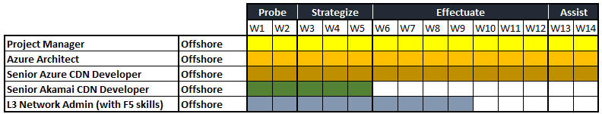
Commercials
Project Cost, Resources & Tentative Schedule
Duration: 14 Weeks Cost: $113,400.00

Slide 12
Gap Analysis Results
Akamai CDN and Azure CDN

Slide 13
CDN Feature 1
Access Control
Akamai CDN
Access control and security features provide user authorization, access control and referrer checking to allow or deny CDN resources based on domain, geographic region, IP, or other parameters.
Azure CDN
Feature Used: Country Filtering
Block or allow countries access to CDN content
Feature Used: Rules Engine
Create rules on Client IP addresses, Referring Domain, Device, Countries to deny access (403)
Feature Used: Token Authentication
Tokens are enabled on CDN Endpoint using an encryption key; one or multiple parameters are set up for the token against which requests to CDN Endpoints are validated – Country, URL, Host, Referrer, IP Address, Protocol and Expiration Time
Requests to Azure CDN Endpoint must contain the generated token having encoded information about the requester; on successful validation of the token by CDN edge POPs, contents are served; this may need code changes
(Azure CDN Standard and Premium)
(Azure CDN Premium from Verizon)
(Azure CDN Premium from Verizon)

Slide 14
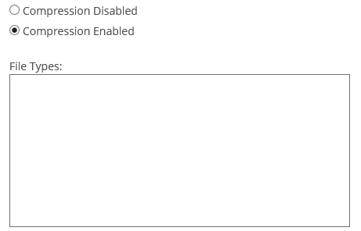
CDN Feature 2
Adaptive Image Compression
Akamai CDN
Offers the ability to vary the level of compression for images delivered to mobile devices based on real-time network conditions
Azure CDN
Azure CDN Standard and Premium
Feature Used: Compression
Can enable compression for default file types; additional file types can be included in the list
At present, Azure CDN is unable to vary levels of compression for images based on network conditions, when viewing the same on mobile devices

Slide 15
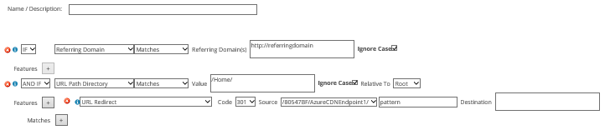
CDN Feature 3
Edge Redirector
Akamai CDN
Manage and offload high volumes of URL redirects to the Akamai Edge; Edge Redirector offloads high volumes of 301 and 302 redirects to the Akamai Edge
Azure CDN
Azure CDN Premium from Verizon
Feature Used: Rules Engine
Can set conditions for URL Redirects, e.g. matching domains and URL Path
Allows dynamic redirection of particular CDN content to another URL
Can perform both 301 and 302 Redirects

Slide 16
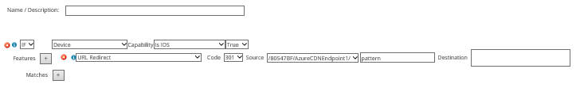
CDN Feature 4
Mobile Detection & Redirect
Akamai CDN
Directing your mobile users to one or more web sites that has already been designed for optimal presentation
Azure CDN
Azure CDN Premium from Verizon
Feature Used: Rules Engine
Can set conditions for URL Redirects based on Device parameters, like, types (Android, iOS), Brand Name, Model Name, Mobile Browser, etc.
Allows dynamic redirection of particular CDN content to another URL, which is optimized for that device; can perform both 301 and 302 Redirects

Slide 17
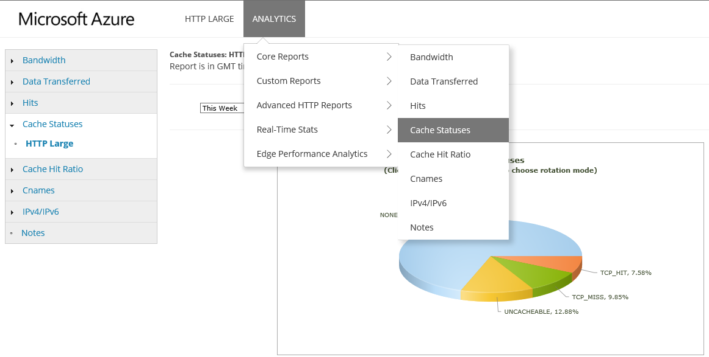
CDN Feature 5
Real User Monitoring
Akamai CDN
Gathers data about individual web page requests and deliveries, and then aggregates and reports back what Akamai has discovered about the site's performance
Azure CDN
Azure CDN Premium from Verizon
Feature Used: Analytics > Core Reports
Reports data for Bandwidth, Data Transferred, Hits, Cache Statuses, Cache Hit Ratio, Cnames and IPv4/IPv6

Slide 18
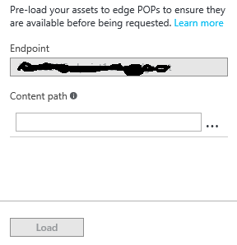
CDN Feature 6
Akamai Instant
Akamai CDN
Looks into the response for links to objects inside the following HTML tags; speeds page load by retrieving the next pages most likely to be requested based on origin analytics, before the web user even requests them
Azure CDN
Azure CDN from Verizon (Standard and Premium)
Feature Used: Pre-load your assets to edge POPs
Pre-load content on Edge POPs thus avoiding the first hit latency
Paths to individual assets needs to be entered for pre-loading
Presently, Azure CDN does not support dynamic pre-loading of assets based on HTML tag contents.

Slide 19
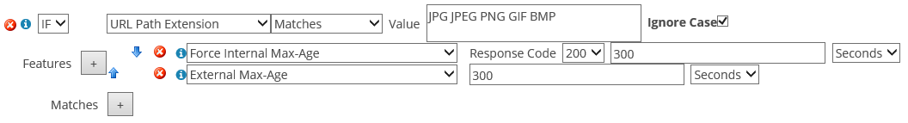
CDN Feature 7
Dynamic Page Caching
Akamai CDN
Access to a rules engine that enables granular caching, segmentation and downstream policies for content based on request criteria such as name/value pairs found in cookies, request headers, and query-strings
Azure CDN
Azure CDN Premium from Verizon
Feature Used: Rules Engine
Can set expiry time (Max-Age) for cache based on conditions for file extensions
Expired cached content can be configured to be delivered when an error occurs during cache revalidation: uses ‘Stale Content Delivery on Error’ feature

Slide 20
Thank you.

Slide 21
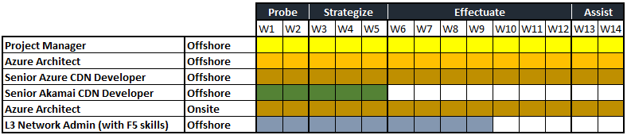
Commercials
Project Cost, Resources & Tentative Schedule
Duration: 14 Weeks Cost: $214,200.00

