Slide 1
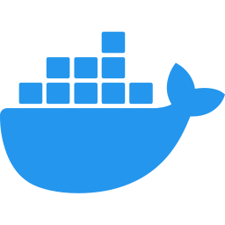










MyShoppingCart: tools and request flow
Everything runs in Docker Compose on one laptop; only ports 8000 (Kong) and 3000 (Grafana) are published. Numbers follow one order from sign-in to PAID.
Docker Compose network (one laptop)
Keycloak 26
realm shop, user alice
JWT keys
catalog-service
products; admins edit
PostgreSQL
catalog database
PostgreSQL
stock + reservations
/products
1
/realms
2
4
product-created
Apache Kafka 3.9
Client
browser, curl
HTTP
Kong 3.9
:8000 storefront + API
order-service
cart, orders
order-created
order-cancelled
inventory-service
stock, /stock
3
6
7
/cart /orders
5
stock-reserved
stock-rejected
9
8
Redis 7.4
carts, 30-day expiry
PostgreSQL
orders + outbox
payment-completed
payment-declined
payment-service
charges, refunds
order events
Grafana LGTM
:3000 traces, metrics, logs
Mailpit
test mailbox, /mail/
SMTP
notification-service
emails per order step
PostgreSQL
payments database
browse :3000
OTel
1
Sign in: Keycloak sign-in through Kong (/realms); the storefront uses PKCE.
4
Price lookup: order calls catalog with a timeout, retry and circuit breaker.
7
Reserve: inventory reserves all the stock or none; none left ends the order OUT_OF_STOCK.
2
Browse: GET /products. catalog-service checks the JWT with Keycloak's keys.
5
One transaction: order, its lines and an outbox row are written together; status PENDING.
8
Pay: payment charges once after StockReserved; above 1000.00 it is declined.
3
Cart and order: The storefront (or curl) fills the cart in Redis and checks out: POST /cart/checkout.
6
Publish: Outbox relay sends OrderCreated to Kafka every 500 ms.
9
Complete: Order becomes PAID or PAYMENT_DECLINED. A decline or cancel puts stock back; a paid cancel is refunded.

