Slide 1

















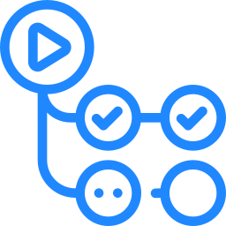


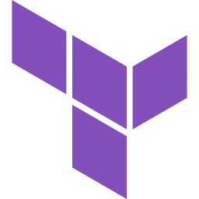
MyShoppingCart target architecture: AWS
One category leader per layer from the technology selection matrix, on AWS as the primary cloud.
Channels
Web storefront
Next.js, server-rendered
Mobile apps
React Native
Seller portal
React SPA
Identity and secrets
Okta
customer + workforce sign-in
HTTPS
Edge and API gateway
Amazon CloudFront
CDN + AWS WAF
Kong Gateway
routing, rate limits, JWT
Spring Cloud Gateway
BFF per channel
HashiCorp Vault
dynamic secrets, PKI
REST / gRPC + JWT
Microservices runtime
Observability
Amazon EKS
Istio mesh, mTLS
Spring Boot 3
Java 21
OpenTelemetry
traces, metrics, logs
Catalog
products, prices
Search
query, facets
Cart
basket, session
Order
owns the saga
Payment
PSP adapter
Inventory
stock, reserve
Customer
profile, address
Recommender
Spring AI
Datadog
dashboards, SLO alerts
outbox + CDC events
each service owns its data
prompts through guardrails
Events and messaging
Data and cache
AI
Apache Kafka
domain events
PostgreSQL
per service
Redis
cart, cache
OpenSearch
search index
Amazon S3
media files
Spring AI
RAG, pgvector
Amazon Bedrock
foundation models
Delivery and platform
GitHub Actions
build, test, scan
SonarQube
quality gate + SAST
Argo CD
GitOps deploy
Terraform
infrastructure as code
AWS
multi-AZ, two regions
Added for a shopping site and not in the matrix: OpenSearch for product search, Amazon S3 for media. Amazon Bedrock replaces Azure OpenAI because the platform runs on AWS. AWS services share the AWS logo.

