Slide 1

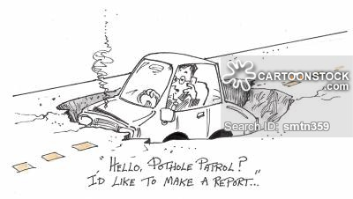
HoP
MIS 6308.001 – SAPM – FALL 2018 – GROUP # 3

Slide 2
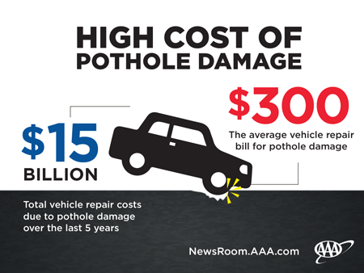
Business Need
BUSINESS
NEED
Notes:
Citizens are spending an average on $300 per vehicle due to potholes. Even pedestrians are spending huge amounts in ‘personal injury claims’ due to presence of potholes. There is absence of a system for them to report a pothole.

Slide 3
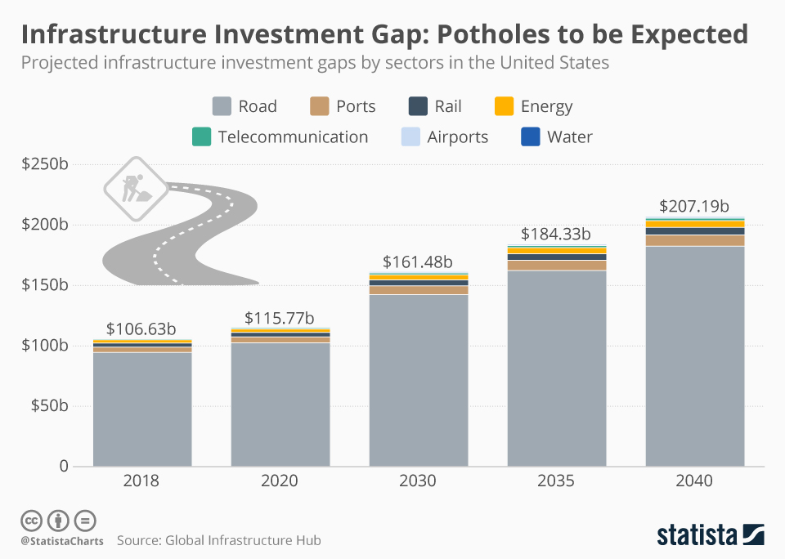

Slide 4
Sponsorship Opportunity
A mobile application (for both android and Mac users) using which :
Registered users can -
Manually report a pothole or confirm/deny automatically detected pothole
Receive cash rewards every month for reporting maximum number of potholes in the state (top 3 registered users only)
All users can –
View alternate route to the destination if number of potholes along the original route is more than 3 per mile
Can view their state’s ranking in infrastructure maintenance
Buy custom reports for individual purposes

Slide 5
Sponsorship Opportunity
The system also aims at monitoring the road repairs such that:
Every 15 days, the concerned authorities will receive consolidated list of potholes in their area, sorted by priority-based-weightage.
It will keep a track of their corrective action – quality of road maintenance, response time and thus rank each state every month.

Slide 6
Estimated resources
Project stakeholders comprising of: | System requirements:
1 Project Manager | Open source database
1 Business Analyst | GPS System
3 Software Developers
2 Software Testers
3 Database Administrators
1 Migration expert
Data Requirements
Pothole data sourced from user or automatic sensor

Slide 7
timeline
Project Phase | Estimated duration (in weeks)
Project planning | 1
Requirement analysis and scope definition | 2
Software development & environment setup | 10
System testing | 2
User acceptance testing | 2
Product migration | 1
Maintenance | 6
TOTAL DURATION | 24

Slide 8
Measures of Success
Pothole free roads.
Reduction in commute time.
30% reduction in recurrence of potholes, annually.
2% reduction in deaths due to accidents caused by potholes.
Possible reduction in infrastructure investment gap

Slide 9
Value to the Sponsor
50% reduction in expenditure on repairing vehicular damage caused by potholes.
Reduction in car maintenance costs.
Reduction in roads operational costs.

Slide 10
Unique Marketing Initiatives

Slide 11
BUGDET + TERMS & CONDITIONS
The project is estimated to cost USD $50,000 of which –
10 % will be due at the beginning of Week #1
60% will be due at the beginning of Week #3
10% will be due at the beginning of Week #15
20% will be due at the end of Week #24
Sensors, for automatic detection of potholes, are prerequisite to the system implementation & should be preinstalled in all vehicles.

Slide 12
CALL TO ACTION

Slide 13
REFERENCES
https://www.statista.com/chart/12886/projected-infrastructure-investment-gaps-by-sectors-in-the-united-states/
https://www.oregon.aaa.com/2016/02/pothole-damage-costs-u-s-drivers-3-billion-annually/

Slide 14
CONTACT US
Name | Email Id:
Namrata Patil | NUP180000@UTDALLAS.EDU
Anand Muraleedharan | AXM170075@UTDALLAS.EDU
Neethu Narayanan | NXN170013@UTDALLAS.EDU
Ayyappa Reddy Satti | ayyappareddy.satti@UTDALLAS.EDU
Jagruti Wagh | JXW180010@UTDALLAS.EDU

