Slide 1
Real Time Analytics
Apache Spark, Kafka, Nodejs, Socket, Highchart

Slide 2
Problem Statement
DEMO needs an real-time analytics dashboard to visualize the number of time taken for data load for each page with query filter & frequently accessed data with user analytics to improve performance of UI.

Slide 3
Solution
Before working on the solution, let’s take a quick look at all the tools we will be using:
Apache Spark – A fast and general engine for large-scale data processing. It is 100 times faster than Hadoop MapReduce in memory and 10x faster on disk. Learn more about Apache Spark
Python – Python is a widely used high-level, general-purpose, interpreted, dynamic programming language. Learn more about Python
Kafka – A high-throughput, distributed, publish-subscribe messaging system. Learn more about Kafka
Node.js – Event-driven I/O server-side JavaScript environment based on V8. Learn more about Node.js
Socket.IO – Socket.IO is a JavaScript library for real-time web applications. It enables real-time, bi-directional communication between web clients and servers. Read more about Socket.IO
Highcharts – Interactive JavaScript charts for web pages. Read more about Highcharts

Slide 4
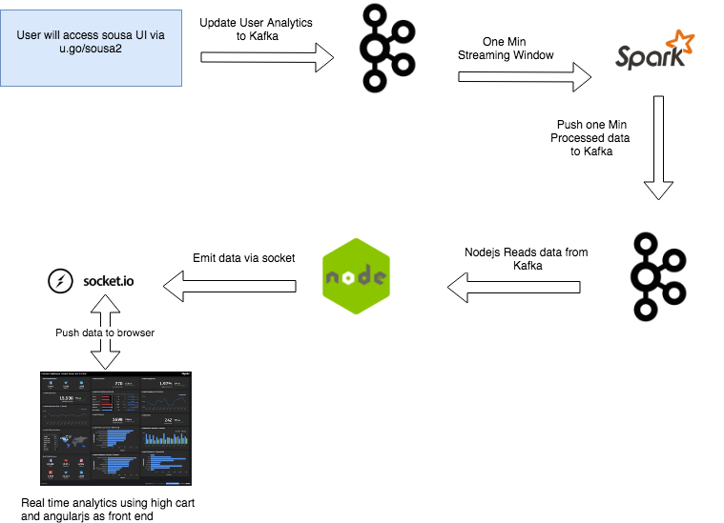
Data Pipeline

