Slide 1

Data Visualization on U.S crime data
P.Anand Sagar 11197418

Slide 2
Motivation
To understand whether the Crime rate in U.S is rising or falling?
One can get awareness about the crime incidents happening at a particular location, so that effective measures can be taken to ensure public safety.
Aim to get a better understanding of the security status in the United states.

Slide 3
Approach
Visualization Tool: Tableau
Dataset: https://oudsl.github.io/tableau-workshop/
Techniques used:
Symbol maps
Bar Graphs
Tree Maps
Bubble Charts

Slide 4
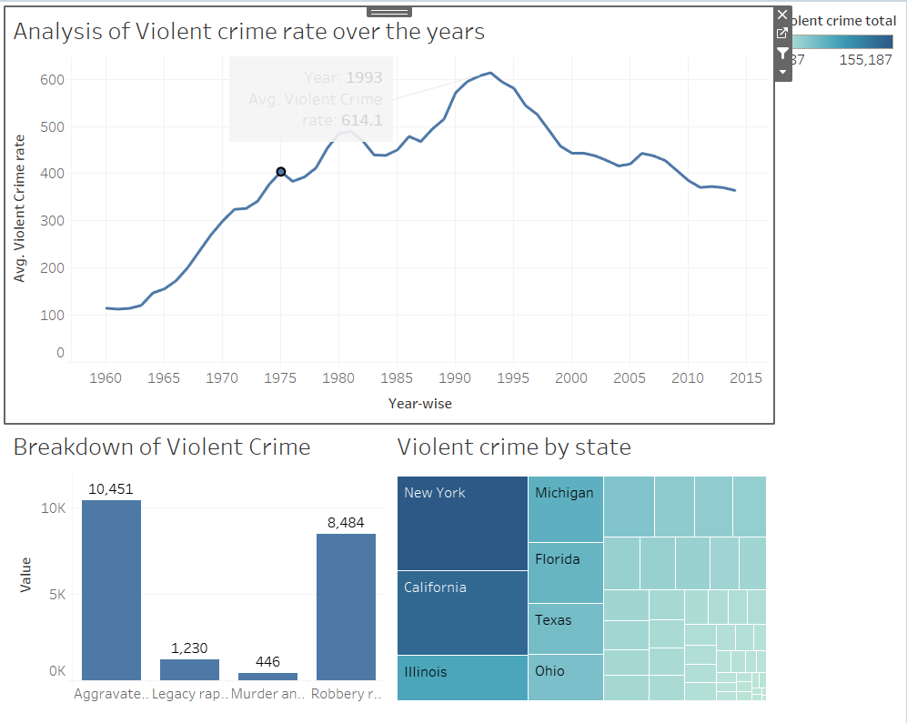
Hypothesis 1
What are the insights on violent crime over the years?

Slide 5
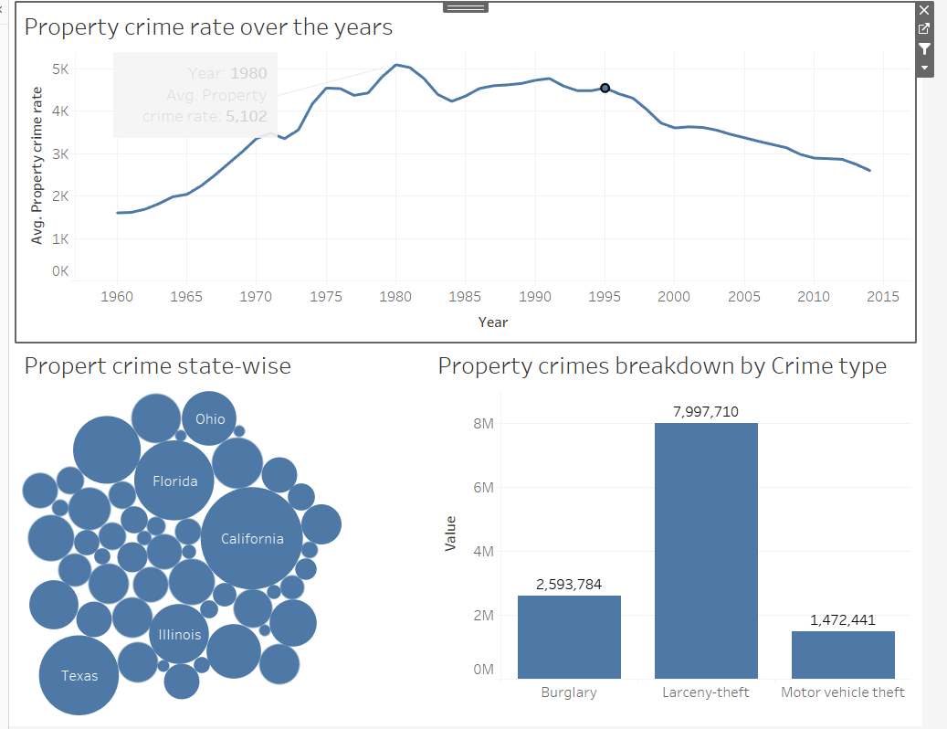
Hypothesis 2
Understanding the trends in Property crime

Slide 6
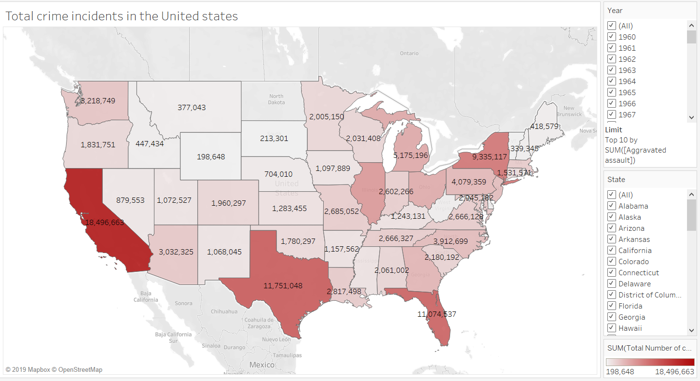
Hypothesis 3
In which state, more safety measures have to be taken to prevent crime?
Total number of crimes = [Aggravated assault] + [Burglary] + [Larceny-theft] + [Legacy rape /1] + [Motor vehicle theft] + [Murder and nonnegligent Manslaughter] + [Robbery] .

Slide 7
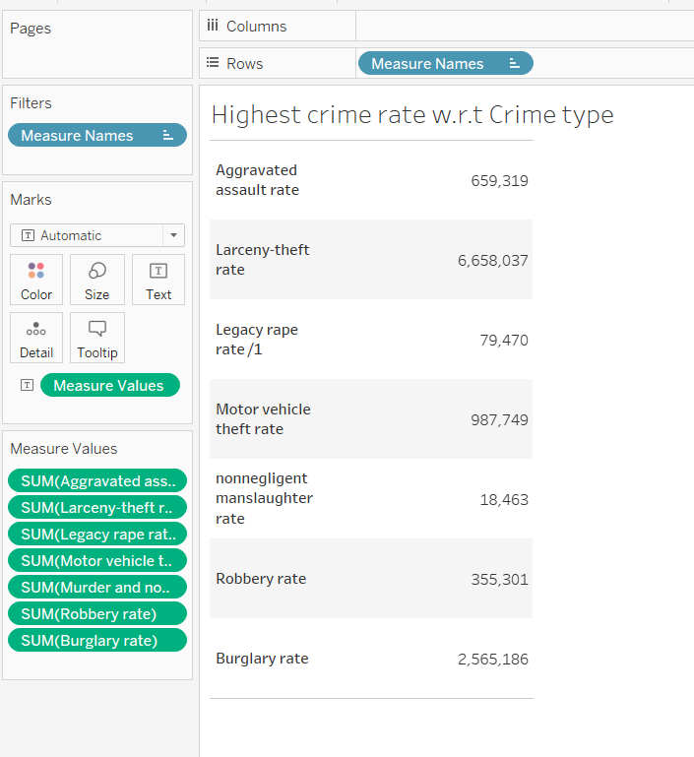
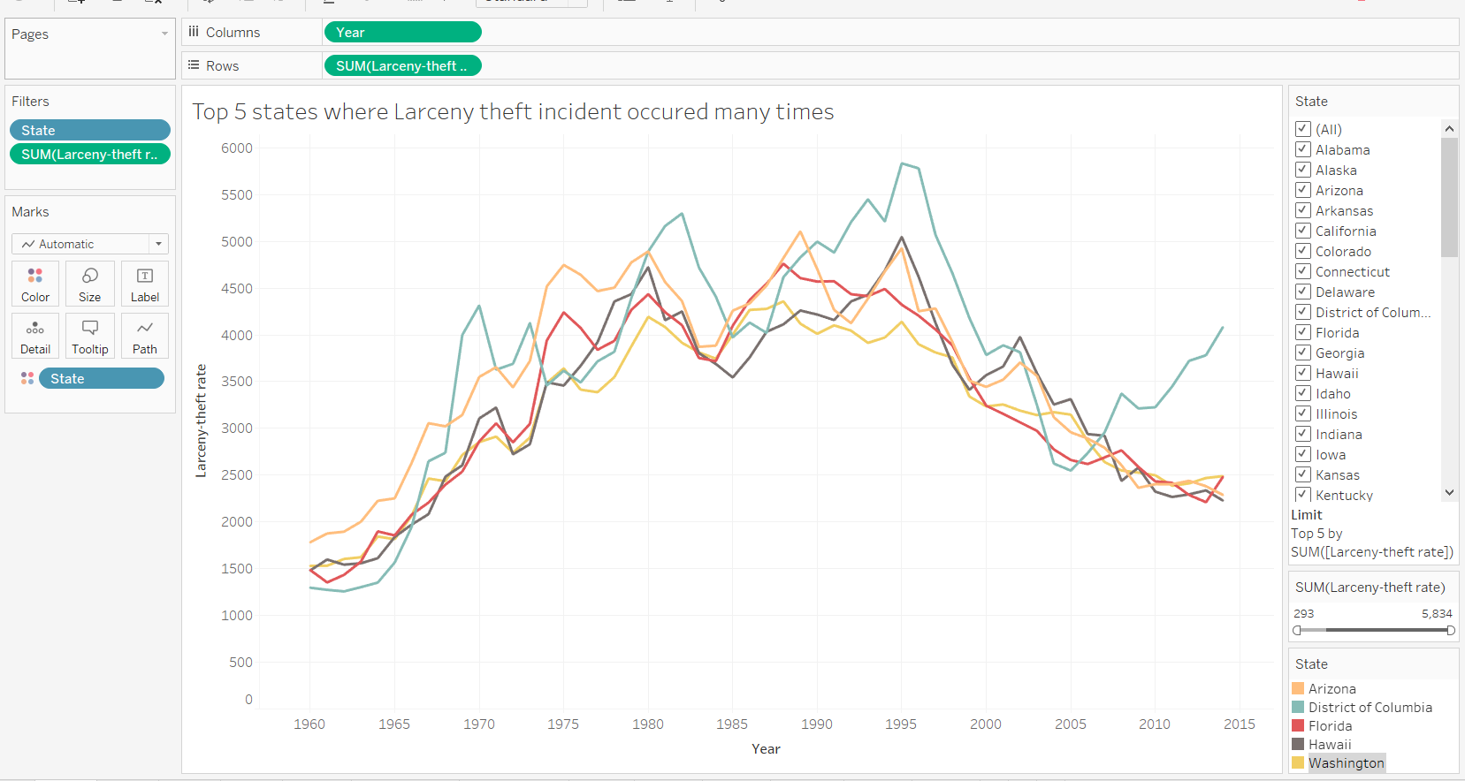
Hypothesis 4
Which type of crime has the highest crime rate among all, and how are the trends varying for the top 5 states of that crime?

Slide 8
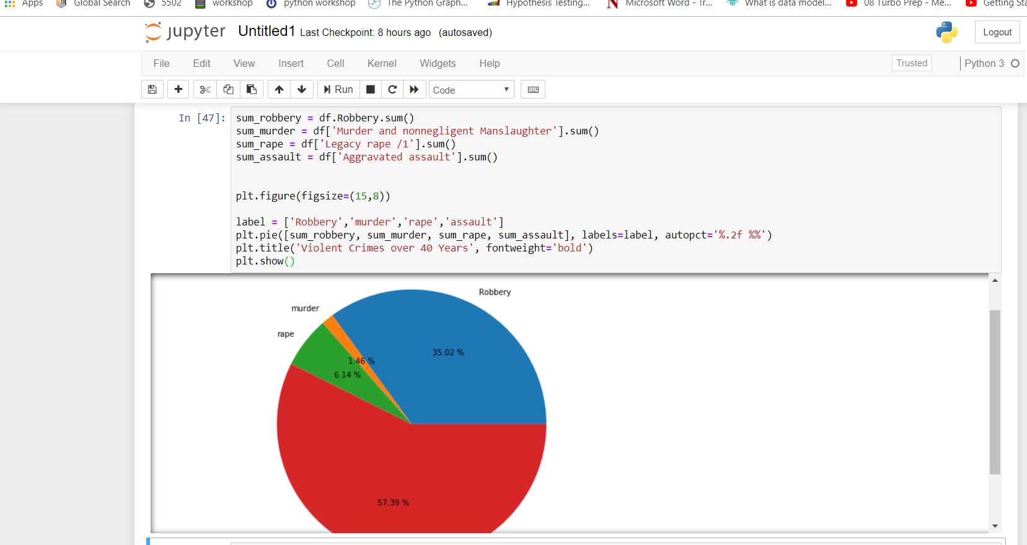
Visualization in Python

Slide 9
Insights
Crime rates have varied over time, reaching the peak in between 1970’s and 1990’s and then the crime has declined majorly. The highest crime rate was in mid-1990’s.
trends of violent crime types and property crime types.
Aggravated assaults were higher in case of Violent crimes and Larceny theft ranks the top among Property crimes.

Slide 10
Future work
Dataset can be updated later by including more columns such as crime incident information reporting by city-wise, Accused and Victim information in order to collect more meaningful data.
Good Usability and interactivity.

Slide 11
THANK YOU!!

